Slide 1
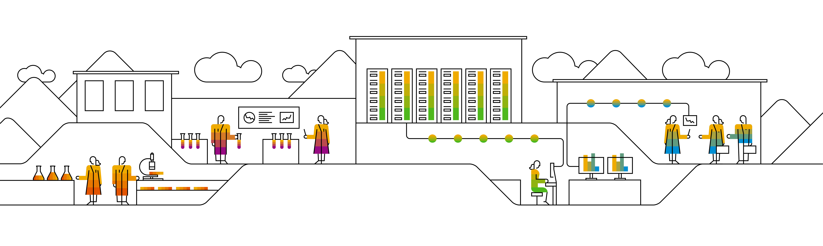

Kubernetes Pods

Slide 2
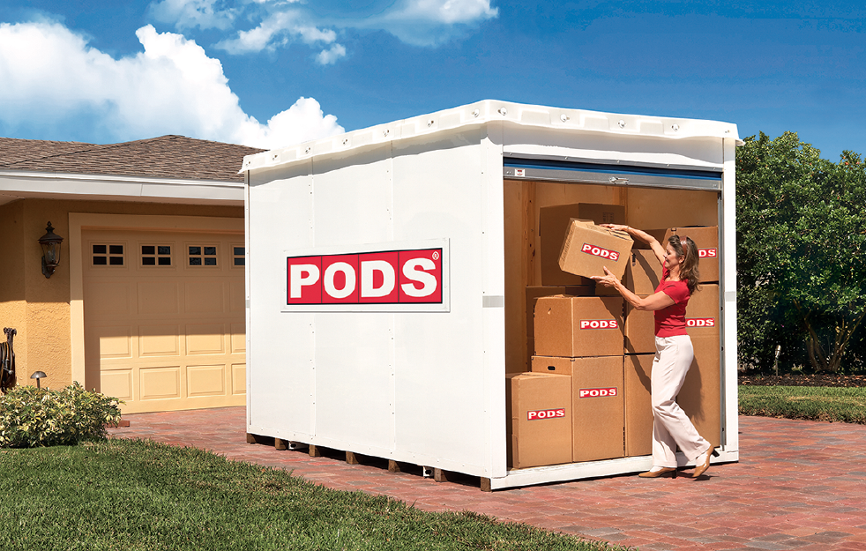
What are these pods, everyone keeps talking about?
A pod is a runtime environment for docker containers
One or more (docker) containers can run within a single pod
All containers in a pod share network & storage
A pod can be considered as a portable, logical host
Pods can communicate with each other
Notes:
A pod (as in a pod of whales or pea pod) is a group of one or more containers (such as Docker containers), with shared storage/network, and a specification for how to run the containers
Containers of a pod share localhost network interface
A pod can provision ephemeral storage or attach persistent storage
Pods are started by kubelet but can die any time without necessarily being re-scheduled
Pods can be probed by kubelet (liveness & readiness probe)
Most important pod phases / status:
Pending
Running
Succeeded
Failed
Unknown
Usually there is 1..1 relation between pod and container on a pod. Only if you have tightly coupled applications it makes sense to run multiple containers in one pod.
Example 1: Having a Jenkins and a logging database in one pod may perform better than in separate pod. However this needs to be evaluated case by case.
Example 2: Having a side car container for maintenance

Slide 3
Pods
A pod (as in a pod of whales or pea pod) is a group of one or more containers (such as Docker containers), with shared storage/network, and a specification for how to run the containers
Containers of a pod share localhost network interface
A pod can provision ephemeral storage or attach persistent storage
Pods are started by kubelet but can deleted any time without necessarily being re-scheduled
Container in a pod can be probed by kubelet (liveness & readiness probe)
Most important pod phases / status:
Pending
Running
Succeeded
Failed
Unknown

Slide 4
Pods – logical hosts
IP: 10.10.10.1
IP: 10.10.10.2
Pod-A
Pod-B
Container:
nginx
Container:
nginx
Container:
proxy
volume
volume
Node
Notes:
Recap: Pods can be considered as logical hosts and host 1..n containers.
Since every pod has its own IP address, it is possible to expose the same port on every pod (e.g. port 80 for a web server). Only within one pod you cannot expose the same port twice (so you cannot run 2 web server container in one pod and expose both on port 80).
Pods provide ephemeral (=non-persisted) storage. However pods are not meant to live forever. When they die, all the data inside is gone too. Use other resources to create persistent storage for your applications.

Slide 5
Sidecar pattern – or when to use multiple container in a pod
Application container
Helper container
IP: 10.10.10.2
Pod-B
Container:
nginx
Container:
proxy
volume
Notes:
We said that a pod may consist of more than one container. But when should you use such a feature? The so called ‘sidecar’ pattern gives a few ideas:
In general there is always one ‘main’ container, often also referred to as the application container. This primary container hosts the core logic of your application. In our example this is a ngnix webserver
The 2nd (sidecar) container provides augmentation to improve the application container. To do so, both container need to share certain resources like disk space or network.
Think of the following setup: You have a webserver serving on port 80 (plain http). To add https you would need to touch your application. Alternatively you could add a proxy container that augments your webserver with https. Simply let your primary container serve port 80 only to localhost and capture that traffic in your proxy container, which then provides https.
Another example would be a configuration update mechanism realized with a helper container. A nginx webserver reads its configuration from a file. If this file is updated, a restart would be required. Think of a helper container, which takes notice of the configuration change and restarts the nginx in order to make it re-load the configuration. This is possible, since both container share the same volume (disks) and also the process namespace (if configured properly).

Slide 6

Pods on process level
mount
mount
uts
uts
pid
pid
user
ipc
net
Notes:
Multiple container within a pod are realized by assigning several shared resources and namespaces to them.
Both containers share the user namespace (user mapping is the same in all containers in a pod), the IPC namespace (all containers can access the same shared memory segments) and the network namespaces (i.e. they are connected through the same virtual network interface and the same network stack).
What separates the containers are individual and dedicated namespaces for PID, UTS (containers have different hostnames) and mounts.

Slide 7
Anti-pattern: don’t create God pods
IP: 10.10.10.2
god-pod
Container:
database
Container:
app-layer
Container:
front-end
Container:
proxy
Container:
app-layer
volume
volume
Notes:
Why don’t we just put all container / pieces belonging to an application stack into ONE single pod? The run nicely co-located on the same host and we don’t have latency issues, they can share a network, IPC and so on…
This is probably a bad idea for following reasons:
Does it scale? Not so well – you can only scale on pod level, so you would need to replicate the complete set. Scaling of individual components is not possible at all
Usually the startup time of these constructs is poor.
Is it easy to schedule? Of course not – in the past an application stack consumed one to several VMs. Nodes in your cluster have to be of adequate size (xxl?) and there should be a sufficient amount of nodes for scaling / re-deployment. Potentially also impacts resource utilization.
Any changes to a single container definition will affect all others. For example, if the image used for the “front-end” is changed, the complete pod gets rescheduled.
Conclusion: as a rule of thumb: one pod – one purpose (+ sidecar, adapter, augmentation)

Slide 8
Basic structure of most K8s resources
api the resource belongs to, e.g. “v1”
apiVersion
value
resource type, e.g. “pod”
kind
value
metadata
metadata like name, annotations or labels are maintained here
metadata object
spec
spec object
specification of the resource based on its “kind”
status
status object
Information supplied by k8s, not maintained by users
Notes:
Example for a resource with different structure: configMap
configMaps have no spec, but a data sections.
When looking at the api reference, you can see this basic structure too. Simply navigate to a resource, like pod, and see with fields and object there are. Usually fields have either a list or string/integer as values. Objects link to their object definition.

Slide 9
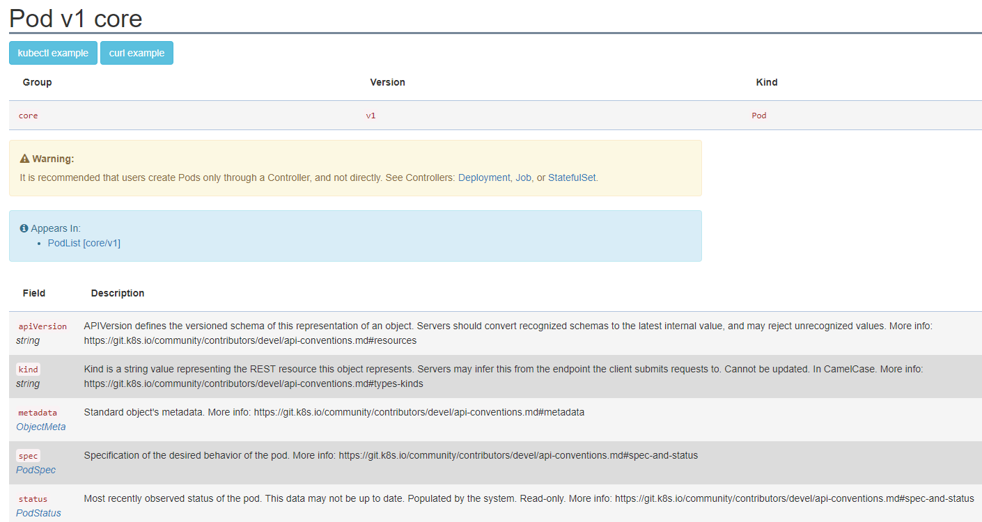
API documentation – Pod structure
https://kubernetes.io/docs/reference/#api-reference
Notes:
If you want to know more about the structure of any kubernetes resource, you can go to the official API documentation on https://kubernetes.io/docs/reference/#api-reference or use “kubectl explain <resource>” command.

Slide 10
kubectl explain pod
$: kubectl explain pods
KIND: Pod
VERSION: v1
DESCRIPTION:
Pod is a collection of containers that can run on a host. This resource is
created by clients and scheduled onto hosts.
FIELDS:
apiVersion <string>
APIVersion defines the versioned schema of this representation of an
object. Servers should convert recognized schemas to the latest internal
value, and may reject unrecognized values. More info:
https://git.k8s.io/community/contributors/devel/api-conventions.md#resources
kind <string>
Kind is a string value representing the REST resource this object
represents. Servers may infer this from the endpoint the client submits
requests to. Cannot be updated. In CamelCase. More info:
https://git.k8s.io/community/contributors/devel/api-conventions.md#types-kinds
metadata <Object>
Standard object's metadata. More info:
https://git.k8s.io/community/contributors/devel/api-conventions.md#metadata
spec <Object>
Specification of the desired behavior of the pod. More info:
https://git.k8s.io/community/contributors/devel/api-conventions.md#spec-and-status
status <Object>
Most recently observed status of the pod. This data may not be up to date.
Populated by the system. Read-only. More info:
https://git.k8s.io/community/contributors/devel/api-conventions.md#spec-and-status
Notes:
kubectl explain <resource> is the command line access to the api documentation. It gives the same information as the online documentation.
You can get more details on specific objects or fields by appending them with .<field> → e.g. “.spec” or “.apiVersion”

Slide 11
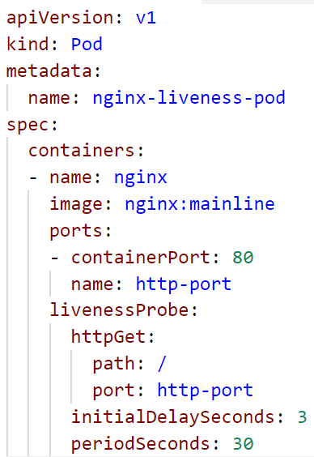
Pod definition - https://kubernetes.io/docs/api-reference/v1.8/#pod-v1-core
Resources of “kind:pod” belong to “apiVersion: v1”
Within “metadata” the pod’s name is specified
The pod’s “spec” provides all the necessary details, like the image to use, to actually start a container
The livenessProbe defines a check, to determine, if the pod is in a healthy state

Slide 12
Liveness & Readiness Probes
Respond with HTTP 200, if you are alive!
Send back the index.html, if you are ready!
HTTP 200 ‘OK’
index.html
nginx-pod
Container:
app
Notes:
Demo: http & exec liveness pods (see pod_exec_liveness & pod_http_liveness yaml files in the solutions folder)
Consequence of failed probe:
liveness: kill the container and restart it depending on the restart policy.
Readiness: mark pod as not ready and don’t route service traffic to it
Other options for probes:
TCP: can a connection be opened successfully?
EXEC: run a command and evaluate return/exit code

Slide 13

Demo
Notes:
Start with the “kubectl explain pod” and “kubectl explain pod.spec”
Show how to get an overview as well as detailed info about a resource type.
When creating pods, demo the --dry-run flag
Create a pod: ~/kubernetes/demo/02b_pod_exec_liveness.yaml
Discuss the probe and how it should fail
Show how it fails & get restarted
Point out the failure threshold
Create a 2nd pod, this time with a web server: ~/kubernetes/demo/02_pod_http_liveness.yaml
Explain the http probe and how it should fill up the logs
Show logs of the container (will be the access log) and discuss the effect of the liveness probe
Access nginx:
Run kubectl port-forward pod/nginx-liveness-pod 8080:80
Open a browser and connect to 127.0.0.1:8080
Port-forward is a nice command to test access to something that you don’t want to expose (yet). However it is not recommended for any production like setup as the traffic is routed via the cluster’s API server

Slide 14
What YOU will do in exercise #02
Create a single pod
nginx
nginx
nginx
content
config
tls certs

