Slide 1


Kubernetes Ingress

Slide 2


External availability of services – how did it work, so far?
Inside K8s
Load Balancer
External IP
Load Balancer
External IP
Service
Pod
Load Balancer
External IP
Service
Pod
Service
Pod
NodePort:30123
Pod
No
de
s
Service
Pod
Notes:
What we’ve learned so far:
To expose a service to the outside world (outside of cluster scoped DNS/IP range), we can use NodePorts or LoadBalancer / External IP services.
The NodePorts are straight forward as they re-use the cluster nodes to get externally available endpoints.
The LoadBalancer type of service however requires a 3rd party entity, which assigns it a public IP address and sets up forwarding rules etc.
The problem here is most likely the availability of such a 3rd party entity that is able to provision IP addresses. It is also possible to assign a previously acquired external IP address manually to a service, but that doesn’t scale well nor is it properly automated.
Additionally, the external endpoints we know, only serve exactly one type of backend. You can have multiple ports in a service, but they all point to the same backend type determined by label selectors. Managing two different applications with one service is not possible (in a reliable way).
Ingress resources address most of the issues.

Slide 3
Ingress
Services target networking on L4
Ingress are a L7 construct
Services can only expose one backend
More backends involved, imply more services needed
Exposing several applications to the internet, requires multiple services ➔ multiple IP endpoints
Ingress resources can help:
Bundle services into one endpoint
Make application available via a URL
TLS support
…
Ingress
Service A
Service B
Service C
Pod A
Pod B
Pod C
Notes:
A service can only serve one backend. Complex applications may need more than one backend. With Ingress resources, several backends can be exposed via a single entrypoint
Allows to create a network entity on top of services to expose applications
Expose applications via a URL and a shared “loadbalancer” IP
Requires an “ingress-controller” inside the cluster
https://kubernetes.io/docs/concepts/services-networking/ingress/

Slide 4

How does it work?
kubernetes internal network
namespace: kube-system
namespace: part-0000
Pod
LoadBalancer Service
Ingress Controller
ClusterIP Service
Pod
*.ondemand.com
35.205.166.164
Ingress Backend
Ingress
Notes:
The routing construct consists of several building blocks:
In part-0000 namespace there are pods & a clusterIP service, which can be used to access the pods cluster-internally
In kube-system namespace a component called “ingress-controller” runs. This component is exposed via loadbalancer service. The IP of this service is registered to a wildcard domain / top level domain.
In kube-system namespace a 2nd component called “ingress-backend” is running.
In part-0000 the user deploys a routing description (ingress resource; regular k8s API object). This routing description is specific to the wildcard domain registered with the loadbalancer service.
The ingress-backend picks up the rules from this and all other namespaces and updates the server config of the ingress-controller
Now all traffic going in to *.ingress.com will be sent to the ingress-controller, evaluated and forwarded according to routing rules defined in the ingress resources.

Slide 5
How does it work?
Ingress
Ingress resource describes the desired state
Cluster specific “ingress controller” will enforce desired state
Creation of endpoints
Creation of an external loadbalancer or re-use of existing
URL mapping
TLS termination
…
https://kubernetes.io/docs/concepts/services-networking/ingress/
https://github.com/kubernetes/ingress-nginx
Ingress-controller
Notes:
The ingress controller needs to be present in the respective cluster. It is configured to watch for new ingress objects being posted to the k8s api server.
Once an ingress resource is created, the controller will try to enforce the desired state. That can include the setup of URL & corresponding routing info etc.
Most common ingress controller is the “nginx ingress controller”

Slide 6

Single service ingress (with TLS)
Ingress controller is in charge of *.ondemand.com domain to register new records
Inside K8s
Pod
Port 80
Ingress
https://koopa.ondemand.com
35.205.166.164
Service
Port 8081
Pod
Port 80
Users access the backend via https://koopa.ondemand.com
TLS secret
server-key.pem
server.pem
TLS termination at Ingress endpoint requires a secret with correct subject
Notes:
The easiest way of using an Ingress is as an entry point to a single service with one to multiple pods. The ingress is created for a dedicated URL (assuming the controller is in control of the domain). Users can use the URL specified with the Ingress resource to access the service & associated backend pods.
You can add TLS termination at the Ingress endpoint by specifying a TLS secret with the corresponding hostname as subject or alternative subject.
From the services perspective everything works as usual. A port and a target port are specified and base on labels and selectors the traffic is routed.

Slide 7
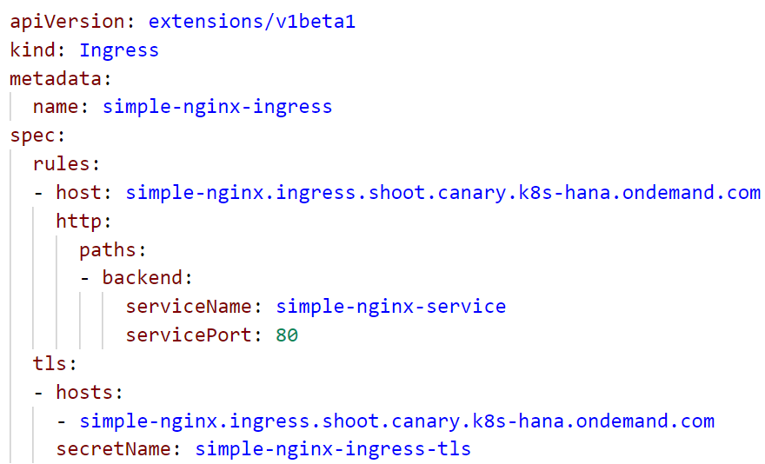
Ingress resource with TLS
spec with rules & managed hosts
Traffic is forwarded to service simple-nginx-service on port 80
support https with the certificates stored in the tls secret
Notes:
In the spec, there is a section about rules & TLS.
Rules define forwarding of incoming traffic to services.

Slide 8

Demo
Notes:
Go to the admin folder in the repo and run the create_ingress_tls.sh script
Create a secret with the generated files as suggested by the script
Use the 09_tls_ingress.yaml to create a deployment, service and corresponding ingress resource
Show the deployment & service
Show the ingress with the host & tls section. Highlight that the nginx itself is not configured for https but the connection terminates at the ingress endpoint.
Kubectl describe ingress <ingress-name> -> show the events for this ingress and point to the cert-manager events to provision the secret
Open the URL in a browser, show the certificate – it should be issued by let’s encrypt.
Go to the yaml file of the deployment and show the init container that runs upon pod start.
Highlight that it writes some text to an emptyDir volume which is then mounted into the nginx container.
Cert manager tutorial: https://gardener.cloud/050-tutorials/content/howto/x509_certificates/

Slide 9

Fanout
Inside K8s
Pod
Port 80
Ingress
https://koopa.ondemand.com/green
https://koopa.ondemand.com/red
35.205.166.164
Service
Port 8081
Pod
Port 80
Pod
Port 80
Service
Port 8081
Users access different backends via different suffixes: /green or /red
Pod
Port 80
Notes:
It is possible to mesh up multiple services within one Ingress endpoint and differentiate via URL paths. A user trying to access green needs to use https://app.ingress.com/my

Slide 10
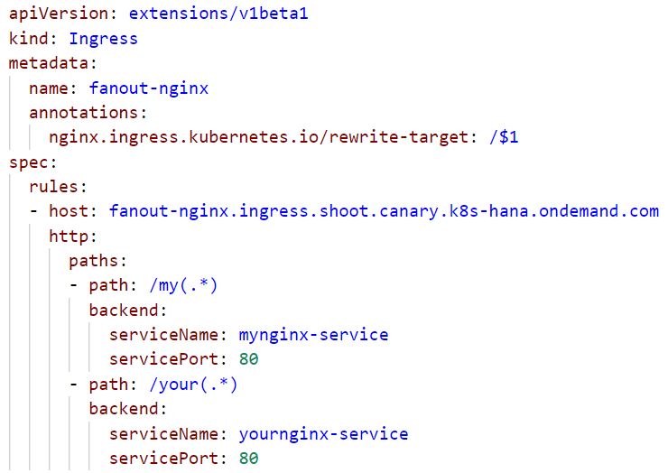
Ingress resource with fanout
Annotation is required to route traffic to /index.html and not /my/index.html
spec with rules & managed host
Traffic to /my is forwarded to service mynginx-service on port 80
Traffic to /your is forwarded to service yournginx-service on port 80
Notes:
In the spec, there is a section about rules & TLS.
Rules define forwarding of incoming traffic to services.
With v0.22 the re-write annotation has been changed. Now it requires capture groups, if you want to pass on any substrings within the URI. Everything not captured will be dropped. In the example above every substring following “/my” and “/your” will be forwarded to the backend.
For details, see:
https://github.com/kubernetes/ingress-nginx/releases/tag/nginx-0.22.0
https://kubernetes.github.io/ingress-nginx/examples/rewrite/#rewrite-target

Slide 11
Demo
Notes:
Use the 09_fanout_and_virtual_host_ingress.yaml to create a deployment, service and corresponding ingress resources
Note, that this file contains not only the fanout demo but based on the same 2 deployments & services also the virtual host demo.
Show the deployments & services
Show the fanout ingress
Highlight the rewrite-target annotation and its importance.
Without this annotation the traffic would be forwarded to my-nginx-service/mynginx or your-nginx-service/yournginx. Obviously none of the services is aware of this path, so you would get an error instead of your index.html.
Open the URL in a browser and show the different endpoints based on their path

Slide 12
Name based virtual hosting
Inside K8s
Pod
Port 80
Ingress
https://green.koopa.ondemand. com
https://red.koopa.ondemand.com/
35.205.166.164
Service
Port 8081
Pod
Port 80
Pod
Port 80
Users access different backends via different URLs
Service
Port 8081
Pod
Port 80
Notes:
The 3rd option to make services available is to have several URLs managed by one Ingress resource. The IP also here, the IP endpoint remains stable.

Slide 13
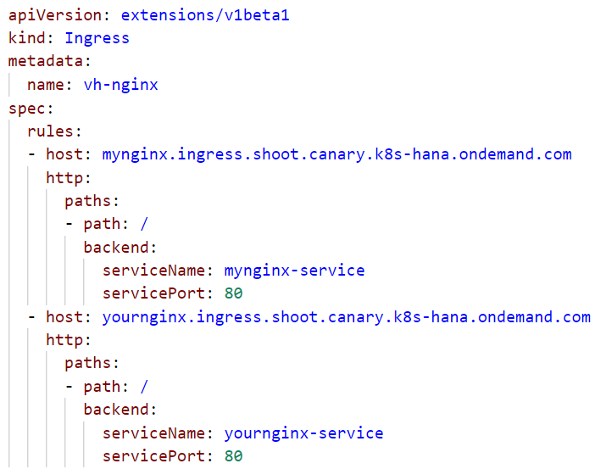
Ingress resource with name based virtual hosting
1st host & forwarding rules
2nd host & forwarding rules
Notes:
In the spec, there is a section about rules & TLS.
Rules define forwarding of incoming traffic to services.

Slide 14
Demo
Notes:
Use the 09_fanout_and_virtual_host_ingress.yaml to create a deployment, service and corresponding ingress resources
Note, that this file contains not only the fanout demo but based on the same 2 deployments & services also the virtual host demo.
Show the deployments & services
Show the virtual hosts ingress
Highlight the rewrite-target annotation and its importance.
Without this annotation the traffic would be forwarded to my-nginx-service/mynginx or your-nginx-service/yournginx. Obviously none of the services is aware of this path, so you would get an error instead of your index.html.
Open the URL in a browser and show the different endpoints based on their URL

Slide 15
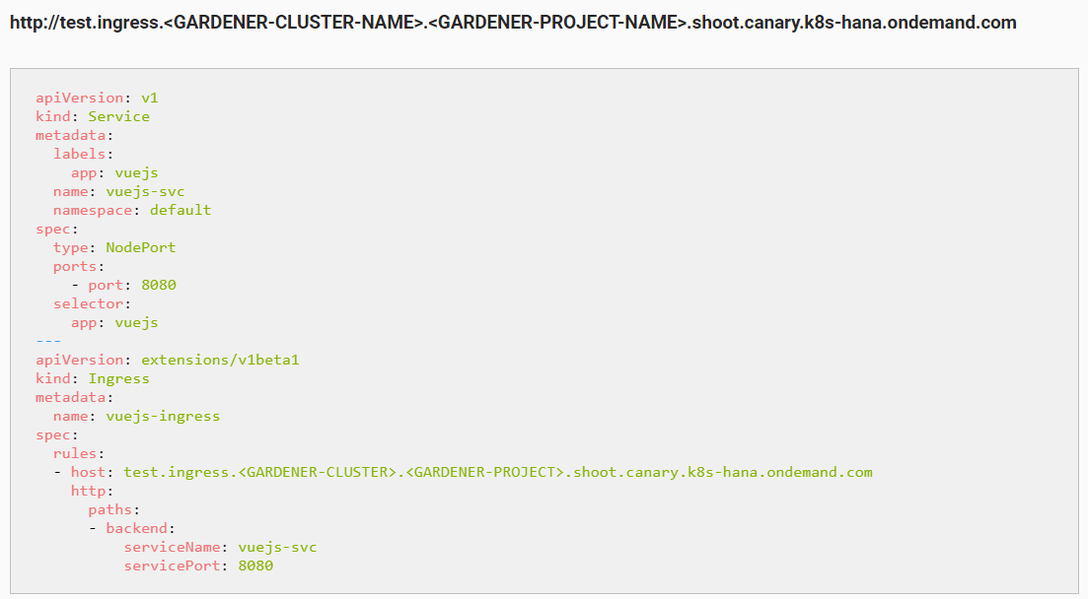
Ingress on Gardener
https://github.wdf.sap.corp/pages/kubernetes/gardener/doc/2017/01/16/howto-service-access.html
Notes:
With Gardener, you get an ingress controller for free ☺ it is also registered with a domain, so you will get your own sub-domain to register your URLs.
The schema is described in the Gardener how-to docs. You might need to adapt the ingress.yaml to your training project.

Slide 16
Desired target state – exercise #07
Ingress as central entry point to cluster
ingress https
ClusterIP service for inter cluster com.
service http
nginx
nginx
nginx
tls secrets for ingress
custom content
config
tls certs

