Slide 1
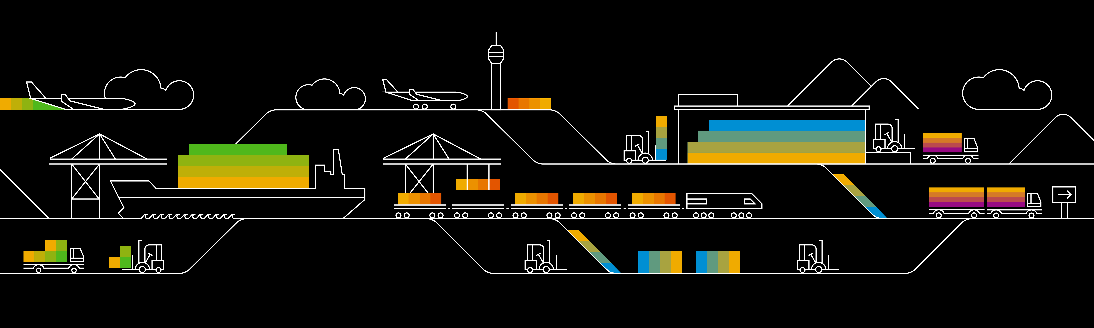
Kubernetes Administration

Slide 2
Service Accounts
Service accounts are technical user in Kubernetes
Bound to a namespace
Allowed to communicate with the API server
Provide identity for pods
Pods can inherit permissions to access the API server or a registry (image pull secret)
Namespace
Pod A
service account
“default”
secrets
Pod B

Slide 3
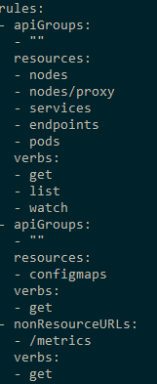
Role based authorization (RBAC)
roles define which api’s / resources can be accessed in which way
Roles can be assigned to service accounts
Roles are pre-configured or custom defined
Bindings: cluster-wide or restricted to namespace
Namespace
Pod A
Role binding
role
Secret A

Slide 4
Demo
Show service accounts
Create a new service account & show created token
Show clusterroles & rolebindings

Slide 5
Image Pulling
Docker
Start Pod with image <>
Image present already?
Worker
Docker
Pod
Pod
Docker pull image
Start Pod with image <>
Notes:
Docker daemon runs on each node and has an individual, local image store
Demo part: show image list of a node

Slide 6

Using Images from a private registry
Kubernetes
Private Registry
Pod A
Image: private.registry.com/my-image:0.1
Notes:
Private registries are usually protect by user & password
An anonymous docker daemon cannot pull images from a protected registry
=> Authentication is required

Slide 7

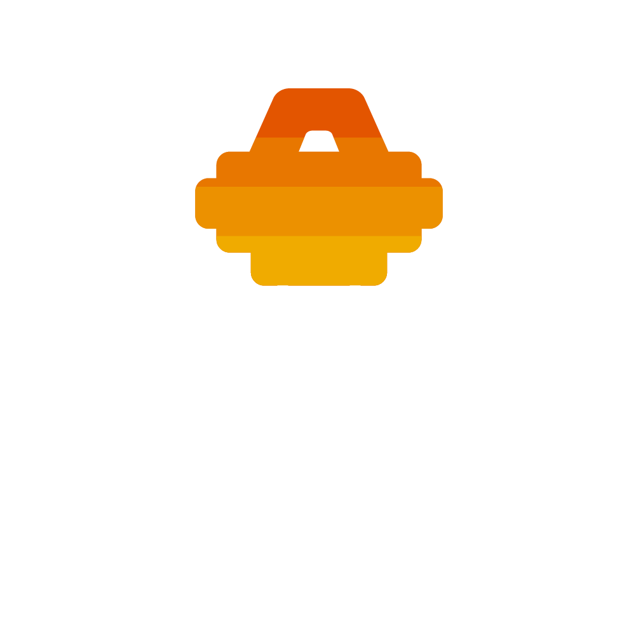
Image Pull Secrets
Kubernetes
Private Registry
Pod A
Image: <>
ImagePullSecret: <>
Image Pull Secret
kubectl create secret docker-registry <name>
--docker-server=<>
--docker-username=<>
--docker-password=<>
--docker-email=<>
Notes:
Image Pull Secrets contain the same info as .docker/config.json & works similar to ‘docker login …’
ImagePullSecrets can be specified as part of the PodSpec: https://kubernetes.io/docs/reference/generated/kubernetes-api/v1.9/#podspec-v1-core

Slide 8
Image Pull Secrets
Kubernetes
Private Registry
Pod A
Image: private.registry.com/my-image:0.1
service account
“default”
Image Pull Secret
Notes:
Assign the image pull secret to the default (or any other) service account
The service account gives its’ identity to the pod => the pot can use the image pull secret

Slide 9
Image Pull Secret together with Artifactory
Corporate Network
Docker build
Docker build
Docker push
DMZ Artifactory
Repository “test”
Docker pull
Image Pull Secret
Image Pull Secret
K8s @GCP
K8s @Azure
Notes:
Docker build => local
Docker push => local to registry with authentication

Slide 10
NetworkPolicy
“Firewall”-like restrictions
Define egress and ingress rules for a service
Requires support by overlay network plugin
access: ok
Pod B
app: nginx
Service
Pod A
Pod M
Selector: access: ok
Selector: app: nginx
access: not ok
Network Policy
Notes:
Demo:
kubectl run nginx --image=nginx --replicas=2
kubectl expose deployment nginx --port=80
kubectl run busybox --rm -ti --image=busybox /bin/sh
# wget --spider --timeout=1 nginx
Kubectl create –f network-policy.yaml
Kubectl run ..
Kubectl run … -l access=true

Slide 11
Desired target state
Filter incoming traffic with a network Policy
service http / https
nginx
nginx
nginx
custom content
config
tls certs

Slide 12
Node Management
Scheduler
cordon
Worker A
Worker B
drain
Pod
Pod
Pod
Pod
Pod
Pod
Notes:
kubectl drain <node> --ignore-daemonset=true

Slide 13
A note on scheduling pods…
Scheduler
Worker A
Worker B
Worker C
Taint: NoUsers
Frontend With Backend
OnNodeB
OnNodeB
Backend With Frontend
Tolerate NoUsers
NotWith Database
NotWith Database

Slide 14
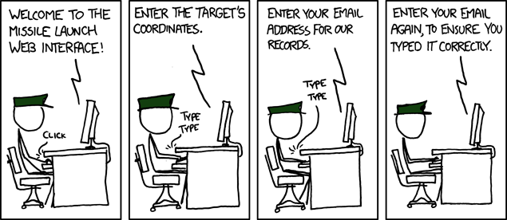
Sometimes working with kubernetes is like …
https://xkcd.com/970/

Slide 15
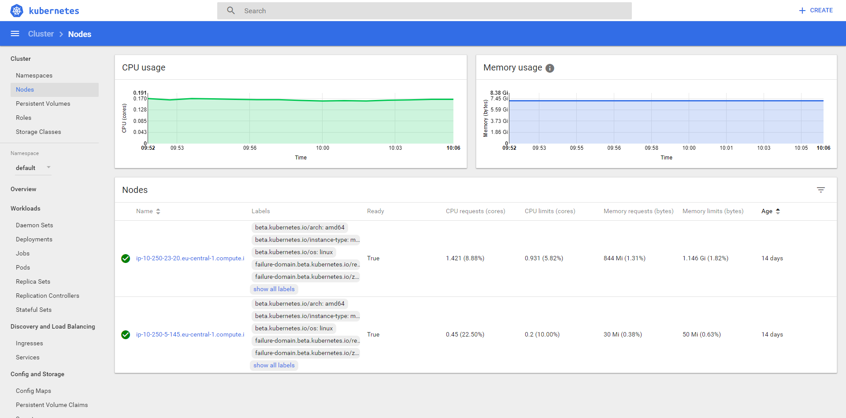
K8s Dashboard
Notes:
Works only with localhost – hence, run commands on a machine, where you have a UI /can access a browser:
- kubectl proxy
- Open browser on localhost:8001 (port may vary) and show the API
- Open browser on localhost:8001:ui, logon with token from kubeconfig
Demo the dashboard
- Show status info & utilization of nodes
- Show deployments & services and how to create a new deployment

Slide 16
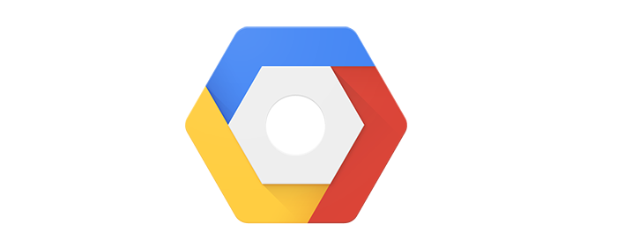
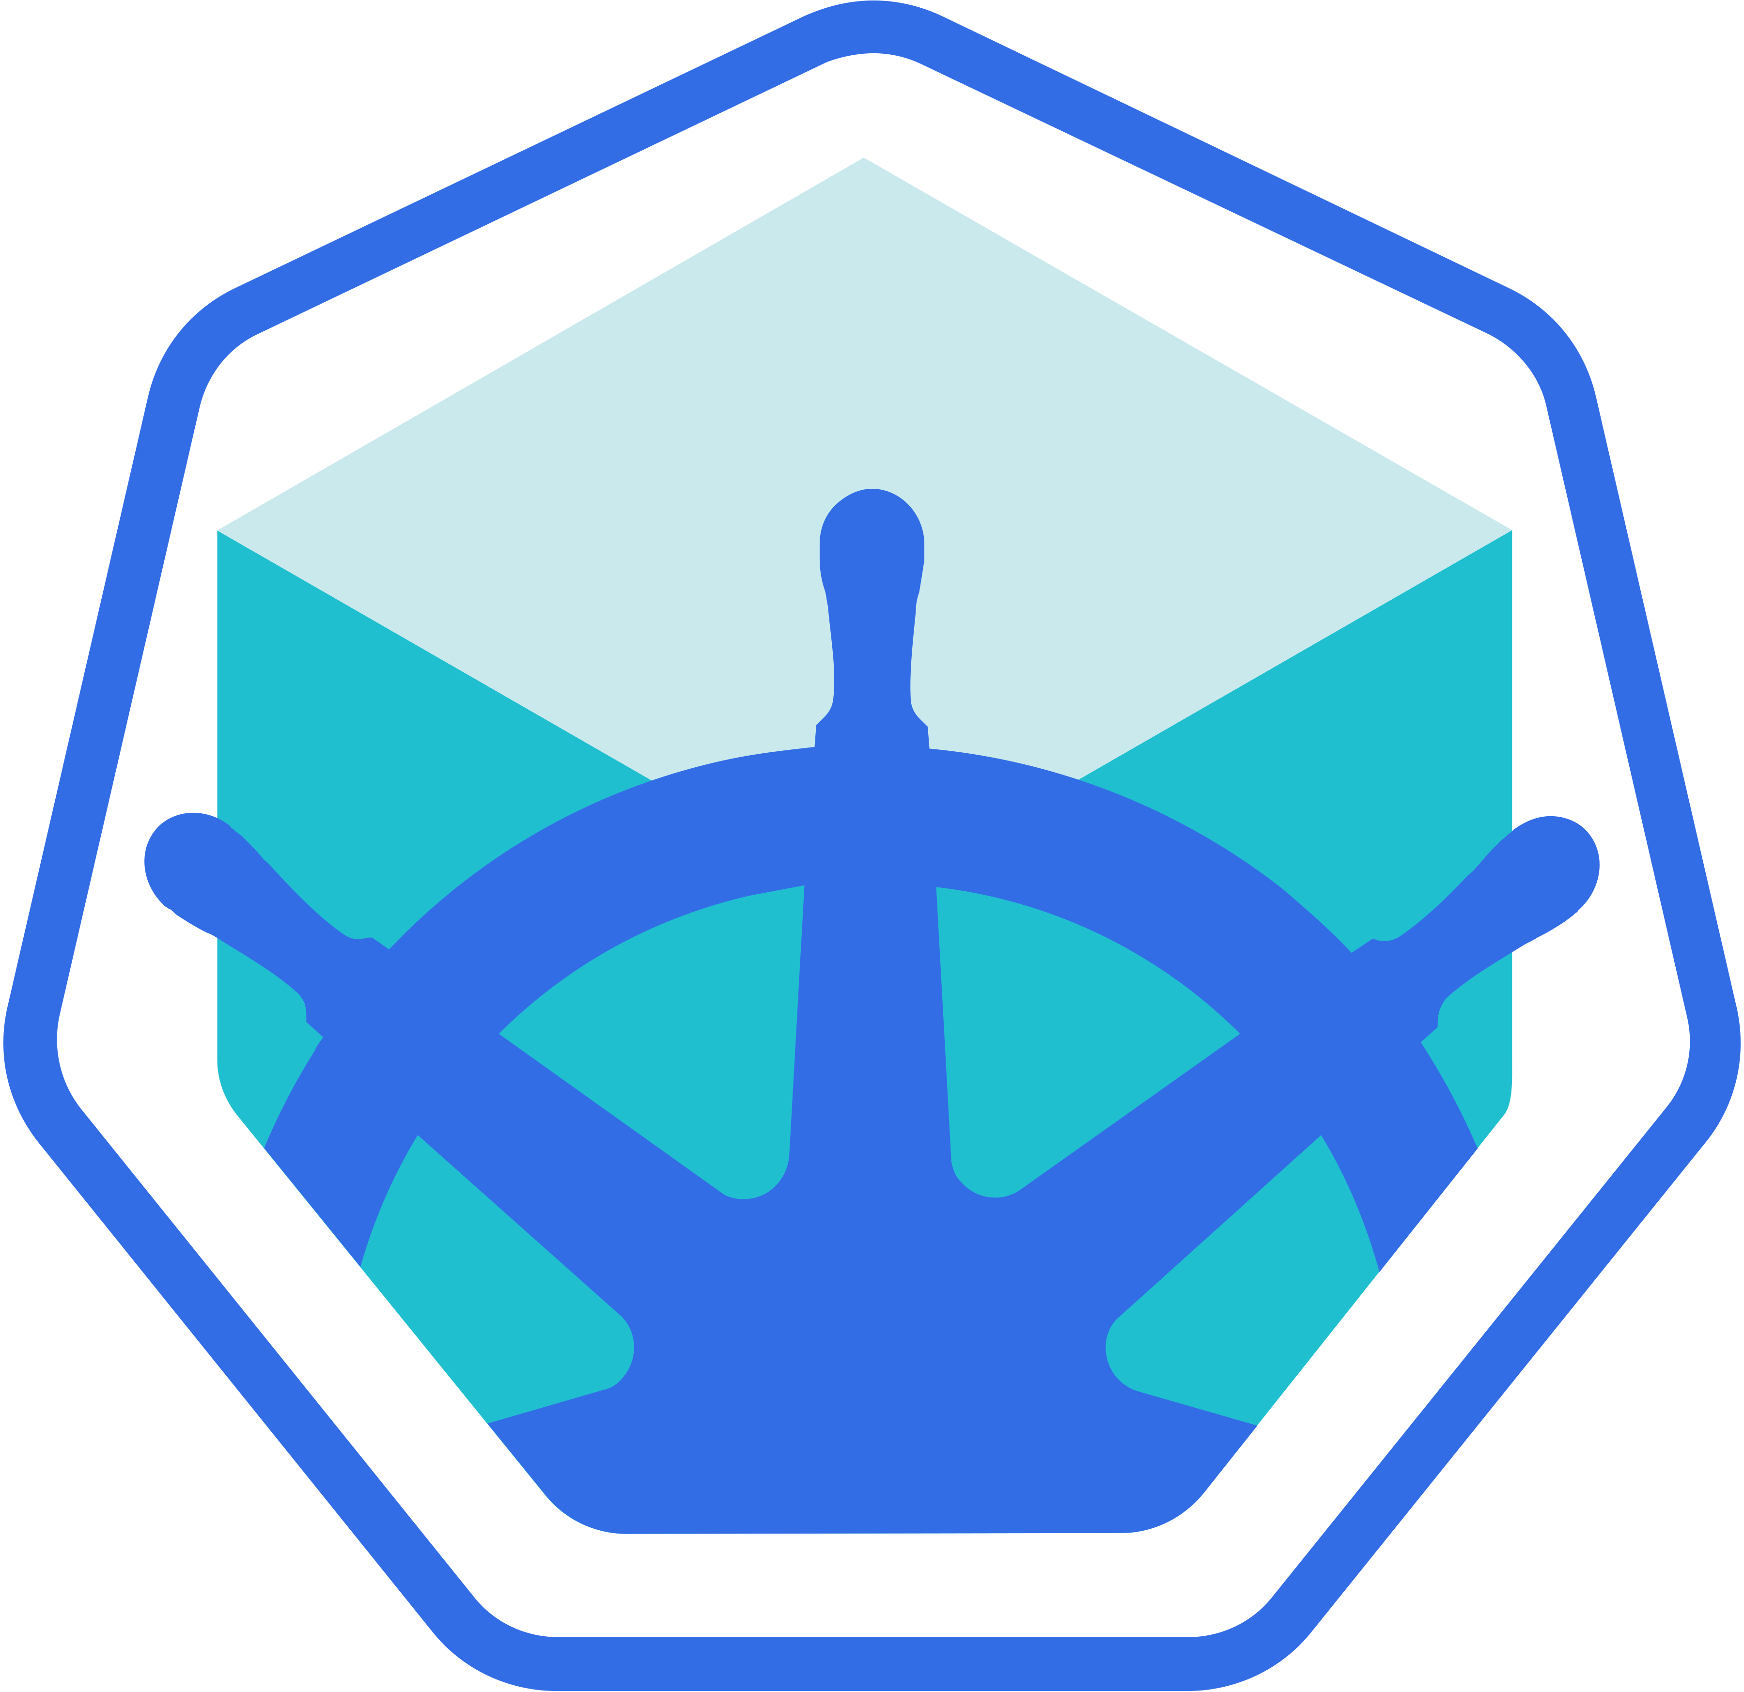
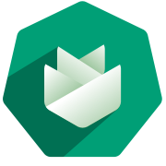
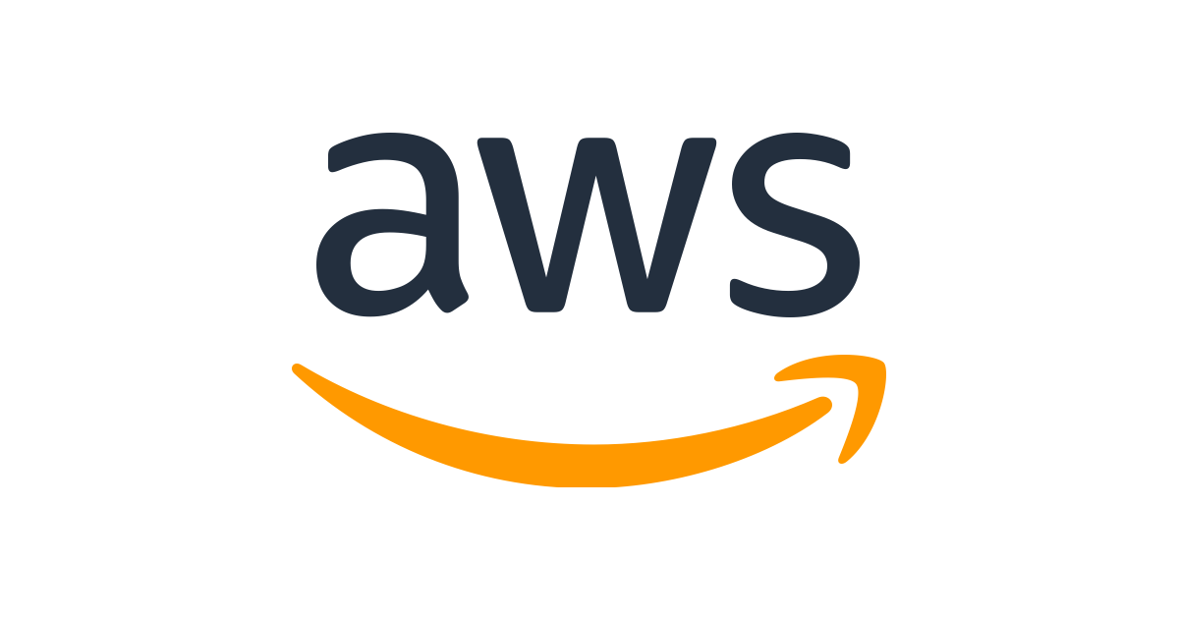
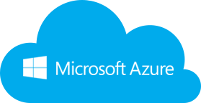

Wherefrom can I get a cluster?
https://github.com/kubernetes/minikube

