Slide 1
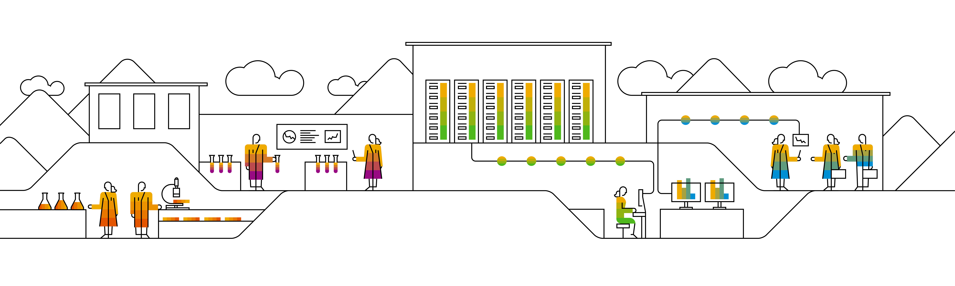

Kubernetes DaemonSets & Jobs
Notes:
When talking about scheduling, there are a few more resource type we have to take a look at (briefly): daemonSet, jobs (& cronJobs)

Slide 2
Some components require to have a pod on every node!
DaemonSet
structure is similar to deployments
selector.matchLabels
PodSpecTemplate
one pod is scheduled on each node
Node A
Node B
Node C
log collection
log collection
log collection
monitoring
monitoring
monitoring
Notes:
A daemonset works almost similar to a deployment. However the replica count is determined by the number of cluster nodes. The daemonset controller will ensure that a corresponding pod is running on each node.
Of course this behavior can be influenced by taints etc. – more details can be found here: https://kubernetes.io/docs/concepts/workloads/controllers/daemonset/

Slide 3





Job & CronJob
If exit code != 0 → consider pod as failed and restart
CronJob
Job
JobSpec
Pod
exit(??)
PodSpecTemplate
Pod terminates successfully – Job is considered ok / complete
Notes:
A job is a single or a set of pods which runs until completed successfully (usually exit code 0). Failed pods can be restarted based on the restart policy.
➔ Jobs are a way to run pods in a reliable way.
With the job resource type you can run tasks with a defined end/ no control loop.
Instances of a job (pods) can also run parallel
More details can be found here: https://kubernetes.io/docs/concepts/workloads/controllers/jobs-run-to-completion/

Slide 4
Kubernetes Extensibility with custom resources
Notes:
Kubernetes is extensible in many different ways. One of the most powerful concepts is the introduction of custom resources and corresponding control loops (usually called “operators”).

Slide 5
What was this something about a “controller”?
Observe
Analyze
Act
CRD
Pod
Operator
CRO
Pod
Notes:
About controller & the operator pattern:
In the beginning of our course we said: “Kubernetes is extensible”. You cannot only bring your workloads into container and onto Kubernetes, you can also enhance the way Kubernetes is working. We start with the simplest way of doing so – writing a “controller” or “operator”. It basically consists of 3 logical parts:
Observe - write a control loop, checking certain objects for their state.
Analyze – check the current state against a desired state (may be stored in a different resource, outside of the cluster, hardcoded, …)
Action – if there’s a difference between desired & current state, the controller should act and trigger a defined action to bring the observed objects into the desired state
Lets combine the controller/operator with another powerful mechanism in the K8s realm: “Custom Resource Definition/Object” API (CRD / CRO)
CRDs allow you to specify your own objects and integrate them with the K8s API (like a deployment or PVC). Once you defined a CRD, you can start to create objects of that type. But only if you have an operator watching for these objects, something will happen.
Example:
You want to run a distributed database on K8s. The actual instances are wrapped into a deployment. However for actions like backup or scaling, you would need to logon to each pod and prepare it manually. A possible solution would be to put scripts into the container images and trigger them. But it still is a manual action to trigger.
Instead writing a controller, that watch for certain annotations in the resources metadata is a very valid option. The controller could not only process the action associated with these annotations but also update them.
A slightly different approach would be to go with an API extension via CRD. Define a representation of your database as a custom resource definition and write an operator that observes/analyzes/acts on objects of this type.

Slide 6
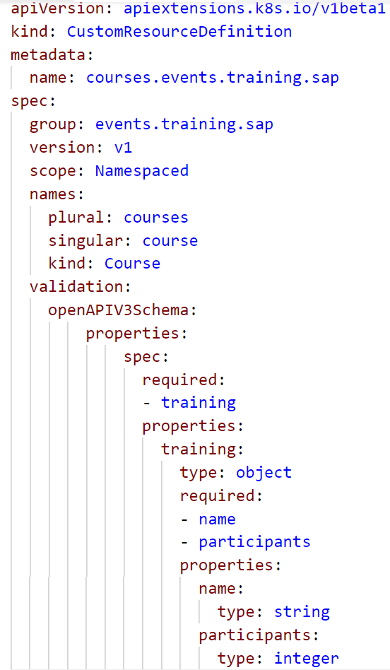
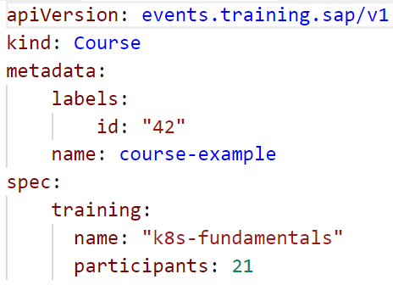
CRD/CRO Example
Newly created API endpoint
API specification
Validation schema to outline resource structure
Resource structured according to validation schema

Slide 7

Demo
Notes:
Optionally you can show this demo
Firstly, try to create the custom resource object (09_cro.yaml). It will fail, as the cluster api doesn’t know about this resource type
Create the custom resource definition (09_crd.yaml). Show the yaml and explain the spec
Group: this is path in the api (like apps or apiextensions.k8s.io)
Version: version of the api objects in this group (like v1 or v1beta1)
Scope: objects can exist within a namespace like pods or outside like nodes
Names: names for the object, can also include a short version like pvc for persistentvolumeclaim
Validation: this is the definition of the objects structure and how to validate it. The example requires the training object with properties name and participants
To move on one could write an operator, that could create namespaces based on course objects.
A real life example is how Gardener manages the shoot clusters. When you create a new Gardener cluster, actually a yaml file is generated and send to the seed clusters api server. The operator evaluates it and triggers corresponding actions.

Slide 8
Kubernetes Scheduling
Notes:
Now that we know most of the Kubernetes resources / objects, let’s take a look at the (pod) scheduling mechanism.

Slide 9
A note on scheduling pods…
Scheduler
Node A
Node B
Node C
Taint: NoUsers
Frontend With Backend
OnNodeB
OnNodeB
Backend With Frontend
Tolerate NoUsers
NotWith Database
NotWith Database
Notes:
There are multiple ways, to influence where pods are scheduled:
Taints & tolerations: a node is tainted and only pods explicitly tolerating the taint will be scheduled
Node selector: specify a node “type” by label to assign a pod to certain node pool
Pod affinity: explicitly schedule a pod on a node where certain pod is already running
Pod anti-affinity: don’t schedule on a node, where a certain pod is already running

Slide 10
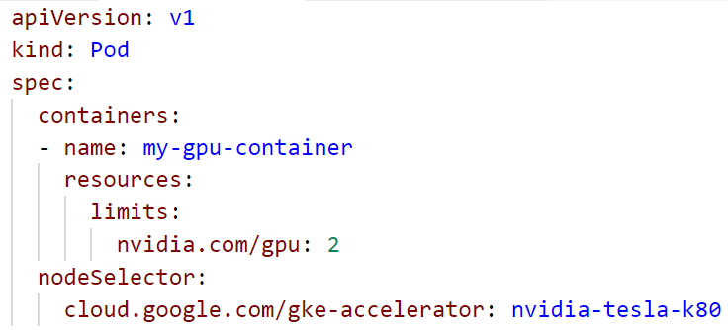
Example: NodeSelector

Slide 11
Optional Demo
Notes:
Custom scheduler - this Demo is optional!
If regular scheduling doesn’t fit to your requirements, you can build a custom scheduler. It’s somewhat similar to the operator concept where you write your own control loop.
All you need is to
a name the scheduler can be referenced by
A control loop watching the API for unscheduled pods referencing the scheduler by name
Access to the cluster API to run the loop and post the bindings
Demo :
kubectl proxy &
Create the deployment 11d_custom_scheduler_deployment.yaml
Show the pod with the specified scheduler name & run a “describe” on it. Highlight the missing default scheduling event → the default scheduler doesn’t pick it up
Run “./11e_custom_scheduler.sh <your-target-namespace>” to start the scheduling loop
Show the scheduled pods
Instead of running the scheduler locally you could also run it within the cluster – simply pack it into a docker image and use it with a deployment.

Slide 12
Kubernetes Image Pulling

Slide 13
ImagePullPolicy
Start Pod with image <> imagepullPolicy <>
imagePullPolicy:
Always
Never
IfNotPresent
Default:
if “:latest” tag is specified: “Always”
Otherwise: IfNotPresent
More info: https://kubernetes.io/docs/concepts/containers/images#updating-image
Notes:
The imagePullPolicy specifies for each container, in which cases the image should be downloaded to the node.
Always:
download each and every time a container is created.
increases security: there is no local image store that could be modified; in case of image updates with the same version tag there are no inconsistencies
may have impact on performance / startup time in case of large image size / poor network
Never:
Requires a local image store on every node
Hard to maintain
No dependency to registry at runtime
IfNotPresent:
“Download once”
May cause issues with outdated images (if version tag is re-used)
Usually sufficient

Slide 14
ImagePullPolicy: IfNotPresent
Docker
Start Pod with image <>
Image present already?
Worker
Docker
Pod
Pod
Docker pull image
Start Pod with image <>
Notes:
The docker daemon runs on each node and has an individual, local image store. So each time a pod is scheduled on a node, the daemon checks, if the image is already present.
If not the image has to be pulled (= downloaded).

Slide 15
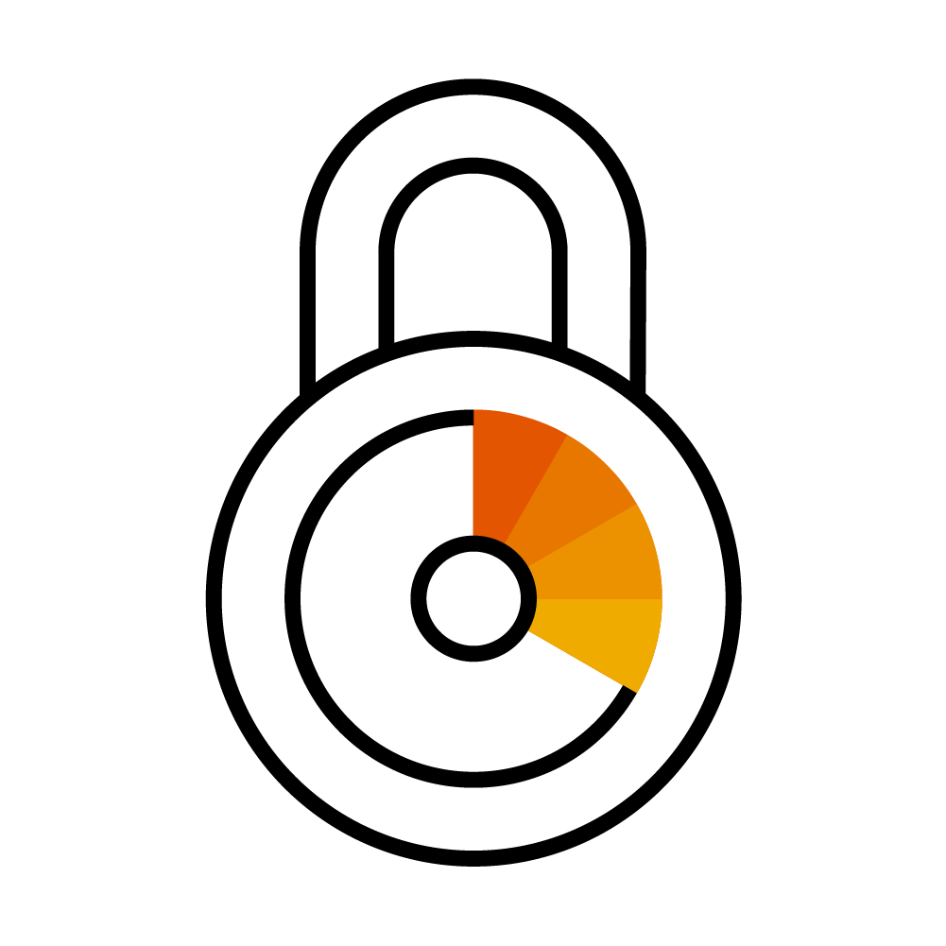
Using Images from a private registry
Kubernetes
Private Registry
Pod A
Image: private.registry.com/my-image:0.1
Notes:
Private registries are usually protect by user & password
Adocker daemon cannot pull images from a protected registry anonymously
=> So there is authentication required, similar to a local docker installation, where you run a docker login <registry>

Slide 16

Image Pull Secrets
Kubernetes
Private Registry
Pod A
Image: <>
ImagePullSecret: <>
Image Pull Secret
kubectl create secret docker-registry <name>
--docker-server=<>
--docker-username=<>
--docker-password=<>
--docker-email=<>
Notes:
Image Pull Secrets contain the same info as .docker/config.json & works similar to ‘docker login …’
ImagePullSecrets can be specified as part of the PodSpec: https://kubernetes.io/docs/reference/generated/kubernetes-api/v1.12/#podspec-v1-core
Without such a secret, the pod will end in an error state because the image cannot be downloaded

Slide 17
Image Pull Secrets
Kubernetes
Private Registry
Pod A
Image: private.registry.com/my-image:0.1
service account
“default”
Image Pull Secret
Notes:
Editing every single pod specification is cumbersome and might introduce dependencies you want to avoid.
The easier way is to assign the image pull secret to the default (or any other) service account.
As explained earlier, the service account gives its’ identity to the pod. Hence the pod can use the image pull secret implicitly.

Slide 18
Image Pull Secret together with Artifactory
Corporate Network
Docker build
Docker build
Docker push
DMZ Artifactory
Repository “test”
Docker pull
Image Pull Secret
Image Pull Secret
K8s @GCP
K8s @Azure
Notes:
How could an example look like?
Imagine, you develop locally and push your ready docker images to the artifactory in DMZ. To do so, you probably use your personal credentials to the registry and the target repository.
To deploy your application to Kubernetes, you write a deployment and specify the image you pushed to artifactory. When posting the deployment to the API server, the pod creation fails as the image cannot be downloaded – permission denied.
So next, you create an Image Pull Secret with the credentials of a technical user and attach it to the default service account of your namespace. Now the docker daemons on your nodes can download the image.

Slide 19
Kubernetes Dashboard addon

Slide 20
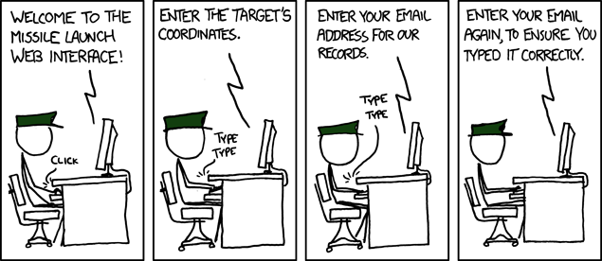
Sometimes working with kubernetes is like …
https://xkcd.com/970/

Slide 21
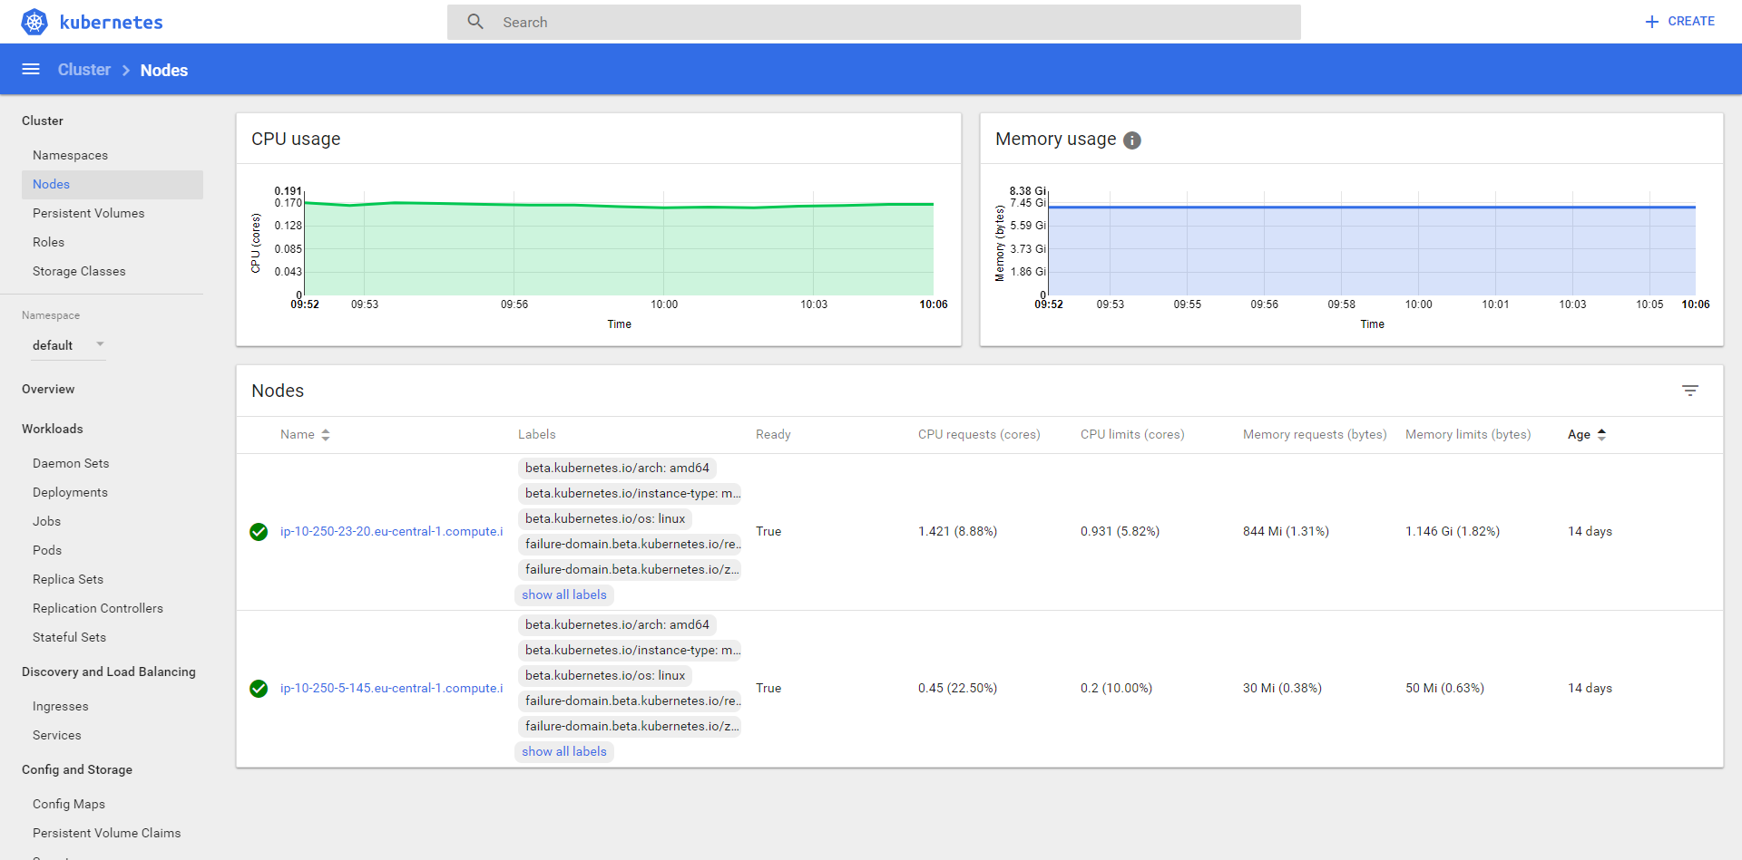
K8s Dashboard

Slide 22
(optional) Demo
Notes:
Optional demo:
To access the cluster’s dashboard, use the Gardener UI or port-forward the to dashboard pod (example: kubectl port-forward -n kube-system addons-kubernetes-dashboard-5486b968b7-zf62b 8443:8443)
Demo the dashboard
- Show status info & utilization of nodes
- Show deployments & services and how to create a new deployment

Slide 23
Kubernetes Gardener

Slide 24
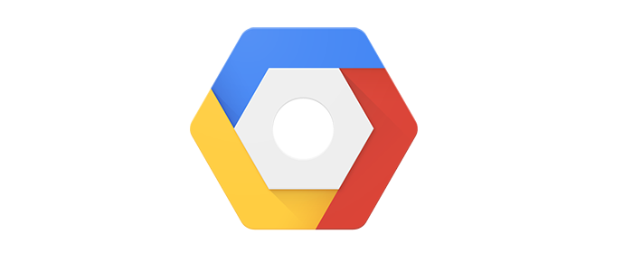
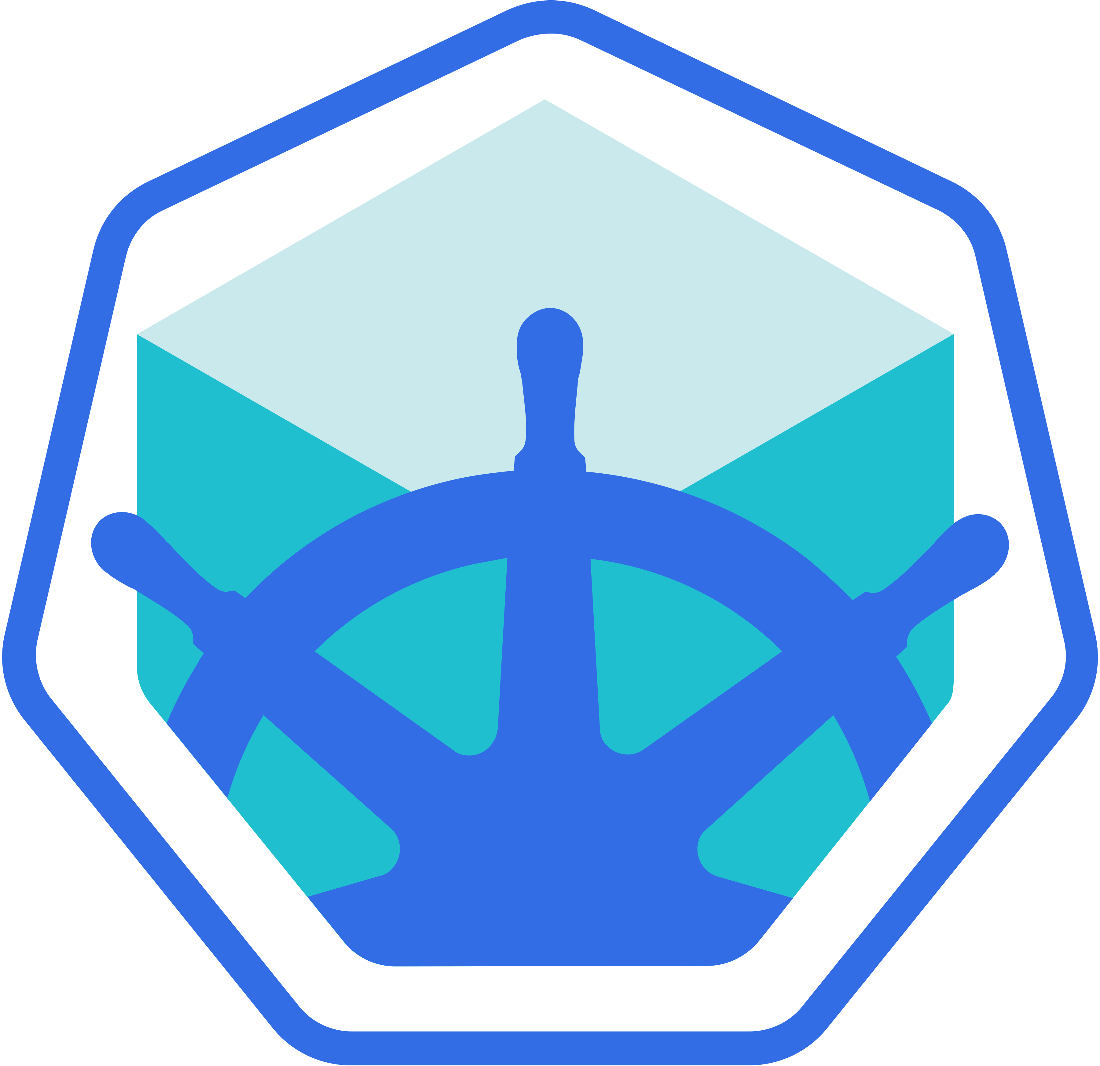


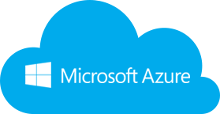
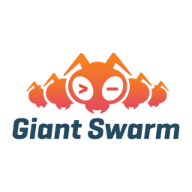
Wherefrom can I get a cluster?
https://github.wdf.sap.corp/pages/kubernetes/gardener
https://github.com/kubernetes/minikube
Notes:
Gardener is SAP’s solution for managed kubernetes cluster. It is open source & completely available on github: https://github.com/gardener/gardener/
Show internal landing page: https://github.wdf.sap.corp/pages/kubernetes/gardener/ including blog & help section
Jam Group Kubernetes Clusters as a Service in SAP Cloud Platform: https://jam4.sapjam.com/groups/Niq7TSBxLlzgb3nroBZJVx/overview_page/e9uqTDxXBRFbk7FJXEA4Cd

Slide 25
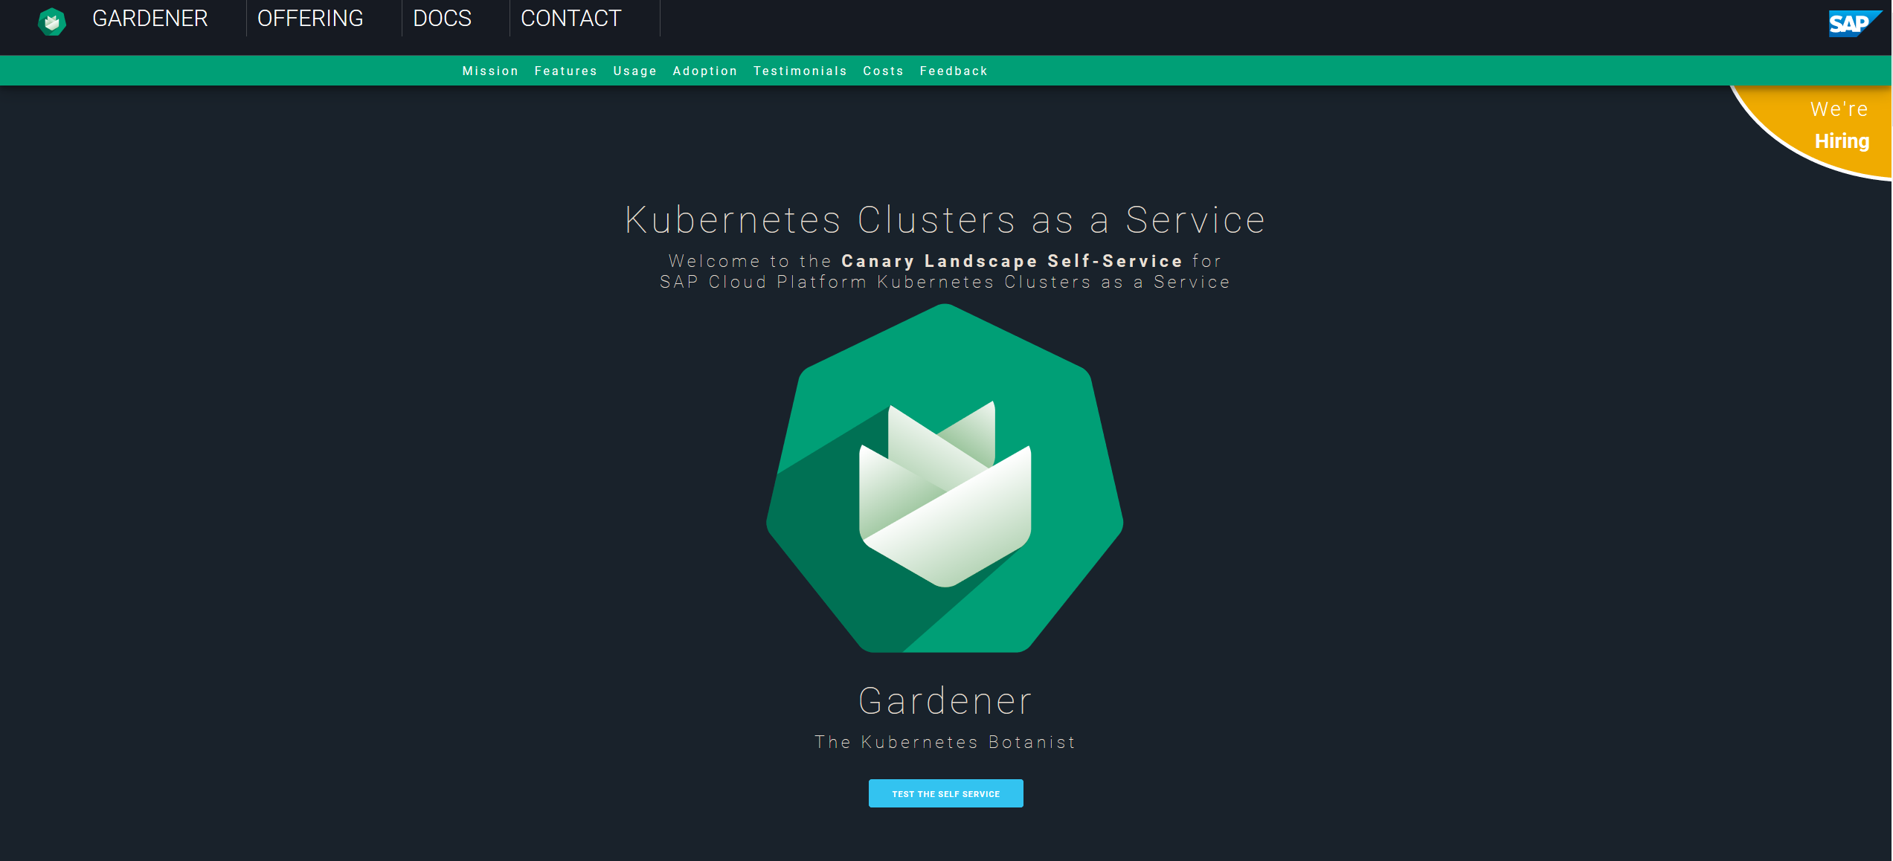
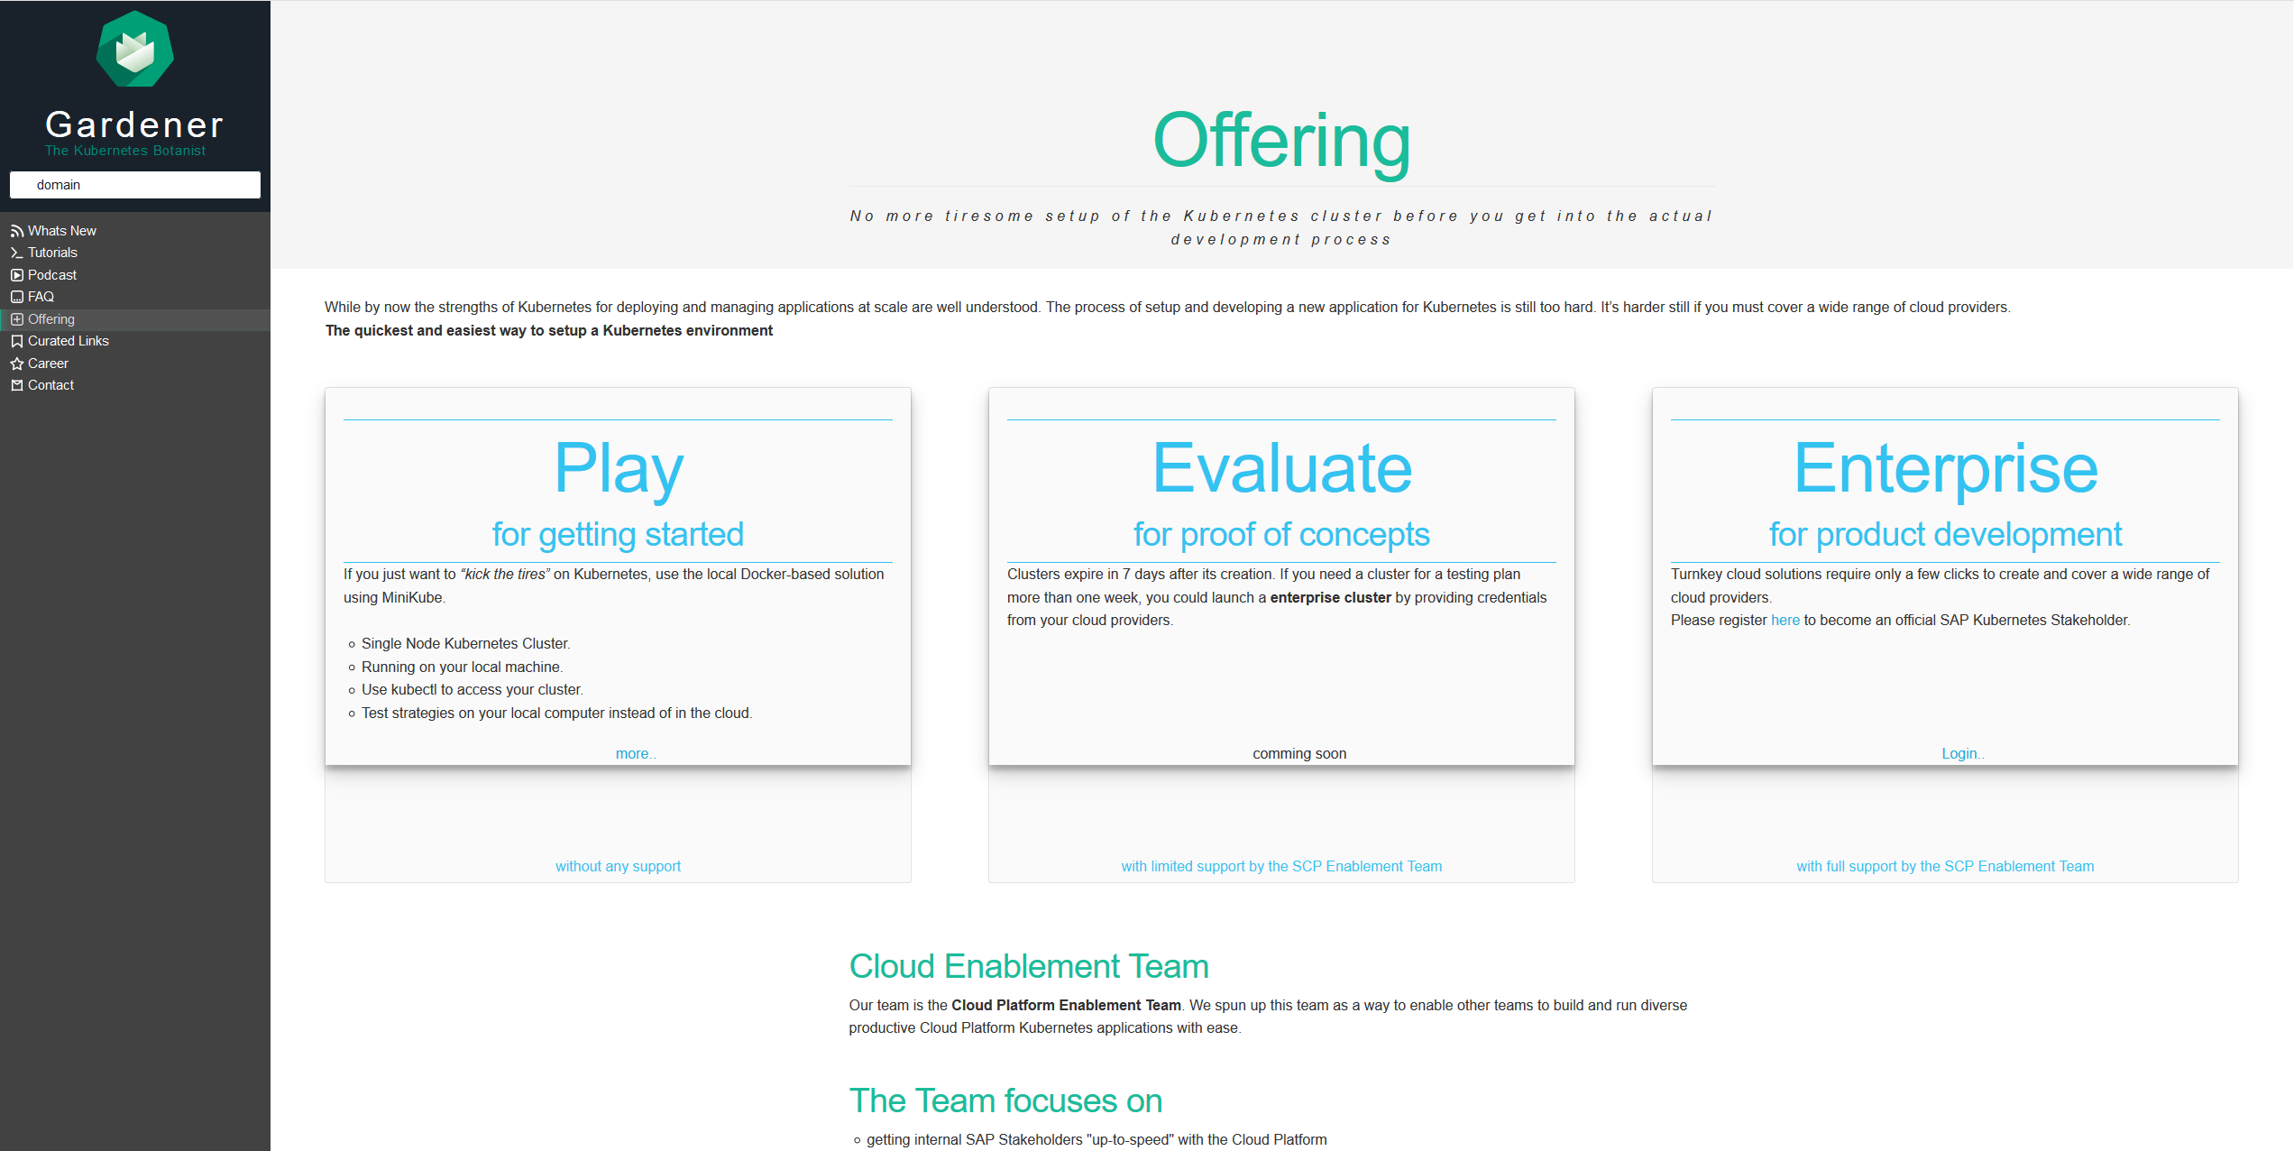
Wherefrom can I get a cluster?
Notes:
https://jam4.sapjam.com/groups/Niq7TSBxLlzgb3nroBZJVx/overview_page/e9uqTDxXBRFbk7FJXEA4Cd

Slide 26
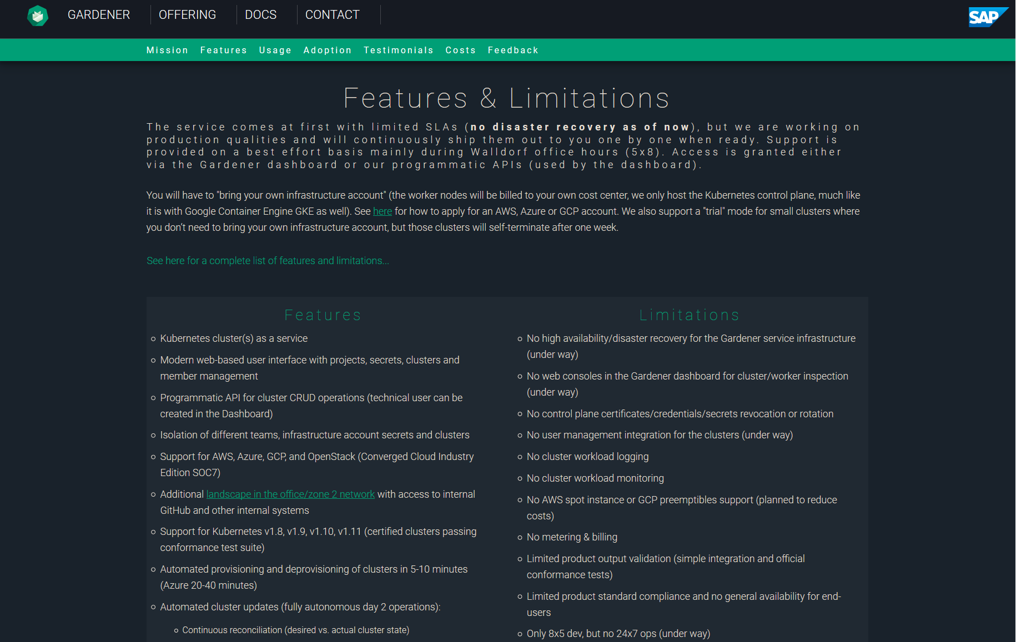
Gardener: Features & Limitations
https://github.wdf.sap.corp/pages/kubernetes/gardener/#features
https://github.wdf.sap.corp/kubernetes/kube-docs/wiki/Gardener-Service-FAQ
Notes:
https://github.wdf.sap.corp/pages/kubernetes/gardener/#features
https://github.wdf.sap.corp/kubernetes/kube-docs/wiki/Gardener-Service-FAQ
https://jam4.sapjam.com/groups/Niq7TSBxLlzgb3nroBZJVx/overview_page/e9uqTDxXBRFbk7FJXEA4Cd

Slide 27
“Traditional” Kubernetes Cluster Set-up
Master
Worker
Master
Worker
Master
Worker
Master
Worker
Master
Worker
Master
Worker
Master
Worker
Master
Worker
Master
HA
Worker
HA
HA
Master
Worker
Master
Master
Worker
Worker
Worker
Master
Worker
HA
Worker
Worker
The red nodes run the control plane,
often in HA and on separate hardware
(usually quite underutilized)
The blue nodes run the actual workload and is managed by Master Nodes (usually pretty well utilized)
Notes:
Setting up lots of small clusters individually leads to resource waste. The control plane / master needs to be high available but the resources reserved for fail-over usually idle.

Slide 28
The Gardener: Control Plane Engineering with minimal TCO!
Seed Cluster
Shoot Clusters
Master
Worker/Minion
Worker/Minion
Worker/Minion
Management Vector
into all
Control Planes
Master
Worker/Minion
Worker/Minion
Worker/Minion
Master
Worker/Minion
Worker/Minion
HA
Worker/Minion
Worker/Minion
manages
Worker/Minion
Worker/Minion
Worker/Minion
Worker/Minion
Worker/Minion
ETCD
API Server
ETCD
Worker/Minion
Worker/Minion
Scheduler
Controller Mgr
Worker/Minion
Auto-scaling via native
hyperscale provider service
or controller on bare metal
Think outside the box /
Move outside the box!
Controller Mgr
Scheduler
API Server
ETCD
…
Notes:
Solution: Gardener runs the control plane / master components of many “worker” clusters in a separate cluster

Slide 29
Appendix

Slide 30
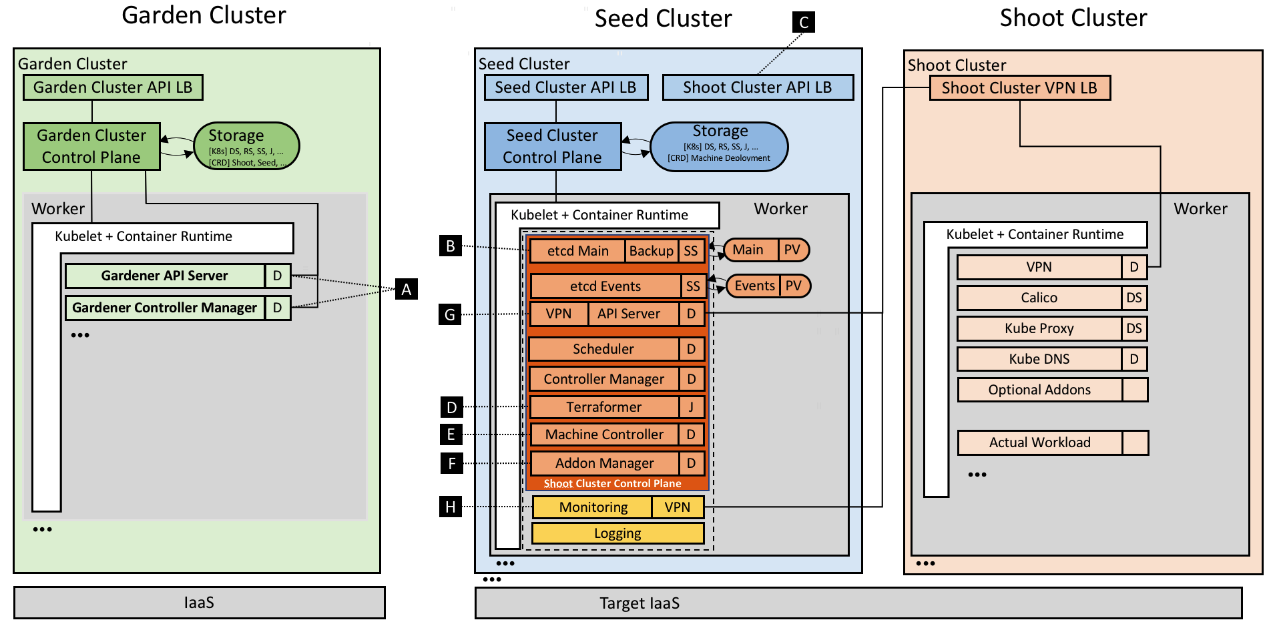
The Gardener: Technical landscape
https://kubernetes.io/blog/2018/05/17/gardener/

