Slide 1
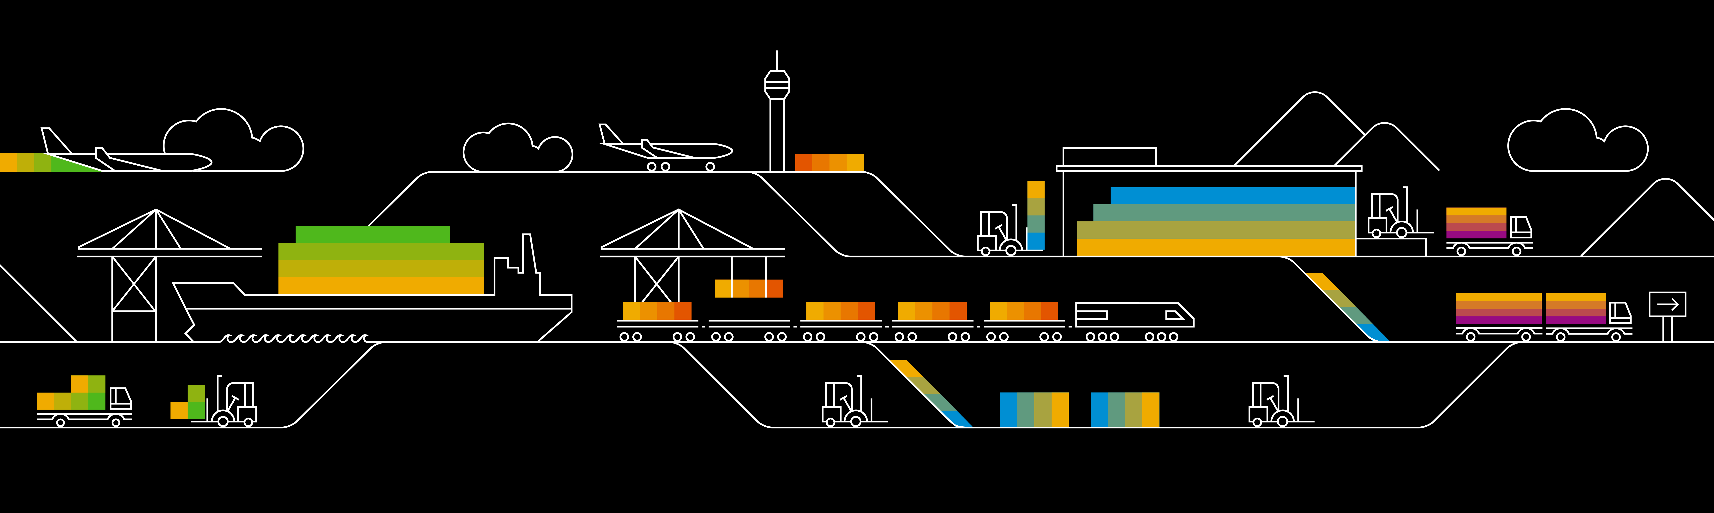

Kubernetes (Cluster) Administration

Slide 2
Service Accounts
Service accounts are technical user in Kubernetes
Bound to a namespace
Allowed to communicate with the API server
Provide identity for pods
Pods can inherit permissions to access the API server or a registry (image pull secret)
Namespace
Pod A
service account
“default”
secrets
Pod B
Notes:
Currently there are two types of users in kubernetes – technical and normal Users. Users are considered to be human (end-)users and you can fine granularily define what each user can. They can also (by default) be cluster admins and have access to everything in the cluster.
The 2nd type of user is a technical user, called “service account”. A service account is bound to a namespace and in every namespace there is “default” service account. Of course it is possible to create further service accounts.
Usually a service account holds an access token allowing to communicate with the cluster’s API server. The token itself is a kubernetes secret. Additionally you can assign an image pull secret to the service account (see slide 5 ff for further info).
When scheduling resources like a pod, they always run in the “name” of the service account. This means, the service account’s secrets will be mounted into the pod. Hence a pod is also able to access the API server with the identity of the service account and its valid credentials.
If not specified differently, the default service account will be used.
Since a pod can access the API, think about possible consequences. Could it modify the system? To avoid potential security issues, it is recommended to limit the access scope of the service account using RBAC → see next slide

Slide 3
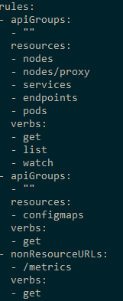
Role based access control (RBAC)
roles define which api’s / resources can be accessed in which way
Roles can be assigned to service accounts
Roles are pre-configured or custom defined
Bindings: cluster-wide or restricted to namespace
Namespace
Pod A
Role binding
role
Secret A
Notes:
To limit the access scope of a service account, you can use existing roles or create your own. These roles are bound to the respective service account.

Slide 4

Demo
Notes:
Show the default service account associate with any namespace (kubectl get sa)
Show the token that is associated with the service account (kubectl get secret)
Show the clusterrolebinding, that makes the participants cluster admin (kubectl get clusterrolebinding)
Create a custom role:
In the demo folder, have a look at 11a_rbac.yaml
explain the access to the different API groups & objects within
The role "pod-master" gives you full access to pods, read access to configmaps and no access to anything else
the YAML creates a service account "pod-master"
The role gets bound to the service account by the rolebinding "pod-master"
Before you switch the kubeconfig context, check, if the secret “admin-access” described in file 07c_demo_secret.yaml is present in your namespace. If not, re-create it (kubectl create –f 07c_demo_secret.yaml)
In the demo folder, run the script 11b_rbac-demo-shell.sh
This script will start a new shell with a temporary kube.config that accesses the cluster as service account pod-master
In this shell, try to get the running pods and the configmaps
Try to get the secrets
Create a pod using the secret “admin-access” with "kubectl create –f 07d_demo_pod_with_secret.yaml" and have a look at its logs to show that secrets are still visible from within the pod although we do not have access to the secrets through the role (potential security leak)
Use the role binding "pod-master" and use kubectl auth can-i … to demo its function.
kubectl auth can-i get nodes --as system:serviceaccount:default:default ➔ expected result: no
kubectl auth can-i get nodes --as system:serviceaccount:part-<id>:default ➔ expected result: yes (due to the clusterrolebinding)

Slide 5
Image Pulling
Docker
Start Pod with image <>
Image present already?
Worker
Docker
Pod
Pod
Docker pull image
Start Pod with image <>
Notes:
The docker daemon runs on each node and has an individual, local image store. So each time a pod is scheduled on a node, the daemon checks, if the image is already present.
If not the image has to be pulled (= downloaded).

Slide 6

Using Images from a private registry
Kubernetes
Private Registry
Pod A
Image: private.registry.com/my-image:0.1
Notes:
Private registries are usually protect by user & password
Adocker daemon cannot pull images from a protected registry anonymously
=> So there is authentication required, similar to a local docker installation, where you run a docker login <registry>

Slide 7

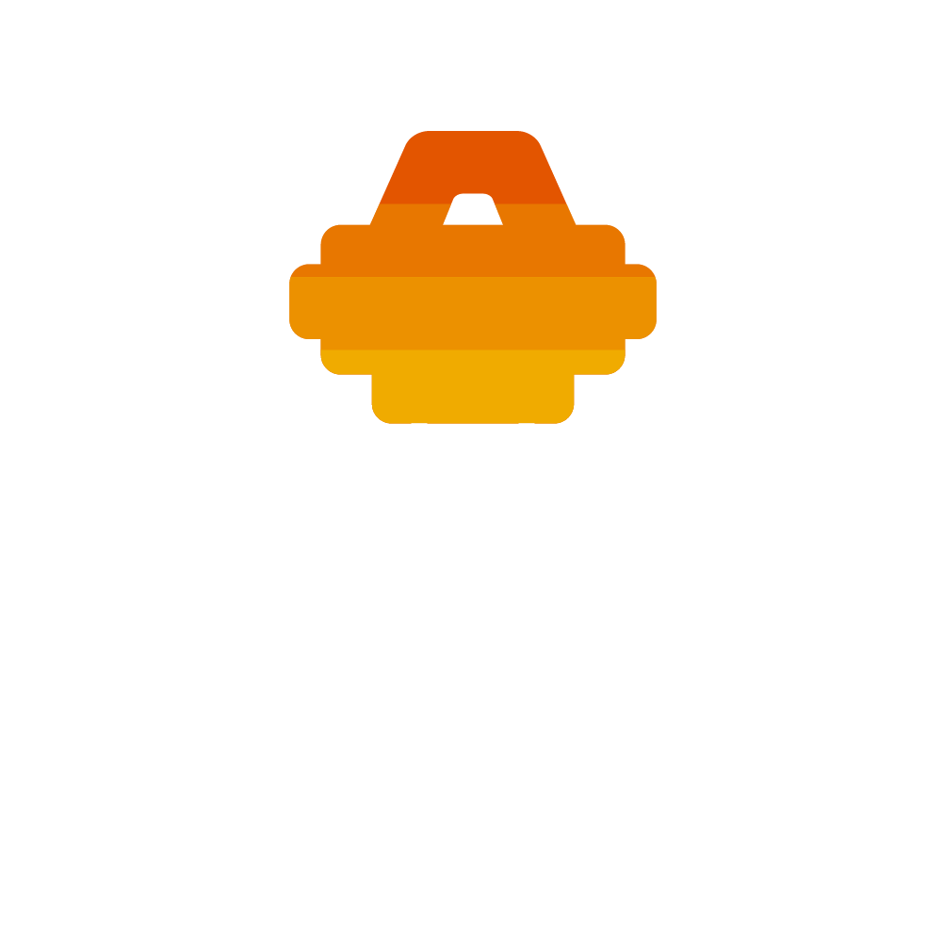
Image Pull Secrets
Kubernetes
Private Registry
Pod A
Image: <>
ImagePullSecret: <>
Image Pull Secret
kubectl create secret docker-registry <name>
--docker-server=<>
--docker-username=<>
--docker-password=<>
--docker-email=<>
Notes:
Image Pull Secrets contain the same info as .docker/config.json & works similar to ‘docker login …’
ImagePullSecrets can be specified as part of the PodSpec: https://kubernetes.io/docs/reference/generated/kubernetes-api/v1.12/#podspec-v1-core
Without such a secret, the pod will end in an error state because the image cannot be downloaded

Slide 8
Image Pull Secrets
Kubernetes
Private Registry
Pod A
Image: private.registry.com/my-image:0.1
service account
“default”
Image Pull Secret
Notes:
Editing every single pod specification is cumbersome and might introduce dependencies you want to avoid.
The easier way is to assign the image pull secret to the default (or any other) service account.
As explained earlier, the service account gives its’ identity to the pod. Hence the pod can use the image pull secret implicitly.

Slide 9
Image Pull Secret together with Artifactory
Corporate Network
Docker build
Docker build
Docker push
DMZ Artifactory
Repository “test”
Docker pull
Image Pull Secret
Image Pull Secret
K8s @GCP
K8s @Azure
Notes:
How could an example look like?
Imagine, you develop locally and push your ready docker images to the artifactory in DMZ. To do so, you probably use your personal credentials to the registry and the target repository.
To deploy your application to Kubernetes, you write a deployment and specify the image you pushed to artifactory. When posting the deployment to the API server, the pod creation fails as the image cannot be downloaded – permission denied.
So next, you create an Image Pull Secret with the credentials of a technical user and attach it to the default service account of your namespace. Now the docker daemons on your nodes can download the image.

Slide 10
A note on scheduling pods…
Scheduler
Node A
Node B
Node C
Taint: NoUsers
Frontend With Backend
OnNodeB
OnNodeB
Backend With Frontend
Tolerate NoUsers
NotWith Database
NotWith Database
Notes:
There are multiple ways, to influence where pods are scheduled:
Taints & tolerations: a node is tainted and only pods explicitly tolerating the taint will be scheduled
Node selector: specify a node “type” by label to assign a pod to certain node pool
Pod affinity: explicitly schedule a pod on a node where certain pod is already running
Pod anti-affinity: don’t schedule on a node, where a certain pod is already running

Slide 11
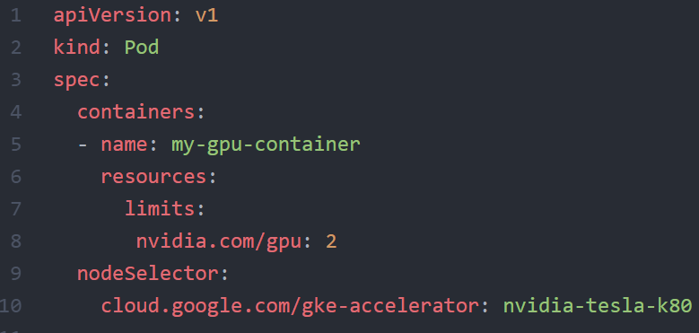
Example: NodeSelector

Slide 12
Optional Demo
Notes:
Custom scheduler - this Demo is optional!
If regular scheduling doesn’t fit to your requirements, you can build a custom scheduler.
All you need is to
a name the scheduler can be referenced by
A control loop watching the API for unscheduled pods referencing the scheduler by name
Access to the cluster API to run the loop and post the bindings
Demo :
kubectl proxy &
Create the deployment 11d_custom_scheduler_deployment.yaml
Show the pod with the specified scheduler name & run a “describe” on it. Highlight the missing default scheduling event → the default scheduler doesn’t pick it up
Run “./11e_custom_scheduler.sh <your-target-namespace>” to start the scheduling loop
Show the scheduled pods
Instead of running the scheduler locally you could also run it within the cluster – simply pack it into a docker image and use it with a deployment.

Slide 13
Kubernetes DaemonSets & Jobs
Notes:
When talking about scheduling, there are a few more resource type we have to take a look at (briefly): daemonSet, jobs (& cronJobs)

Slide 14
Some components require to have a pod on every node!
DaemonSet
structure is similar to deployments
selector.matchLabels
PodSpecTemplate
one pod is scheduled on each node
Node A
Node B
Node C
log collection
log collection
log collection
monitoring
monitoring
monitoring
Notes:
A daemonset works almost similar to a deployment. However the replica count is determined by the number of cluster nodes. The daemonset controller will ensure that a corresponding pod is running on each node.
Of course this behavior can be influenced by taints etc. – more details can be found here: https://kubernetes.io/docs/concepts/workloads/controllers/daemonset/

Slide 15



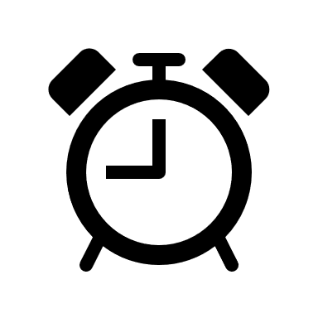

Job & CronJob
If exit code != 0 → consider pod as failed and restart
CronJob
Job
JobSpec
Pod
exit(??)
PodSpecTemplate
Pod terminates successfully – Job is considered ok / complete
Notes:
A job is a single or a set of pods which runs until completed successfully (usually exit code 0). Failed pods can be restarted based on the restart policy.
➔ Jobs are a way to run pods in a reliable way.
With the job resource type you can run tasks with a defined end/ no control loop.
Instances of a job (pods) can also run parallel
More details can be found here: https://kubernetes.io/docs/concepts/workloads/controllers/jobs-run-to-completion/

Slide 16
Kubernetes Policies

Slide 17
Policy objects in Kubernetes
Only 1 Loadbalancer Service!
ResourceQuota
Resource management
No more than 200MB memory!
LimitRange
Communication to DB is forbidden
NetworkPolicy
Security
Beta: Do not run as root user
PodSecurityPolicy
Notes:
Resource Quota and LimitRanges can be used to control requested as well as actual resource consumption + # of k8s objects per namespace. Example: if the memory quota per pod is 200 MB and you want to start, let’s say a Jenkins which would require more – the application will not be able to start before being killed for exceeding the memory limit.
Network policies control traffic within the cluster – details on next slide.
PodSecurityPolicies specify (security relevant) runtime conditions for pods. https://kubernetes.io/docs/concepts/policy/pod-security-policy/

Slide 18
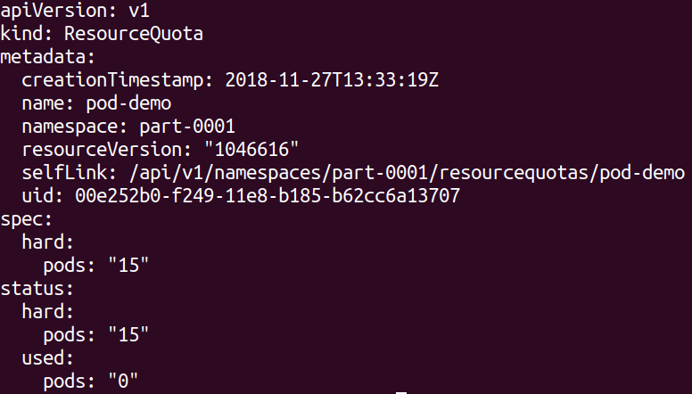
Policy: ResourceQuota
Used to define limits on different resources in a namespace.
namespaced Resource
Set “hard” limits on resources like
Pods
Number of PVCs
Memory (of all pods combined)
More information here.

Slide 19

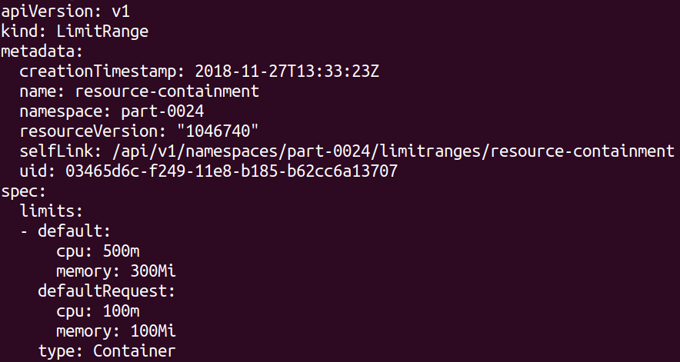
Policy: LimitRanges
Each pod consumes a certain amount of cpu or memory.
With resource spec each Container can request cpu and memory and set its own limits. If it consumes more resources it will be killed.
LimitRanges are used to set maximum/default limits/requests of
cpu
memory

Slide 20
NetworkPolicy
“Firewall”-like restrictions
Define egress and ingress rules for a service
caller: mario
Mario
Selector: location: castle
location: castle
Service
direct-line-to-peach
Peach
Bowser
Network Policy
Selector: caller: mario
Selector: location: castle
Notes:
Network policies are kubernetes object just as pods. The need an overlay network that supports the enforcement of their rules, like Calico.
Basically they define rules for incoming (ingress) and outgoing (egress) traffic to pods. As filter rules you can set IP addresses or use labels. Filter actions are deny or allow.
In the example above, let’s assume princess Peach is at her castle (pod). She has created a service in order to be callable, but only as long as her location = castle. That works quite well, only that Bowser keeps calling her all the time. So Peach decides to allow only calls from Mario and puts a network policy in place. The policy filters incoming calls when she has her “location: castle” label and allows only those to pass, that have a label “caller: mario” attached. As a result Bowser is no longer able to call her.

Slide 21
More on Network Policies
2 policyTypes:
Ingress: rules for incoming traffic
Egress: rules for outgoing traffic
3 kinds of Rules:
ipBlock: range of IP addresses given as CIDR
podSelector: labels of Pods allowed
namespaceSelector: labels of Namespaces
Last two can be combined to specify certain pods in certain namespases (since 1.11)

Slide 22
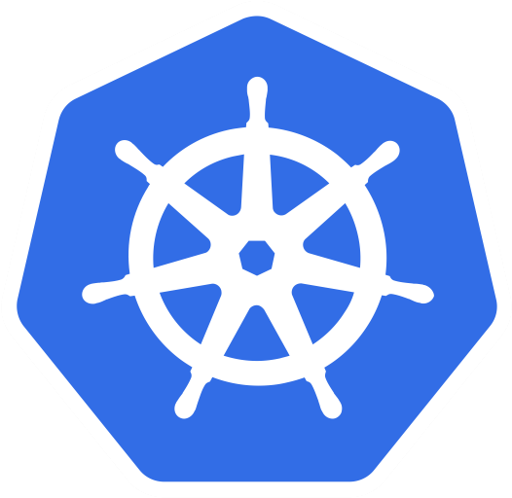
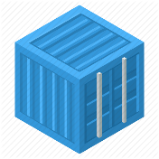
Network Policy for Ads:DB
Ingress:
Allow traffic from ads:app
Egress:
no egress traffic
Pods Ads:DB only receives requests from Ads:App
Pods Ads:DB don’t send any requests to anybody.
bulletinboard- ads
component: ads
module: app
pod: ads-app…ent-xx-yy
Postgresql
component: ads
module: db
pod: ads-db-statefulset-0
Notes:
Normally part of Day4
Who is “talking” to ads:db? A: ads:app
In which direction does the traffic go? -> Ingress
Does ads:db talk to anybody by itself? -> no Egress

Slide 23
Network Policies for Ads:App
Ingress:
Allow traffic from ingress-controller in kube-system namespace
Egress:
Allow traffic to kube-DNS
Allow traffic to Ads:DB
app: nginx-ingress
Ingress-controller
bulletinboard- ads
component: ads
component: controller
name: kube-system
module: app
origin: gardener
pod
pod: ads-app…ent-xx-yy
Request to: ads-db-0….
Namespace: kube-system
Namespace: <your Space>
Request to dns: get ip of ads-db-0….
k8s-app: kube-dns
Postgresql
component: ads
Kube-DNS
module: db
pod
pod: ads-db-statefulest-0
Notes:
Normally part of Day4

Slide 24
NetworkPolicy
“Firewall”-like restrictions
Define egress and ingress rules for a service
Requires support by overlay network plugin
access: ok
Pod B
app: nginx
Service
Pod A
Pod M
Selector: access: ok
Selector: app: nginx
access: not ok
Network Policy
Notes:
Network policies are kubernetes object just as pods. The need an overlay network that supports the enforcement of their rules, like Calico.
Basically they define rules for incoming (ingress) and outgoing (egress) traffic to pods. As filter rules you can set IP addresses or use labels. Filter actions are deny or allow.
In the example above, the network policy is enforced for access to “Pod A”, determined by its label and the corresponding selector.
Pod B is allowed to access pod A since it has the correct label. Traffic from pod M will be blocked.
Demo:
kubectl run nginx --image=nginx --replicas=2
kubectl expose deployment nginx --port=80
kubectl run busybox --rm -ti --image=busybox /bin/sh
# wget --spider --timeout=1 nginx
Kubectl create –f network-policy.yaml
Kubectl run ..
Kubectl run … -l access=true

Slide 25
Demo
Notes:
Demo:
Create a deployment & a corresponding service (if not yet done)
kubectl run nginx --image=nginx --replicas=2
kubectl expose deployment nginx --port=80
Create a helper pod, logon to it and get the index.html page from the nginx backend.
kubectl run connector --rm -ti --restart=Never --image=alpine:3.8
# wget --timeout=1 nginx
Remove the index.html page & stay connected to the shell session
Create the network policy in a 2nd shell:
kubectl create –f network-policy.yaml
Show the network policy definition and explain:
it’s implicitly a whitelisting
network policy can handle egress and ingress traffic. However the example is only of incoming (ingress) traffic.
The cidr block are required, if you want to access your service later from SAP networks. Otherwise all requested without the label (i.e. not cluster internal) will be blocked too.
Switch back to the helper pod and re-run the wget command ➔ expected result: failure due to the missing label
Label you helper pod accordingly (can be done from the 2nd shell session, so stay connected to your helper pod)
kubectl label pod connector access=true
Re-run the wget command ➔ expected result: works again

Slide 26
Exercise #08
Filter incoming traffic with a network Policy
service http / https
nginx
nginx
nginx
custom content
config
tls certs

Slide 27
Kubernetes Dashboard addon

Slide 28
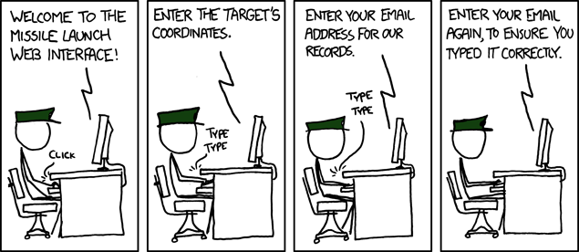
Sometimes working with kubernetes is like …
https://xkcd.com/970/

Slide 29
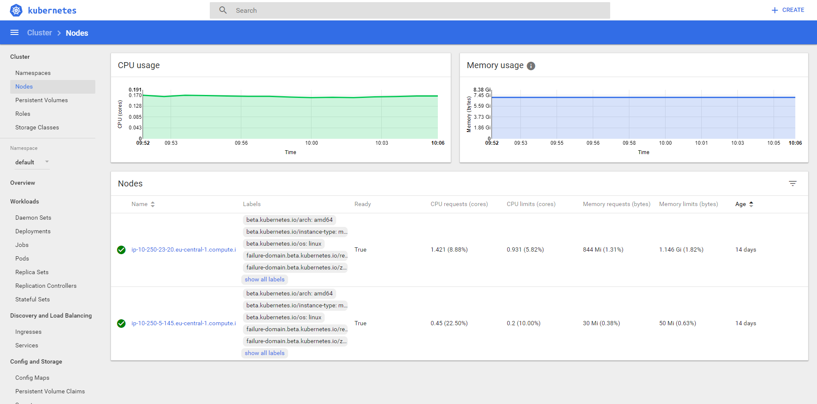
K8s Dashboard

Slide 30
(optional) Demo
Notes:
Optional demo:
To access the cluster’s dashboard, use the Gardener UI or port-forward the to dashboard pod (example: kubectl port-forward -n kube-system addons-kubernetes-dashboard-5486b968b7-zf62b 8443:8443)
Demo the dashboard
- Show status info & utilization of nodes
- Show deployments & services and how to create a new deployment

Slide 31
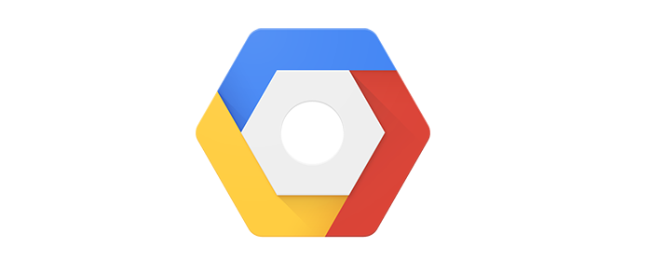
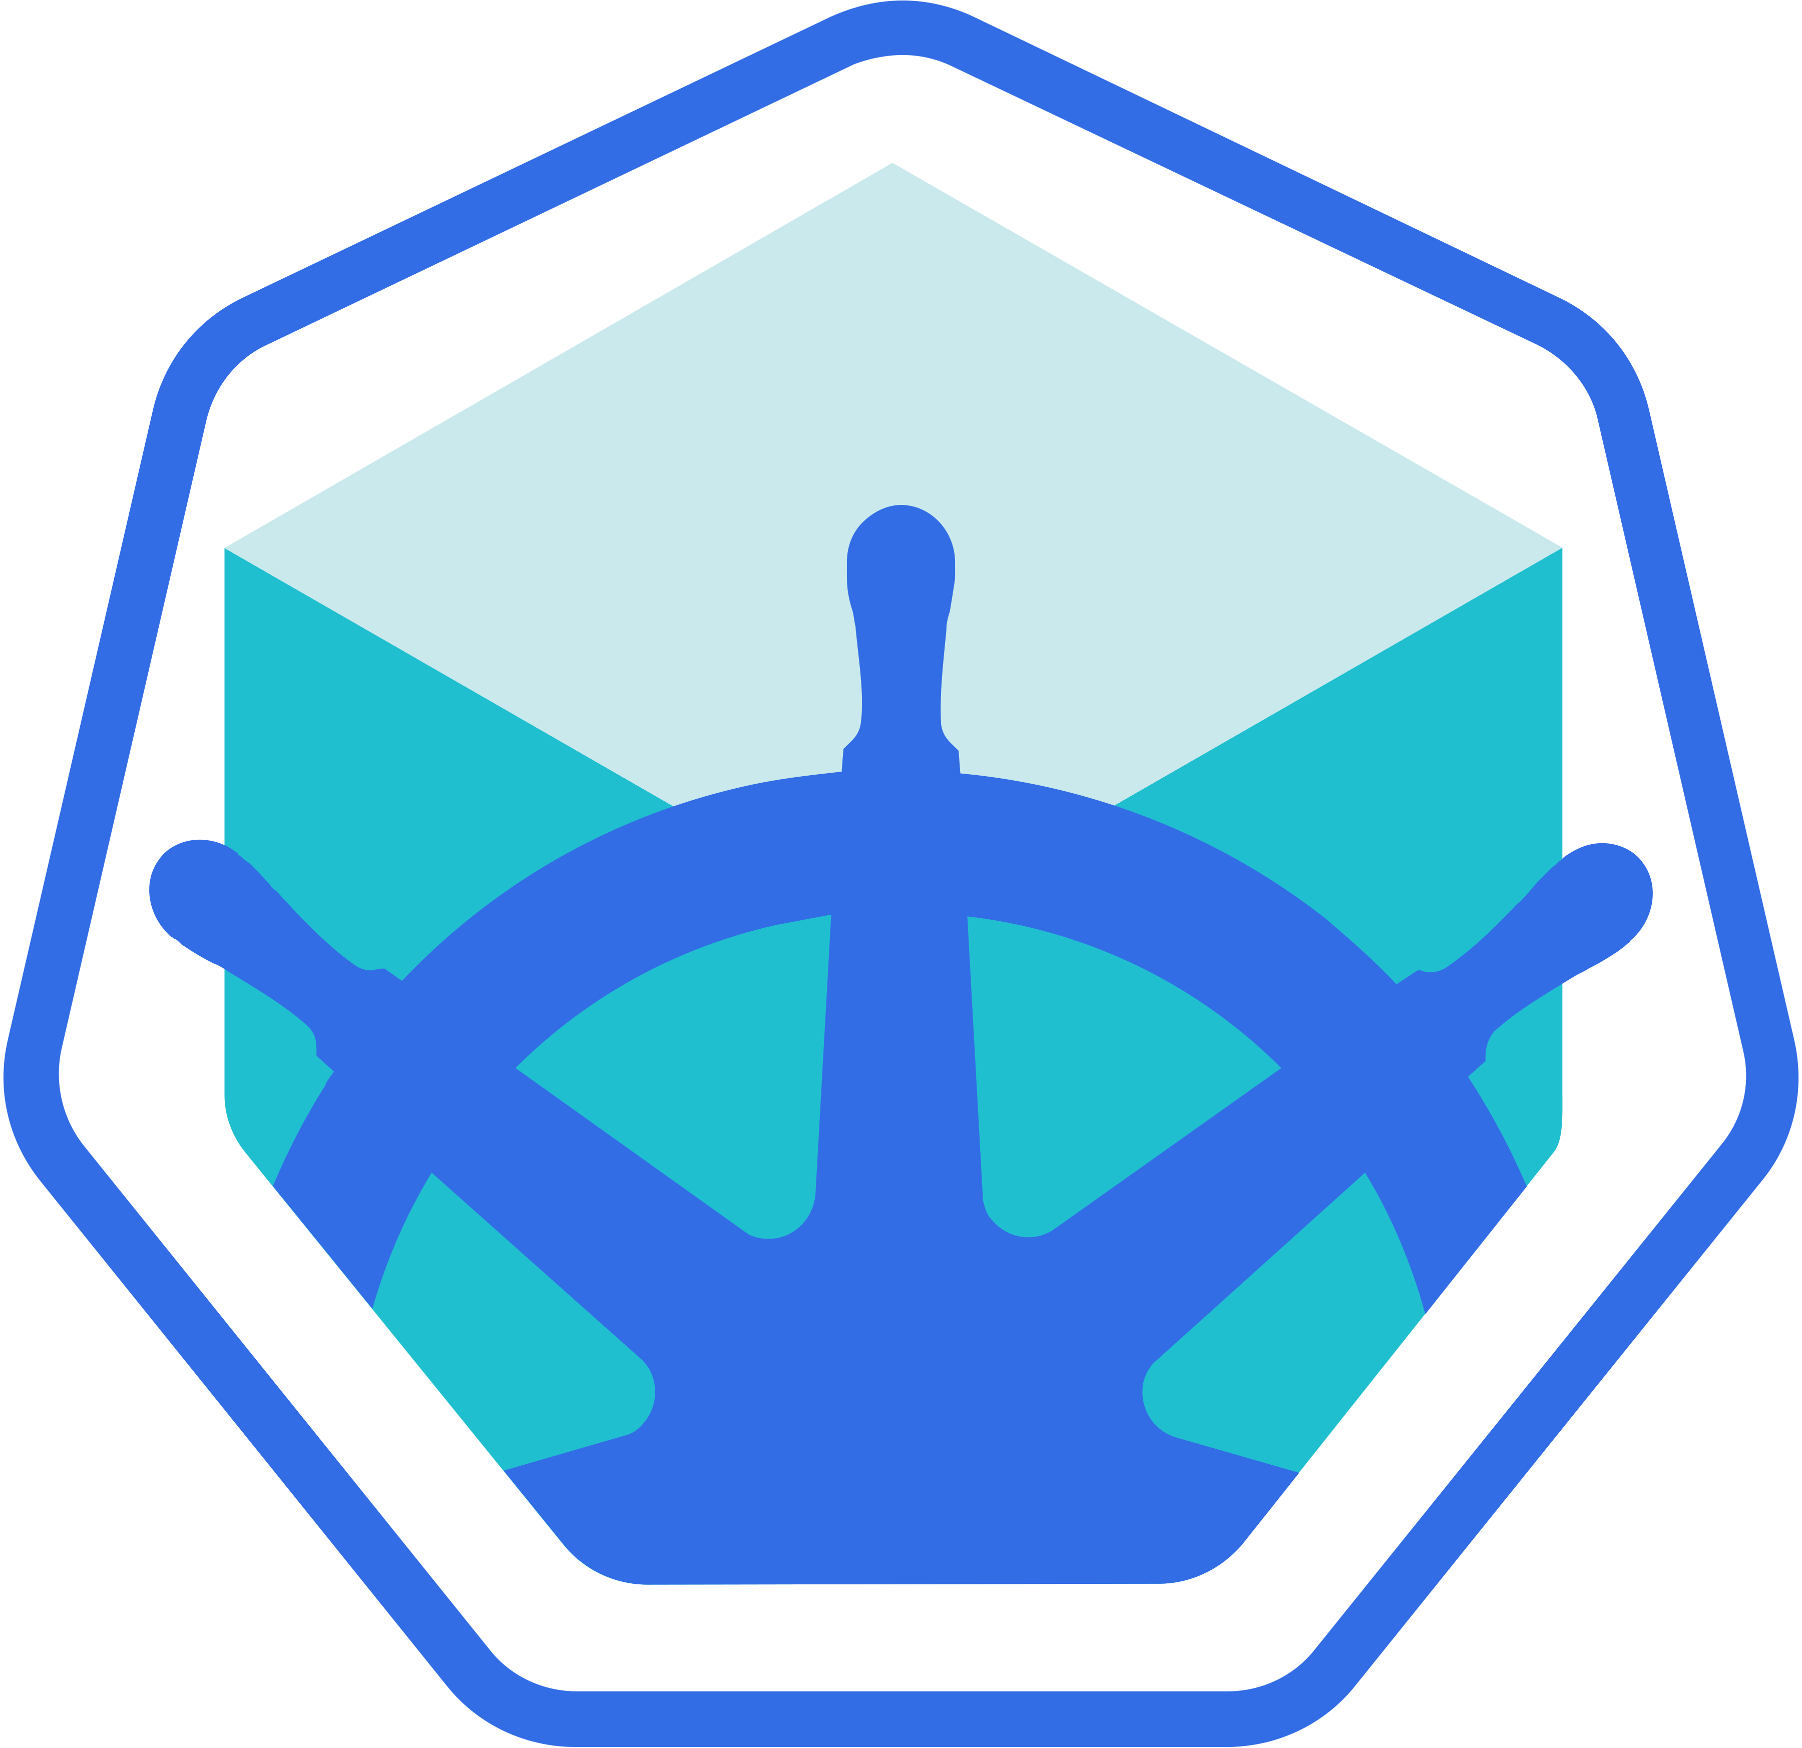
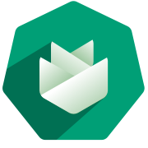

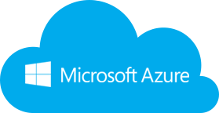
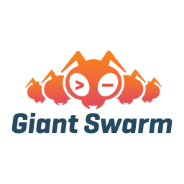
Wherefrom can I get a cluster?
https://github.wdf.sap.corp/pages/kubernetes/gardener
https://github.com/kubernetes/minikube
Notes:
Gardener is SAP’s solution for managed kubernetes cluster. It is open source & completely available on github: https://github.com/gardener/gardener/
Show internal landing page: https://github.wdf.sap.corp/pages/kubernetes/gardener/ including blog & help section
Jam Group Kubernetes Clusters as a Service in SAP Cloud Platform: https://jam4.sapjam.com/groups/Niq7TSBxLlzgb3nroBZJVx/overview_page/e9uqTDxXBRFbk7FJXEA4Cd

Slide 32
“Traditional” Kubernetes Cluster Set-up
Master
Worker
Master
Worker
Master
Worker
Master
Worker
Master
Worker
Master
Worker
Master
Worker
Master
Worker
Master
HA
Worker
HA
HA
Master
Worker
Master
Master
Worker
Worker
Worker
Master
Worker
HA
Worker
Worker
The red nodes run the control plane,
often in HA and on separate hardware
(usually quite underutilized)
The blue nodes run the actual workload and is managed by Master Nodes (usually pretty well utilized)
Notes:
Setting up lots of small clusters individually leads to resource waste. The control plane / master needs to be high available but the resources reserved for fail-over usually idle.

Slide 33
The Gardener: Control Plane Engineering with minimal TCO!
Seed Cluster
Shoot Clusters
Master
Worker/Minion
Worker/Minion
Worker/Minion
Management Vector
into all
Control Planes
Master
Worker/Minion
Worker/Minion
Worker/Minion
Master
Worker/Minion
Worker/Minion
HA
Worker/Minion
Worker/Minion
manages
Worker/Minion
Worker/Minion
Worker/Minion
Worker/Minion
Worker/Minion
ETCD
API Server
ETCD
Worker/Minion
Worker/Minion
Scheduler
Controller Mgr
Worker/Minion
Auto-scaling via native
hyperscale provider service
or controller on bare metal
Think outside the box /
Move outside the box!
Controller Mgr
Scheduler
API Server
ETCD
…
Notes:
Solution: Gardener runs the control plane / master components of many “worker” clusters in a separate cluster

Slide 34
Appendix

Slide 35
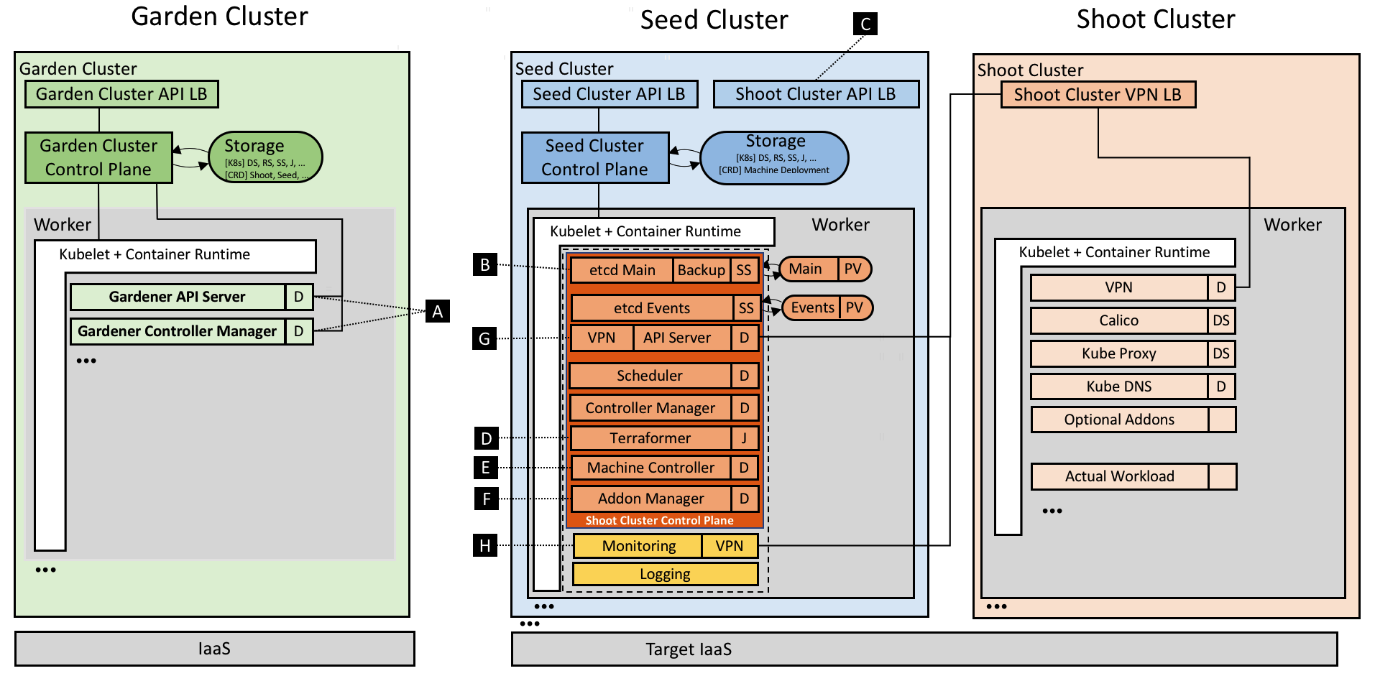
The Gardener: Technical landscape
https://kubernetes.io/blog/2018/05/17/gardener/

Slide 36
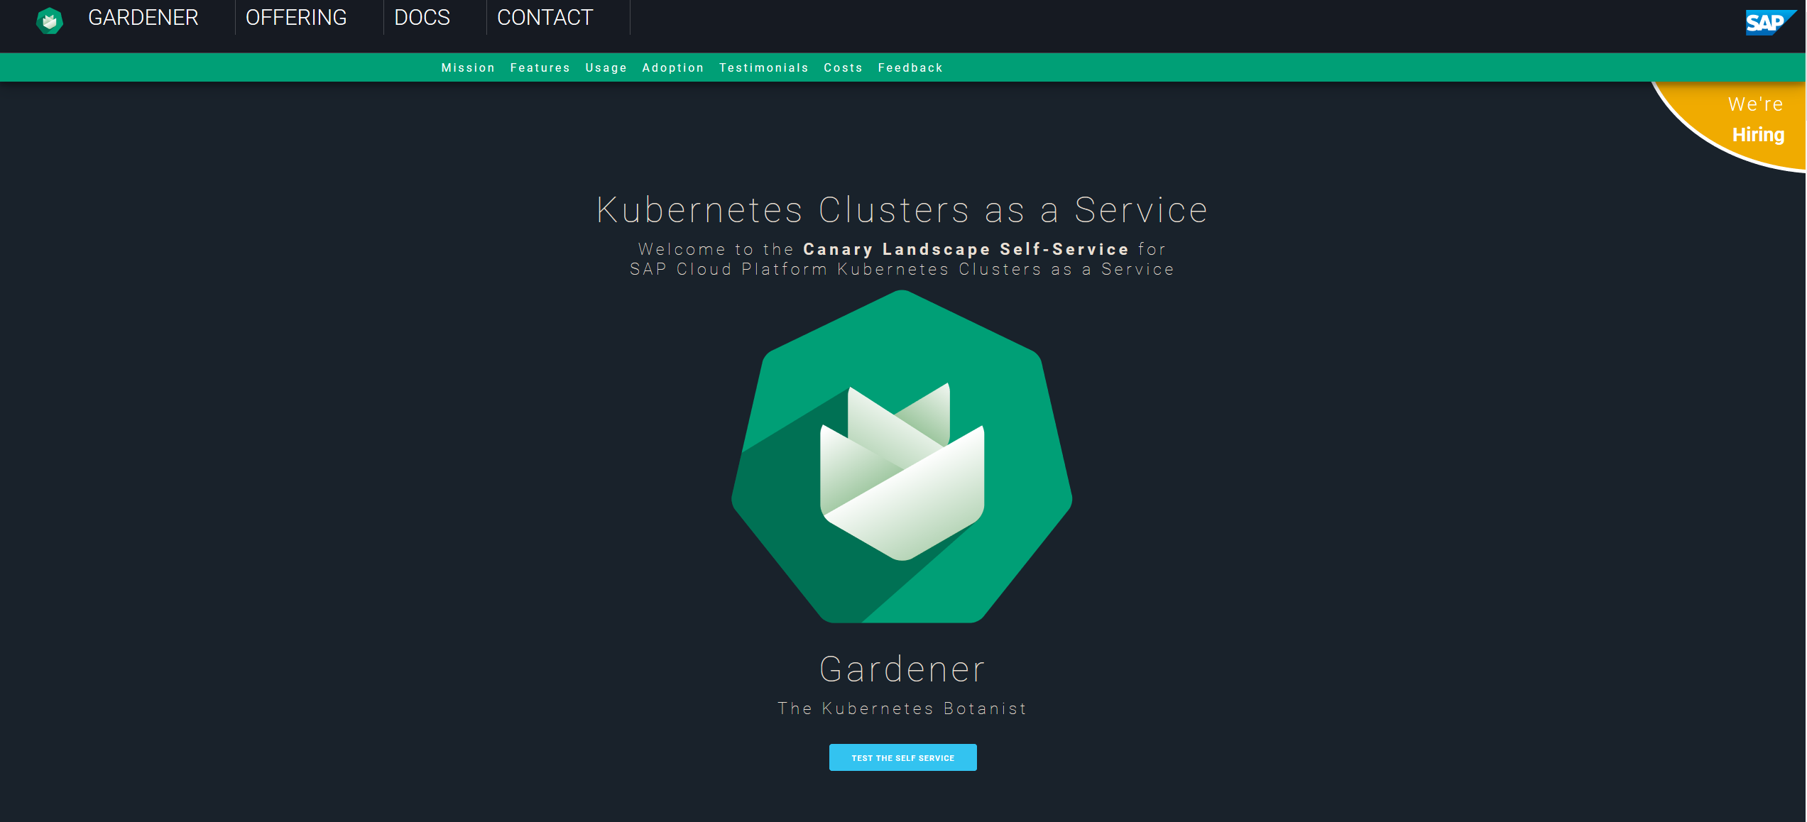
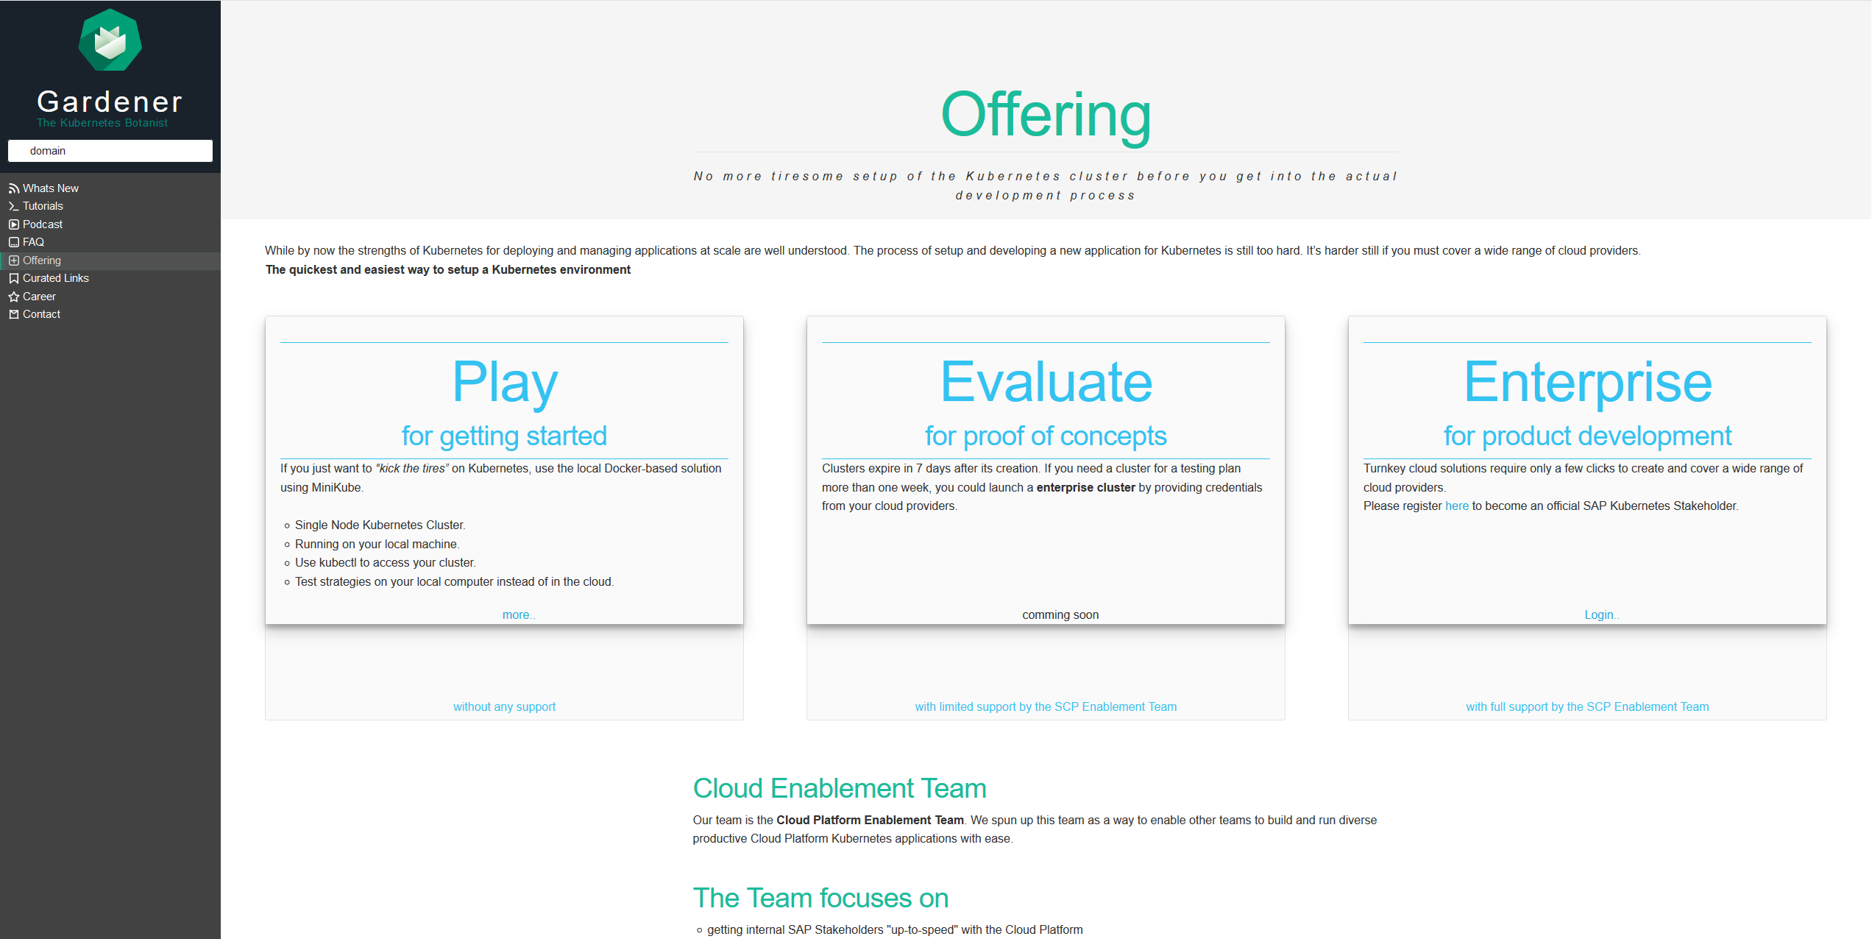
Wherefrom can I get a cluster?
Notes:
https://jam4.sapjam.com/groups/Niq7TSBxLlzgb3nroBZJVx/overview_page/e9uqTDxXBRFbk7FJXEA4Cd

