Slide 1


Kubernetes Troubleshooting

Slide 2
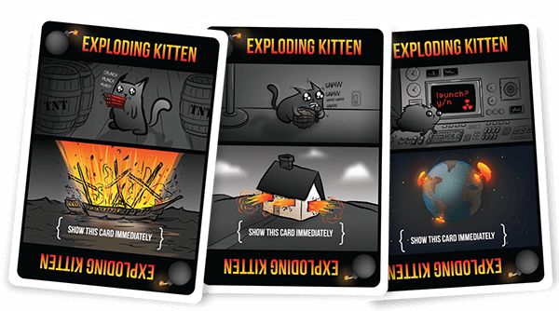
IF YOU DRAW AN EXPLODING KITTEN CARD, YOU EXPLODE. WHEN YOU EXPLODE, YOU DIE AND YOU'RE OUT OF THE GAME.
https://explodingkittens.com/
Notes:
Pretty much as with software operations, in the game exploding kittens, you want to be the last man/women standing. This slide deck is about troubleshooting pods and services.

Slide 3
What kind of errors did you face, so far?
CrashLoopBackOff
Pending … … …
ErrImagePull
ImagePullBackOff
ContainerCreating … … …
Notes:
Make this interactive and ask participants first!
There are lots of different errors and way more reasons for a pod to terminate.
CrashLoopBackOff: container has been started multiple times and almost immediately exited with exit-code != 0. K8s will stop trying now.
ErrImagePull: failed to pull docker image from specified registry/repo
ImagePullBackOff: many ErrImagePull => K8s will stop trying now
Pending: pod not yet created (and no resources to do so)
ContainerCreating: trying to create the container, but something is not yet available (like a mount point/volume)

Slide 4
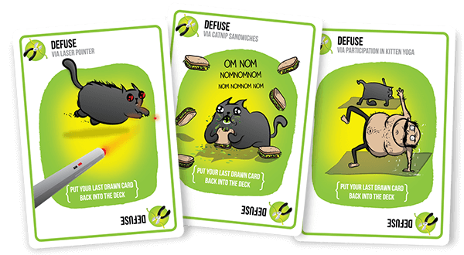
UNLESS!
YOU PLAY A DEFUSE CARD, WHICH WILL STOP THE KITTEN FROM EXPLODING USING THINGS LIKE LASER POINTERS, KITTEN YOGA, AND CATNIP SANDWICHES.
https://explodingkittens.com/
Notes:
If you face an error there are a few thing you can always check. Debugging relevant information is store in the logs of a pod but also hidden in the events associated with the resource your currently looking at.

Slide 5
Pod failure - where to look for information
kubectl get pods
NAME READY STATUS RESTARTS AGE
nginx 0/1 CrashLoopBackOff 5 5s
Is any container in the pod running?
What is the pod’s status?
Where there any (recent) restarts
Notes:
In case something does not work as expected:
Check, if the resource is available (kubectl get pod)
Check, if the status indicates an error

Slide 6
Pod failure - where to look for information
kubectl logs [--previous] <pod name>
If the container ran, there might be logs available – also from the previous container
kubectl exec –ti <pod name> /bin/bash
If the container is still running, exec into the pod and debug it from within
Notes:
In case something does not work as expected:
In case the pod was started, the might be logs -> use “kubectl get logs <pod name>” to look into it or add the –previous flag to access older logs
If the error is with the application and not the container, exec into the container an look around

Slide 7

Demo
Notes:
Use the crashloop and app_failure demos
Crashloop:
Show the yaml file
Run the pod and show the restart counter & error message with kubectl get pods
Show the logs of the pod ➔ expected output: /bin/sh: no-such-cmd: not found
App failure:
Show the yaml file
Start the pod and show it is running
Use port forward to get to the index.html page (kubectl port-forward app-failure 8080:80)
Show the error message with kubectl logs … & exec into the pod. Show the directory without the index.html file
Explanation: upon start with a default configuration nginx looks at a /usr/share/nginx/html for an index.html file. If this file is not found, nginx attempts a “list directory” action, which is also forbidden in the default configuration.
These 2 strategies can be used for application debugging. Usually issues are not connected to the cluster itself.

Slide 8
Pod failure - where to look for information
kubectl describe pod test-pod
Name: test-pod
Namespace: default
…
PodScheduled False
…
Events:
Type Reason Age From Message
---- ------ ---- ---- -------
Warning FailedScheduling 2s default-scheduler persistentvolumeclaim "nginx-pvc" not found
Pod was not scheduled
Reason for failure can be found in the events section
Notes:
In case something does not work as expected:
In case the pod was not started, use “kubectl describe pod <name>” to look at events. They usually contain a hint about what went wrong

Slide 9
Issues with services
kubectl -n kube-system describe svc node-exporter
…
Selector: component=node-exporter
Type: ClusterIP
IP: None
Port: metrics 9100/TCP
TargetPort: 9100/TCP
Endpoints: 10.250.0.2:9100,10.250.0.3:9100,10.250.0.4:9100
Session Affinity: None
Events: <none>
Correct labels?
Correct target port of pods?
Are any pods available?
https://kubernetes.io/docs/tasks/debug-application-cluster/debug-service/
Notes:
There are various reasons why a service may not be working properly. Kube-dns & kube-proxy might have issues but most likely the issues during a training are user-specific.
So here are a few ideas how to debug a service based on the “describe command”
Are you using the correct set of labels (key:value pairs) to select pods that should be managed by the service?
Test with “kubectl get pods –l <key>=<value>” as described in the selector of the service.
Are you targeting the correct port? The target port is the port specified in the pod spec.
Are there any pods available? The “Endpoints” part of the description lists all the IP addresses of the pods identified by the label. Run the query with from step 1 with “-o wide” and check for the IP addresses. If there are no endpoints listed, either the label/selector part is wrong or there are simply no pods (e.g. because someone deleted the deployment)

Slide 10
Demo
Notes:
This demo is about services and how they relate to endpoints.
Start by deploying 06c_service_issues.yaml
Get the public IP of the service and open it in a browser
The answer should be something like “this site can’t be reached”
Show the service with describe ➔ highlight the empty “endpoints” list
Scale the deployment up to 3 and reload the page to display the welcome text
Again, describe the service and show the endpoints list
Next, run the selection query of the service manually: kubectl get pods -l tier=web-frontend -o wide
The IP addresses of the pods and the service endpoints should match
10 most common reasons why k8s deployments fail
https://kukulinski.com/10-most-common-reasons-kubernetes-deployments-fail-part-1/
https://kukulinski.com/10-most-common-reasons-kubernetes-deployments-fail-part-2/

