Slide 1

Kubernetes ConfigMaps and Secrets

Slide 2
What‘s the issue?
How to supply credentials for an application running in Kubernetes?
Avoid to store confidential data in images that may become publicly available
Adapt configuration to various runtime environments / how keep the image generic?
Cluster A
Docker Hub
Image A
Image A
Cluster B
Image A

Slide 3
How to solve it?
Separate configuration & credentials from the application
Store information in specific data objects in etcd
https://kubernetes.io/docs/concepts/configuration/secret
https://kubernetes.io/docs/tasks/configure-pod-container/configure-pod-configmap/
etcd
IP: 10.10.10.1
secret
Pod-A
container
nginx
configMap
Notes:
Secrets & configMaps are always bound to a namespace. Use the volume API to integrate both into your pods.
The data itself will be stored in etcd

Slide 4
What data can configmaps & secrets store?
etcd
stringData:
key: value
key: |
multiline
value
binaryData:
key: base64-encoded-value
secret
configMap
Size limit of 1MB imposed by etcd
Notes:
Configmaps and secret are based on key-value pairs. Allowed values are string or binary data. When using binary data, base64 encoding of the binary is mandatory.
In addition, it is possible to have a multiline value assigned to a single key. This way files can be stored & used by applications.
The content of both configmaps & secrets can be project to environment variables of a container or mounted to the container file system via the volumes API.

Slide 5

How to create configmaps & secrets
kubectl create [configmap | secret <type> ] <name>
--from-file <filename>
--from-literal <key=value>
kubectl apply –f resource.yaml
Secrets store their data (string & binary) by default base64 encoded
Configmaps store only binary data base64 encoded
Notes:
Key-value pairs can be parsed from the command line directly. Supported options are literals, where the key-value pairs are specified directly as well as parsing from files.
In addition the configmap/secret object can be described in a yaml file just as any other Kubernetes resource.

Slide 6
ConfigMaps Example
Store structured data as key:value pairs in etcd
ConfigMaps can have multiple key:value pairs referenced as “data”
It is possible to store multi-line strings as values
kubectl create configmap test-config
--from-literal=test.type=unit
--from-literal=test.exec=always
kubectl create configmap run-config
--from-file=config.json
Parse content from command line
Parse content from file
Notes:
ConfigMaps can be created via command line either with “from-literal” or based on files. Of course it is also valid to create a yaml file.
It is important to remember, that any data stored in configMaps will be uploaded to etcd, the distributed key value store that persists the cluster’s state. So don’t store large files in configMaps!

Slide 7
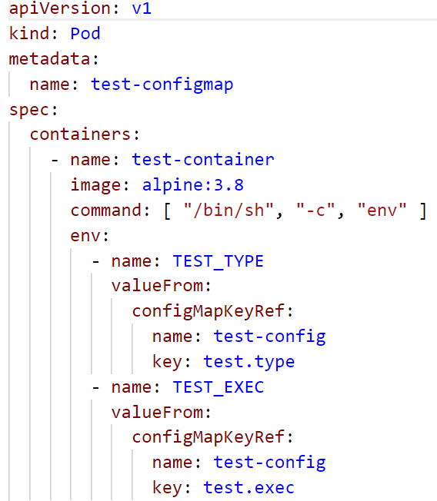
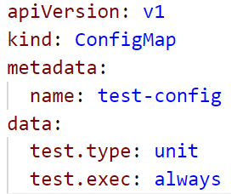
ConfigMaps usage in container environment
ConfigMap data can be projected to
The container’s file system
The container’s environment variables
Notes:
Once the configMap is created it’s content can be projected into a pod’s container as an environment variable or mounted as a file.

Slide 8

Demo
Notes:
Create a configmap example:
kubectl create configmap test-config --from-literal=test.type=unit --from-literal=test.exec=always
Show the 07b_pod_with_configmap.yaml => you can include all values from a configmap or reference to specific keys. It is also possible to reference multiple configMaps. When deploying it to the cluster it will start & go to status “completed” very quickly. Use “kubectl get pods -a” to display also terminated/completed pods. Use “kubectl logs test-configmap” to view the environment sent to stdout.
Instead of mapping the configMap content to environment variables, it is also possible to mount them as files to a directory. This will be part of the exercise.

Slide 9
Secrets
Stores data base64 encoded
Can contain several key:value pairs or files in data section
Can be read by anyone in namespace with watch/list ability
Risk: API server / etcd potentially store information in plaintext
generic
Use to store credentials
Pod-A
Container
TLS
Use to store certificates
docker registry
Use to store credentials to a docker registry
Notes:
There are 3 different types of secrets
generic: to store credentials like passwords. Include as env variables or mount files
TLS: store certificates to setup TLS e.g. with a webserver
Docker-registry: Contains credentials to authenticate pulls from protected registry like the docker store or a private registry. Assign the secret as “imagePullSecret” to a pod, to use the credentials for image pulling for this pod.

Slide 10
Create a secret from the command line
Store credentials in a files
$: echo admin > username.txt
$: cat username.txt
admin
$: echo Secret4ever > password.txt
$: cat password.txt
Secret4ever
$: kubectl create secret generic admin-access \
--from-file=./username.txt \
--from-file=./password.txt
secret "admin-access" created
$: kubectl get secret admin-access -o yaml
apiVersion: v1
data:
password.txt: U2VjcmV0NGV2ZXIK
username.txt: YWRtaW4K
kind: Secret
metadata:
name: admin-access
namespace: default
type: Opaque
Upload files to K8s as an object of type secret
File name became “key”
File content became “value” and is base64 encoded data
Notes:
Secrets can be created based on files or values from literals. The data gets base64 encoded and as long as you view the resource via kubectl, it stays this way. To view the data take the string, print it to stdout and pipe it into base64 -d.
Example: echo U2VjcmV0NGV2ZXIK | base64 -d

Slide 11
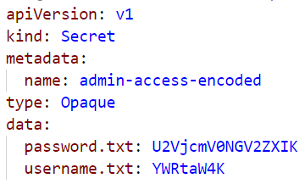
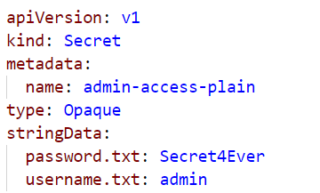
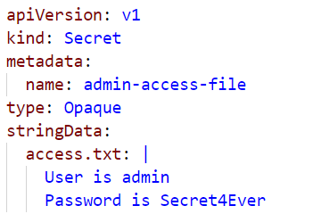
How to create yaml files containing valid secrets
“data” requires base64 encoding of all values no matter if binary or not
“stringData” allows to write plain-text values into yaml files
Multiline value to a single key
Notes:
To rebuild the demo use the 07d_demo_pod_with_secret.yaml and 07c_demo_secret.yaml from ./kubernetes/demo. It contains the secret & a pod mounting the secret.

Slide 12
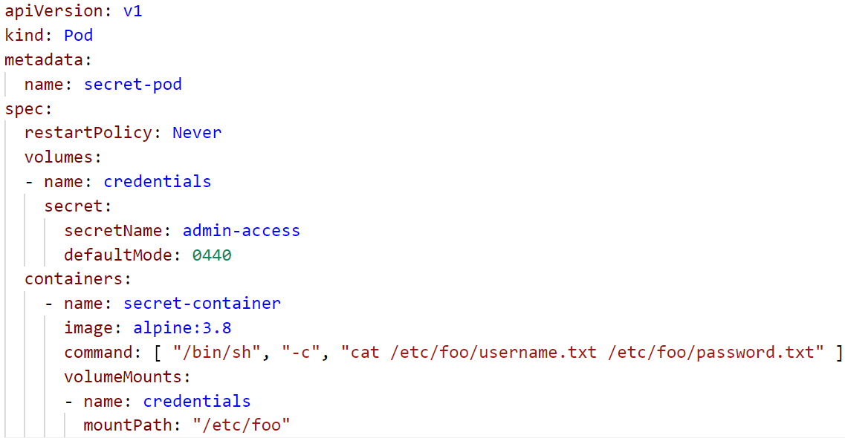
Use a secret in a pod
Assign the secret to the pod like a regular volume
Specify default access permissions
Project the secret’s content to the container file system & access it
$ kubectl logs secret-pod
admin
Secret4ever
The secret’s content is no longer decoded
Notes:
Use the secret like any other volume and bind it to the pod. When mounted into the filesystem the content/values are decoded and available in plain text. So be careful what you do. Eventually you want to set (linux) permissions for the files (like 400 so only the owner is allowed to read it).

Slide 13
Demo
Notes:
Create a secret from the command line or use the yaml
echo admin > username.txt
echo Secret4ever > password.txt
kubectl create secret generic admin-access --from-file=./username.txt --from-file=./password.txt
Print the secret in yaml format and send the value for password to base64 -decode: echo U2VjcmV0NGV2ZXIK | base64 -d
Schedule the demo pod for secrets (make sure the secret name matches) and query the logs
=> highlight that the values are accessible in clear text within the pod context

Slide 14
Desired target state – exercise #06
Expose nginx via https
service http / https
nginx
nginx
nginx
Add usage of configuration & secrets to the deployment
create configuration and tls secrets
custom content
config
tls certs

Slide 15
Appendix

Slide 16

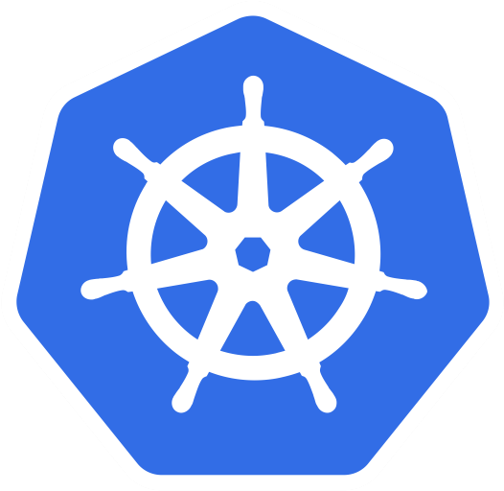
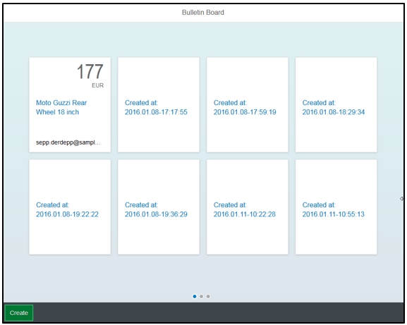


Bulletinboard in K8s: Target picture overall
ingr/ svc
HTTP/ REST
svc
HTTPS/ REST
nwp
nwp
bulletinboard- ads
bulletinboard-users
cm
cm
sec
pod
sec
pod
deployment
deployment
svc
svc
nwp
postgresql
nwp
postgresql
cm
cm
https://github.wdf.sap.corp/slvi/docker-k8s-training/blob/k8s-bulletinboard/kubernetes/k8s-bulletinboard/README.md
sec
pod
sec
pod
statefulset
statefulset

Slide 17
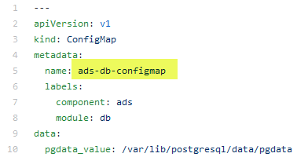
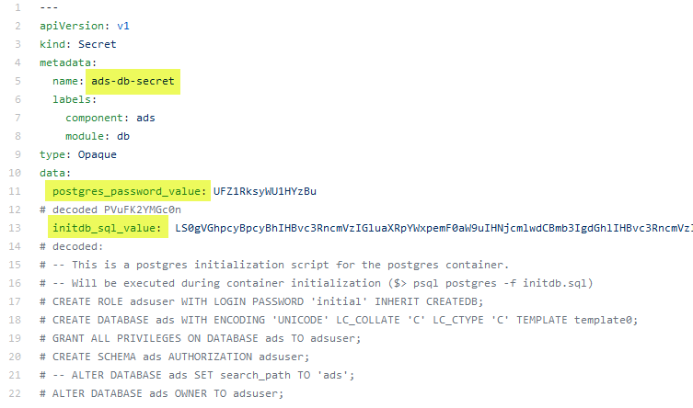
Bulletinboard in K8s: ads DB
Configmap: - postgres db files path
Secret: - initdb.sql script - postgres superuser pw
Docker container: postgres:9.6
configmap: ads-db-configmap
secret: ads-db-secret
pod: ads-db-statefulset-0
statefulset: ads-db-statefulset

Slide 18
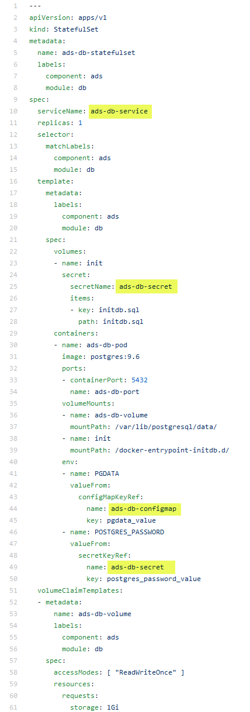
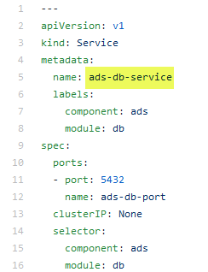
Bulletinboard in K8s: Ads:DB, Dependencies across entities - 2
ads-db-service.yaml
ads-db-statefulset.yaml
ads-db-secret.yaml
ads-db-configmap.yaml
https://github.wdf.sap.corp/slvi/docker-k8s-training/tree/k8s-bulletinboard/kubernetes/k8s-bulletinboard/solutions/ads

Slide 19
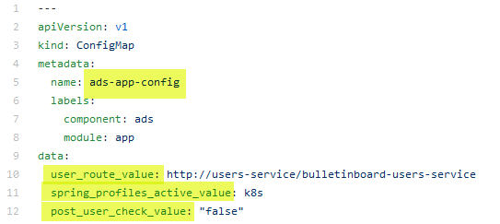
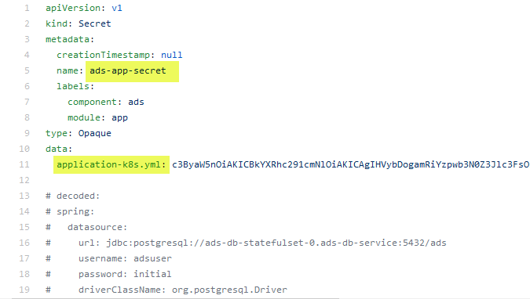
Bulletinboard in K8s: ads app
Configmap: - environment variables: user_route, spring_profile_active, post_user_check
Secret: - application-k8s.yml
configmap: ads-app-configmap
bulletinboard- ads
secret: ads-app-secret
pod: ads-app…ent-xx-yy
deployment: ads-app-deployment

Slide 20
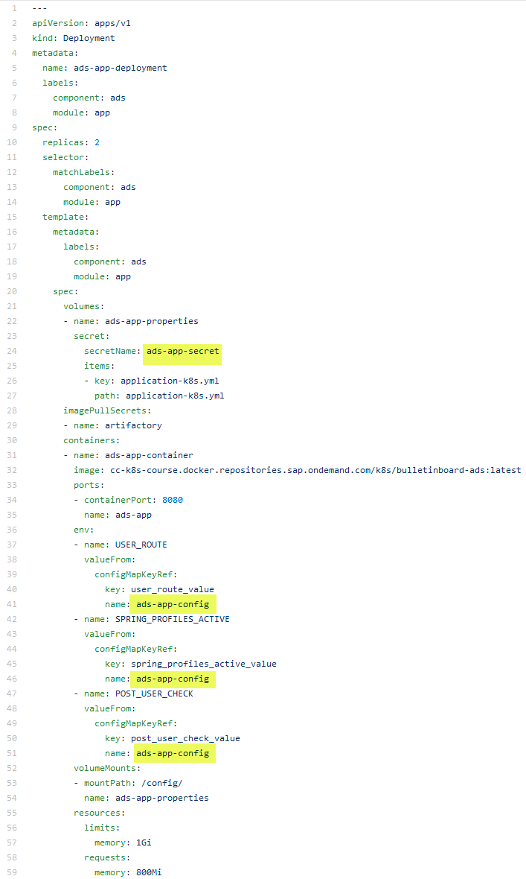
Bulletinboard in K8s: Ads:App, Dependencies across entities - 2
ads-app-deployment.yaml
ads-app-secret.yaml
ads-app-configmap.yaml
https://github.wdf.sap.corp/slvi/docker-k8s-training/tree/k8s-bulletinboard/kubernetes/k8s-bulletinboard/solutions/ads

