Slide 1


Kubernetes Security

Slide 2

Cluster Access Management

Slide 3
Service Accounts
Service accounts are technical user in Kubernetes
Bound to a namespace
Allowed to communicate with the API server
Provide identity for pods
Pods can inherit permissions to access the API server or a registry (image pull secret)
Namespace
Pod A
runs as “default”
service account
“default”
Pod B
runs as “default”
secrets
Notes:
Currently there are two types of users in kubernetes – technical and normal Users. Users are considered to be human (end-)users and you can fine granularily define what each user can. They can also (by default) be cluster admins and have access to everything in the cluster.
The 2nd type of user is a technical user, called “service account”. A service account is bound to a namespace and in every namespace there is “default” service account. Of course it is possible to create further service accounts.
Usually a service account holds an access token allowing to communicate with the cluster’s API server. The token itself is a kubernetes secret. Additionally you can assign an image pull secret to the service account (see slide 5 ff for further info).
When scheduling resources like a pod, they always run in the “name” of the service account. This means, the service account’s secrets will be mounted into the pod. Hence a pod is also able to access the API server with the identity of the service account and its valid credentials.
If not specified differently, the default service account will be used.
Since a pod can access the API, think about possible consequences. Could it modify the system? To avoid potential security issues, it is recommended to limit the access scope of the service account using RBAC → see next slide

Slide 4



Access tokens
Anyone within the pod can use the key to access the API server
Each service account has a secret with a key to the API server
Pod A
service account
“default”
API Server
This key grants access to the API server
Keys are mounted as volume into any pod by default
access key to API server
Notes:
The tokens to access the API server deserve some extra thoughts. Every service account comes with such a token and by default, all pods mount the token of their respective service account. So basically we allow each and every application running in our cluster to talk to the API server and potentially read secrets or modify objects.
Though there are some applications that require this access, most of our workloads don’t. Hence it is recommended to switch off this feature and explicitly mount the tokens when needed. The service account object has a field “automountServiceAccountToken” which should be set to false.

Slide 5
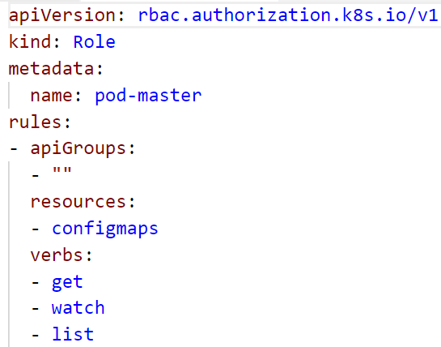
Role based access control (RBAC)
roles define which api’s / resources can be accessed in which way
Roles can be assigned to service accounts
Roles are pre-configured or custom defined
Bindings: cluster-wide or restricted to namespace
Namespace
ConfigMap
get
Role binding
get
role
Secret
Notes:
To limit the access scope of a service account, you can use existing roles or create your own. These roles are bound to the respective service account.
Roles define which resources of which api group are allowed to access with a certain set of actions. The example shown in the screenshot allows the actions “get”, “list” and “watch” for “configmaps”. Everything else would be blocked.
To assign the role to a user, you can create a role binding.

Slide 6

Demo
Notes:
Show the default service account associate with any namespace (kubectl get sa)
Show the token that is associated with the service account (kubectl get secret)
Show the clusterrolebinding, that makes the participants cluster admin (kubectl get clusterrolebinding)
Create a custom role:
In the demo folder, have a look at 11a_rbac.yaml
explain the access to the different API groups & objects within
The role "pod-master" gives you full access to pods, read access to configmaps and no access to anything else
the YAML creates a service account "pod-master"
The role gets bound to the service account by the rolebinding "pod-master"
Before you switch the kubeconfig context, check, if the secret “admin-access” described in file 07c_demo_secret.yaml is present in your namespace. If not, re-create it (kubectl create –f 07c_demo_secret.yaml)
In the demo folder, run the script 11b_rbac-demo-shell.sh
This script will start a new shell with a temporary kube.config that accesses the cluster as service account pod-master
In this shell, try to get the running pods and the configmaps
Try to get the secrets
Create a pod using the secret “admin-access” with "kubectl create –f 07d_demo_pod_with_secret.yaml" and have a look at its logs to show that secrets are still visible from within the pod although we do not have access to the secrets through the role (potential security leak)
Use the role binding "pod-master" and use kubectl auth can-i … to demo its function.
kubectl auth can-i get nodes --as system:serviceaccount:default:default ➔ expected result: no
kubectl auth can-i get nodes --as system:serviceaccount:part-<id>:default ➔ expected result: yes (due to the clusterrolebinding)

Slide 7

Runtime Constraints for Pods

Slide 8


How to prevent apps to wreak havoc?
Limit CPU & memory consumption
Limit resource consumption
Prevent container from accessing the host & limit the blast radius
Add security constraints
Notes:
The pod & container spec provide several options to prevent security issues.
Firstly, it is possible to limit the resource consumption of each container. This way it is not possible to consume all the resources of a host.
Secondly, you can specify certain security aspects, such as allowed capabilities, access to the underlying host or the user-IDs which are allowed in the context of the container.

Slide 9
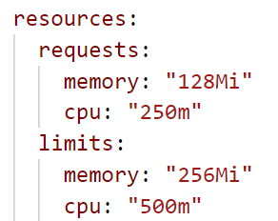
spec.containers[].resources*
Explicitly requesting resources and specifying limits help to schedule a pod
https://github.com/kubernetes/community/blob/master/contributors/design-proposals/node/resource-qos.md
Notes:
Resources are specified on container level.
It is a very good practice to specify the limits as well as the “initial” requests for cpu and memory. Request information make scheduling a lot easier.
CPU can be quantified as 1-n CPU (vCPU/vCore for cloud, hyperthread for bare-metal Intel processor) or a fraction of 1. Fractions are specified as in two different notations 0.25 (one quarter of a CPU) or 250m (250 millicpu), but both are understood as the same value.
Memory is measured in bytes. It is possible to express it as integer, abbreviate with E, P, T, G, M, K or use the power-of-two equivalents Ei, Pi, Ti, Gi, Mi, Ki

Slide 10







Security contexts and other ways to break things
Pod
Pods may be configured that all container:
can access the host file system
use the host network
share the host IPC namespace
The SecurityContext
specifies user and group ID for processes
adds Linux capabilities & security profiles
can set the container root filesystem to read-only
allows privilege escalation / run in “privileged mode”
Container
Container
Node
Notes:
On pod as well as container spec level you have certain parameter to prevent or provoke security incidents.
It is possible to grant host access in different ways – all of these may provoke security incidents:
Mount the host’s file system (inkl. a mount of the root file system “/”)
Join the host’s IPC namespace
Use the host’s network directly instead of an isolated network namespace
Run with user ID 0 (root)
Allow child processes to gain more privileges than their parent process (escalation)
Add capabilities (like SYS_ADMIN) or alter seccomp / seLinux profiles to allow dangerous system calls / access to the kernel
Of course these switches can be used to restrain a process:
Run with a different user ID than 0 within the container (“runAsNonRoot” / “runAsUser”)
Drop all capabilities & apply a strict set of seccomp / seLinx rules
Switch the container root filesystem to read- only (makes it harder to install something with apt-install)
Mount file systems (like pvc) with a specific group ID (ideally != 0)

Slide 11
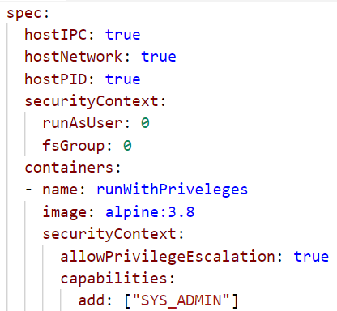
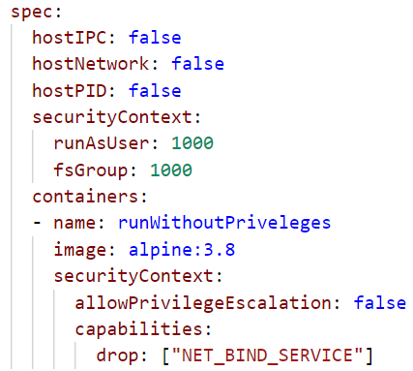
Security contexts and other ways to break things
Allow/deny to access the host
Allow to access the host
Run as root user | 1000
Run as root user | 1000
Allow privilege escalation & add a capability
Deny privilege escalation & drop a capability
Notes:
On pod as well as container spec level you have certain parameter to prevent or provoke security incidents.
It is possible to grant host access in different ways – all of these may provoke security incidents:
Mount the host’s file system (inkl. a mount of the root file system “/”)
Join the host’s IPC namespace
Use the host’s network directly instead of an isolated network namespace
Run with user ID 0 (root)
Allow child processes to gain more privileges than their parent process (escalation)
Add capabilities (like SYS_ADMIN) or alter seccomp / seLinux profiles to allow dangerous system calls / access to the kernel
Of course these switches can be used to restrain a process:
Run with a different user ID than 0 within the container (“runAsNonRoot” / “runAsUser”)
Drop all capabilities & apply a strict set of seccomp / seLinx rules
Switch the container root filesystem to read- only (makes it harder to install something with apt-install)
Mount file systems (like pvc) with a specific group ID (ideally != 0)

Slide 12

PID Limits (alpha feature)
To prevent fork bombs it is essential to limit the number of processes per cgroup
Feature is implemented on kubelet level in alpha stage
https://github.com/kubernetes/kubernetes/issues/43783
Notes:
Forking tons of new processes can bring down a host easily. To prevent such an attack being driven from within a pod, limiting the number of processes allowed per process group / cgroup is very important.
Unfortunately the current implementation is only in alpha stage and implemented on kubelet level.

Slide 13

Policies

Slide 14
Policy objects in Kubernetes
Only 1 Loadbalancer Service!
ResourceQuota
Resource management
No more than 200MB memory!
LimitRange
Communication to DB is forbidden
NetworkPolicy
Security
Beta: Do not run as root user
PodSecurityPolicy
Notes:
Resource Quota and LimitRanges can be used to control requested as well as actual resource consumption + # of k8s objects per namespace. Example: if the memory quota per pod is 200 MB and you want to start, let’s say a Jenkins which would require more – the application will not be able to start before being killed for exceeding the memory limit.
Network policies control traffic within the cluster – details on next slide.
PodSecurityPolicies specify (security relevant) runtime conditions for pods. https://kubernetes.io/docs/concepts/policy/pod-security-policy/

Slide 15
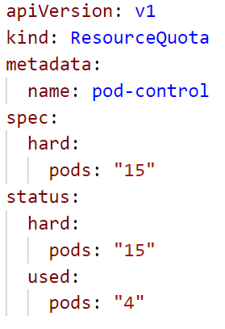
Policy: ResourceQuota
Used to define limits on different resources in a namespace.
namespaced Resource
Set “hard” limits on resources like
Pods
Number of PVCs
Memory (of all pods combined)
More information here.

Slide 16
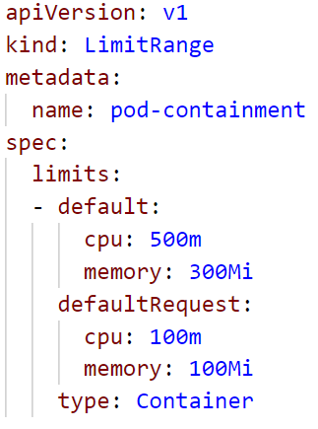
Policy: LimitRanges
Each pod consumes a certain amount of cpu or memory.
LimitRanges are used to enforce specification of cpu & memory resources
It can specify default values that are applied to every container in a namespace (can be overwritten / explicitly specified resources take precedence)

Slide 17

PodSecurityPolicy – initial state without constraints
service account
“default”
Pod A
host fs
Without podSecurityPolicies everything is allowed
A container could run with root permissions on the host and mount the hosts file system
Notes:
Without any pod security policy (psp) there are no centrally enforced constraints for containers. A container may run with root capabilities on the host and even mount the host’s file system with root permissions. In this case containment & isolation is impossible.

Slide 18


PodSecurityPolicy
service account
“default”
Pod A
host fs
As soon as it the controller is active, no pods are accepted anymore
The controller for pod security policies runs as part of the cluster’s control plane
Controller
Notes:
A Pod Security Policy is a cluster-level resource that controls security sensitive aspects of the pod specification. The PodSecurityPolicy objects define a set of conditions that a pod must run with in order to be accepted into the system, as well as defaults for the related fields.
Once the controller is active, every pods needs to be associated with a policy object. We will see on the next slide, how that works.
But as long as there is no policy, no pod will be accepted & scheduled in the entire cluster.

Slide 19

PodSecurityPolicy
service account
“default”
Pod A
host fs
Role binding
The controller checks the pod according to the policy definition
role
“Activate” the policy for your service account
PodSecurityPolicy
Controller
Notes:
In order to make use of it, the usage of the policy has to be authorized by a (newly defined) role. Now you can attach the policy via a rolebinding to a service account and the pods will be scheduled, if its definition matches the criteria of the policy

Slide 20
PodSecurityPolicy
service account
“default”
Pod A
host fs
Role binding
“no host fs”
In case host fs access is forbidden, the pod will be rejected
role
PodSecurityPolicy
Controller
Notes:
In order to make use of it, the usage of the policy has to be authorized by a (newly defined) role. Now you can attach the policy via a rolebinding to a service account and the pods will be scheduled, if its definition matches the criteria of the policy

Slide 21
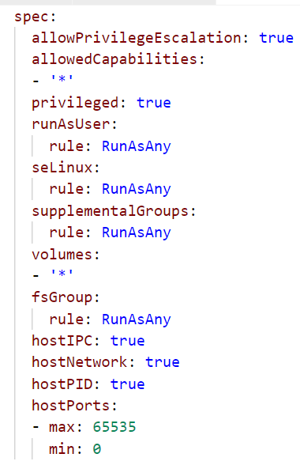
“Allow everything” PodSecurityPolicy
Manage user & permissions
Manage file systems
Allow host access
Notes:
Details: https://kubernetes.io/docs/concepts/policy/pod-security-policy/
This is an example of a pod security policy that basically allows everything. There are no restrictions of user IDs, privileges or file system groups. Container validated against this rule may run with root permissions.
It is also possible to access the host in almost any possible way.

Slide 22
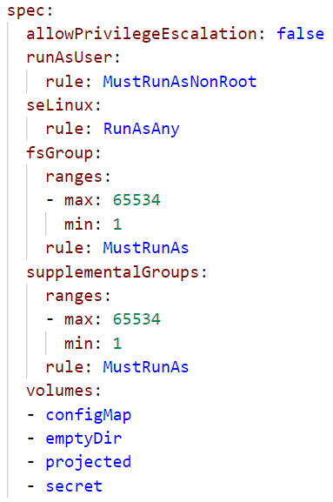
Restrictive PodSecurityPolicy
Process is not allow to run with UID 0
File system groups & supplemental groups cannot be 0
Whitelist volume types
Notes:
Details: https://kubernetes.io/docs/concepts/policy/pod-security-policy/
This is an example of a way more restrictive pod security policy. Pods validated against it, must not use volume types other than configMap, emptyDir, projected (project multiple info in the same directory) & secret. PVC or host fs are blocked.
The usage of UID 0 is also forbidden.

Slide 23
NetworkPolicy
“Firewall”-like restrictions
Define egress and ingress rules for a service
caller: mario
Mario
Selector: location: castle
location: castle
Service
direct-line-to-peach
Peach
Bowser
Network Policy
accept: caller: mario
Selector: location: castle
Notes:
Network policies are kubernetes object just as pods. The need an overlay network that supports the enforcement of their rules, like Calico.
Basically they define rules for incoming (ingress) and outgoing (egress) traffic to pods. As filter rules you can set IP addresses or use labels. Filter actions are deny or allow.
In the example above, let’s assume princess Peach is at her castle (pod). She has created a service in order to be callable, but only as long as her location = castle. That works quite well, only that Bowser keeps calling her all the time. So Peach decides to allow only calls from Mario and puts a network policy in place. The policy filters incoming calls when she has her “location: castle” label and allows only those to pass, that have a label “caller: mario” attached. As a result Bowser is no longer able to call her.

Slide 24
More on Network Policies
2 policyTypes:
Ingress: rules for incoming traffic
Egress: rules for outgoing traffic
3 kinds of Rules:
ipBlock: range of IP addresses given as CIDR
podSelector: labels of Pods allowed
namespaceSelector: labels of Namespaces
Last two can be combined to specify certain pods in certain namespases (since 1.11)

Slide 25
NetworkPolicy
“Firewall”-like restrictions
Define egress and ingress rules for a service
Requires support by overlay network plugin
access: ok
Pod B
app: nginx
Service
Pod A
Pod M
Selector: access: ok
Selector: app: nginx
access: not ok
Network Policy
Notes:
Network policies are kubernetes object just as pods. The need an overlay network that supports the enforcement of their rules, like Calico.
Basically they define rules for incoming (ingress) and outgoing (egress) traffic to pods. As filter rules you can set IP addresses or use labels. Filter actions are deny or allow.
In the example above, the network policy is enforced for access to “Pod A”, determined by its label and the corresponding selector.
Pod B is allowed to access pod A since it has the correct label. Traffic from pod M will be blocked.
Demo:
kubectl run nginx --image=nginx --replicas=2
kubectl expose deployment nginx --port=80
kubectl run busybox --rm -ti --image=busybox /bin/sh
# wget --spider --timeout=1 nginx
Kubectl create –f network-policy.yaml
Kubectl run ..
Kubectl run … -l access=true

Slide 26
Demo
Notes:
Demo:
Createa a peach-pod and corresponding service
kubectl apply –f 11_network_policy_resources.yaml
Create a helper pod, logon to it and get the index.html page.
kubectl run mario --generator=run-pod/v1 -i --tty --restart=Never --rm --image=alpine:3.8 /bin/sh
# wget --timeout=1 -q -O direct-line-to-peach
Create the network policy in a 2nd shell:
kubectl create -f 11c_network_policy_ingress.yaml
Show the network policy definition and explain:
it’s implicitly a whitelisting
network policy can handle egress and ingress traffic. However the example is only of incoming (ingress) traffic.
The cidr block are required, if you want to access your service later from SAP networks. Otherwise all requested without the label (i.e. not cluster internal) will be blocked too.
Switch back to the helper pod and re-run the wget command ➔ expected result: failure due to the missing label
Label you helper pod accordingly (can be done from the 2nd shell session, so stay connected to your helper pod)
kubectl label pod marion caller=mario
Re-run the wget command ➔ expected result: works again

Slide 27
Exercise #09
Filter incoming traffic with a network Policy
service http / https
nginx
nginx
nginx
custom content
config
tls certs

Slide 28

Attacking K8s

Slide 29


Setup
K8s
API Server
Container
Host
root@container:$
> Hello world!
Linux Kernel
Notes:
Here’s our setup for the security discussion:
A kubernetes cluster runs as usual with one to many nodes. Each node is a linux host with a kernel, docker daemon and kubelet. We also have the master with API server and etcd where configuration, some passwords and the cluster state is stored.
On the host we see here, there is a container running which was taken over by an attacker (i.e. us). The attacker is connected to a shell session within the container now.

Slide 30

Scenario 1: Bitcoin, Ethereum, Monero!
K8s
Internet
API Server
Container
Host
root@container:$
> apt install <some miner>
> € € € € € € € € €...
Linux Kernel
Notes:
The easiest thing we can do as an attacker is to abuse the compute power by doing some crypto mining. All we need, is to download mining software from the internet, connect it to some anonymous mining pool and wait.

Slide 31
How to prevent this?
K8s
Internet
API Server
Container
Host
Block egress traffic with network policies
root@container:$
> apt install <some miner>
> € € € € € € € € €...
images don’t have tools like curl or wget
Linux Kernel
Limit resource consumption via container / pod spec
Notes:
What could be done to limit the impact of such an attack or to prevent parts of it?
Why should everyone be able to communicate with the internet by default? Blocking any egress traffic by default (with a network policy) and explicitly allow dedicated outbound connections will increase your cluster security significantly.
Apply resource constraints that fit your app.
Build (docker) images without curl, wget or similar tools (ideally also without apt/apk).

Slide 32

Scenario 2: Take over the cluster / hosts
K8s
API Server
Container
Schedule new pod / container
Host
root@container:$
> cat /hostfs/etc/passwd
> ls /var/lib/kubelet
Service account access token
Access API server via kubernetes.default.svc.cluster.local
Linux Kernel
> mount host file system to container > worse, if container runs as root
Notes:
Instead of abusing the compute power of a single container, an attacker could also try to move forward and gain access to more parts of the infrastructure. Unfortunately, Kubernetes makes our life easy here.
Try to become aware of the environment. Check the content of /proc/self/cgroup – does it contain a “kube” string?
Check, if there is a service account access token mounted to the default location /var/run/secrets/kubernetes.io/serviceaccount/token
Try to abuse the token to talk to the cluster’s API server. Use the FQDN of the kubernetes service in the default namespace for it. Note – this part requires curl or a similar tool.
If you’re able to access the API server, try to do something more meaningful – inject a sidecar container to all deployments or schedule a daemonset that mounts the host file system of each node. Try to write something as user root the node.

Slide 33
How to prevent this?
K8s
API Server
Container
Host
Limit access scope with RBAC
Service account access token
Don’t automount access tokens
Linux Kernel
Notes:
The first and probably most important part: disable the automount option for the service account access token. There are very few container which would require permissions to talk to the api server. For these the mount option can be enabled explicitly or you run them with a different service account.
To disable the mount option, you should edit the service account object itself.
Also the access scope to the API should be limited via an RBAC role(binding). Does the service account really need to modify something or is viewing a few dedicated resources sufficient?

Slide 34
How to prevent this?
K8s
API Server
Container
Host
root@container:$
> cat /hostfs/etc/passwd
> ls /var/lib/kubelet
Service account access token
Security policy:
- run as non-root
- block host file system access
Linux Kernel
Notes:
Finally, pod security policies can prevent usage of the host’s file system or network.
Pods attempting to mount the host file system or run as user root will be rejected.

Slide 35
Demo
Notes:
To demonstrate scenario #2, we prepared a separate repo: https://github.wdf.sap.corp/ps-container/host-fs-access-hack
It contains a Dockerfile as well as some scripts & descriptions / explanations.
The attack will look like this:
You want to schedule an nginx image and found this super fancy fork of nginx (something comparable happened to Tesla with a crypto miner). Now the nginx image is a little bit extended – it has curl and a special run_nginx.sh script. The script checks, if a service account access token is available and if the answer is yes, it will be abused to schedule a daemon set with host fs access. Check the logs of the daemon set pods to see, if it worked.
Of course, after the script ran, nginx will be started too ;)
To make life easier, the Docker image has already been build & uploaded to artifactory in DMZ. All you need to do, is to create an imagepullsecret with name “artifactory” and read access to cc-k8s-course.docker.repositories.sap.ondemand.com/security-examples/nginx-host-fs-hack. As it is the same org as we use on day 4, you can also use the same username / password for it (check https://github.wdf.sap.corp/slvi/docker-k8s-training/blob/master/kubernetes/k8s-bulletinboard/exercise_02_ads_app.md#step-0-imagepullsecret-for-sap-artifactory-repo-cc-k8s-course).
To run the attack, you may use this deployment: https://github.wdf.sap.corp/ps-container/host-fs-access-hack/blob/master/host-fs-deployment.yaml

