Slide 1
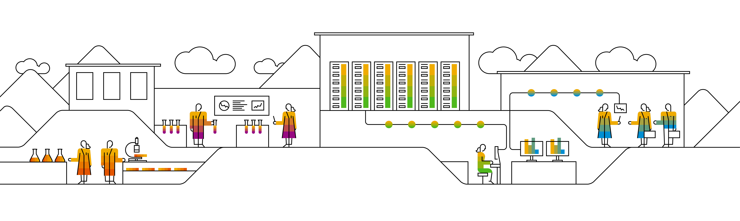


Kubernetes Pipeline for: Bulletinboard

Slide 2

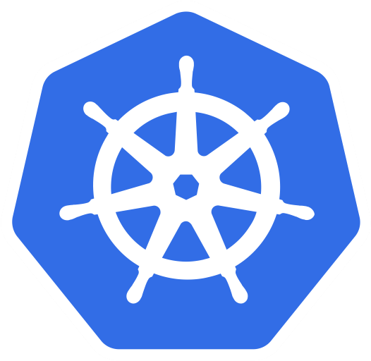
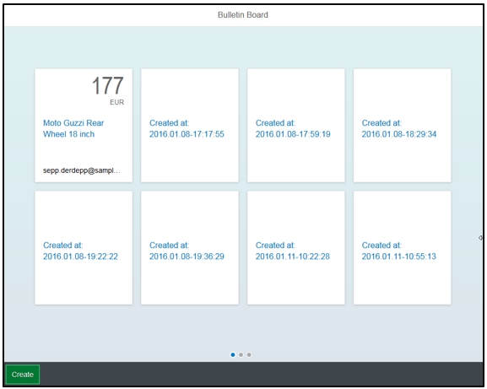


Bulletinboard in K8s
ingr/ svc
HTTP/ REST
svc
HTTPS/ REST
nwp
nwp
bulletinboard- ads
bulletinboard-users
cm
cm
sec
pod
sec
pod
deployment
deployment
svc
svc
nwp
postgresql
nwp
postgresql
cm
cm
https://github.wdf.sap.corp/slvi/docker-k8s-training/blob/k8s-bulletinboard/kubernetes/k8s-bulletinboard/README.md
sec
pod
sec
pod
statefulset
statefulset
Notes:
- Discuss statefulset vs deployment
- Discuss headless service vs ???
- Discuss service vs ingress

Slide 3
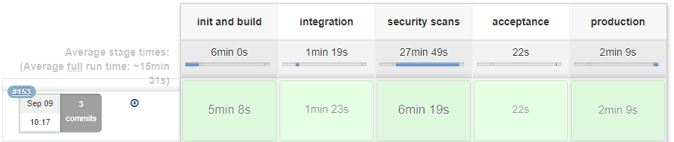
Pipelines for Bulletinboard-Ads-K8s
try hadolint yourself: docker run --rm --it hadolint/hadolint < Dockerfile
Custom Pipeline with piper steps
Central xMake multistage Docker build
Includes hadolint for Dockerfile linting
Includes executeProtecodeScan piper step to scan Docker image
Deploys to integration, acceptance and production namespace
Executes curls against integration to test.

Slide 4
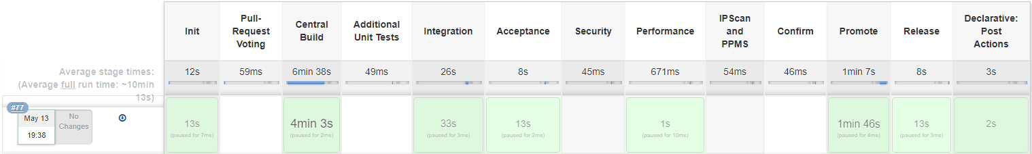
Pipelines for Bulletinboard-Users-K8s
Piper 3.0 pipeline
Central xMake multistage Docker build
Deploys to integration, acceptance and production namespace

Slide 5
Protocode Scan integration
Protecode or Black Duck Binary Analysis scans binaries, like a Docker image, for security vulnerabilities.
It identifies files with VCSS v2 and v3 ratings.
Pipeline will stop if there is a component in the scanned file with a (non – triaged) VCSS v3 > 7.0 rating

Slide 6
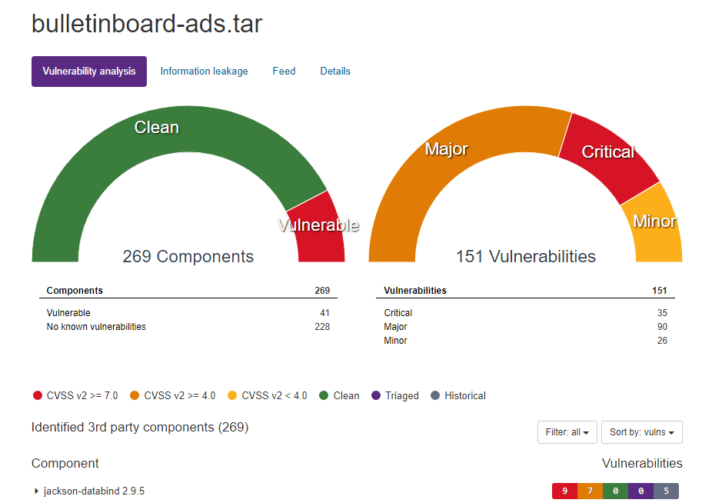
The first scan
Protecode UI
We started with this:
A bit older spring boot 1.5.15 (from July 2018) java application
Put into a public openjdk:8-jdk docker image
Image size ~530mb
Scan time was 30-60 min.
Result:
41 vulnerable components with 151 issues with CVSS v2 > 4.0

Slide 7
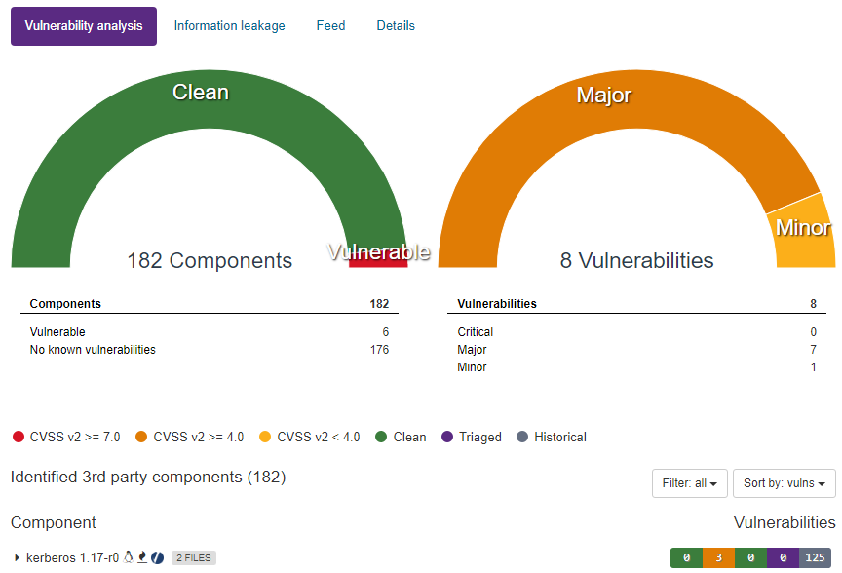
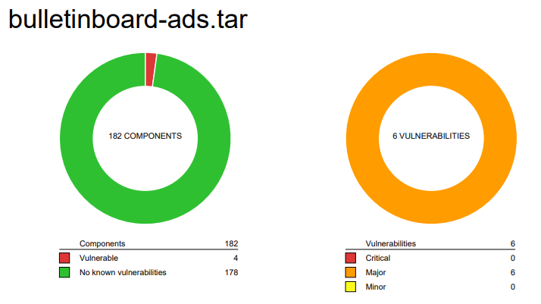
Intermediate Stage
We improved this by
Upgrading to Spring Boot 2.1.7
Moved to alpine:edge image and installed latest Java package
Manual removed one vulnerable lib file
This reduced image size to ~130mb and reduced scan times to ~10min.
Result:
1 triaged issue, 3 excluded issues in pipeline
6 Components with 8 vulnerabilities all with VCSS v3 < 7.0
Protecode UI

Slide 8
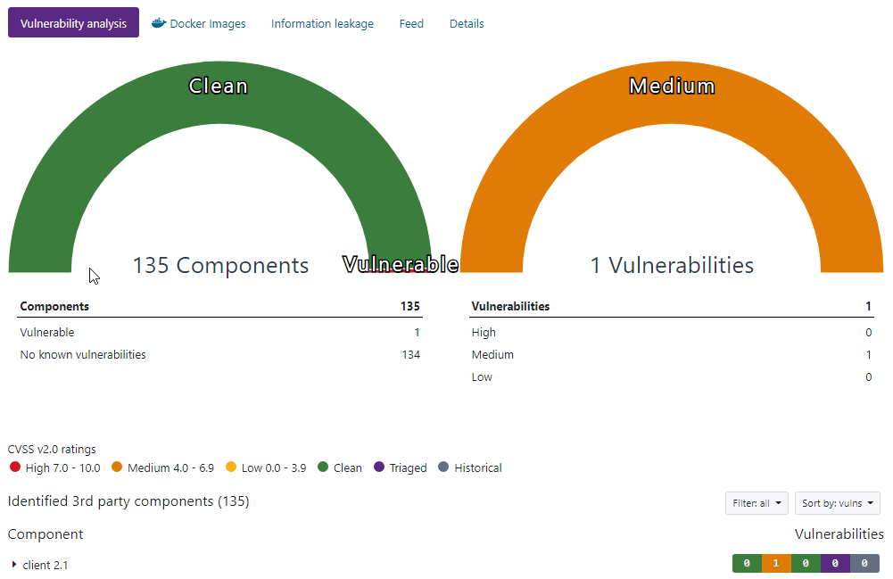
Current Scans
We improved this further by
Keeping Dependency versions up to date.
Runtime change to custom Java11 JRE
Final image from scratch. Libs from latest alpine:edge
This reduced image size to ~110mb and reduced scan times to ~4-5min.
Result:
1 Issue remains, due to a false positive matching, Synopsys R&D is investigating this. (postgres-jdbc-2.42.8 falsely accused of CVE-2019-13567)
Protecode UI

Slide 9
Current Dockerfile
FROM maven:3.6-jdk-8-alpine as builder
WORKDIR /build
COPY src ./src
COPY pom.xml ./pom.xml
RUN mvn clean verify
FROM alpine:edge as lib-container
RUN apk --no-cache add openssl=1.1.1d-r2 && \
apk --no-cache add libssl1.1=1.1.1d-r2 && \
apk --no-cache add libcrypto1.1=1.1.1d-r2 && \
apk --no-cache add zlib=1.2.11-r3
FROM azul/zulu-openjdk-alpine:11 as jre-builder
RUN jlink \
--add-modules java.base,java.logging,java.xml,jdk.unsupported,java.sql,java.naming,java.desktop,java.management,java.security.jgss,java.instrument \
--verbose --strip-debug \
--compress 2 --no-header-files \
--no-man-pages --output /jre
Builds Java Application with Maven (always loads all dependencies)
RUN apk --no-cache add binutils=2.32-r0 && \
strip -p --strip-unneeded jre/lib/server/libjvm.so
RUN rm jre/lib/libsplashscreen.so
FROM scratch as bulletinboard-ads
COPY --from=lib-container /lib/libz.so.1 /lib/libz.so.1
COPY --from=lib-container /lib/ld-musl-x86_64.so.1 /lib/ld-musl-x86_64.so.1
COPY --from=lib-container /lib/libcrypto.so.1.1 /lib/libcrypto.so.1.1
COPY --from=lib-container /lib/libc.musl-x86_64.so.1 /lib/libc.musl-x86_64.so.1
COPY --from=lib-container /lib/libssl.so.1.1 /lib/libssl.so.1.1
COPY --from=jre-builder /jre jre
COPY --from=builder /build/target/bulletinboard-ads-spring-boot-0.0.1.jar /
CMD ["jre/bin/java","-Xmx768m", "-Xms512m", "-jar", "bulletinboard-ads-spring-boot-0.0.1.jar"]
Creates custom Java 11 Runtime Environment
Provides latest libraries needed yet not provided by Java Runtime Builder
Accumulates all parts Builds from scratch Only includes what is really necessary for app to run

