Slide 1


Kubernetes Security

Slide 2


How to prevent apps to wreak havoc?
Limit CPU & memory consumption
Limit resource consumption
Prevent container from accessing the host & limit the blast radius
Add security constraints
Notes:
The pod & container spec provide several options to prevent security issues.
Firstly, it is possible to limit the resource consumption of each container. This way it is not possible to consume all the resources of a host.
Secondly, you can specify certain security aspects, such as allowed capabilities, access to the underlying host or the user-IDs which are allowed in the context of the container. This will be part of the next presentation.

Slide 3







Security contexts and other ways to break things
Pod
Pods may be configured that all container:
can access the host file system
use the host network
share the host IPC namespace
The SecurityContext
specifies user and group ID for processes
adds Linux capabilities & security profiles
can set the container root filesystem to read-only
allows privilege escalation / run in “privileged mode”
Container
Container
Node
Notes:
On pod as well as container spec level you have certain parameter to prevent or provoke security incidents.
It is possible to grant host access in different ways – all of these may provoke security incidents:
Mount the host’s file system (inkl. a mount of the root file system “/”)
Join the host’s IPC namespace
Use the host’s network directly instead of an isolated network namespace
Run with user ID 0 (root)
Allow child processes to gain more privileges than their parent process (escalation)
Add capabilities (like SYS_ADMIN) or alter seccomp / seLinux profiles to allow dangerous system calls / access to the kernel
Of course these switches can be used to restrain a process:
Run with a different user ID than 0 within the container (“runAsNonRoot” / “runAsUser”)
Drop all capabilities & apply a strict set of seccomp / seLinx rules
Switch the container root filesystem to read- only (makes it harder to install something with apt-install)
Mount file systems (like pvc) with a specific group ID (ideally != 0)

Slide 4
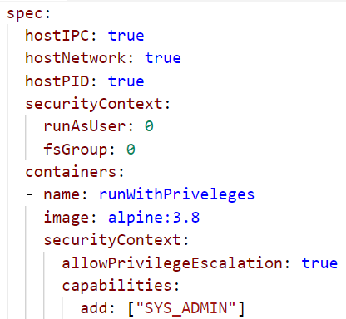
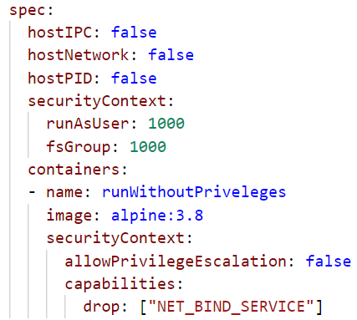
Security contexts and other ways to break things
Allow/deny to access the host
Allow to access the host
Run as root user | 1000
Run as root user | 1000
Allow privilege escalation & add a capability
Deny privilege escalation & drop a capability
Notes:
On pod as well as container spec level you have certain parameter to prevent or provoke security incidents.
It is possible to grant host access in different ways – all of these may provoke security incidents:
Mount the host’s file system (inkl. a mount of the root file system “/”)
Join the host’s IPC namespace
Use the host’s network directly instead of an isolated network namespace
Run with user ID 0 (root)
Allow child processes to gain more privileges than their parent process (escalation)
Add capabilities (like SYS_ADMIN) or alter seccomp / seLinux profiles to allow dangerous system calls / access to the kernel
Of course these switches can be used to restrain a process:
Run with a different user ID than 0 within the container (“runAsNonRoot” / “runAsUser”)
Drop all capabilities & apply a strict set of seccomp / seLinx rules
Switch the container root filesystem to read- only (makes it harder to install something with apt-install)
Mount file systems (like pvc) with a specific group ID (ideally != 0)

Slide 5

PID Limits (alpha/beta feature)
To prevent fork bombs it is essential to limit the number of processes per cgroup
Feature is implemented on kubelet level in alpha stage
https://github.com/kubernetes/kubernetes/issues/43783
Notes:
Forking tons of new processes can bring down a host easily. To prevent such an attack being driven from within a pod, limiting the number of processes allowed per process group / cgroup is very important.
Unfortunately the current implementation is only in alpha stage and implemented on kubelet level.

Slide 6

Policies

Slide 7
Policy objects in Kubernetes
Only 1 Loadbalancer Service!
ResourceQuota
Resource management
No more than 200MB memory!
LimitRange
Beta: Do not run as root user
PodSecurityPolicy
Security
Communication to DB is forbidden
NetworkPolicy
Notes:
Resource Quota and LimitRanges can be used to control requested as well as actual resource consumption + # of k8s objects per namespace. Example: if the memory quota per pod is 200 MB and you want to start, let’s say a Jenkins which would require more – the application will not be able to start before being killed for exceeding the memory limit.
Network policies control traffic within the cluster – details on next slide.
PodSecurityPolicies specify (security relevant) runtime conditions for pods. https://kubernetes.io/docs/concepts/policy/pod-security-policy/

Slide 8

PodSecurityPolicy – initial state without constraints
service account
“default”
Pod A
host fs
Without podSecurityPolicies everything is allowed
A container could run with root permissions on the host and mount the hosts file system
Notes:
Without any pod security policy (psp) there are no centrally enforced constraints for containers. A container may run with root capabilities on the host and even mount the host’s file system with root permissions. In this case containment & isolation is impossible.

Slide 9


PodSecurityPolicy
service account
“default”
Pod A
host fs
As soon as it the controller is active, no pods are accepted anymore
The controller for pod security policies runs as part of the cluster’s control plane
Controller
Notes:
A Pod Security Policy is a cluster-level resource that controls security sensitive aspects of the pod specification. The PodSecurityPolicy objects define a set of conditions that a pod must run with in order to be accepted into the system, as well as defaults for the related fields.
Once the controller is active, every pods needs to be associated with a policy object. We will see on the next slide, how that works.
But as long as there is no policy, no pod will be accepted & scheduled in the entire cluster.

Slide 10

PodSecurityPolicy
service account
“default”
Pod A
host fs
Role binding
The controller checks the pod according to the policy definition
role
“Activate” the policy for your service account
PodSecurityPolicy
Controller
Notes:
In order to make use of it, the usage of the policy has to be authorized by a (newly defined) role. Now you can attach the policy via a rolebinding to a service account and the pods will be scheduled, if its definition matches the criteria of the policy

Slide 11
PodSecurityPolicy
service account
“default”
Pod A
host fs
Role binding
“no host fs”
In case host fs access is forbidden, the pod will be rejected
role
PodSecurityPolicy
Controller
Notes:
In order to make use of it, the usage of the policy has to be authorized by a (newly defined) role. Now you can attach the policy via a rolebinding to a service account and the pods will be scheduled, if its definition matches the criteria of the policy

Slide 12
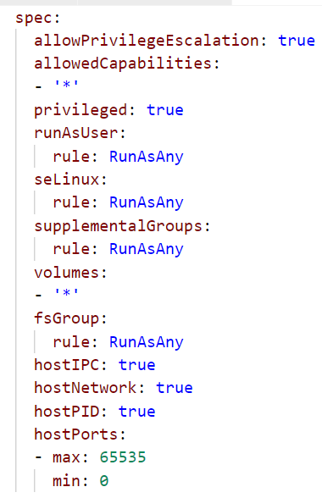
“Allow everything” PodSecurityPolicy
Manage user & permissions
Manage file systems
Allow host access
Notes:
Details: https://kubernetes.io/docs/concepts/policy/pod-security-policy/
This is an example of a pod security policy that basically allows everything. There are no restrictions of user IDs, privileges or file system groups. Container validated against this rule may run with root permissions.
It is also possible to access the host in almost any possible way.

Slide 13
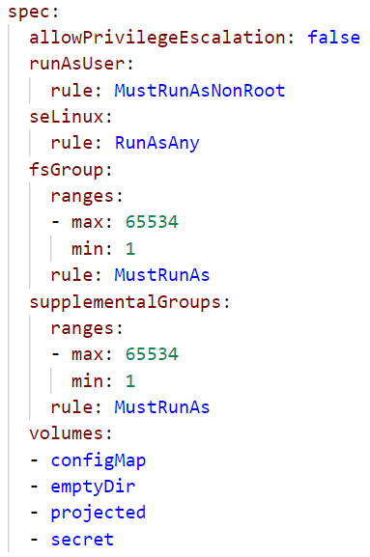
Restrictive PodSecurityPolicy
Process is not allow to run with UID 0
File system groups & supplemental groups cannot be 0
Whitelist volume types
Notes:
Details: https://kubernetes.io/docs/concepts/policy/pod-security-policy/
This is an example of a way more restrictive pod security policy. Pods validated against it, must not use volume types other than configMap, emptyDir, projected (project multiple info in the same directory) & secret. PVC or host fs are blocked.
The usage of UID 0 is also forbidden.

Slide 14



NetworkPolicy
“Firewall”-like restrictions
Define egress and ingress rules for a service
caller: mario
Mario
Selector: location: castle
location: castle
Service
direct-line-to-peach
Peach
Bowser
Network Policy
accept: caller: mario
Selector: location: castle
Notes:
Network policies are kubernetes object just as pods. The need an overlay network that supports the enforcement of their rules, like Calico.
Basically they define rules for incoming (ingress) and outgoing (egress) traffic to pods. As filter rules you can set IP addresses or use labels. Filter actions are deny or allow.
In the example above, let’s assume princess Peach is at her castle (pod). She has created a service in order to be callable, but only as long as her location = castle. That works quite well, only that Bowser keeps calling her all the time. So Peach decides to allow only calls from Mario and puts a network policy in place. The policy filters incoming calls when she has her “location: castle” label and allows only those to pass, that have a label “caller: mario” attached. As a result Bowser is no longer able to call her.

Slide 15
More on Network Policies
2 policyTypes:
Ingress: rules for incoming traffic
Egress: rules for outgoing traffic
3 kinds of Rules:
ipBlock: range of IP addresses given as CIDR
podSelector: labels of Pods allowed
namespaceSelector: labels of Namespaces
Last two can be combined to specify certain pods in certain namespases (since 1.11)

Slide 16

Demo
Notes:
Demo:
Create a deployment & a corresponding service (if not yet done)
kubectl run nginx --image=nginx --replicas=2
kubectl expose deployment nginx --port=80
Create a helper pod, logon to it and get the index.html page from the nginx backend.
kubectl run connector --rm -ti --restart=Never --image=alpine:3.8
# wget --timeout=1 nginx
Remove the index.html page & stay connected to the shell session
Create the network policy in a 2nd shell:
kubectl create –f network-policy.yaml
Show the network policy definition and explain:
it’s implicitly a whitelisting
network policy can handle egress and ingress traffic. However the example is only of incoming (ingress) traffic.
The cidr block are required, if you want to access your service later from SAP networks. Otherwise all requested without the label (i.e. not cluster internal) will be blocked too.
Switch back to the helper pod and re-run the wget command ➔ expected result: failure due to the missing label
Label you helper pod accordingly (can be done from the 2nd shell session, so stay connected to your helper pod)
kubectl label pod connector access=true
Re-run the wget command ➔ expected result: works again

Slide 17

Attacking K8s

Slide 18


Setup
K8s
API Server
Container
Host
root@container:$
> Hello world!
Linux Kernel
Notes:
Here’s our setup for the security discussion:
A kubernetes cluster runs as usual with one to many nodes. Each node is a linux host with a kernel, docker daemon and kubelet. We also have the master with API server and etcd where configuration, some passwords and the cluster state is stored.
On the host we see here, there is a container running which was taken over by an attacker (i.e. us). The attacker is connected to a shell session within the container now.

Slide 19

Scenario 1: Bitcoin, Ethereum, Monero!
K8s
Internet
API Server
Container
Host
root@container:$
> apt install <some miner>
> € € € € € € € € €...
Linux Kernel
Notes:
The easiest thing we can do as an attacker is to abuse the compute power by doing some crypto mining. All we need, is to download mining software from the internet, connect it to some anonymous mining pool and wait.

Slide 20
How to prevent this?
K8s
Internet
API Server
Container
Host
Block egress traffic with network policies
root@container:$
> apt install <some miner>
> € € € € € € € € €...
images don’t have tools like curl or wget
Linux Kernel
Limit resource consumption via container / pod spec
Notes:
What could be done to limit the impact of such an attack or to prevent parts of it?
Why should everyone be able to communicate with the internet by default? Blocking any egress traffic by default (with a network policy) and explicitly allow dedicated outbound connections will increase your cluster security significantly.
Apply resource constraints that fit your app.
Build (docker) images without curl, wget or similar tools (ideally also without apt/apk).

Slide 21


Scenario 2: Take over the cluster / hosts
K8s
API Server
Container
Schedule new pod / container
Host
root@container:$
> cat /hostfs/etc/passwd
> ls /var/lib/kubelet
Service account access token
Access API server via kubernetes.default.svc.cluster.local
Linux Kernel
> mount host file system to container > worse, if container runs as root
Notes:
Instead of abusing the compute power of a single container, an attacker could also try to move forward and gain access to more parts of the infrastructure. Unfortunately, Kubernetes makes our life easy here.
Try to become aware of the environment. Check the content of /proc/self/cgroup – does it contain a “kube” string?
Check, if there is a service account access token mounted to the default location /var/run/secrets/kubernetes.io/serviceaccount/token
Try to abuse the token to talk to the cluster’s API server. Use the FQDN of the kubernetes service in the default namespace for it. Note – this part requires curl or a similar tool.
If you’re able to access the API server, try to do something more meaningful – inject a sidecar container to all deployments or schedule a daemonset that mounts the host file system of each node. Try to write something as user root the node.

Slide 22
How to prevent this?
K8s
API Server
Container
Host
Limit access scope with RBAC
Service account access token
Don’t automount access tokens
Linux Kernel
Notes:
The first and probably most important part: disable the automount option for the service account access token. There are very few container which would require permissions to talk to the api server. For these the mount option can be enabled explicitly or you run them with a different service account.
To disable the mount option, you should edit the service account object itself.
Also the access scope to the API should be limited via an RBAC role(binding). Does the service account really need to modify something or is viewing a few dedicated resources sufficient?

Slide 23
How to prevent this?
K8s
API Server
Container
Host
root@container:$
> cat /hostfs/etc/passwd
> ls /var/lib/kubelet
Service account access token
Security policy:
- run as non-root
- block host file system access
Linux Kernel
Notes:
Finally, pod security policies can prevent usage of the host’s file system or network.
Pods attempting to mount the host file system or run as user root will be rejected.

Slide 24
Demo
Notes:
To demonstrate scenario #2, we prepared a separate repo: https://github.wdf.sap.corp/slvi/host-fs-access-hack
It contains a Dockerfile as well as some scripts & descriptions / explanations.
The attack will look like this:
You want to schedule an nginx image and found this super fancy fork of nginx (something comparable happened to Tesla with a crypto miner). Now the nginx image is a little bit extended – it has curl and a special run_nginx.sh script. The script checks, if a service account access token is available and if the answer is yes, it will be abused to schedule a daemon set with host fs access. Check the logs of the daemon set pods to see, if it worked.
Of course, after the script ran, nginx will be started too ;)
To make life easier, the Docker image has already been build & uploaded to artifactory in DMZ. All you need to do, is to create an imagepullsecret with name “artifactory” and read access to cc-k8s-course.docker.repositories.sap.ondemand.com/security-examples/nginx-host-fs-hack. As it is the same org as we use on day 4, you can also use the same username / password for it (check https://github.wdf.sap.corp/slvi/docker-k8s-training/blob/master/kubernetes/k8s-bulletinboard/exercise_02_ads_app.md#step-0-imagepullsecret-for-sap-artifactory-repo-cc-k8s-course).
To run the attack, you may use this deployment: https://github.wdf.sap.corp/ps-container/host-fs-access-hack/blob/master/host-fs-deployment.yaml

Slide 25

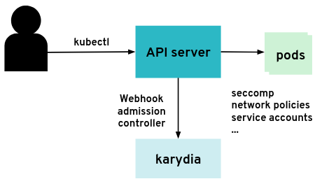
Karydia – secure by default
Unmount service account token!
Restrict network communication!
Restrict system calls!
Run with minimal privileges!
https://github.com/karydia/karydia

Slide 26
Exercise #09
Filter incoming traffic with a network Policy
service http / https
nginx
nginx
nginx
custom content
config
tls certs

