Slide 1
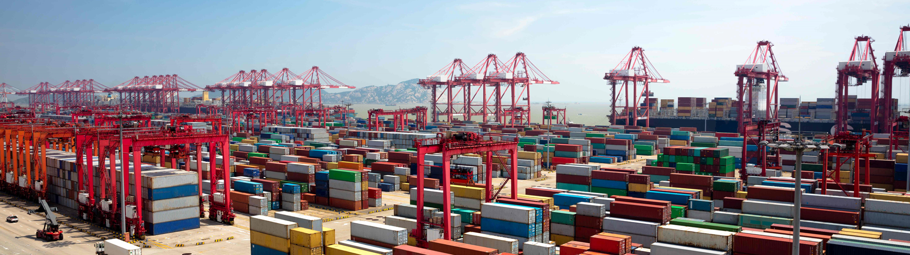

Docker and Kubernetes
Hands-On Training
Thomas Buchner, STS Infrastructure
Hendrik Kahl, SLV ABAP Component Validation

Slide 2

Containers
under the hood

Slide 3
Linux Features
Namespaces
Isolation of resources per process
7 different namespaces
netfilter
Firewall and packet manipulation
cgroups
Manage resource allocation
Netlink
Interprocess communication between containers
SELinux/AppArmor
Security profiles to govern access to resources
capabilities
Granular control of privileges
seccomp
Limitation of syscalls to processes
Docker Runtime
dockerd
Container
Container
Container
Container
Linux
namespaces
Netlink
SELinux
netfilter
seccomp
capabilities
cgroups
AppArmor
Hardware
Notes:
Containers make heavy use of features that are offered by the Linux kernel. These features are going to be described in detail on the following slides.

Slide 4
Linux Features
Chroot
Changes the root directory for a process to any given directory
Namespaces
Different processes see different environments even though they are on the same host/OS
Seven different namespaces for
PID (process tree)
mnt (mount points)
Net (network interfaces and connectivity)
IPC (interprocess communication framework)
UTS (hostnames, date & time, etc.)
UID (user IDs and mappings)
cgroup (control groups for resource allocation)
Control groups (cgroups)
manage/limit resource allocation to individual processes
Prioritization ('nice' for a set of processes and not just one)
capabilities
without capabilities: root can do everything, everybody else may do nothing
38 granular facilities to control privileges
netfilter
firewall and packet manipulation (iptables/nftables)
can manipulate almost all network traffic going in/out a host
used to direct network packages to individual containers
Netlink
Interprocess communication between containers
SELinux/AppArmor
Security profiles to govern access to resources
seccomp
Limitation of allowed kernel syscalls
Unallowed syscalls lead to process termination

Slide 5




Filesystem isolation with chroot
/
Chroot makes any directory the topmost/root directory of a process
New process can only see files and directories under that special root directory
Provides file system isolation
bin
home
foo
/
container101
chroot
bin
container
lib
bin
usr
lib
usr
usr
Notes:
With chroot we can start a new process making a specified directory the new processes' topmost directory. Processes running in that chroot can only see those parts of the filesystem which are subdirectories of it.
Chroot is part of Unix and was initially integrated to test Unix installation routines. It is still very often used for bootstrapping a system during installation.
One problem with chroot is: since the process that gets started inside the chroot can no longer see the full filesystem, all files required to load and run that process must be copied to the chroot directory (and subdirectories) first - a tedious task that can take some time, and is trial and error.

Slide 6
Process (and more) isolation with namespaces
Linux process tree
Namespaces give a process a limited view on the process table
Only processes in the same namespace can see each other
Processes get new PIDs in namespace
Still visible with their original PID outside of namespace
Same principle applies to mount, uid, cgroup, …, namespaces
1
3
27
16
namespaced process tree
1 (31)
49
51
31
4 (62)
7 (12)
62
12
Notes:
Man-page definition: A namespace wraps a global system resource in an abstraction that makes it appear to the processes within the namespace that they have their own isolated instance of the global resource. Changes to the global resource are visible to other processes that are members of the namespace, but are invisible to other processes [outside of that namespace]. One use of namespaces is to implement containers.
Linux offers namespaces for seven different resources: PID table, mount table, user mapping table, IPC, network stack, UTS (host and domain name) and cgroups.

Slide 7
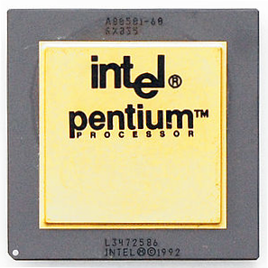

Resource limitations with cgroups
cgroups limit access of a process to system resources
Several processes can be in the same cgroup they all share the resource limit
cgroups offer resource control for
CPU
memory
block I/O
and others
cgroup
Process
Process
Process
Process
Notes:
Wikipedia definition: cgroups (abbreviated from control groups) is a Linux kernel feature that limits, accounts for, and isolates the resource usage (CPU, memory, disk I/O, network, etc.) of a collection of processes.
With cgroups, processes can be kept from eating up all system resources. Multiple processes can be added to one single cgroup - they will then all share the resource limits of it.

Slide 8


Container security with seccomp
Every program uses system calls to interact with the operating system
seccomp can block individual system calls
whitelisting
blacklisting
systemcall trapping
Application
system calls
write
stat
reboot
Kernel
Notes:
An application will eventually (after doing tons of nested library calls) call the operating system to do things - like reading or writing to files or sending data across the network. Talking to the operating system is done through system calls or syscalls. Syscalls are the interface between user space (where your application runs in) and kernel space (where the operating system does its job) and there are around 340 of them (syscalls).
While most system calls are necessary for programs to do their job (e.g. a program cannot even be loaded into memory without the “execve” system call) some are potentially dangerous and would allow a process to break free from its container or to cause harm to other containers (such as the reboot system call which would reboot the host terminating all containers on it).
With seccomp, individual system calls can be blocked to reduce the security risk which is commonly done in container environments (Docker for instance blocks around 40 system calls by default).

Slide 9
Let’s use these features to start our first container…
# cgexec –r cpu,memory,pids:/container unshare --pid --uts --mount --user --fork chroot container
cgroups resource limitation
chroot filesystem isolation
namespaces process isolation

Slide 10
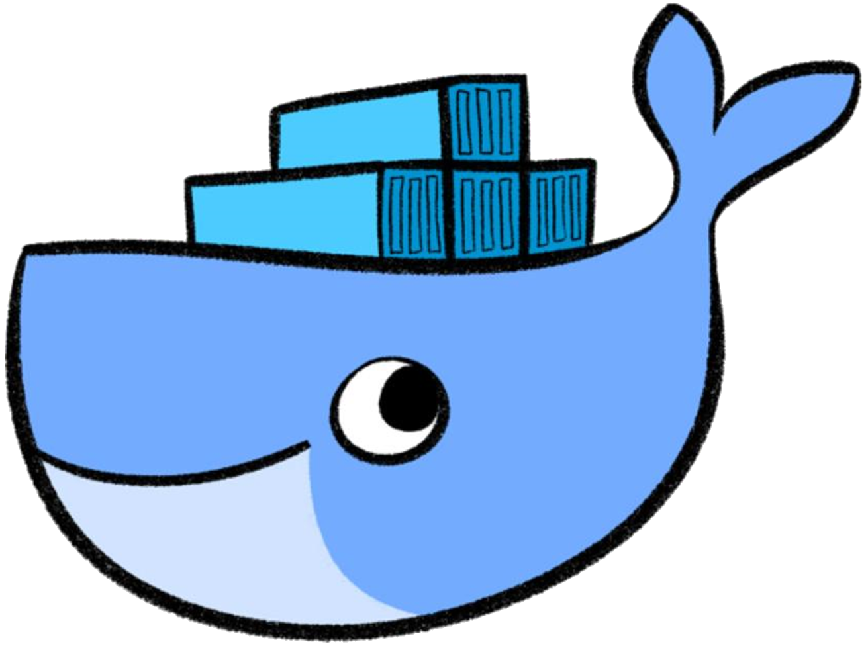
Containers made easy

Slide 11
Let’s start our first container… the easy way!
$ docker run container
cgroups resource limitation
chroot filesystem isolation
namespaces process isolation
seccomp & capabilities additional security
iptables network routing
and more…
Notes:
You actually specify an image name as argument of the docker run but that will be explained in the next few slides.

Slide 12
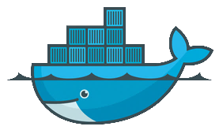
Containers and where they come from
App
(e.g. nginx)
Isolated environment in which an application runs
Like a computer in a computer… without the OS overhead
Containers are created from images…
… which can be downloaded from a central registry
… or can be built on the fly
Each container has one main process with PID 1
started whenever a container is created
no init system
processes present in host system with PID ≠ 1
Tools
Libs
$ docker ps -a
CONTAINER ID IMAGE COMMAND CREATED STATUS PORTS NAMES
9682e4fba8b7 busybox "sh" 27 minutes ago Up 27 minutes elated_saha
eb2e127b9647 debian "bash" 2 days ago Exited (0) 25 hours ago goofy_shaw
e7a7aeca8c41 test_nginx "nginx –g..." 3 days ago Exited (1) 7 minutes ago pensive_elion
7318e13769aa busybox "sh" 6 days ago Exited (0) 6 days ago goofy_saha
$

Slide 13


Images
Images are …
templates that containers are created from
pulled from a registry
created from a Dockerfile or by committing changes
consist of several layers
can be and actually are stacked upon each other
$ docker images
REPOSITORY TAG IMAGE ID CREATED SIZE
test_nginx latest ee56ce14b382 3 days ago 108MB
<none> <none> 2af6607c94b9 13 days ago 108MB
debian latest 6d83de432e98 4 weeks ago 100MB
busybox latest 6ad733544a63 4 weeks ago 1.13MB
$

Slide 14
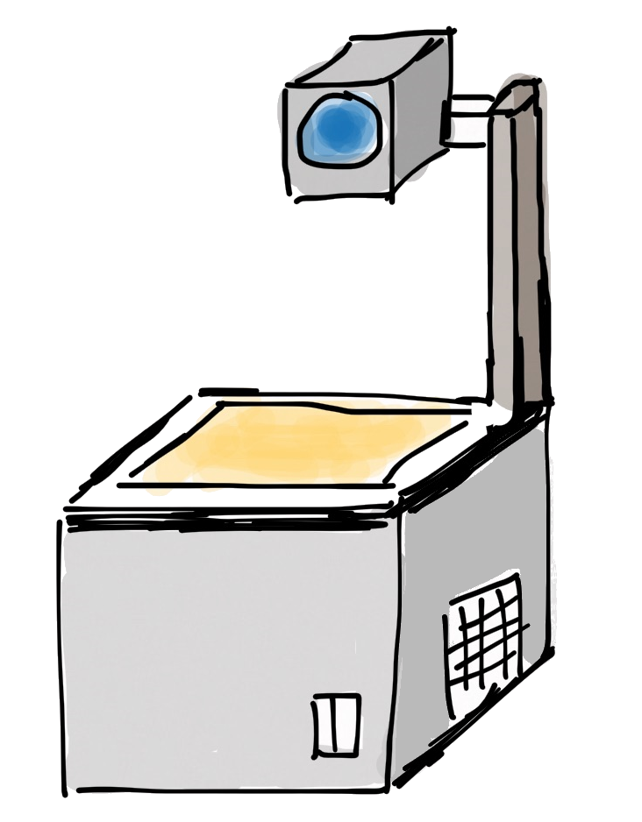
Layers of images and containers
Container
writable layer
Image
PHP
Apache
Busybox
Base Image (e.g. Debian)
Notes:
Containers consist of several filesystem layers. In order to get the idea, remember your school time when you certainly had to deal with that device on the left.
On an overhead slide projector, you put on a slide, you write on it and everybody can see what you wrote. You put up another slide on top and write on it - now everybody can see what is written on both slides but all you write goes to the topmost slide, you can no longer write on the lowest slide. You can put yet another slide on top of the stack, you can write on that… and so on.
With an overlay filesystem, it is exactly like that. Several different filesystem layers will be stacked on top of each other and the contents will merge - when you read files, you will not even notice which layer they are from. Writing however will always go to the topmost filesystem layer, all underlaying layers will be read-only.
Docker uses these layers to enable stacking of images. Container images can extend existing images which is facilitated by these layers. They will be discussed in more depth in the chapter about images.

Slide 15

Registries
Public registries
Docker Hub https://hub.docker.com
lots of ready-made and official images
anyone can upload his images
Private registries
Docker Hub https://hub.docker.com
Individual Organizations and projects
Automated builds
Local private registries
Runs as a container on any Docker host
Selected by image tagging
Local / insecure registries must be explicitly enabled in dockerd configuration
$ docker search busybox
NAME DESCRIPTION STARS OFFICIAL AUTOMATED
busybox Busybox base image. 1158 [OK]
progrium/busybox 66 [OK]
hypriot/rpi-busybox-httpd Raspberry Pi compatible Docker Image with ... 39
radial/busyboxplus Full-chain, Internet enabled, busybox made... 17 [OK]
$
Notes:
Docker images can be made available by means of registries. The most common registry is the Docker Hub. Many images are made available here and a simple “docker pull xyz” will download image xyz from Docker Hub. Docker Hub is a public registry meaning that everybody can use it.
If you want to offer your images to only a limited group of peers, private registries come in handy. These require authentication before images can be pulled from or pushed to it. Docker Hub also offers private registries.
If you do not want to use a public hosted registry (Docker Hub is a public cloud registry), you can set up a local private registry yourself which is fairly straightforward. After all, a registry is just another docker image, cf. https://hub.docker.com/r/_/registry.
Note: There is no control of what people put into images. You can only trust official images of official 'providers' (e.g. of nginx). Check the Dockerfile to be clear on what is inside an image.

Slide 16
Docker‘s client/server architecture
ReST
Docker Runtime
docker client
dockerd
nginx
nginx
Docker daemon is the control entity of everything (docker runtime)
Docker client (the docker command) just tells the daemon what to do
Communication through ReST API
when on same host: Unix socket /var/run/docker.sock
when on different hosts: TCP, via port 2375 or 2376
Building images: everything is transferred from client to dockerd
Libs
Libs
Host OS
Hardware
Notes:
Docker is a client-server architecture. The docker command you use to interact with Docker does nothing but talk to the Docker daemon. All the magic of pinning up containers, downloading images and even building images is done inside the Docker daemon. Communication between the Docker client and the Docker daemon happens through a ReST API over http/https.
If both, docker client and docker daemon, run on the same host, communication will take place through a socket file (/var/run/docker.sock). It is however also possible to have the Docker client on your local laptop and the Docker daemon on a computer somewhere totally different. In that case, communication goes through TCP, the target port on the Docker daemon will be 2375 for unencrypted HTTP and 2376 for TLS secured HTTPS.
Note:
If you want to talk to dockerd directly, you can do so using curl (you will need curl and libcurl >= 7.40): curl --unix-socket /var/run/docker.sock http://localhost/containers/json
Or use your web browser if you enabled dockerd‘s TCP socket: http://<hostname>:2375/containers/json

Slide 17
runC
nginx
runC is the bed on which containers run
Infrastructure plumbing
Setup of Linux kernel features (namespaces, cgroups, etc…)
Managing the network routing
Spun out of dockerd in 2015
Implements the OCI container standard
runC, Docker… what?
runC only sets up and runs the containers as instructed by Docker
runC does not know anything about images, registries, etc.
runC can be used in different container platforms, not just Docker
dock
Libs
runC
Host OS
Notes:
Remember all the stuff we did some slides back? Setting up namespaces, putting processes into cgroups, chrooting into directories, applying seccomp profiles?
In former times, this was all managed by the Docker daemon but starting with Docker 1.11 it was decided to spin out all of that “infrastructure plumbing” into a separate piece of software that follows the OCI reference specification. That piece of software is runC.
If your want to know more about runC, visit https://blog.docker.com/2015/06/runc/.

Slide 18
Configuration of the Docker daemon
Different places to configure the Docker daemon
systemd unit drop-in : environment settings
/etc/sysconfig/docker : command options for dockerd
/etc/docker/config.json : general config options for drivers, etc…
systemd unit drop-in
dockerd
/etc/docker/config.json
Example: Setting up the proxy server
Proxy is an environment setting
/etc/sysconfig/docker
[Service]
Environment="http_proxy=http://proxy.wdf.sap.corp:8080"
Environment="https_proxy=http://proxy.wdf.sap.corp:8080"
/etc/systemd/system/docker.service.d/proxy

