Slide 1

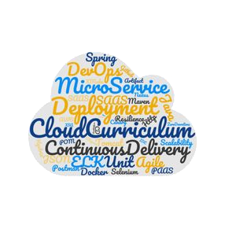

D R A F T Under Construction !
Kubernetes Microservice-based sample app: Bulletinboard

Slide 2


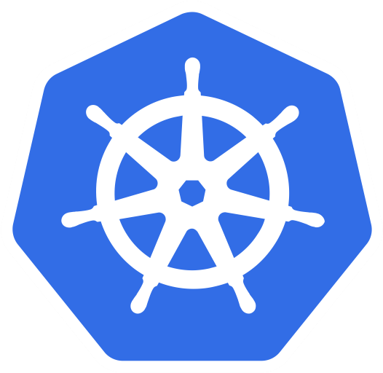
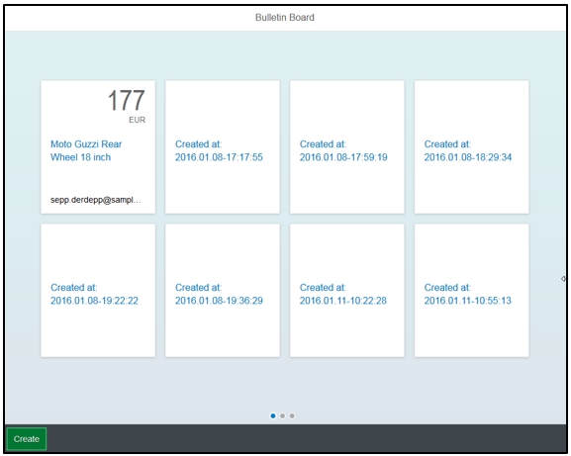


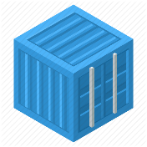
Bulletinboard in K8s: Exercise “Users App + DB with helm”
ingr/ svc
HTTP/ REST
svc
HTTPS/ REST
nwp
nwp
bulletinboard- ads
bulletinboard-users
cm
cm
ü
sec
pod
pod
deployment
deployment
svc
svc
nwp
postgresql
nwp
postgresql
cm
cm
ü
sec
pod
sec
pod
statefulset
statefulset

Slide 3
Bulletinboard in K8s: The user helm chart I
/: gives a 'Users: OK' string and 200 code.
/api/v1.0/users: takes GET/POST to read or post user data
/api/v1.0/users/{id}
The users app:
stores user data
ads:app asks users:app for user-data to check if user is premium user (= a user allowed to change ads data)
No UI
Api: / : returns ‘Users: OK’ if running /api/v1.0/users : GET/POST /api/v1.0/users/{id} : GET/PUT/DEL
Data-fields: id: int; permiumUser: bool; email: email
The chart “bulletinboard-users”:
Chart.yaml
values.yaml
templates/
users-app.yaml
users-db.yaml
networkpolicies.yaml
post-install-job.yaml
_helpers.tpl
Notes.txt
contains basic Chart info
Contains config values for users-db and users-app
contains text functions used in the yamls
contains a note written after install of the chart

Slide 4

Bulletinboard in K8s: The user helm chart II
networkpolicies.yaml
users-app.yaml
HTTP/ REST
svc
Network Policy for
user-app
user-db
ConfigMap
Service
Deployment
nwp
bulletinboard-users
cm
Curl to create premium-user 42
pod
deployment
svc
users-db.yaml
post-install-job.yaml
ConfigMap
Secret
Service
StatefulSet
Job
nwp
postgresql
Image with curl
cm
pod
sec
pod
Job
statefulset

Slide 5
Exercise 4: bulletinboard-user helm chart

Slide 6
Appendix

Slide 7
What YOU will do in exercise #0x
nginx
nginx
nginx
content
config
tls certs

Slide 8

Demo
Notes:
Show all namespaces in cluster
If not yet mentioned, explain that everyone has their own namespace. Please be a good citizen and don’t sabotage the others.
Query a pod from a dedicated namespace ( e.g. kube-system), explain “-n <namespace>” flag

