Slide 1

Docker Images

Slide 2
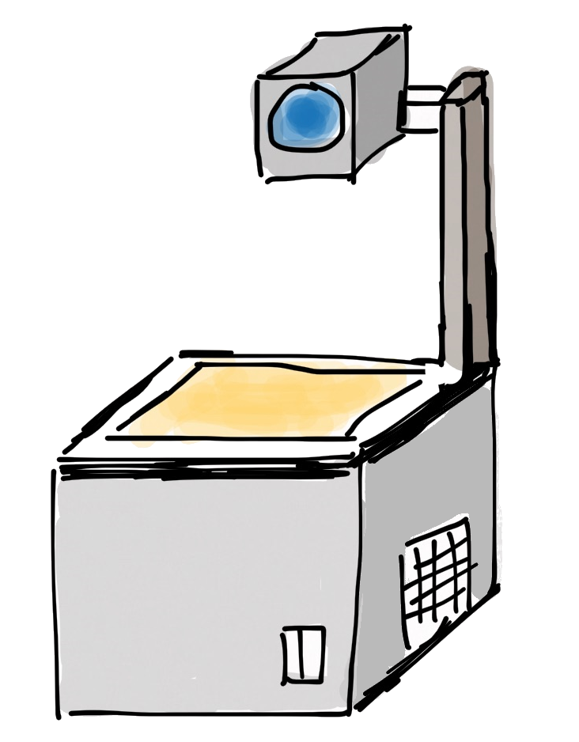
Layers of images and containers
Container
writable layer
Image
PHP
Apache
Busybox
Base Image (e.g. Debian)

Slide 3


Advantages of layers
tomcat:7.0-jre7
openjdk:7-jre
nginx:1.12
buildpack-deps:jessie-curl
debian:jessie
debian:jessie
debian:jessie
Layers get shared between images - downloaded and persistent only once

Slide 4
Image Layers
Example: nginx image…
… and its history
Container RW layer
$ docker image history nginx:latest
IMAGE CREATED CREATED BY SIZE
cd5239a0906a 7 days ago /bin/sh -c # CMD ["nginx" "-g" "daem... 0B […]
<missing> 7 days ago /bin/sh -c apt-get install nginx && ... 53.7MB
[…]
<missing> 6 weeks ago /bin/sh -c # ADD file:ec5be7eec56a749... 55.3MB
nginx
debian:stretch-slim
scratch
Notes:
Images were discussed earlier in the context of layered file system.
You can create a new image by starting from another image (or empty 'scratch') and adding 'things'. These 'things' are usually files – which add another layer in the file system hierarchy – or environment settings. Installing software means adding another layer.

Slide 5

Committing changes
new RW layer
Container RW layer
image
Committed layer
commit
image
nginx
nginx
debian:stretch-slim
debian:stretch-slim
scratch
scratch
No build automatization
No change history
Notes:
You can also make manual changes to images by:
Start a container from an image
Make manual changes, e.g. install software, change config / settings (in files), … that manifest in the file system (persisted).
'Commit' the changes by writing a new image that contains the current state, i.e. the changes relative to the starting image.
Drawback: Manual changes leave no trace / history / version control. Not repeatable. Also: Since the container is in running state, it is not guaranteed that you commit a consistent state.

Slide 6
Committing changes
new Container RW layer
Container RW layer
image
Not recommended !
Committed layer
commit
image
nginx
nginx
debian:stretch-slim
debian:stretch-slim
scratch
scratch
e.g. my-nginx:v1.0
e.g. my-nginx:2.0
No build automatization
No change history
Notes:
You can also make manual changes to images by:
Start a container from an image
Make manual changes, e.g. install software, change config / settings (in files), … that manifest in the file system (persisted).
'Commit' the changes by writing a new image that contains the current state, i.e. the changes relative to the starting image.
Drawback: Manual changes leave no trace / history / version control. Not repeatable.
Also: Since the container is in running state, it is not guaranteed that you commit a consistent state.

Slide 7
Information about images
Available images
the command docker image list gives a list of all available images on a host
$ docker image list
REPOSITORY TAG IMAGE ID CREATED SIZE
nginx stable ecc98fc2f376 13 days ago 109MB
nginx latest dbfc48660aeb 13 days ago 109MB
nginx mainline dbfc48660aeb 13 days ago 109MB
jenkins/jenkins lts 9cff19ad8c8b 2 weeks ago 730MB
busybox latest 59788edf1f3e 3 weeks ago 1.15MB
alpine 3.8 196d12cf6ab1 6 weeks ago 4.41MB
nginx 1.15.3 06144b287844 7 weeks ago 109MB
registry.ingress.wdfcw43a.k8s-train.shoot.canary.k8s-hana.ondemand.com/nginx bf91e3ea 06144b287844 7 weeks ago 109MB
…
useful description
Creation Date
image name
Image ID
Image size

Slide 8

Demo
Notes:
Let’s take a closer look at the images.
From the docker cli, you have several ways of accessing them:
docker image list ➔ gives you all downloaded images
docker inspect <image>:<tag> ➔ gives you meta info on the image incl. CMD/Entrypoint, ports etc
docker history <image>:<tag> ➔ gives you the image’s history
Show these commands for any available image like nginx
Next, demo the commit command:
docker run -it nginx:mainline /bin/bash
Create a file & exit
run “docker commit <container> <repo-name>:<tag>
Now re-run the history cmd on your newly created image. Discuss the added layer and the visible information vs. what you did.

Slide 9
Registries
Docker Runtime
dockerd
container
container
image storage
Registry
nginx
busybox
pull
whalesay
exim
httpd
nginx
java
busybox
debian
push
mysql
whalesay
php
Notes:
Images are kept in 'docker registries'. The docker runtime will look in the configured registry when it needs to load an image (e.g. for a 'docker run'). When it doesn't have the image already in its local cache, it will load it from the registry.
The default registry is the docker hub: hub.docker.com. You can also have local registries, e.g. to have tight control of what goes in.
Registries can have a private section which requires a login. With “docker login” you can store your credentials locally (~/.docker/config.json) and authorize your requests.

Slide 10




Docker login credentials
Private Registry
dockerd
docker login <registry url>
-u <username>
-p <password>
User Management
config.json
Notes:
Some, if not most registries require to log in to push or even to pull images.
With 'docker login', one can submit the username and password for a given registry (specified by its URL). Docker will persist these login credentials in a config.json (usually found in ~/docker/config.json) and use them every time a registry is accessed.

Slide 11
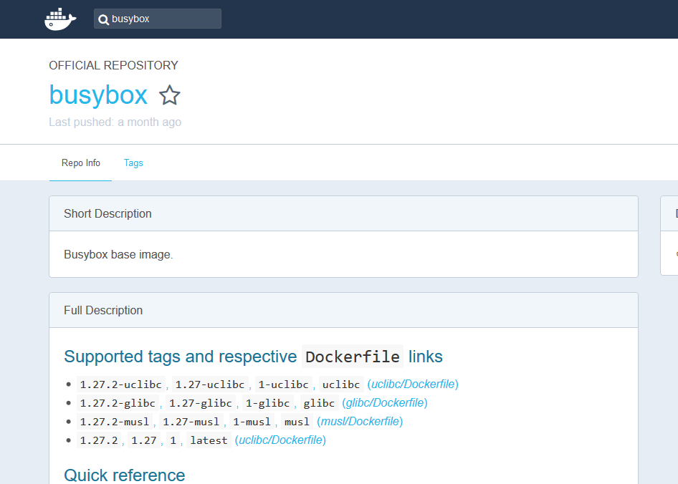
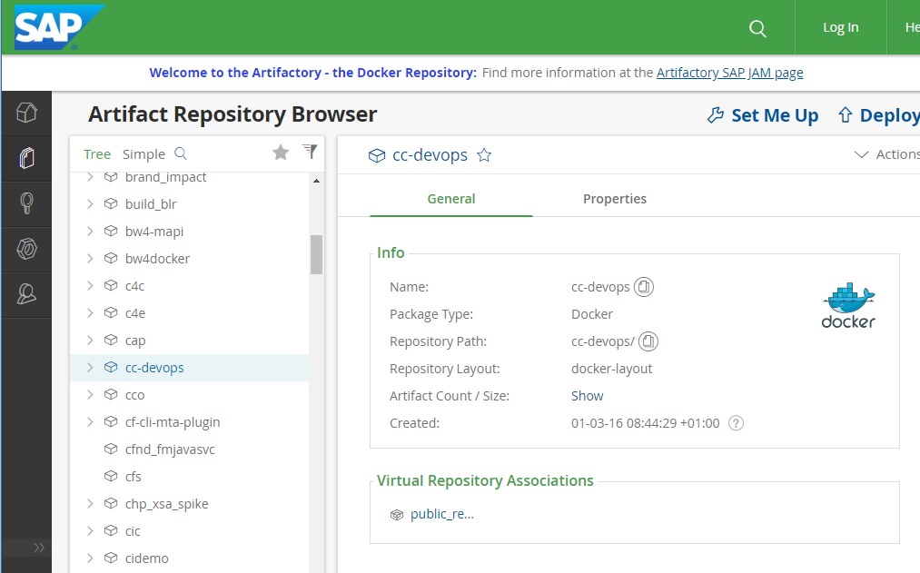
Registries for images
Docker Hub
JFrog Artifactory
Notes:
The docker hub offers (provides storage and the push/pull protocol for) docker images.
Each docker image has a clearly specified version. There can be multiple version tags.
The 'Dockerfile' defines the automated build instructions and show what is in the image. (see Dockerfile chapter). Dockerfiles are also included in images and document the contents.
At SAP, Artifactory is the preferred solution to host and distribute your Docker images.

Slide 12
Image names & tags
$ docker image list
REPOSITORY TAG IMAGE ID
my-registry.ondemand.com/busybox 0.1 6ad733544a63
repository
Version tag
Registry URL
image hash
$ docker tag 6ad733544a63 my-registry.ondemand.com/busybox:0.1
docker push my-registry.com/busybox:0.1
Notes:
Let’s talk about image names and tags. Docker has a system of creating URIs for any image, where the URI includes the registry as well as the image name & tag.
Registry URL: the registry this image has been downloaded from or where it should be uploaded to. Docker is also configured with a default registry (run “docker info” to get the info). For most installations this will be hub.docker.com (translates to https://index.docker.io/v1/). So or any image related to the docker hub, the registry URL string is omitted.
Repository: you could also call it the image’s name. Can contain subfolders. When you download images from docker hub you will only see the repo name here, no registry URL.
Tag: alpha-numeric string, free text. Anybody with write permissions on the repo can re-upload a different image with the same tag. Last write wins ;) however usually version tags are quite stable. There is one special tag, called “latest”. It is just a placeholder for “no tag”. So “my-registry.com/busybox” and “my-registry.com/busybox:latest” are the same thing.
It is best practice to always use an explicit tag and not to override existing tags.
How to use tagging? Docker knows a “tag” command, so let’s have look:
Tagging works like creating a sym-link on Linux. You can have as many different references to an images as you want.
To tag an image, you can reference it either by its ID or its repository:tag link.
Docker tag: assign the full string of registry URL + repo + version tag to an image
Docker push: send the image to the remote location, that is encoded in the image name
tag vs name
Building a Docker Image
With the command “docker build -t tagname .” you are creating a Docker image and tag it with a "name:tag" format.
So for example, you are building your image as “docker build -t myimage:1.0 .” which creates a new image that is named myimage with a version of 1.0.
Creating a Docker Container
The --name parameter is then used, when you create and start a new container based of your image.
So for example, you run a new container using the following command: “docker run -it --name mycontainerinstance myimage”.
This creates a new container based of your image myimage. This container instance is named mycontainerinstance.
From: https://stackoverflow.com/questions/41520614/docker-tag-vs-name-clarification

Slide 13
Demo
Notes:
Prerequisites: you have trusted the certificate of the registry for this training (the one deployed into the cluster)
Explain how to work with (remote) registries:
Docker image list
Next, tag one of the existing images with a different repo/tag combination like “docker tag nginx:mainline my-nginx:v0.1”
List the images again and outline that both nginx:mainline as well as my-nginx:v0.1 have the same image ID. The image is not stored twice but simply referenced by different names
Now you can tag the niginx with the URL of your remote registry as well registry.ingress.<clustername>.k8s-train.shoot.canary.k8s-hana.ondemand.com/nginx:v0.1
Push the image to the remote location (use the full string again): docker push registry.ingress.<clustername>.k8s-train.shoot.canary.k8s-hana.ondemand.com/nginx:v0.1
If you get a certificate error, you haven’t trusted the CA that signed the registries certificates. If anyone of the participants face this issue, they should re-run the get_kube_config.sh script and restart their docker daemon.

