Slide 1

Docker and Kubernetes
Hands-On Training
Thomas Buchner, STS Infrastructure
Hendrik Kahl, SLV ABAP Component Validation

Slide 2

Docker Images

Slide 3
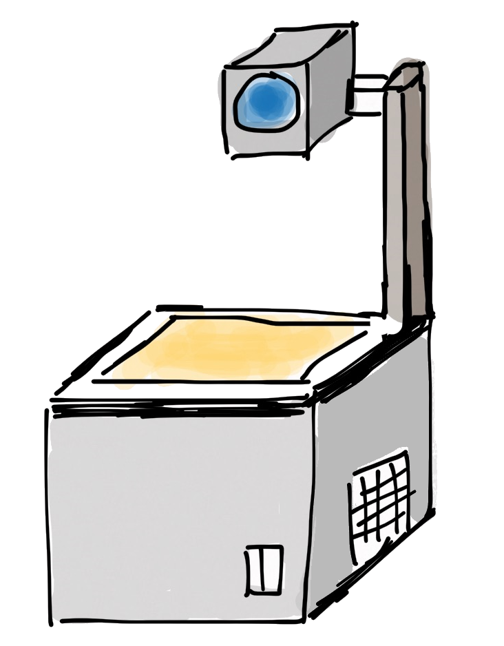
Layers of images and containers
Container
writable layer
Image
PHP
Apache
Busybox
Base Image (e.g. Debian)

Slide 4
Image Layers
Example – nginx image
Example – Azure App Service php
Container rw layer
Container rw layer
appsvc/php
nginx
php:7.0.6-apache
debian:stretch-slim
debian:jessie
scratch
scratch
Notes:
Images consist of different layers, depending on how they were built, which base images they come from and what software components are in it.
Every container will use the same set of image layers which are immutable (all containers will refer to the same bytes of data on the disk holding the image). However, every container gets an individual read/write layer that is unique to each container.

Slide 5

Committing changes
commit
New container rw layer
Container rw layer
image
comitted layer
image
nginx
nginx
debian:stretch-slim
debian:stretch-slim
scratch
scratch
No build automatization
No change history
Notes:
With “docker commit”, the read/write layer can be persisted into an immutable image layer, creating a new image.
Docker commit is good for persisting quick and small changes into an image. It has however two important drawbacks:
Building images with “docker commit” cannot be easily automated
All changes introduced to an image with “docker commit” cannot be examined in the images change history
Using “docker commit” to produce image that are intended for distribution is therefore highly discouraged.

Slide 6
Registries
Docker Runtime
dockerd
container
container
image storage
Registry
nginx
busybox
exim
httpd
whalesay
nginx
java
busybox
debian
mysql
whalesay
php

Slide 7
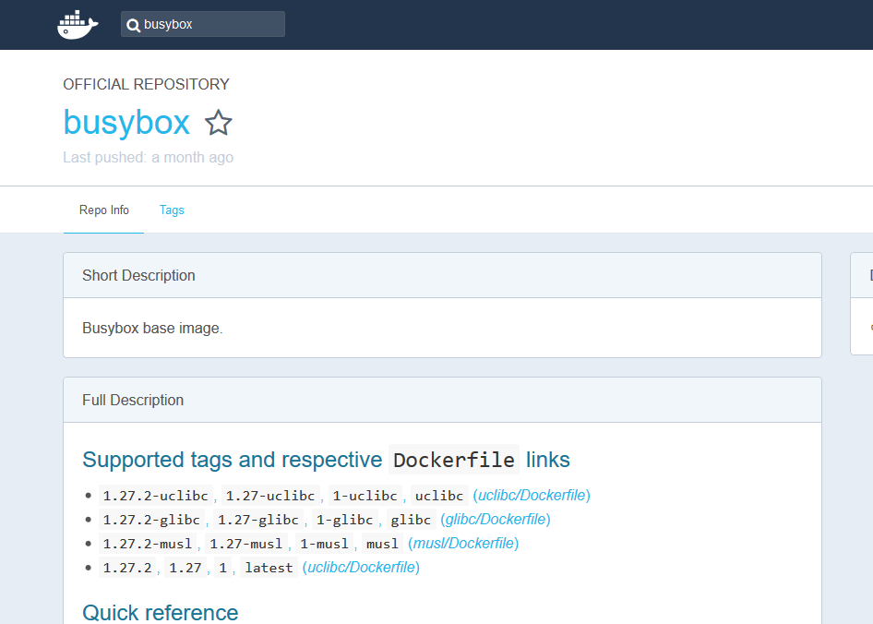
Docker Hub
https://hub.docker.com

Slide 8
Information about containers
Available/present containers
the command docker ps gives a list of all running containers on a host (use –a to see also terminated containers)
$ docker search busybox
NAME DESCRIPTION STARS OFFICIAL AUTOMATED
busybox Busybox base image. 1160 [OK]
progrium/busybox 66 [OK]
hypriot/rpi-busybox-httpd Raspberry Pi compatible Docker Image with ... 39
radial/busyboxplus Full-chain, Internet enabled, busybox made... 17 [OK]
hypriot/armhf-busybox Busybox base image for ARM. 8
...
official project maintainer
useful description
image name
automatically built on Docker Hub
LIKES!

