Slide 1
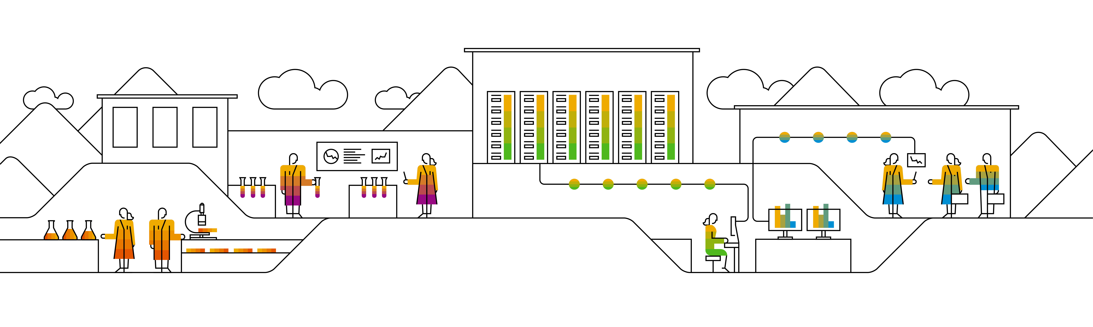

Kubernetes Security

Slide 2
Service Accounts
Service accounts are technical user in Kubernetes
Bound to a namespace
Allowed to communicate with the API server
Provide identity for pods
Pods can inherit permissions to access the API server or a registry (image pull secret)
Namespace
Pod A
runs as “default”
service account
“default”
Pod B
runs as “default”
secrets
Notes:
Currently there are two types of users in kubernetes – technical and normal Users. Users are considered to be human (end-)users and you can fine granularily define what each user can. They can also (by default) be cluster admins and have access to everything in the cluster.
The 2nd type of user is a technical user, called “service account”. A service account is bound to a namespace and in every namespace there is “default” service account. Of course it is possible to create further service accounts.
Usually a service account holds an access token allowing to communicate with the cluster’s API server. The token itself is a kubernetes secret. Additionally you can assign an image pull secret to the service account (see slide 5 ff for further info).
When scheduling resources like a pod, they always run in the “name” of the service account. This means, the service account’s secrets will be mounted into the pod. Hence a pod is also able to access the API server with the identity of the service account and its valid credentials.
If not specified differently, the default service account will be used.
Since a pod can access the API, think about possible consequences. Could it modify the system? To avoid potential security issues, it is recommended to limit the access scope of the service account using RBAC → see next slide

Slide 3



Access tokens
Anyone within the pod can use the key to access the API server
Each service account has a secret with a key to the API server
Pod A
service account
“default”
API Server
This key grants access to the API server
Keys are mounted as volume into any pod by default
access key to API server
Notes:
The tokens to access the API server deserve some extra thoughts. Every service account comes with such a token and by default, all pods mount the token of their respective service account. So basically we allow each and every application running in our cluster to talk to the API server and potentially read secrets or modify objects.
Though there are some applications that require this access, most of our workloads don’t. Hence it is recommended to switch off this feature and explicitly mount the tokens when needed. The service account object has a field “automountServiceAccountToken” which should be set to false.

Slide 4
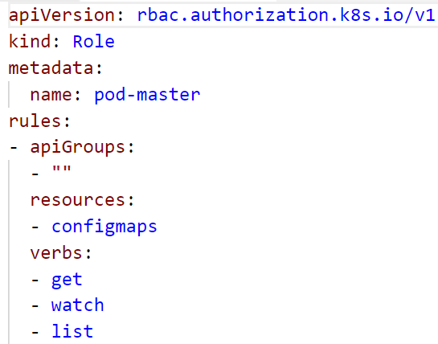
Role based access control (RBAC)
roles define which api’s / resources can be accessed in which way
Roles can be assigned to service accounts
Roles are pre-configured or custom defined
Bindings: cluster-wide or restricted to namespace
Namespace
ConfigMap
get
Role binding
get
role
Secret
Notes:
To limit the access scope of a service account, you can use existing roles or create your own. These roles are bound to the respective service account.
Roles define which resources of which api group are allowed to access with a certain set of actions. The example shown in the screenshot allows the actions “get”, “list” and “watch” for “configmaps”. Everything else would be blocked.
To assign the role to a user, you can create a role binding.

Slide 5

Demo
Notes:
Show the default service account associate with any namespace (kubectl get sa)
Show the token that is associated with the service account (kubectl get secret)
Show the clusterrolebinding, that makes the participants cluster admin (kubectl get clusterrolebinding)
Create a custom role:
In the demo folder, have a look at 11a_rbac.yaml
explain the access to the different API groups & objects within
The role "pod-master" gives you full access to pods, read access to configmaps and no access to anything else
the YAML creates a service account "pod-master"
The role gets bound to the service account by the rolebinding "pod-master"
Before you switch the kubeconfig context, check, if the secret “admin-access” described in file 07c_demo_secret.yaml is present in your namespace. If not, re-create it (kubectl create –f 07c_demo_secret.yaml)
In the demo folder, run the script 11b_rbac-demo-shell.sh
This script will start a new shell with a temporary kube.config that accesses the cluster as service account pod-master
In this shell, try to get the running pods and the configmaps
Try to get the secrets
Create a pod using the secret “admin-access” with "kubectl create –f 07d_demo_pod_with_secret.yaml" and have a look at its logs to show that secrets are still visible from within the pod although we do not have access to the secrets through the role (potential security leak)
Use the role binding "pod-master" and use kubectl auth can-i … to demo its function.
kubectl auth can-i get nodes --as system:serviceaccount:default:default ➔ expected result: no
kubectl auth can-i get nodes --as system:serviceaccount:part-<id>:default ➔ expected result: yes (due to the clusterrolebinding)

Slide 6
Kubernetes Policies

Slide 7
Policy objects in Kubernetes
Only 1 Loadbalancer Service!
ResourceQuota
Resource management
No more than 200MB memory!
LimitRange
Communication to DB is forbidden
NetworkPolicy
Security
Beta: Do not run as root user
PodSecurityPolicy
Notes:
Resource Quota and LimitRanges can be used to control requested as well as actual resource consumption + # of k8s objects per namespace. Example: if the memory quota per pod is 200 MB and you want to start, let’s say a Jenkins which would require more – the application will not be able to start before being killed for exceeding the memory limit.
Network policies control traffic within the cluster – details on next slide.
PodSecurityPolicies specify (security relevant) runtime conditions for pods. https://kubernetes.io/docs/concepts/policy/pod-security-policy/

Slide 8
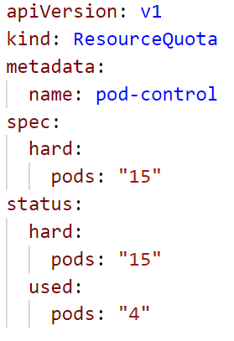
Policy: ResourceQuota
Used to define limits on different resources in a namespace.
namespaced Resource
Set “hard” limits on resources like
Pods
Number of PVCs
Memory (of all pods combined)
More information here.

Slide 9
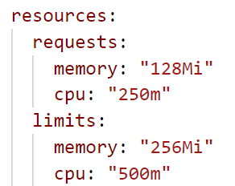
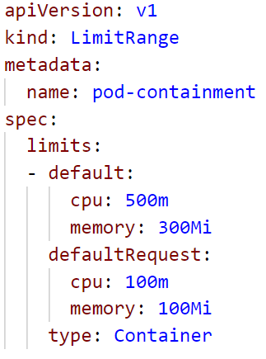
Policy: LimitRanges
Each pod consumes a certain amount of cpu or memory.
With resource spec each Container can request cpu and memory and set its own limits. If it consumes more resources it will be killed.
LimitRanges are used to set maximum/default limits/requests of
cpu
memory

Slide 10
NetworkPolicy
“Firewall”-like restrictions
Define egress and ingress rules for a service
caller: mario
Mario
Selector: location: castle
location: castle
Service
direct-line-to-peach
Peach
Bowser
Network Policy
Selector: caller: mario
Selector: location: castle
Notes:
Network policies are kubernetes object just as pods. The need an overlay network that supports the enforcement of their rules, like Calico.
Basically they define rules for incoming (ingress) and outgoing (egress) traffic to pods. As filter rules you can set IP addresses or use labels. Filter actions are deny or allow.
In the example above, let’s assume princess Peach is at her castle (pod). She has created a service in order to be callable, but only as long as her location = castle. That works quite well, only that Bowser keeps calling her all the time. So Peach decides to allow only calls from Mario and puts a network policy in place. The policy filters incoming calls when she has her “location: castle” label and allows only those to pass, that have a label “caller: mario” attached. As a result Bowser is no longer able to call her.

Slide 11
More on Network Policies
2 policyTypes:
Ingress: rules for incoming traffic
Egress: rules for outgoing traffic
3 kinds of Rules:
ipBlock: range of IP addresses given as CIDR
podSelector: labels of Pods allowed
namespaceSelector: labels of Namespaces
Last two can be combined to specify certain pods in certain namespases (since 1.11)

Slide 12
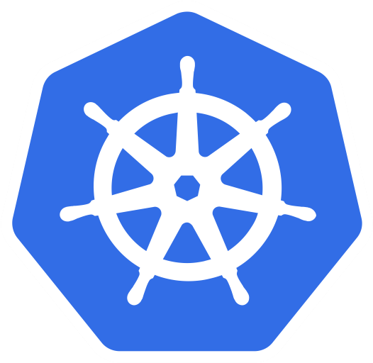
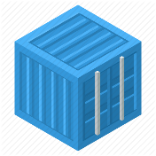
Network Policy for Ads:DB
Ingress:
Allow traffic from ads:app
Egress:
no egress traffic
Pods Ads:DB only receives requests from Ads:App
Pods Ads:DB don’t send any requests to anybody.
bulletinboard- ads
component: ads
module: app
pod: ads-app…ent-xx-yy
Postgresql
component: ads
module: db
pod: ads-db-statefulset-0
Notes:
Normally part of Day4
Who is “talking” to ads:db? A: ads:app
In which direction does the traffic go? -> Ingress
Does ads:db talk to anybody by itself? -> no Egress

Slide 13
Network Policies for Ads:App
Ingress:
Allow traffic from ingress-controller in kube-system namespace
Egress:
Allow traffic to kube-DNS
Allow traffic to Ads:DB
app: nginx-ingress
Ingress-controller
bulletinboard- ads
component: ads
component: controller
name: kube-system
module: app
origin: gardener
pod
pod: ads-app…ent-xx-yy
Request to: ads-db-0….
Namespace: kube-system
Namespace: <your Space>
Request to dns: get ip of ads-db-0….
k8s-app: kube-dns
Postgresql
component: ads
Kube-DNS
module: db
pod
pod: ads-db-statefulest-0
Notes:
Normally part of Day4

Slide 14
NetworkPolicy
“Firewall”-like restrictions
Define egress and ingress rules for a service
Requires support by overlay network plugin
access: ok
Pod B
app: nginx
Service
Pod A
Pod M
Selector: access: ok
Selector: app: nginx
access: not ok
Network Policy
Notes:
Network policies are kubernetes object just as pods. The need an overlay network that supports the enforcement of their rules, like Calico.
Basically they define rules for incoming (ingress) and outgoing (egress) traffic to pods. As filter rules you can set IP addresses or use labels. Filter actions are deny or allow.
In the example above, the network policy is enforced for access to “Pod A”, determined by its label and the corresponding selector.
Pod B is allowed to access pod A since it has the correct label. Traffic from pod M will be blocked.
Demo:
kubectl run nginx --image=nginx --replicas=2
kubectl expose deployment nginx --port=80
kubectl run busybox --rm -ti --image=busybox /bin/sh
# wget --spider --timeout=1 nginx
Kubectl create –f network-policy.yaml
Kubectl run ..
Kubectl run … -l access=true

Slide 15
Demo
Notes:
Demo:
Create a deployment & a corresponding service (if not yet done)
kubectl run nginx --image=nginx --replicas=2
kubectl expose deployment nginx --port=80
Create a helper pod, logon to it and get the index.html page from the nginx backend.
kubectl run connector --rm -ti --restart=Never --image=alpine:3.8
# wget --timeout=1 nginx
Remove the index.html page & stay connected to the shell session
Create the network policy in a 2nd shell:
kubectl create –f network-policy.yaml
Show the network policy definition and explain:
it’s implicitly a whitelisting
network policy can handle egress and ingress traffic. However the example is only of incoming (ingress) traffic.
The cidr block are required, if you want to access your service later from SAP networks. Otherwise all requested without the label (i.e. not cluster internal) will be blocked too.
Switch back to the helper pod and re-run the wget command ➔ expected result: failure due to the missing label
Label you helper pod accordingly (can be done from the 2nd shell session, so stay connected to your helper pod)
kubectl label pod connector access=true
Re-run the wget command ➔ expected result: works again

Slide 16
Exercise #08
Filter incoming traffic with a network Policy
service http / https
nginx
nginx
nginx
custom content
config
tls certs

Slide 17

Attacking K8s

Slide 18


Setup
K8s
API Server
Container
Host
root@container:$
> Hello world!
Linux Kernel
Notes:
Here’s our setup for the security discussion:
A kubernetes cluster runs as usual with one to many nodes. Each node is a linux host with a kernel, docker daemon and kubelet. We also have the master with API server and etcd where configuration, some passwords and the cluster state is stored.
On the host we see here, there is one container running (of course managed by kubernetes as a pod, deployment, …). The attacker (i.e. we) is connected to a shell session within the container.

Slide 19

Scenario 1: Bitcoin, Ethereum, Monero!
K8s
Internet
API Server
Container
Host
root@container:$
> apt install <some miner>
> € € € € € € € € €...
Linux Kernel

Slide 20
How to prevent this?
K8s
Internet
API Server
Container
Host
root@container:$
> apt install <some miner>
> € € € € € € € € €...
Block egress traffic with network policies
Linux Kernel
Limit resource consumption via container / pod spec

Slide 21

Scenario 2: Take over the cluster / hosts
K8s
API Server
Container
Schedule new pod / container
Host
root@container:$
> cat /hostfs/etc/passwd
> ls /var/lib/kubelet
Service account access token
Access API server via kubernetes.default.svc.cluster.local
Linux Kernel
> mount host file system to container > worse, if container runs as root

Slide 22
How to prevent this?
K8s
API Server
Container
Host
Limit access scope with RBAC
Service account access token
Don’t automount access tokens
Linux Kernel

Slide 23
How to prevent this?
K8s
API Server
Container
Host
root@container:$
> cat /hostfs/etc/passwd
> ls /var/lib/kubelet
Service account access token
Security context & policies:
run as non-root & block host file system access
Linux Kernel

