Slide 1

Creating images with Dockerfiles

Slide 2

Building Docker images
Docker Runtime
Creating a Docker image involves two things
A Dockerfile containing directives on how the image is meant to be built
A build-context (or PATH) which is a directory on your hard disk
every file to be added to the image must be inside the build-context
Image is built by the Docker daemon
the whole build-context is sent to the daemon
Dockerfile is processed
Image stored in the local image store
dockerd
image storage
my image
docker build
“Warning: Do not use your root directory, /, as the PATH as it causes the build to transfer the entire contents of your hard drive to the Docker daemon.”
https://docs.docker.com/engine/reference/builder/#usage

Slide 3
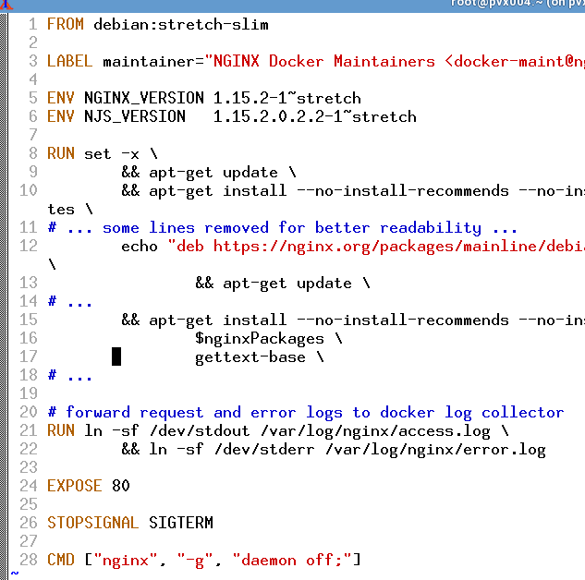
Ingredients of a Dockerfile
First line: FROM
Meta-data can be added as LABEL
Environment variables can come in handy with ENV
You can ADD or COPY files to the image
It is possible to RUN commands in the image
Do not forget to EXPOSE network ports
Containers start their life with a CMD or an ENTRYPOINT
Each line is executed in a temporary container which gets persisted as a new layer on top of the existing layers.
Remember the layer limit – keep it short and simple.

Slide 4
Dockerfile directives (1)
FROM
first line in a Dockerfile
specifies which image to build upon / to extend
special case: FROM scratch starts from scratch without any previous image
ENV
Sets an environment variable
Will be present during the build process and in the final image
Examples:
FROM debian:jessie
will pull the a Debian image from Docker Hub and use it as base image
FROM scratch
will start with an empty image
Examples:
ENV http_proxy http://proxy:8080
will set the http_proxy environment while building the image and in the finished image

Slide 5
Dockerfile directives (2)
LABEL
sets meta-data of an image
labels are key-value pairs
Examples:
LABEL maintainer="Homer Simpson"
adds a piece of meta-data to the image specifying the maintainer

Slide 6
Dockerfile directives (3)
ADD
adds a file from the build-context to the image
can download files from a URL
will automatically extract archives
COPY
copies a file from the build-context to the image
no additional magic like the ADD command
does not copy files inside the image
Examples:
ADD rootfs.tar.bz2 /
will extract the contents of rootfs.tar.bz2 to the root directory / of the image
ADD http://plx172:1080/pic.jpg /usr/share/pics
will download a picture from plx172 and place it into the image at /usr/share/pics
Examples:
COPY default.conf /etc/nginx/conf.d/
will copy the file default.conf into the image at /etc/nginx/conf.d/default.conf

Slide 7
Dockerfile directives (4)
RUN
runs the specified command in the image
command binary and shell must be present in the image
EXPOSE
exposes a port
exposed ports can be automatically mapped by Docker
Examples:
RUN apt-get update
will run the Debian package manager and build its package cache inside the image
RUN cp /etc/nginx/nginx.conf /root
will copy the file /etc/nginx/nginx.conf within the image to the directory /root within the image
Examples:
EXPOSE 80
will expose port 80 so that “docker run -P” can automatically map it to a port on the host

Slide 8
Dockerfile directives (5)
CMD
specifies the command to run when a container is created from the image
all but the last CMD directive are ignored
can be overridden upon container instantiation
ENTRYPOINT
sets the program to be directly run when a container is created
can be overridden with the option “--entrypoint”.
Examples:
CMD /bin/helloworld
will run a hello-world program when the container is started. This form is executed in a shell
CMD ["nginx", "-c", "daemon off;"]
will run the nginx binary with the arguments “-c” and “daemon off;” This form is directly executed via a system call (without shell)
Examples:
ENTRYPOINT [ "/usr/bin/nginx" ]
starts nginx directly without using a shell to start it. (Note the brackets)

Slide 9
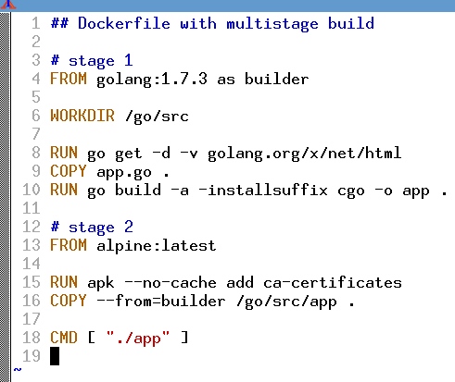
Docker multistage builds
First build stage with dedicated stage name ("as builder")
Second stage is done in a container totally separate from first stage
Files get copied from the container of the first build stage

Slide 10
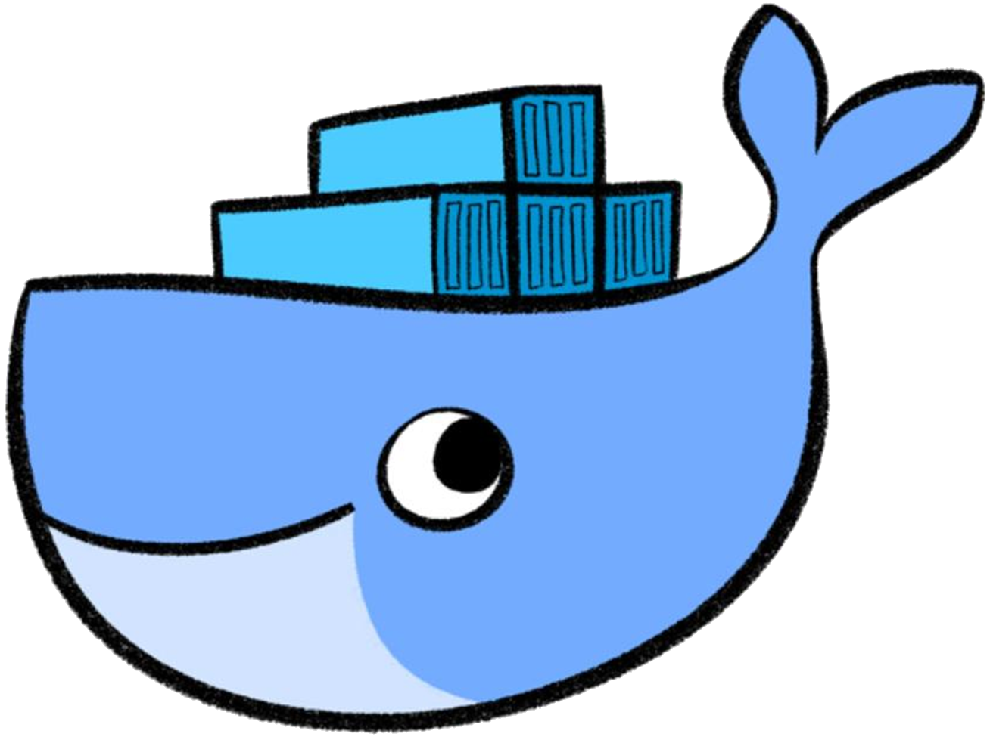

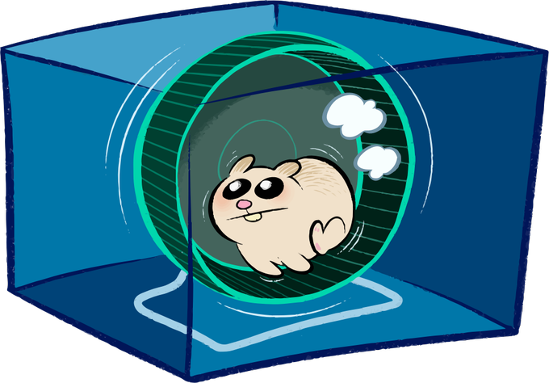
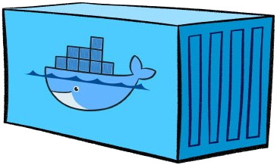
Entrypoints, CMDs and the container lifecycle
ENTRYPOINT is /bin/bash
config.json
ENTRYPOINT?
run ENTRYPOINT with CMD as argument
add some salt and pepper…
set up cgroups…
merge image layers…
create namespaces
CMD?
CMD is nginx -c daemon off;
PID 1
ENTRYPOINT CMD
/bin/bash nginx –c deamon off;

Slide 11

Exercise #5 & #6 – Dockerfiles

