Slide 1

Cluster Access Management

Slide 2
Service Accounts
Service accounts are technical user in Kubernetes
Bound to a namespace
Allowed to communicate with the API server
Provide identity for pods
Pods can inherit permissions to access the API server or a registry (image pull secret)
Namespace
Pod A
runs as “default”
service account
“default”
Pod B
runs as “default”
secrets
Notes:
Currently there are two types of users in kubernetes – technical and normal Users. Users are considered to be human (end-)users and you can fine granularily define what each user can. They can also (by default) be cluster admins and have access to everything in the cluster.
The 2nd type of user is a technical user, called “service account”. A service account is bound to a namespace and in every namespace there is “default” service account. Of course it is possible to create further service accounts.
Usually a service account holds an access token allowing to communicate with the cluster’s API server. The token itself is a kubernetes secret. Additionally you can assign an image pull secret to the service account (see slide 5 ff for further info).
When scheduling resources like a pod, they always run in the “name” of the service account. This means, the service account’s secrets will be mounted into the pod. Hence a pod is also able to access the API server with the identity of the service account and its valid credentials.
If not specified differently, the default service account will be used.
Since a pod can access the API, think about possible consequences. Could it modify the system? To avoid potential security issues, it is recommended to limit the access scope of the service account using RBAC → see next slide

Slide 3



Access tokens
Anyone within the pod can use the key to access the API server
Each service account has a secret with a key to the API server
Pod A
service account
“default”
API Server
This key grants access to the API server
Keys are mounted as volume into any pod by default
access key to API server
Notes:
The tokens to access the API server deserve some extra thoughts. Every service account comes with such a token and by default, all pods mount the token of their respective service account. So basically we allow each and every application running in our cluster to talk to the API server and potentially read secrets or modify objects.
Though there are some applications that require this access, most of our workloads don’t. Hence it is recommended to switch off this feature and explicitly mount the tokens when needed. The service account object has a field “automountServiceAccountToken” which should be set to false.

Slide 4
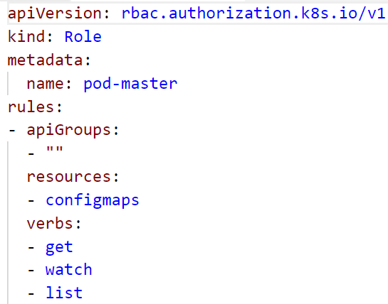
Role based access control (RBAC)
roles define which api’s / resources can be accessed in which way
Roles can be assigned to service accounts
Roles are pre-configured or custom defined
Bindings: cluster-wide or restricted to namespace
Namespace
ConfigMap
get
Role binding
get
role
Secret
Notes:
To limit the access scope of a service account, you can use existing roles or create your own. These roles are bound to the respective service account.
Roles define which resources of which api group are allowed to access with a certain set of actions. The example shown in the screenshot allows the actions “get”, “list” and “watch” for “configmaps”. Everything else would be blocked.
To assign the role to a user, you can create a role binding.

Slide 5

Demo
Notes:
Show the default service account associate with any namespace (kubectl get sa)
Show the token that is associated with the service account (kubectl get secret)
Show the clusterrolebinding, that makes the participants cluster admin (kubectl get clusterrolebinding)
Create a custom role:
In the demo folder, have a look at 11a_rbac.yaml
explain the access to the different API groups & objects within
The role "pod-master" gives you full access to pods, read access to configmaps and no access to anything else
the YAML creates a service account "pod-master"
The role gets bound to the service account by the rolebinding "pod-master"
Before you switch the kubeconfig context, check, if the secret “admin-access” described in file 07c_demo_secret.yaml is present in your namespace. If not, re-create it (kubectl create –f 07c_demo_secret.yaml)
In the demo folder, run the script 11b_rbac-demo-shell.sh
This script will start a new shell with a temporary kube.config that accesses the cluster as service account pod-master
In this shell, try to get the running pods and the configmaps
Try to get the secrets
Create a pod using the secret “admin-access” with "kubectl create –f 07d_demo_pod_with_secret.yaml" and have a look at its logs to show that secrets are still visible from within the pod although we do not have access to the secrets through the role (potential security leak)
Use the role binding "pod-master" and use kubectl auth can-i … to demo its function.
kubectl auth can-i get nodes --as system:serviceaccount:default:default ➔ expected result: no
kubectl auth can-i get nodes --as system:serviceaccount:part-<id>:default ➔ expected result: yes (due to the clusterrolebinding)

Slide 6

Image Pulling

Slide 7
ImagePullPolicy
Start Pod with image <> imagepullPolicy <>
imagePullPolicy:
Always
Never
IfNotPresent
Default:
if “:latest” tag is specified: “Always”
Otherwise: IfNotPresent
More info: https://kubernetes.io/docs/concepts/containers/images#updating-image
Notes:
The imagePullPolicy specifies for each container, in which cases the image should be downloaded to the node.
Always:
download each and every time a container is created.
increases security: there is no local image store that could be modified; in case of image updates with the same version tag there are no inconsistencies
may have impact on performance / startup time in case of large image size / poor network
Never:
Requires a local image store on every node
Hard to maintain
No dependency to registry at runtime
IfNotPresent:
“Download once”
May cause issues with outdated images (if version tag is re-used)
Usually sufficient

Slide 8
ImagePullPolicy: IfNotPresent
Docker
Start Pod with image <>
Image present already?
Worker
Docker
Pod
Pod
Docker pull image
Start Pod with image <>
Notes:
The docker daemon runs on each node and has an individual, local image store. So each time a pod is scheduled on a node, the daemon checks, if the image is already present.
If not the image has to be pulled (= downloaded).

Slide 9
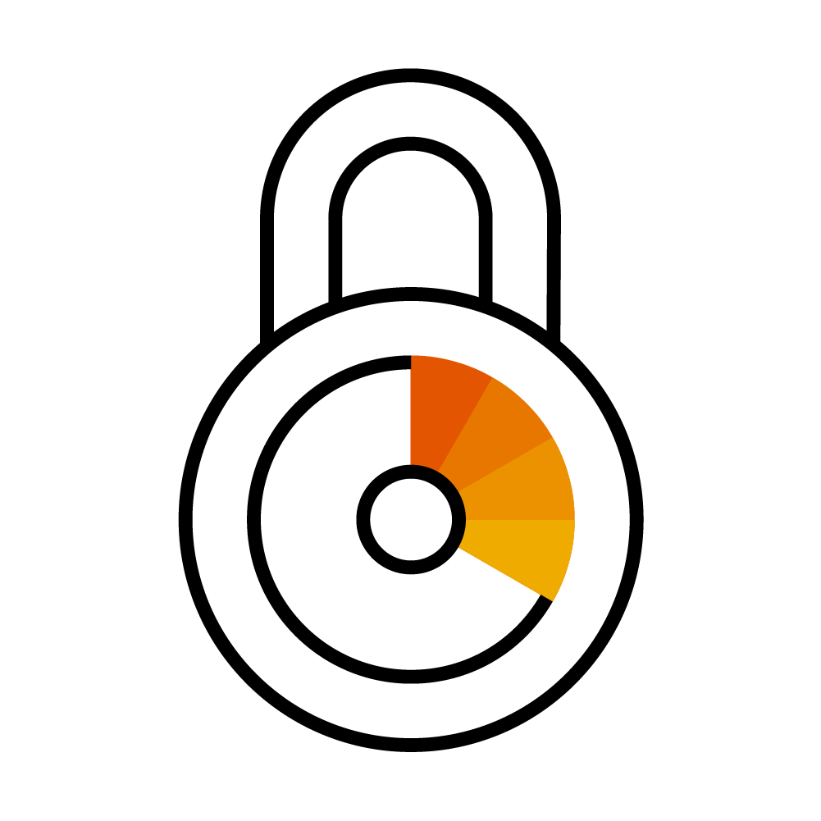
Using Images from a private registry
Kubernetes
Private Registry
Pod A
Image: private.registry.com/my-image:0.1
Notes:
Private registries are usually protect by user & password
Adocker daemon cannot pull images from a protected registry anonymously
=> So there is authentication required, similar to a local docker installation, where you run a docker login <registry>

Slide 10

Image Pull Secrets
Kubernetes
Private Registry
Pod A
Image: <>
ImagePullSecret: <>
Image Pull Secret
kubectl create secret docker-registry <name>
--docker-server=<>
--docker-username=<>
--docker-password=<>
--docker-email=<>
Notes:
Image Pull Secrets contain the same info as .docker/config.json & works similar to ‘docker login …’
ImagePullSecrets can be specified as part of the PodSpec: https://kubernetes.io/docs/reference/generated/kubernetes-api/v1.12/#podspec-v1-core
Without such a secret, the pod will end in an error state because the image cannot be downloaded

Slide 11
Image Pull Secrets
Kubernetes
Private Registry
Pod A
Image: private.registry.com/my-image:0.1
service account
“default”
Image Pull Secret
Notes:
Editing every single pod specification is cumbersome and might introduce dependencies you want to avoid.
The easier way is to assign the image pull secret to the default (or any other) service account.
As explained earlier, the service account gives its’ identity to the pod. Hence the pod can use the image pull secret implicitly.

Slide 12
Image Pull Secret together with Artifactory
Corporate Network
Docker build
Docker build
Docker push
DMZ Artifactory
Repository “test”
Docker pull
Image Pull Secret
Image Pull Secret
K8s @GCP
K8s @Azure
Notes:
How could an example look like?
Imagine, you develop locally and push your ready docker images to the artifactory in DMZ. To do so, you probably use your personal credentials to the registry and the target repository.
To deploy your application to Kubernetes, you write a deployment and specify the image you pushed to artifactory. When posting the deployment to the API server, the pod creation fails as the image cannot be downloaded – permission denied.
So next, you create an Image Pull Secret with the credentials of a technical user and attach it to the default service account of your namespace. Now the docker daemons on your nodes can download the image.

Slide 13

Runtime Constraints for Pods

Slide 14


How to prevent apps to wreak havoc?
Limit CPU & memory consumption
Limit resource consumption
Prevent container from accessing the host & limit the blast radius
Add security constraints
Notes:
The pod & container spec provide several options to prevent security issues.
Firstly, it is possible to limit the resource consumption of each container. This way it is not possible to consume all the resources of a host.
Secondly, you can specify certain security aspects, such as allowed capabilities, access to the underlying host or the user-IDs which are allowed in the context of the container. This will be part of the next presentation.

Slide 15
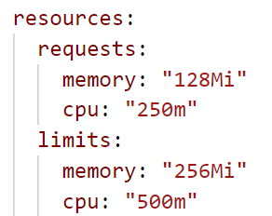
Constrains on pod level:
Field: .spec.containers[].resources*
Explicitly requesting resources and specifying limits help to schedule a pod
https://github.com/kubernetes/community/blob/master/contributors/design-proposals/node/resource-qos.md
Notes:
Resources are specified on container level.
It is a very good practice to specify the limits as well as the “initial” requests for cpu and memory. Request information make scheduling a lot easier.
CPU can be quantified as 1-n CPU (vCPU/vCore for cloud, hyperthread for bare-metal Intel processor) or a fraction of 1. Fractions are specified as in two different notations 0.25 (one quarter of a CPU) or 250m (250 millicpu), but both are understood as the same value.
Memory is measured in bytes. It is possible to express it as integer, abbreviate with E, P, T, G, M, K or use the power-of-two equivalents Ei, Pi, Ti, Gi, Mi, Ki

Slide 16
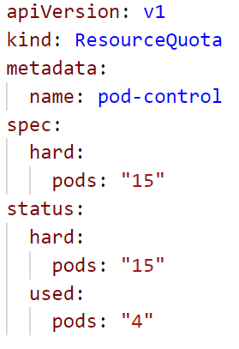
Policy: ResourceQuota
Used to define limits on different resources in a namespace.
namespaced Resource
Set “hard” limits on resources like
Pods
Number of PVCs
Memory (of all pods combined)
More information here.

Slide 17
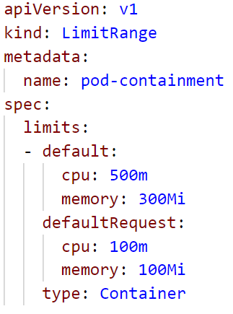
Policy: LimitRanges
Each pod consumes a certain amount of cpu or memory.
LimitRanges are used to enforce specification of cpu & memory resources
It can specify default values that are applied to every container in a namespace (can be overwritten / explicitly specified resources take precedence)

