Slide 1
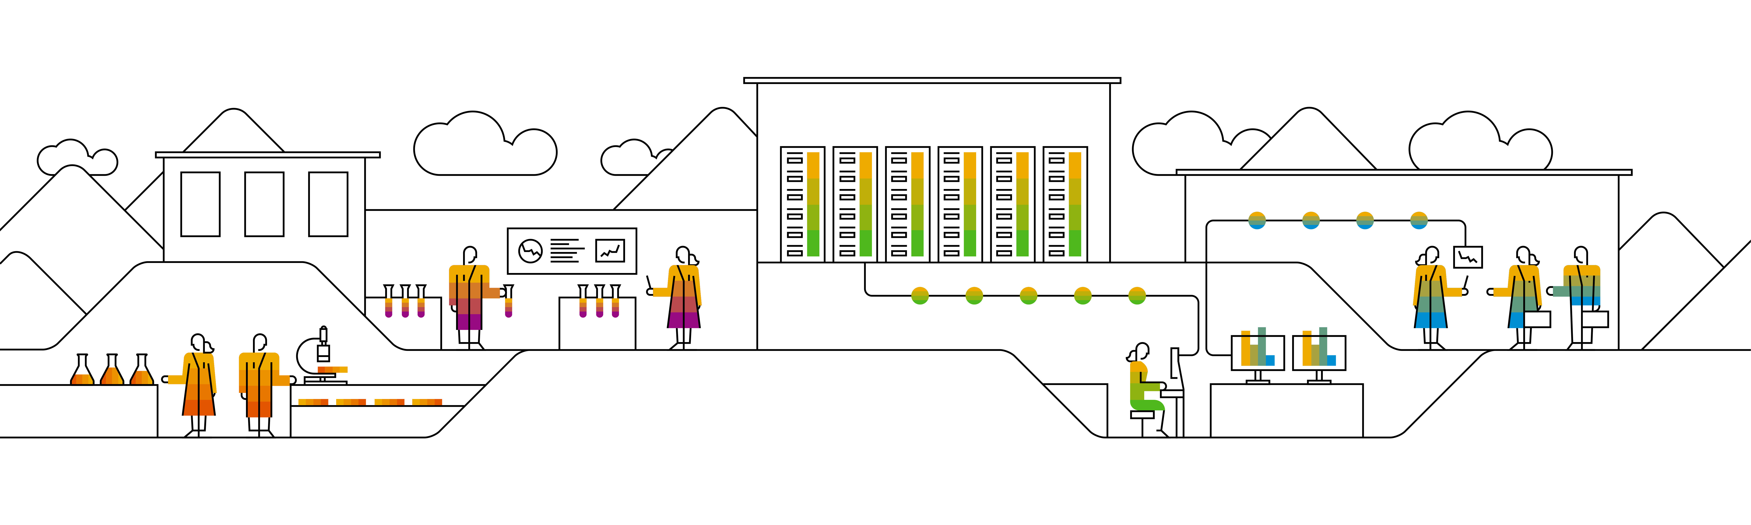

Kubernetes Networking and services

Slide 2
Objectives of k8s networking
all Pods can communicate with all other Pods without using network address translation (NAT).
all Nodes can communicate with all Pods without NAT.
the IP that a Pod sees itself as, is the same IP that others see it as.
https://sookocheff.com/post/kubernetes/understanding-kubernetes-networking-model/

Slide 3
Scenarios of k8s networking
Highly coupled container to container communication
Pod to pod communication
Pod to service communication
Egress / ingress communication with the internet
Cluster internal DNS resolution
Notes:
Based on the objectives, we can derive a few scenarios which the k8s network stack should be able to run.
The container to container communication is achieved by having all docker container joining the same linux namespace for networking. This way they can use the localhost interface to communicate.
Pod to pod communication is also achieved with docker means & the overlay network
For services the cluster is heavily using ip_tables to manage netfilter and re-write IP addresses. In future IPVS might substitute ip_tables. The kube-proxy component is helping to maintain all of these.
Traffic to and from the internet is usually exposed via ip_tables and or network address translation.
It is also reasonable to have a cluster internal DNS resolution. There is a DNS service deployed to our training cluster.

Slide 4
Pod communication
Docker
bridge into host network & local subnet per host
host port mapping required to communicate with container on different host
Kubernetes – need to communicate regardless of host
Solution:
one subnet for cluster
every pod gets an unique IP from subnet range
All containers in a pod share network namespace (=> get same IP) and communicate via localhost interface with each other
Benefits: no port mapping, every pod can expose default ports (e.g. 80, 443)
Node A
Node B
IP: 10.10.10.1
IP: 10.10.10.2
IP: 10.10.20.1
Pod
Pod
Pod
Notes:
Docker, as used in this course, is ok to use on one host. If more hosts are involved it is getting more and more complex. To mask/cover this, there is a software-defined network (referred to as “overlay network”) added to Kubernetes. It assigns an IP to every pod and manages the routing tables in the back.
So regardless on which node a pod runs, it will be reachable via its unique internal IP.
To enable external exposure a so called “service” resource is needed. Also services can serve as static endpoints internally to bundle several pods of the same kind (like in a load balancing scenario).

Slide 5


Why do we need services?
GET: nasty-koopa 10.10.20.23:80
IP: 10.10.20.23
IP: 10.10.20.42
Pod-Name: nasty-koopa
Pod-Name: evil-koopa
Notes:
Motivation:
Pods are mortal ➔ no suitable endpoints for communication
IP address of a pod might change ➔ efforts to maintain routing tables increases
Need for reliable & stable endpoint

Slide 6
Services – Stable network endpoints
GET: koopa-service 10.30.42.5:80
Service Name: koopa-service
IP: 10.10.20.23
IP: 10.10.20.42
Pod-Name: nasty-koopa
Pod-Name: evil-koopa
Notes:
Services are a logical abstraction of a set of pods serving the purpose (like 3 pods with a webserver).
Services provide cluster-internal as well as external connectivity
Cluster internally, DNS entries are created for services and named ports

Slide 7
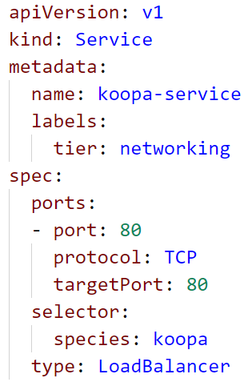
Services
Route traffic via services to talk to a set (1..n) of pods
Target pods are determined by label.selctors similar to deployment <> pods
Services expose ports and forward traffic to mapped target ports of pods
Ports can be named. When using these names the port can change later without any impact
kube-proxy & kube-dns create iptables rules and allow service discovery
To expose a service externally either create allocate a NodePort or use a LoadBalancer
Notes:
Similar to how deployments work, also the service determines its managed pods by labels and corresponding selectors.
A service always maps its own port to a target port on the actual pods. So when your pods exposes port 80 (target port), your service can expose a different port (8080). The service would receive traffic on 8080 and route it to 80 on any pod that fits its selector.
Another feature is the “named” port. You can assign a name to a port and use this in your implementations. If the port changes later, there is no update needed elsewhere as you are referencing it by its name.

Slide 8

Labels & Named Ports
IP: 10.10.10.1
IP: 10.10.10.3
koopa-Pod
goomba-Pod
Port: 80
Name: http
Port: 8080
species=koopa
species=goomba
Service
Selector: species=goomba
TargetPort: 8080
Port: 80
Service
Selector: species=koopa
TargetPort: http
Port: 80
Port: 80
Port: 80
Notes:
Usually a port is referenced by its value – the port number. However the port can be considered an interface and interfaces might change over time.
K8s offers to give a (DNS compatible) name to any port on container & service level. The DNS name is available cluster internally only, as the cluster DNS usually does not connect with an external DNS server.
Once you name ports, you can reference them by name and the value might change over time without impacting the application.

Slide 9
Service types: Cluster IP, NodePort, Loadbalancer
Cluster IP
service is only routable inside the Kubernetes cluster’s subnet
Default service type, every service regardless of its type gets a cluster ip
LoadBalancer
Allocates a publicly routable IP address and forwards incoming requests to the respective service
Dependent on infrastructure provider – might not be available everywhere
NodePort
Allocates a free port from range 30000 – 32767
The port is opened on all nodes of the cluster, incoming traffic is routed to the respective service

Slide 10
ClusterIP services – cluster internal load balancing
Cluster
Use “koopa-service” as DNS name to connect to it
Connect to 10.10.10.1/2/3 ?
nasty-koopa
IP: 10.10.10.1
evil-koopa
Pod
IP: 10.10.10.2
koopa-service
IP: 10.10.20.2
IP: 10.20.10.1
naughty-koopa
IP: 10.10.20.1

Slide 11

Demo
Notes:
If not yet present, create a deployment of an nginx webserver first (kubectl run nginx-demo --image=nginx:mainline)
Create a service
Use “expose” to create a service for your deployment (kubectl expose deployment <name> --port=80 --target-port=80 –type=ClusterIP)
Explain the command and the ports (port = service, target-port = pod)
Show the service with the clusterIP address and associated end points (use kubectl describe)
Scale the deployment up and show again the updated list of end points
Spin up a tmp pod “kubectl run dns-test --rm -ti --restart=Never --image=alpine:3.8”
Do a “nslookup <service name>” and point to the the cluster DNS, every namespace is a subdomain
use the DNS name of a service to download an index.html (i.e. “wget nginx-demo”)
Finally, delete the service

Slide 12
Introducing NodePorts
GET: node:30021
Cluster
IP: 10.20.10.1
Service
Selector: species=koopa
Type: NodePort
TargetPort: 80
Port: 80
NodePort: 30021
NodePort: 30021
Node A
Node B
IP: 10.10.10.1
IP: 10.10.20.1
nasty-koopa
evil-koopa
species=koopa
Port: 80
Port: 80
species=koopa
Notes:
A nodePort is a port that is opened on every node of the cluster. It is associated with a service and any incoming traffic at this nodePort will be routed to the corresponding service. From there it will be forwarded to service’s pods, regardless on which node it they actually run.

Slide 13
Demo
Notes:
Demo for node ports
Again, create a service
Use “expose” to create a service for your deployment (kubectl expose deployment <name> --port=80 --target-port=80 –type=NodePort)
Show the service with the clusterIP address and the nodePort (use kubectl describe)
Highlight, that the service also includes a cluster IP
Connect to the NodePort Service from the outside (of the cluster)
Get the IP address of the cluster’s nodes (kubectl get nodes –o wide)
Combine the node’s IP with the port and access the service
Finally, delete the service

Slide 14
Introducing LoadBalancers
GET: koopa.ondemand.com:80
IP: 35.65.257.1
Port: 80
LoadBalancer
Cluster
IP: 10.20.10.1
Service
Selector: species=koopa
Type: LoadBalancer
TargetPort: 80
Port: 80
NodePort: 30021
NodePort: 30021
Node A
Node B
IP: 10.10.10.1
IP: 10.10.20.1
nasty-koopa
evil-koopa
species=koopa
Port: 80
Port: 80
species=koopa
Notes:
A LoadBalancer is a single network endpoint with a unique IP which will be associated with a service. Incoming traffic to this IP on the service port will be forwarded through the service to the pods matching the labels specified in the service description.
LoadBalancers are an external entity provided to the cluster by Cloud Providers and their actual implementation varies among the different cloud platforms (GCP, Azure, AWS, OpenStack). If your cluster runs in an environment that does not support LoadBalancers, you can still try to create them but their state will remain “Pending” without ever getting an IP.

Slide 15
Demo
Notes:
Demo for Loadbalancer
Again, create a service
Use “expose” to create a service for your deployment (kubectl expose deployment <name> --port=80 --target-port=80 –type=LoadBalancer)
Show the service with the clusterIP address and the nodePort and the external IP (use kubectl describe)
Highlight, that the service also includes a cluster IP and a nodePort
Wait until the external IP is assigned and point out that this involves cluster external mechanisms provided by the underlying infrastructure platform. It might not work the same way everywhere.
Connect to the service from the outside (of the cluster) via the LoadBalancer IP and port 80 (port of the service)
Once again, show that the new node port is working as well / additionally
Get the IP address of the cluster’s nodes (kubectl get nodes –o wide)
Combine the node’s IP with the port and access the service
Finally, delete the service

Slide 16
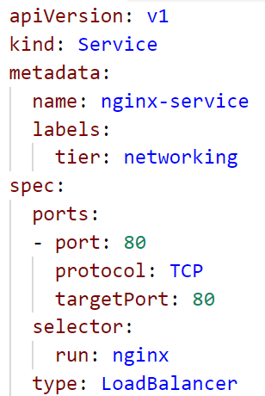
So many different ports…
GET: nginx:80
Chosen at random
Port: 80
LoadBalancer
Port: 80
Service
Selector: app=nginx
Type: LoadBalancer
TargetPort: 80
Port: 80
NodePort: 30021
Node B
IP: 10.10.10.1
Pod
app=nginx
Port: 80
Notes:
A LoadBalancer is a single network endpoint with a unique IP which will be associated with a service. Incoming traffic to this IP on the service port will be forwarded through the NodePorts and the service to the pods matching the labels specified in the service description.

Slide 17
What YOU will do in exercise #04
Make your pods available via a service
nginx
nginx
nginx
content
config
tls certs

