Slide 1
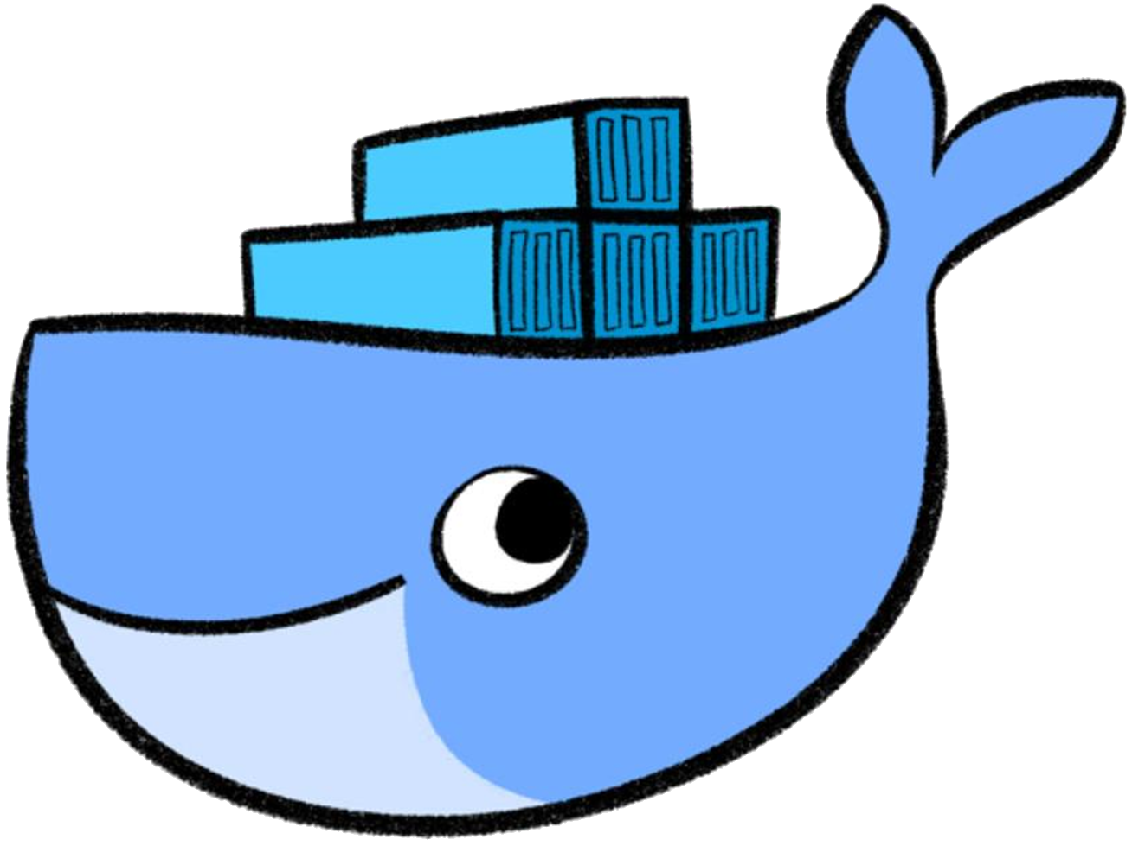
Containers made easy

Slide 2
Linux Features
Namespaces
Isolation of resources per process
7 different namespaces
netfilter
Firewall and packet manipulation
cgroups
Manage resource allocation
Netlink
Interprocess communication between containers
SELinux/AppArmor
Security profiles to govern access to resources
capabilities
Granular control of privileges
seccomp
Limitation of syscalls to processes
Docker Runtime
dockerd
Container
Container
Container
Container
Linux
namespaces
Netlink
SELinux
netfilter
seccomp
capabilities
cgroups
AppArmor
Hardware
Notes:
Containers make heavy use of features that are offered by the Linux kernel. These features are going to be described in detail on the following slides.

Slide 3
Let’s start our first container… the easy way!
$ docker run container
cgroups resource limitation
chroot filesystem isolation
namespaces process isolation
seccomp & capabilities additional security
iptables network routing
and more…
Notes:
You actually specify an image name as argument of the docker run but that will be explained in the next few slides.

Slide 4


Images
Images are filesystem snapshots that function as the root filesystem of a container at startup + some metadata.
They can be
pulled from a registry
created from a Dockerfile or by committing changes.
Images consist of several layers that are stacked upon each other.
$ docker images
REPOSITORY TAG IMAGE ID CREATED SIZE
test_nginx latest ee56ce14b382 3 days ago 108MB
<none> <none> 2af6607c94b9 13 days ago 108MB
debian latest 6d83de432e98 4 weeks ago 100MB
busybox latest 6ad733544a63 4 weeks ago 1.13MB
$

Slide 5
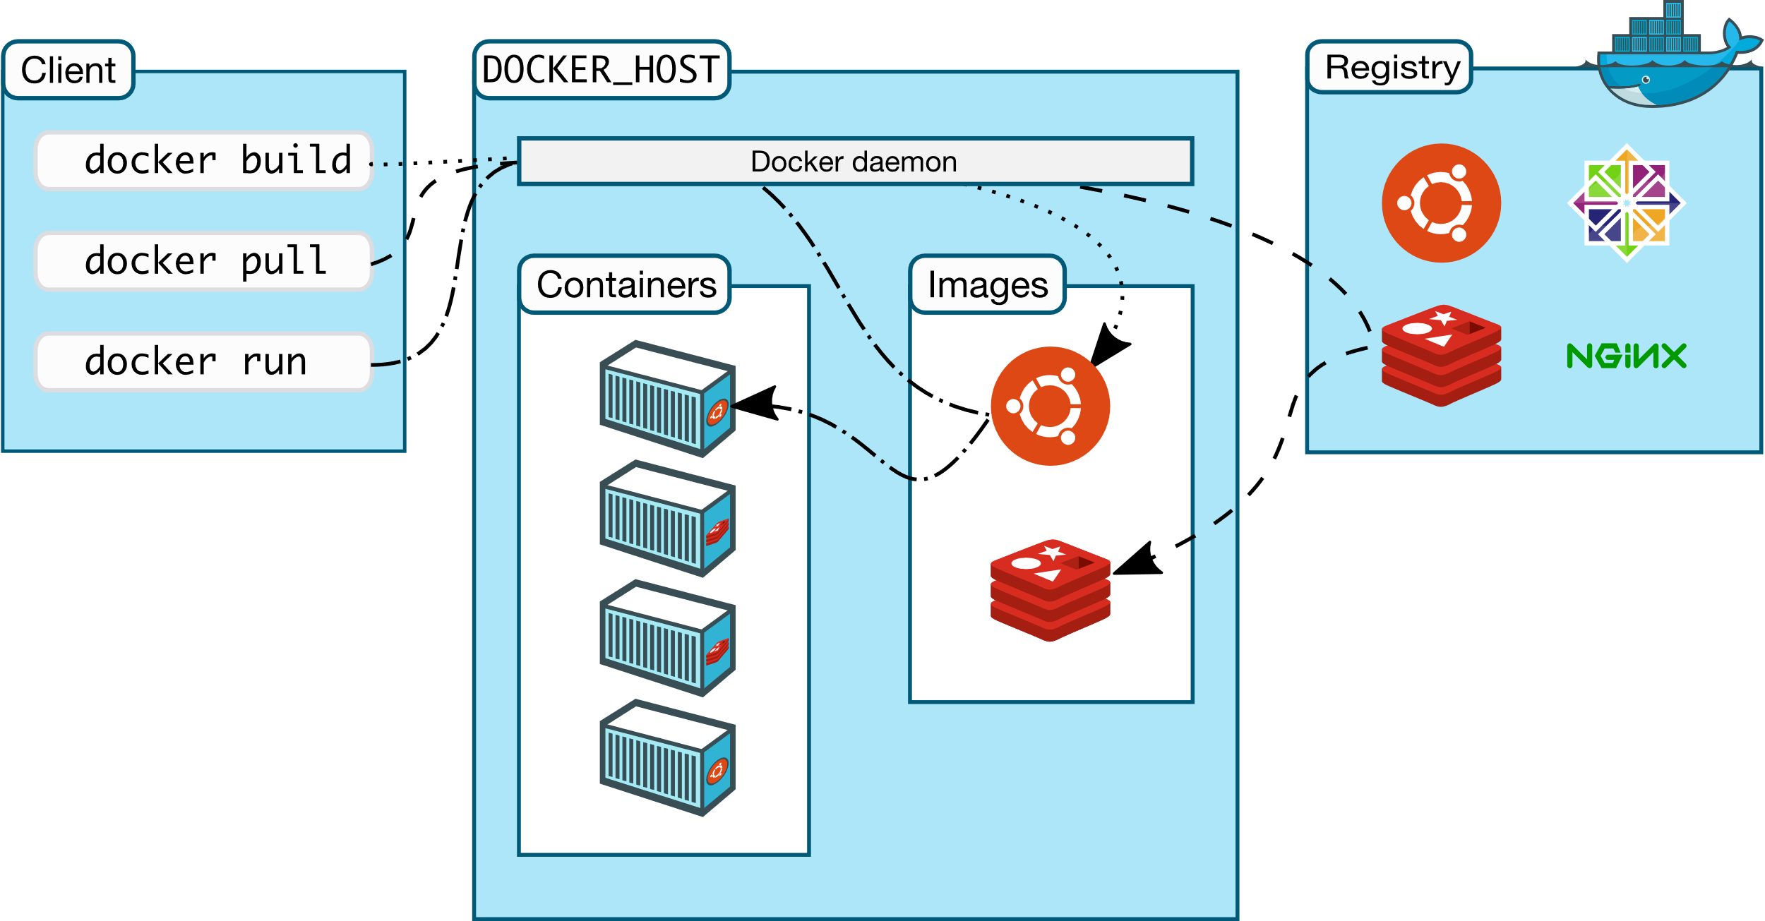
Docker eco-system
https://docs.docker.com/engine/docker-overview/
Notes:
Docker offers more than “just” running containers. It brings a complete eco-system of building, persisting and sharing containers.
The client triggers the docker host to execute actions related to container lifecycle, but also building, downloading & sharing images. The Docker Registry concepts allows to store images permanently. The most famous registry is the docker hub.

Slide 6

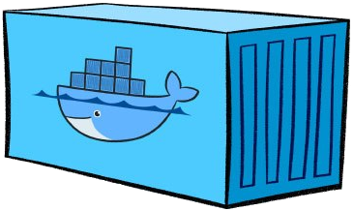
Docker‘s client/server architecture
Client
DOCKER_HOST
docker run
ReST
Docker daemon
docker pull
docker build
Docker ...
Docker client instructs Docker daemon what to do – the real hard work is done by the Docker daemon
Notes:
Docker is a client-server architecture. The docker command you use to interact with Docker does nothing but talk to the Docker daemon. All the magic of pinning up containers, downloading images and even building images is done inside the Docker daemon. Communication between the Docker client and the Docker daemon happens through a ReST API over http/https.
If both, docker client and docker daemon, run on the same host, communication will take place through a socket file (/var/run/docker.sock). It is however also possible to have the Docker client on your local laptop and the Docker daemon on a computer somewhere totally different. In that case, communication goes through TCP, the target port on the Docker daemon will be 2375 for unencrypted HTTP and 2376 for TLS secured HTTPS.
Note:
If you want to talk to dockerd directly, you can do so using curl (you will need curl and libcurl >= 7.40): curl --unix-socket /var/run/docker.sock http://localhost/containers/json
Or use your web browser if you enabled dockerd‘s TCP socket: http://<hostname>:2375/containers/json

Slide 7

A look into the docker engine
Docker daemon is the central entry point for all API requests
dockerd
Container runtime to handle container lifecycle based on OCI specs
containerd
shim process which takes over parent ownership of a running container
containerd-shim
containerd-shim
containerd-shim
runc
runc
runc
runc actually starts the container
Notes:
The docker daemon works as central entry point. It receives API requests and is home of docker specific features.
Containerd actually is the container runtime. It is a refactored part of the former docker engine and handles the complete lifecycle of a container. It works on the basis of the open container initiative (OCI) specifications for container runtimes. Containerd also depends on OCI compatible images (root file system + container.json)
Containerd instructs runc to start a container. Runc sets up all the linux magic with cgroups etc and forks the container’s PID #1. Afterwards it will exit(0) and handover parent ownership of the container to containerd-shim. The shim module is there to decouple the daemon and container processes.
Details can be found here:
https://containerd.io/
https://www.slideshare.net/PhilEstes/diving-through-the-layers-investigating-runc-containerd-and-the-docker-engine-architecture
https://hackernoon.com/docker-containerd-standalone-runtimes-heres-what-you-should-know-b834ef155426?gi=c8140ae48de2

Slide 8



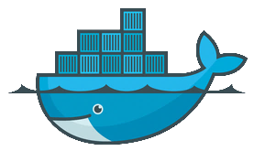




Open Container Initiative
Engines
Runtimes
OS
gVisor
Notes:
There are many different ways how container are build and run. The open container initiative aims to establish a container standards like a common image format. Based on these standards compatible container engines and runtimes can be build.
Though we are mainly talking about Docker, there are more container engines available.
Rocket (rkt) – formerly build by CoreOS it is now part of RedHad -> IBM. Future is unknown…
Docker – currently the standard container engine for most at SAP
Cri-o – lightweight alternative to Docker when used with Kubernetes. Compatible with OCI specs
As seen on the previous slide, docker delegates the actual scheduling of a process to runC as the container runtime. RunC can be replaced by other compatible tools like:
gVisor
kata
Both add more virtualization to achieve a higher level of isolation / security and to shield the host OS kernel
Since container usually bring their own libs and tools an operating system hosting these container has a different set of requirements. It should run stable, be immutable / have quick patch cycles and in general have only those tools & libs that are required to run a container. A full-blown Ubuntu with a package manager and a variety of pre-installed tools can also host a container runtime, but most of the features are never used.
There are different minimal OS to host container:
coreOS – container linux
Atomic host by RedHat
…

Slide 9
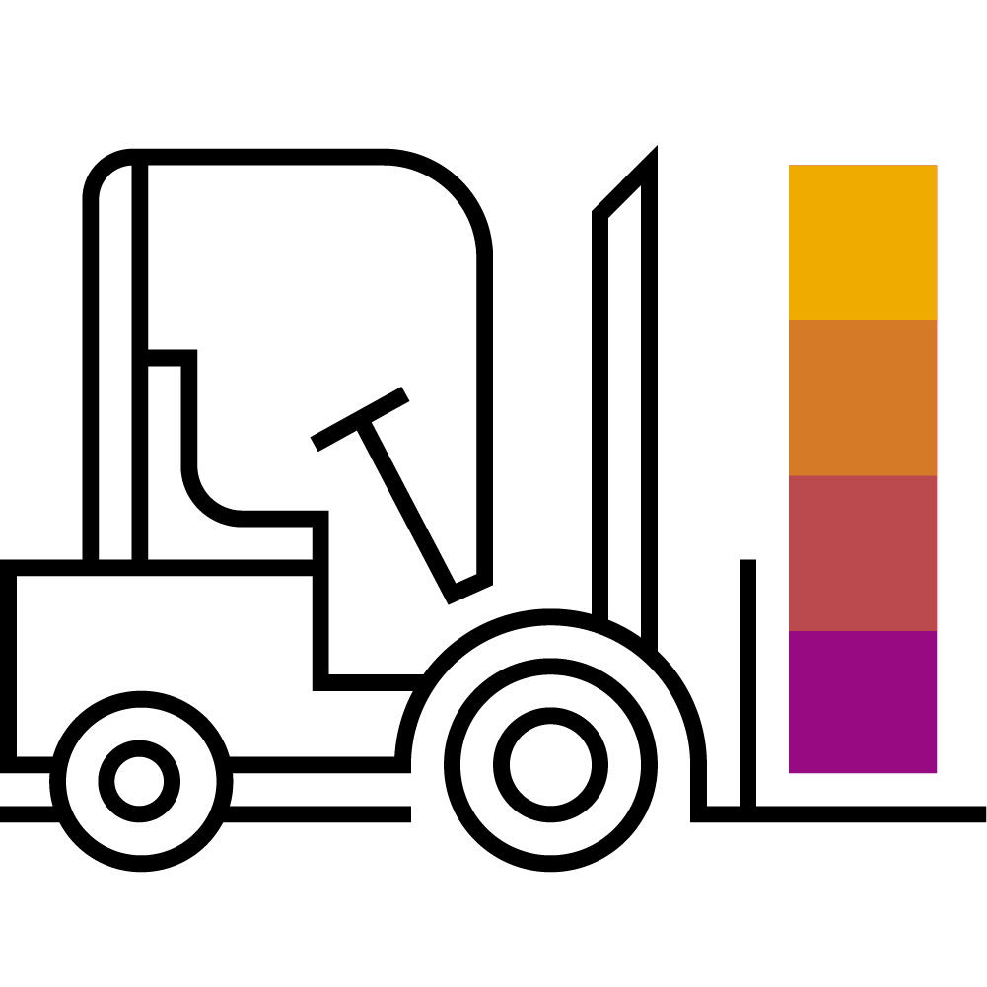
Working with Containers

Slide 10
Lifecycle of a container
Image
PHP
Apache
docker run
Busybox
Base Image (e.g. Debian)
docker create
docker start
writable layer a320d5f4bd36
writable layer a320d5f4bd36
docker start
docker stop
docker rm
writable layer a320d5f4bd36
writable layer a320d5f4bd36
Notes:
When talking about a “container”, we are referring to the combination of read-only layers from the image and one read-write layer on top of it. You can derive / instantiate an indefinite number of containers from the same image. They only vary by the read-write layer on top. Or stated another way: A container consists of just the read-write layer, some meta data (settings, flags pass on start) and a reference to the image. All containers share only one common image.
The container lifecycle illustrates, what happens to this read-write layer. With “docker create” you tell docker to create such a read-write layer. With “docker start” you bring it to life, meaning a process with ID 1 is started. The “run” command combines “create” & “start”.
Once you have the read-write layer everything that happens inside the container is stored there. You can “stop” the container (killing PID 1) and re-start it. Since all these operations happen on the same read-write layer, everything you did when the container ran, is still present.
But if you “rm” the read-write layer everything is irretrievably gone.

Slide 11

Demo
Notes:
Now that you talked about the theory, it’s time for a demo.
Get started by introducing the docker cli a bit more detailed.
Simply run “docker” and explain the output & where to get more info for each command
Talk about the container, image, volume and network sub commands ➔ they grant access to management of the respective objects (create, remove, list, …)
Let’s discuss a few things more detailed.
“docker run” was already used by participants, but do execute it again → docker run -it docker/whalesay cowsay boo
let’s see where these containers ended up: docker container list –a
Explain the –a flag
Access the logs of your whalesay container
Re-start you whalesay container & show logs again
Point out that it’s still the same read-write layer
Execute the docker run layer again and highlight that it’s a new rw layer now
Finally, remove the container(s) with prune

Slide 12
Detached, interactive, tty, tt-what?
docker run –i –t ubuntu /bin/bash
docker run –d ubuntu /bin/httpd
stdin
Keyboard
stdin
Keyboard
Process
Process
Display
Log collector
stdout
stderr
stdout
stderr
Running an interactive session requires -i & -t :
-t allocates a pseudo-tty, -i keeps stdin open.
Running a detached session keeps process 1 alive without stdin open.
Notes:
First, lets take a look at how terminals used to work. The standard input stream (stdin) is used to send input to the process. The standard output and error streams send the output to a terminal to display (as text).
Docker allows to use stdin interactively and receive the results via stdout/stderr. To keep stdin open, the –i flag is required (interactive). To capture the output accordingly a pseudo-tty is required. Use –t to allocate it. Try to run “docker -i ubuntu:18.04” – you will be able to type (something like “exit”) but you don’t see the output. Try the same again, but adding a “-t”. You will be able to type & see what happens.
Use the combination of interactive and tty (combine to –it) when you start a shell or anything else that requires input.
Docker also allows to start containers in the background (similar to a linux processes started in background). No output will be sent to the user but captured for logging (check the container logs, if there are any). Use the –d switch ('daemon') to run the process in background and check with “docker ps”.
Use the detached mode to run daemons or applications that have a control loop like a websever.

Slide 13
Demo
Notes:
Interactive vs detached:
Run an alpine:3.8 container with the –it flag. You can now interact with the shell.
Run a nginx:mainline container with the -it flag. You’re now connected to PID #1 of the container but it’s a daemon process, so you cannot do anything. Abort or detach from it.
Run a docker inspect on the nginx image and show the cmd / entrypoint: docker image inspect nginx | grep -i cmd
Briefly discuss the inspect command
The cmd specifies what happens upon container start -> the webserver is started and keeps running in an endless loop.
That’s why you probably want to start in detached mode -> docker run –d nginx:mainline
Show the running container with docker container list
Finally, exec into the container and explain the exec command

Slide 14
Information about containers
Available / present containers
the command docker container list gives a list of all running containers on a host (use –a to see terminated containers as well)
$ docker ps –a
CONTAINER ID IMAGE COMMAND CREATED STATUS PORTS NAMES
dded97d9a7d6 docker/whalesay "cowsay 'Rick Astley'" 8 minutes ago Exited (0) 8 minutes ago ecstatic_goldstine
b69038e9ff35 busybox "sh" About an hour ago Created admiring_ritchie
e7a7aeca8c41 test_nginx "nginx -g 'daemon ..." 4 days ago Exited (1) 24 hours ago pensive_elion
494b7b8c9f39 mynginx1 "nginx -g 'daemon ..." 7 days ago Up 24 hours 0.0.0.0:32768->812/tcp happy_ride
image
creation time
forwarded network ports
unique ID for each container (truncated)
program that runs within the container
friendly name
current status and exit code
Notes:
The container IDs reference the read-write layer on top of the immutable read-only image layers.
The UUID has 64 digits but is truncated to just 12 digits, use --no-trunc to see all of them.
A stopped container retains the state of its r/w file system layer (you see them when you start the container again).

Slide 15
Executing commands in a container
It is possible to run additional commands in a container
Useful for debugging
Command must be present in the container
Interactive/detached mode – also applies here
$ docker container exec –i –t <container ID or name> <command>
$ docker exec -i -t 494b7b8c9f39 /bin/sh
# ls -al /usr/sbin/nginx
-rwxr-xr-x 1 root root 1253840 Nov 21 14:28 /usr/sbin/nginx
# exit
$
Notes:
To be able to connect to the container in an interactive shell session, again -i and -t are required. They can be combined to -it.

Slide 16
Getting logs from a container
Docker collects logs from programs inside containers
stdout and stderr of the main process get collected
logs from programs can be redirected to /dev/stdout and /dev/stderr
logs still available even after a container terminated
$ docker logs <container ID or name>
$ docker container logs 494b7b8c9f39
10.19.91.230 - - [01/Dec/2017:14:48:12 +0000] "GET / HTTP/1.1" 200 230 "-" "Mozilla/5.0 (Windows NT 10.0; Win64; x64; rv:57.0) Gecko/20100101 Firefox/57.0" "-"
10.19.91.230 - - [01/Dec/2017:14:48:12 +0000] "GET /it_works.jpg HTTP/1.1" 200 25676 "http://pvxka22:32780/" "Mozilla/5.0 (Windows NT 10.0; Win64; x64; rv:57.0) Gecko/20100101 Firefox/57.0" "-"
2017/12/01 14:48:12 [error] 8#8: *1 open() "/srv/www/htdocs/favicon.ico" failed (2: No such file or directory), client: 10.19.91.230, server: localhost, request: "GET /favicon.ico HTTP/1.1", host: "pvxka22:32780"
10.19.91.230 - - [01/Dec/2017:14:48:12 +0000] "GET /favicon.ico HTTP/1.1" 404 169 "-" "Mozilla/5.0 (Windows NT 10.0; Win64; x64; rv:57.0) Gecko/20100101 Firefox/57.0" "-“
$

Slide 17
Stopping a container
A container can be forcibly stopped
necessary for containers with daemon processes
friendly termination with SIGTERM, after timeout (default 10 seconds) with SIGKILL *
$ docker stop <container ID or name>
$ docker container list
CONTAINER ID IMAGE COMMAND CREATED STATUS PORTS NAMES
494b7b8c9f39 mynginx1 "nginx -g ..." 7 days ago Up 24 hours 0.0.0.0:32768->812/tcp happy_ride
$ docker container stop -t 5 happy_ride
494b7b8c9f39
$ docker container list
CONTAINER ID IMAGE COMMAND CREATED STATUS PORTS NAMES
$
* you can specify wait time between SIGTERM and SIGKILL with the "-t" option

Slide 18

Removing a container
Finally, a container can and should be removed
all data in the container that was not part of the image is lost
when a container is removed, it is gone
removing an active container must be forced and will kill it
$ docker rm <container ID or name>
$ docker container list -a
CONTAINER ID IMAGE COMMAND CREATED STATUS PORTS NAMES
dded97d9a7d6 docker/whalesay "cowsay 'Ri..." About an hour ago Exited (0) happy_pony
9682e4fba8b7 busybox "sh" 25 hours ago Up 25 hours elated_saha
$ docker container rm 9682e4fba8b7 dded97d9a7d6
dded97d9a7d6
Error response from daemon: You cannot remove a running container…
$ docker container rm 9682e4fba8b7 --force
9682e4fba8b7
$ docker container list -a
CONTAINER ID IMAGE COMMAND CREATED STATUS PORTS NAMES
$

Slide 19

Exercise #1 – Container Lifecycle

Slide 20
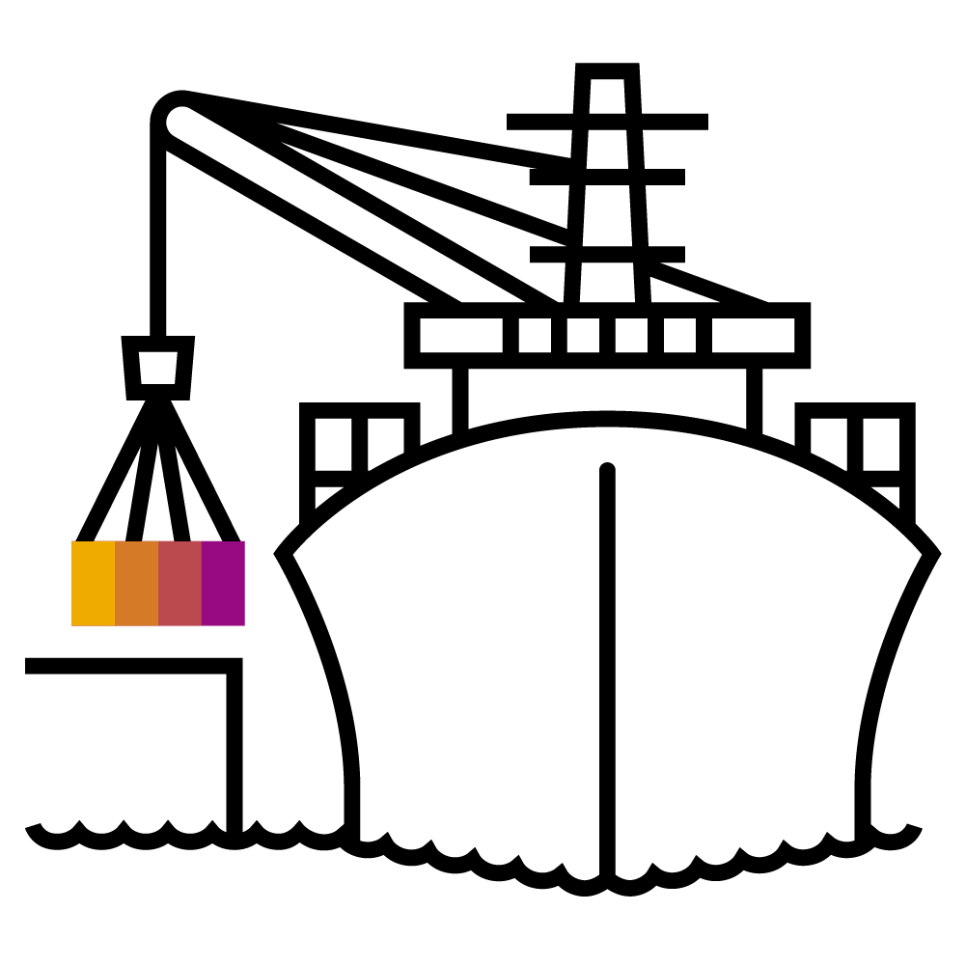
Ports and Volumes

Slide 21
Docker networking
HOST
DOCKER_HOST
nginx
Containers in isolated network
private network 172.17.0.0/16
Containers can see each other
Not reachable from outside
NAT to connect to the outside world
nginx
nginx
:80
:80
172.17.0.2
172.17.0.3
172.17.0.0/16
172.17.0.1
:80
:81
:80
192.168.2.42

Slide 22
Port forwarding
Port forwarding
Port forwarding to host
docker run -p <host port>:<container port> …
Containers expose ports, can be mapped automatically
docker run -P …
Exposed ports can be inspected
nginx
:80
NAT
:81
Notes:
Every docker host spins up a local private network. A container will get an IP address form this network to be reachable locally. So as long as all container are on the same host, they can communicate via this network.
However, this is a very unlikely scenario. Probably there are more hosts involved or you want to expose your application to the outside. Docker supports network address translation (NAT) to map a <container_ip>:<port> to a port on the external network interface of the docker host. If you have a container with 172.16.0.2:80 locally it could be exposed to the outside on 192.168.52.1:32710 (ip address of the docker host + unused port).
This feature is called port forwarding and docker knows two flavors of it.
Map a dedicated host port to a container port – this has to be specified manually. So you have to keep track of all your used ports in order to avoid conflicts. Use the “-p” (lower case) switch and specify host port & container port.
Map a random port to a container port. Use the “-P” (upper case) switch. Docker detects the ports a container exposes and automatically assigns an unused port. Check with “docker ps” or “docker container list”, which port was assigned.

Slide 23
Demo
Notes:
Let’s get back to our nginx examples.
Docker run -d -p 8081:80 nginx:mainline
Access the nginx on port localhost:8081
Run the same with -P and get the port via docker container list
Access the nginx via the random port
It’s important to remember – the first port is referencing the port that is opened on the docker host, the 2nd port is referencing the container port.
Talking about networking:
Docker network list
Show the different docker networks and create a new bridge network (docker network create test)
If you want to wire 2 containers, you have to put them into the same docker network. But be careful, DNS resolution doesn’t work in the default network!
Spin up a nginx: docker run -d --name nginx --network test nginx:mainline
Spin up a helper: docker run -it --name helper --network test alpine:3.8
From within the helper container, show the dns resolution : nslookup nginx
And connect to the webserver: wget nginx
Show the downloaded index.html page: cat index.html
So actually it is possible to wire container with docker directly, but kubernetes will make things easier ☺

Slide 24
Demo: Sample
HOST
DOCKER_HOST
Containers in isolated network
private network ‘test’ (172.18.0.0/16)
Containers can see each other
Not reachable from outside
NAT to connect to the outside world
nwnginx
nwhelper
:80
172.18.0.2
172.18.0.3
test: 172.18.0.0/16
172.18.0.1
:80
192.168.253.132

Slide 25
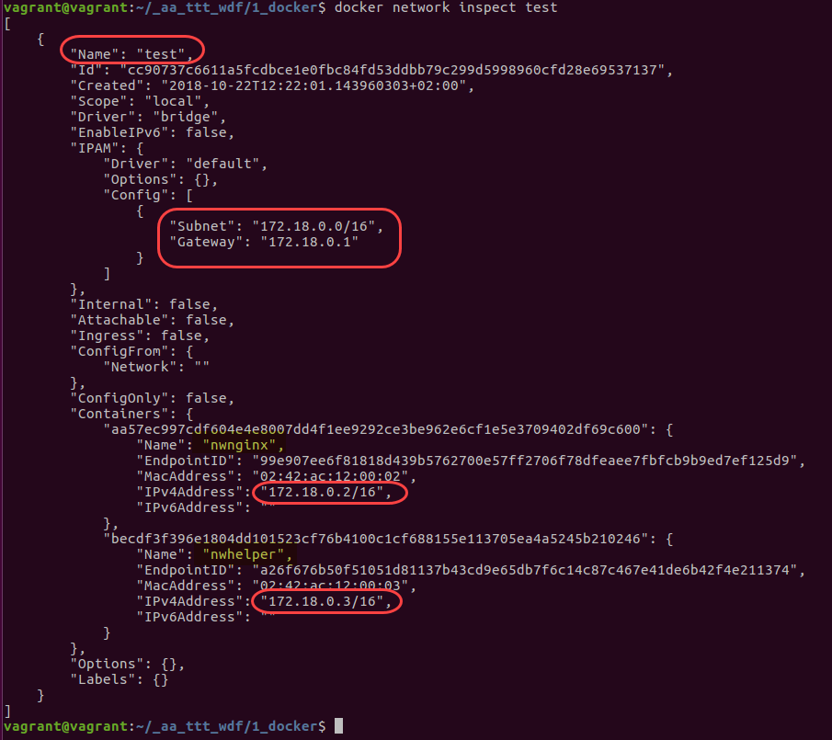
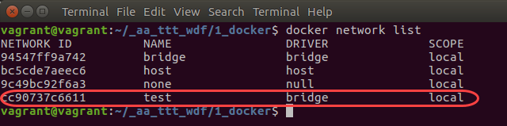
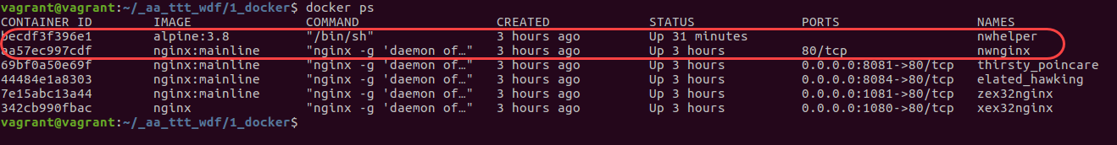
Demo: Sample

Slide 26

Volumes
Container
Local Filesystem
Bind mounts
Hides everything in destination directory
Named volumes
Contents in container are merged with volume
No straightforward access from host
writable layer
Image
wiki-server
golang
Alpine
Volume mount
Notes:
Since it is not recommendable to store data in a docker container, adding a persistence is quite important. With the volumes API it is possible to assign persistent storage to a container.
Docker supports 2 ways of doing so:
Bind mounts: mount a local host directory onto a certain path in the container. Everything that was present before in the target directory is hidden (nature of the bind mount). For example, if you have some configuration you want to inject, write your config file, store it on your docker host at /home/container/config and mount the content of this directory to /usr/application/config (assuming the application reads config from there).
Command: docker run –v <source path>:<container path> …
Named volumes: docker can create a separated storage volume. Its lifecycle is independent from the container but still managed by docker. Upon creation, the content of the mount target is merged into the volume.
Command: docker run –v <vol name>:<container path> …
How to differentiate between bind mounts and named volumes?
When specifying an absolute path, docker assumes a bind mount.
When you just give a name (like in a relative path “config”), it will assume a named volume and create a volume “config”.
Note: Persistent storage is 'provided' by the host. It can be a part of the file system on the host directly but also an NFS mount.

Slide 27
Volumes
Persistent storage in containers
Filesystem in containers is not persistent
Volumes used add outside storage to containers
bind-mounts vs. volumes
Bind mounts
Hides everything in destination directory
docker run –v <source path>:<container path> …
Named volumes
Contents in container are merged with volume
No straightforward access from host
docker run –v <vol name>:<container path> …
Notes:
Since it is not recommendable to store data in a docker container, adding a persistence is quite important. With the volumes API it is possible to assign persistent storage to a container.
Docker supports 2 ways of doing so:
Bind mounts: mount a local host directory onto a certain path in the container. Everything that was present before in the target directory is hidden (nature of the bind mount). For example, if you have some configuration you want to inject, write your config file, store it on your docker host at /home/container/config and mount the content of this directory to /usr/application/config (assuming the application reads config from there).
Named volumes: docker can create a separated storage volume. Its lifecycle is independent from the container but still managed by docker. Upon creation, the content of the mount target is merged into the volume.
How to differentiate between bind mounts and named volumes?
When specifying an absolute path, docker assumes a bind mount.
When you just give a name (like in a relative path “config”), it will assume a named volume and create a volume “config”.
Note: Persistent storage is 'provided' by the host. It can be a part of the file system on the host directly but also an NFS mount.

Slide 28
Demo
Notes:
Volumes are the docker way to work with any kind of persistent data.
Let’s start simple and (bind) mount a directory into a container. Therefore assume you have a toolbox container and you need some environment in there (like a config file or ssh keys).
docker run -it -v /home/vagrant:/mnt/home alpine:3.8
Show the content of /mnt/home, which would be you’re home directory
Let’s see what else you could do with a bind mount:
Docker run -it -v /home/vagrant:/etc alpine:3.8
What happens? Well, our home directory is mounted to /etc. The original content of /etc is still there but hidden.
Of course you can also inject a nginx index page or any configuration this way, but that’s part of the exercise ;)
Let’s move on to docker volumes. When working with a container, you might want to persist some data during runtime. For this example you will use a Jenkins and make it’s home a volume.
docker run -d -P -v jenkins_home:/var/jenkins_home jenkins/jenkins:lts
Next, get the ports and connect the port that forwards to container port 8080
On the jenkins logon page, you’re asked for a password, run “docker logs <container name>” and obtain the logon token
Logon to the jenkins and choose “select plugins to install”, select “none” (upper left corner) and continue.
Create a user e.g ‘root’ with a simple password and finish the setup.
Now stop the container and restart it – obviously you’re still able to logon with the credentials created before.
Finally, delete the container and with that also the RW layer and re-execute the docker run jenkins command.
Connect to your new jenkins (get the ports before) and logon with the same credentials as you’re still referring to the same jenkins home.
Inspect the jenkins_home volume (docker volume inspect jenkins_home) and go to it’s path (probably you need to be root for that) and show the content.
Highlight, that the volume upon creation was empty. With the first start of jenkins, content was written to it. However when launching the 2nd jenkins container the content was not overwritten / re-initialized. So if you need to persist some initial data, a named volume might be useful.
Downsides: it’s hard to move a volume to another host, but the k8s storage api will provide better ways of adding persistence.

Slide 29
Exercise #2 – Ports and Volumes

