Slide 1
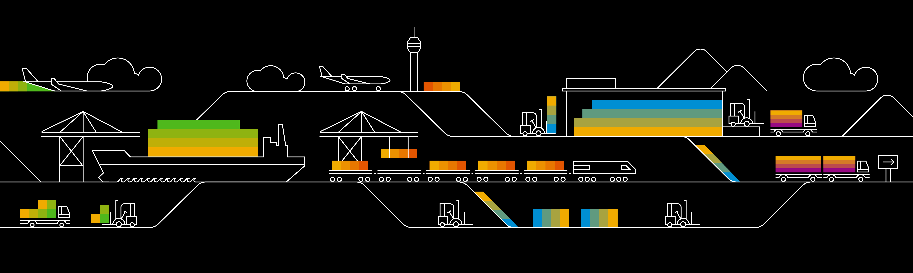
Kubernetes & helm

Slide 2
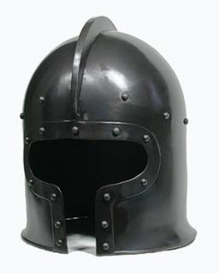

What’s this “helm”?
?
Helm is the “apt-get” for Kubernetes
Preconfigured & parameterized packages of Kubernetes resources
Designed to manage applications with several isolated components
Supports “release management” with updates & roll-backs
Initially build by Deis (a Microsoft company), handed over to CNCF by now

Slide 3
Helm architecture
Client side: helm
Applications are organized in “charts”
Tells tiller-server what to do
Server side: tiller
Installs charts into “releases”
Manages state of all releases
Namespace
Pod A
Chart
K8s yaml
values
dependencies
helm client
tiller-server
release
“my_app”
secrets
Pod B
.kube/ config
Notes:
Helm has to components, the locally running client and the tiller-server. When you run “helm init” it will try to use the kubeconfig to access the cluster and deploy the tiller-server. But be careful with namespaces and specify where your tiller-server should run.
To use helm, you need the pre-packages software in so called charts. A chart is a description of how to deploy & parameterize an application. This includes yaml templates for pods, services or configMaps.
Upon installation of the chart, there is a go-templating engine evaluating the given parameters and substituting variables.

Slide 4
Helm charts
Packages of predefined, parameterized K8s resources are called “charts”
wordpress/
Chart.yaml - A file containing information about the chart
requirements.yaml - A file listing dependencies for the chart
values.yaml - The default configuration values for this chart
charts/ - A directory containing any charts upon which this chart depends.
templates/ - A directory of templates that, when combined with values, will generate valid Kubernetes manifest files.

Slide 5
Working with helm
Chart repository
- helm repo update
- helm search <chart>
- helm fetch <chart>
Namespace
Pod A
helm client
tiller-server
release
“my_app”
.kube/ config
secrets
Pod B
- helm install <chart> <parameter>
- helm list
- helm status <release>
Notes:
Helm charts can be stored locally or in a repository.

Slide 6

Demo
Notes:
Start with showing the helm binary – simply run “helm” without anything else
If not yet done, run a “helm init” to deploy tiller. But probably there is already a tiller from the time when you created the registry.
Show the tiller pod in kube-system namespace. Explain, that for helm init, participants should target their own namespace. Otherwise they will connect to the same tiller. Highlight that in order to setup tiller with cluster access (i.e. outside of it’s namespace a clusterrolebinding is required)
Run “helm list” to show the already installed charts and explain that they are called a “release”.
To prepare the next exercise, explain that an empty return (still rc=0) is ok to validate that tiller installed & ready. If not, you would get an error message.
Next move on to the question, wherefrom to get charts:
Open https://github.com/helm/charts in a browser
Talk about the different “levels” – currently incubator, test & stable and go to stable
Pick up any chart (e.g. mongo db or wordpress) and go into details.
Discuss the info on the readme page, especially the “installing the chart” and “configuration”
Highlight that any parameter in configuration has a default value or is not set.
Highlight that any parameter in configuration can be overwritten / customized either by using “--set key=value” or a values.yaml file.
The default values can be found in the repo in a values.yaml file too.
Go to the templates and take a look at one of the yaml files. Explain that helm uses a go-based engine to render the charts upon deployment ➔ substituting variables with specific values.
Finally run a helm install for the chart you choose and show the created object / run some of the commands printed out.
You can also talk about the --debug (verbosity) & --dry-un (simulation mode) commands for helm actions like install.

Slide 7

Exercise #09

