Slide 1
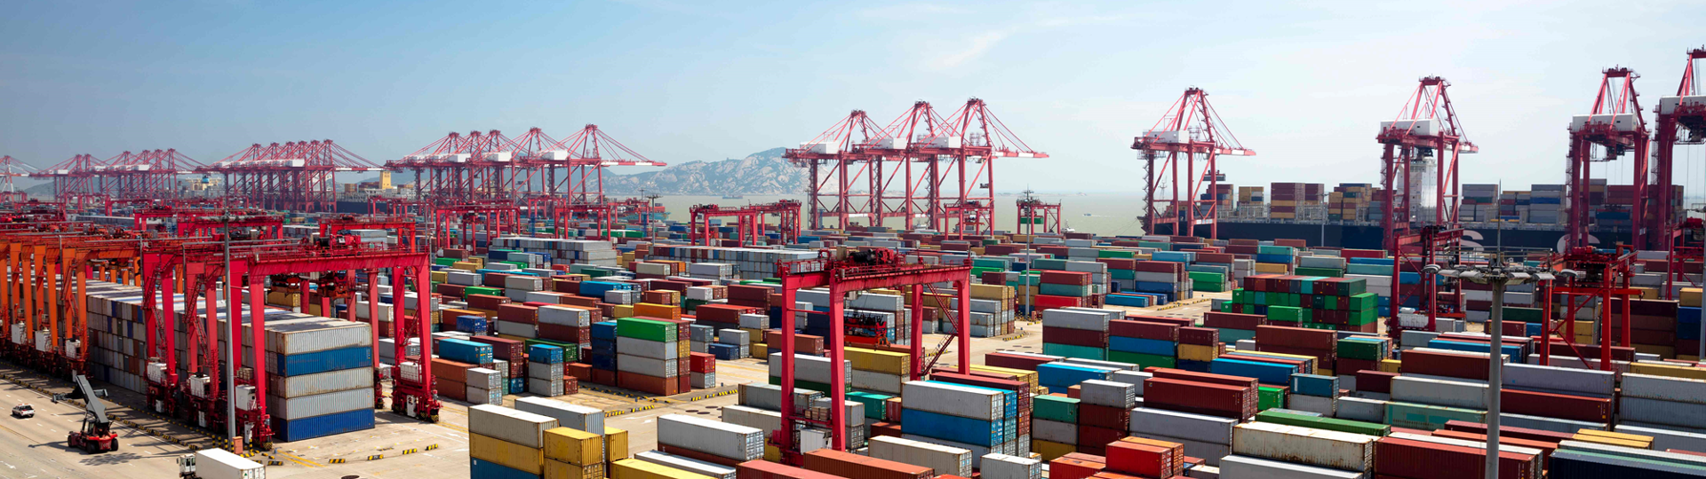

Docker and Kubernetes
Hands-On Training
Thomas Buchner, STS Infrastructure
Hendrik Kahl, SLV ABAP Component Validation

Slide 2
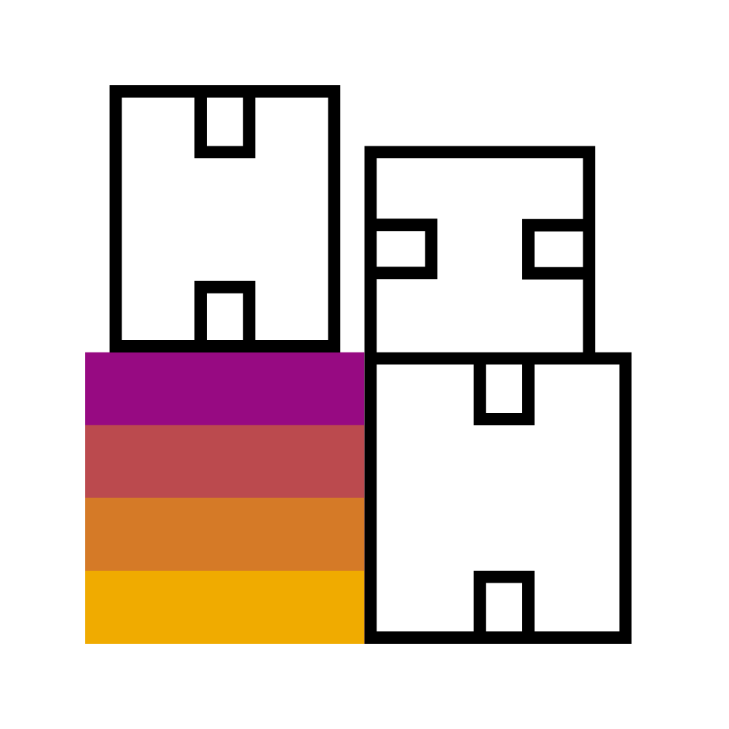
Basics of Containers

Slide 3
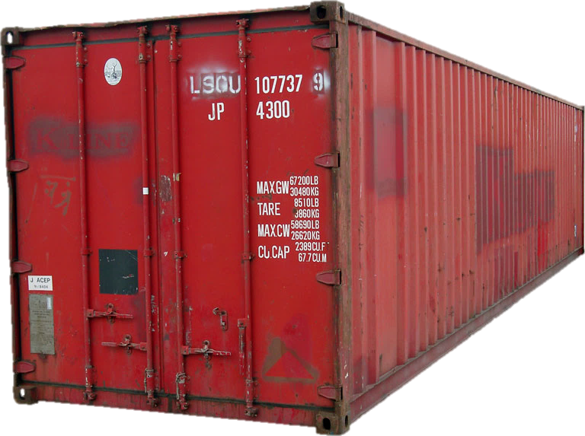
What is a Container?
App
(e.g. nginx)
Convenient package to ship „things“
Open specification
Stackable
Isolated
Portable
Lightweight
Tools
Libs
Notes:
Lots of the attributes of a regular ISO container apply to software containers.

Slide 4
Containers vs. Virtual Machines
VM
VM
VM
nginx
nginx
nginx
Docker Runtime
Libraries
Libraries
Libraries
dockerd
nginx
nginx
nginx
MTA
MTA
OS
OS
OS
virtual HW
virtual HW
virtual HW
Libs
Libs
Libs
Tools
Tools
Libs
Libs
Host OS
Host OS
Hypervisor
Hardware
Hardware
Notes:
What are the differences between containers and virtual machines? At first, they look similar – they both offer slicing up a host into isolated environments for applications.
Virtual machines need a Hypervisor which provides virtual hardware on which a regular operating system runs with your application running on top. Every VM has its own guest OS kernel, its own set of libraries and its own dedicated storage. The disadvantage to the VM landscape in the slide above is that is that you need to take care of all the guest OS’es (patches etc.), the VMs need quite a lot of resources for themselves (exist in memory for each VM) and it requires a fair amount of time to boot them up (because they are not shared).
Containers run directly on the OS kernel of the host, there is no Hypervisor and no guest OS. The containers are just regular processes that have been isolated from each other and from the host operating system but they all share the same operating system kernel and environment. The advantage is that there is no additional overhead for guest operating systems – containers start up almost instantly and require far less resources than VMs do.

Slide 5
A container is just a process bound by Linux Primitives.
Notes:
The Linux kernel does not know about containers at all – for it, containers are nothing more than just regular processes running on the system. They are managed like all other processes by the kernel.
The Linux kernel however offers several features that Docker and other container engines leverage to achieve an almost complete isolation of processes from each other. These features are outlined on the next slide and will be discussed in detail in “Members of the Docker Universe”.

Slide 6

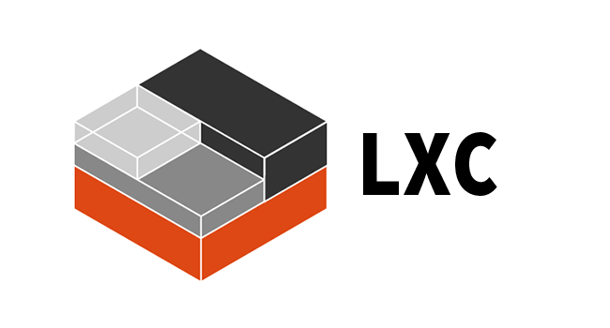
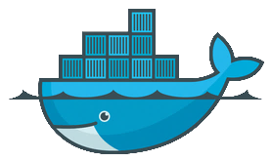
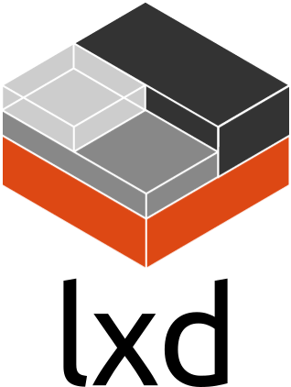

Container engines There is more than just Docker…
LXC / LXD
VM Containers in Linux kernel eventually enhanced by Ubuntu
Docker
That’s what we are talking about, since 2013
rkt [ˈr(ɒ)kit]
Container engine by CoreOS to replace Docker
cri-o
New lightweight container runtime to implements Kubernetes' container runtime interface
Notes:
There are several different container engines that make use of the container features of the Linux kernel.
The big player – and the one that SAP is focusing on – is Docker.
But there is LXC (this more or less started it all as some kind of lightweight virtualization), LXD (an extension to LXC from Ubuntu) and rkt (pronounced “Rocket”) by CoreOS. Since CoreOS was recently acquired by RedHat, we will see which direction it will head to…
Using docker at this point is safe since it is mainstream and possibly required changes moving to rkt should be small.

