Slide 1

Docker Images

Slide 2
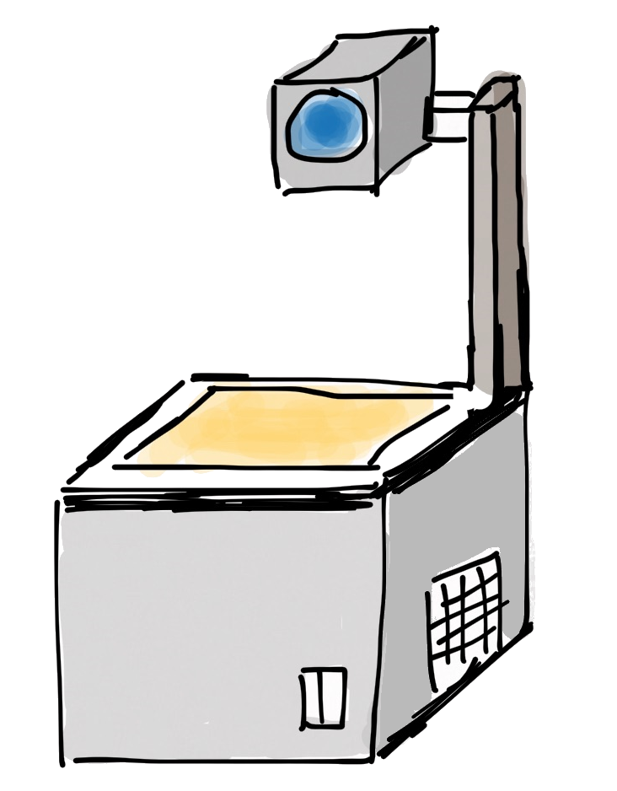
Layers of images and containers
Container
writable layer
Image
PHP
Apache
Busybox
Base Image (e.g. Debian)

Slide 3
Image Layers
Example: nginx image…
… and its history
Container RW layer
$ docker image history nginx:latest
IMAGE CREATED CREATED BY SIZE
cd5239a0906a 7 days ago /bin/sh -c # CMD ["nginx" "-g" "daem... 0B […]
<missing> 7 days ago /bin/sh -c apt-get install nginx && ... 53.7MB
[…]
<missing> 6 weeks ago /bin/sh -c # ADD file:ec5be7eec56a749... 55.3MB
nginx
debian:stretch-slim
scratch
Notes:
Images were discussed earlier in the context of layered file system.
You can create a new image by starting from another image (or empty 'scratch') and adding 'things'. These 'things' are usually files – which add another layer in the file system hierarchy – or environment settings. Installing software means adding another layer.

Slide 4

Committing changes
new RW layer
Container RW layer
image
Committed layer
commit
image
nginx
nginx
debian:stretch-slim
debian:stretch-slim
scratch
scratch
No build automatization
No change history
Notes:
You can also make manual changes to images by:
Start a container from an image
Make manual changes, e.g. install software, change config / settings (in files), … that manifest in the file system (persisted).
'Commit' the changes by writing a new image that contains the current state, i.e. the changes relative to the starting image.
Drawback: Manual changes leave no trace / history / version control. Not repeatable.

Slide 5
Registries
Docker Runtime
dockerd
container
container
image storage
Registry
nginx
busybox
pull
whalesay
exim
httpd
nginx
java
busybox
debian
push
mysql
whalesay
php
Notes:
Images are kept in 'docker registries'. The docker runtime will look in the configured registry when it needs to load an image (e.g. for a 'docker run'). When it doesn't have the image already in its local cache, it will load it from the registry.
The default registry is the docker hub: hub.docker.com. You can also have local registries, e.g. to have tight control of what goes in.

Slide 6
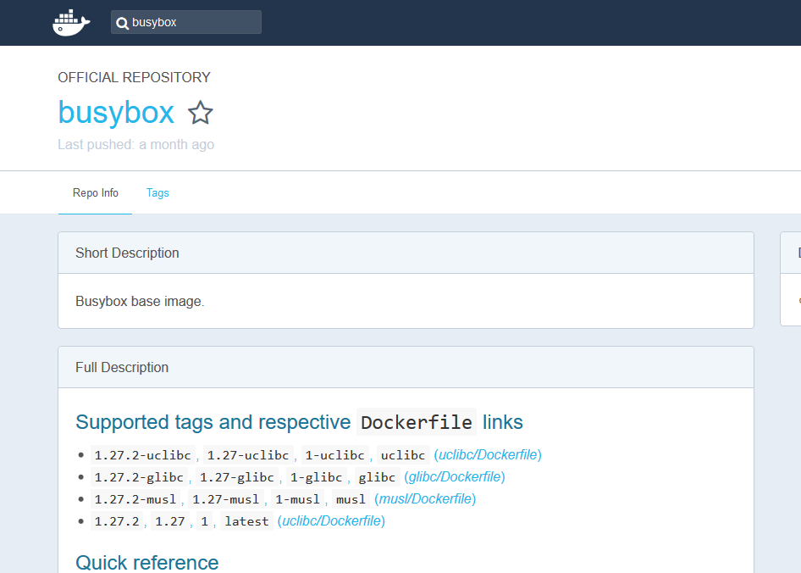
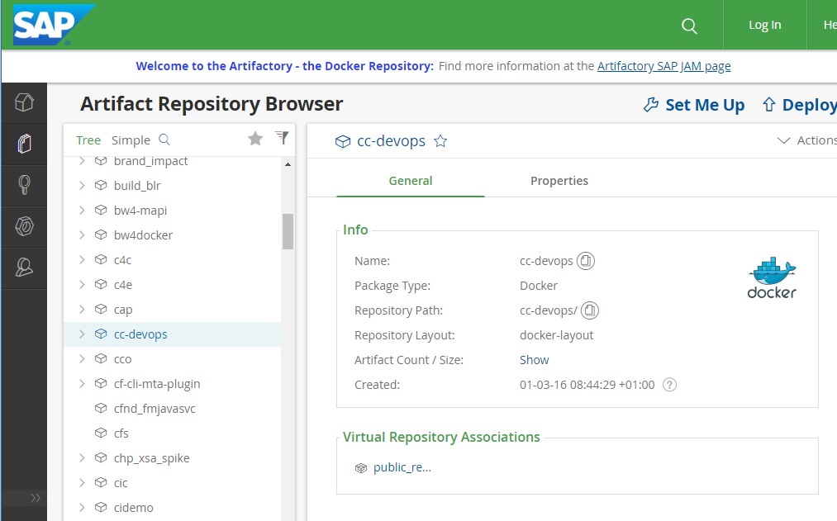
Registries for images
Docker Hub
JFrog Artifactory
Notes:
The docker hub offers (provides storage and the push/pull protocol for) docker images.
Each docker image has a clearly specified version. There can be multiple version tags.
The 'Dockerfile' defines the automated build instructions and show what is in the image. (see Dockerfile chapter). Dockerfiles are also included in images and document the contents.
At SAP, Artifactory is the preferred solution to host and distribute your Docker images.

Slide 7
Information about containers
Available images
the command docker image list gives a list of all available images on a host
$ docker search busybox
NAME DESCRIPTION STARS OFFICIAL AUTOMATED
busybox Busybox base image. 1160 [OK]
progrium/busybox 66 [OK]
hypriot/rpi-busybox-httpd Raspberry Pi compatible Docker Image with ... 39
radial/busyboxplus Full-chain, Internet enabled, busybox made... 17 [OK]
hypriot/armhf-busybox Busybox base image for ARM. 8
...
official project maintainer
useful description
image name
automatically built on Docker Hub
👍
LIKES!

