Slide 1


Kubernetes Core components

Slide 2
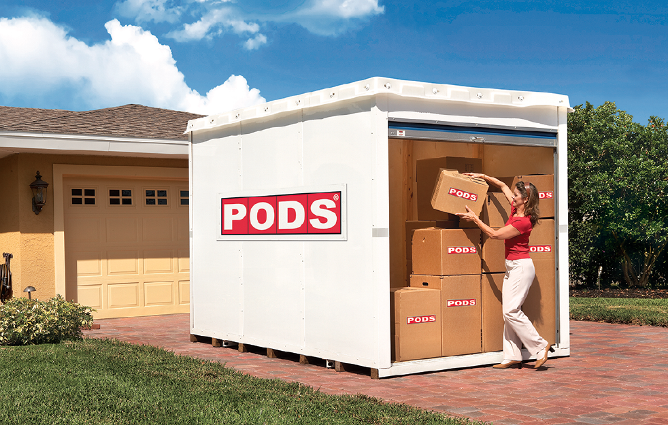
What are these pods, everyone keeps talking about?
A pod is a runtime environment for docker containers
One or more (docker) containers can run within a single pod
All containers in a pod share network & storage
A pod can be considered as a portable, logical host
Pods can communicate with each other
Notes:
Usually there is 1..1 relation between pod and container on a pod. Only if you have tightly coupled applications it makes sense to run multiple containers in one pod.
Example 1: Having a Jenkins and a logging database in one pod may perform better than in separate pod. However this needs to be evaluated case by case.
Example 2: Having a side car container for maintenance

Slide 3
Architecture overview
kubectl
Master
Nodes
API Server
kubelet
proxy
etcd
(distributed) key-value store
Docker
Scheduler
Pod
Pod
Controller Manager
Notes:
The API Server is the center piece. All requests towards the cluster go through it.
The cluster components also talk to the api server to sync their activities.

Slide 4
Core Components - master
etcd
(distributed), high-availability key-value store
Persists state of the cluster
API Server
Central entry point to modify and inspect the cluster state.
Receives RESTful requests and persists changes in etcd.
Controller-Manager
Manages controllers. Various controllers are working to align the spec of a resource with its state.
Scheduler
Binds pods to nodes for execution
Notes:
Example: replicationcontroller: Will see that the specified number of pods for an replication controller resource is really running.

Slide 5
Core Components - worker
kubelet
Runs on every node in a cluster
Manages the containers running on the worker node
Talks to API Server to see if new pods are bound to worker node
Monitors the state of the node
Actually starts containers
kube-proxy
Implements virtual IPs for services in the cluster network.
Docker/rkt
Container runtime on the individual node
Pod
The smallest, schedulable resource that is managed by the kubelet on the node
Pods wrap around one or more (docker) containers
Notes:
For kube-proxy: https://kubernetes.io/docs/concepts/services-networking/service/#virtual-ips-and-service-proxies

Slide 6
Core Components - clients
kubectl
Command line client for Kubernetes. Talks via REST to the API Server.
Cluster administration tasks
User tasks like creating, deleting and modifying of resources
Run `kubectl` or `kubectl <command> --help` to get detailed information
The rest api can also be used directly with tools like curl.
There are official client libraries for the REST API at least for go, python or java.

Slide 7
What happens if we run nginx?
Run nginx
kubectl
Master
Nodes
API Server
kubelet
proxy
etcd
(distributed) key-value store
Docker
Scheduler
Pod
Pod
Controller Manager
Notes:
Now that we explained all the components, let’s walk through an example and see them in action.
The user wants to run an nginx webserver and declares this wish via kubectl to the cluster’s API server.
The API server stores the desired state in etcd
The controller manager will engage the replication controller which will create pod resources according to the required number of replicas.
The scheduler monitors the API server for unscheduled pods and assigns a node to the pod definition (stored in etcd)
The kubelet monitors, if there are new pods to be scheduled on its worker note. If yes, it takes action
https://medium.com/jorgeacetozi/kubernetes-master-components-etcd-api-server-controller-manager-and-scheduler-3a0179fc8186

Slide 8
What happens if we run nginx?
Observe
Analyze
Act
Control loops
Check API for changes
Current state
Desired state
Detect delta
Enforce the desired state
Notes:
Based on the previous example, can we describe an abstraction of the schema? => Observe, Analyze, Act
The user declares the desired state and the cluster takes care of its fulfillment. This holds true for all actions like create, update/patch or deletion of a resource.
Observe - a control loop, checking certain objects for their state.
Analyze – check the current state against a desired state (may be stored in a different resource, outside of the cluster, hardcoded, …)
Action – if there’s a difference between desired & current state, the controller should act and trigger a defined action to bring the observed objects into the desired state

Slide 9
API Structure
/api -- core objects like pods or services /api/<apigroup> -- added later as the API grew
/ api / <version> / namespaces / <ns> / <resource-type-name> / <resource-name>

Slide 10
API Versioning
v1alpha1 -- cluster may explode, volatile api changes expected v1beta1 -- generally stable v1 -- GA (general availability)
Notes:
beta:
aims for backwards compatibility,
may have bugs
used in production with caution
v1 / GA:
no bugs of course
available until deprecated (3 releases or max 1 year)

Slide 11
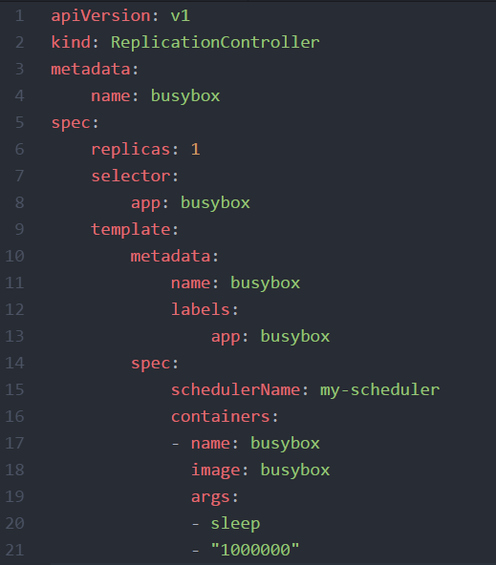
YAML
YAML: “YAML Ain't Markup Language”
YAML is a human friendly data serialization standard for all programming languages.
Indentation based
Supports key:value maps and lists
Supports nesting - a value can also contain another key:value map or a list

Slide 12
Infrastructure for this training
local participant VM
K8s-training cluster
.kube/config
API server IP
User
Access token
Name-space
Master
Nodes
kubectl
API Server
Docker
Pod
Pod
@SAP
etcd
(distributed) key-value store
Gardener on GCP

Slide 13

Demo
Notes:
Call kubectl without any sub-command and explain how to get more info
Show and explain kubectl config *
Explain KUBECONFIG env variable & the default location ~/.kube/config
Show the kubeconfig yaml file with the current context and the namespace
Show access to cluster with kubectl -> kubectl get nodes
Explain basic syntax of kubectl [verb] [resource type] [specific resource by name or label] [options / switches like –o yaml]
Show kubectl get & describe nodes and talk about details of the node, like resource utilization or docker version
Run kubectl proxy &
Open localhost:8001 in browser and show api tree, traverse through it and go to namespace kube-system and show some pods
Query API server with curl (again via localhost)
If you have kubectl version v1.11 or higher:
Show kubectl api-versions => similar to what you did with the proxy, just easier
Show kubectl api-resources => gives info about all the cluster resources incl short names!

Slide 14
What YOU will do during this training…
Networking layer
nginx
nginx
nginx
Application layer
content
config
tls certs
Persistence layer

Slide 15

Exercise 01
Notes:
~10min

