Slide 1
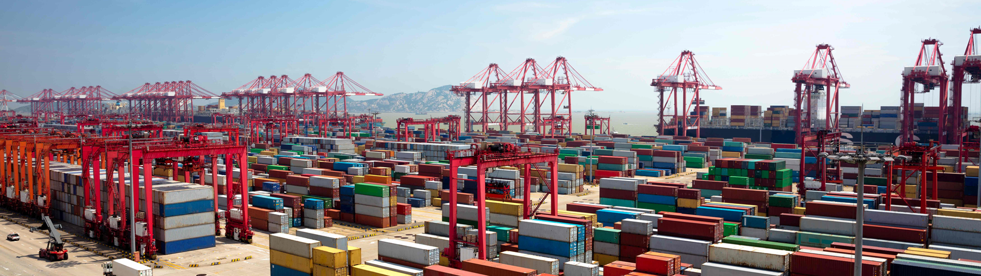
Docker and Kubernetes
Hands-On Training
Thomas Buchner, STS Infrastructure
Hendrik Kahl, SLV ABAP Component Validation

Slide 2

Members of the Docker Universe

Slide 3
Linux Features
Namespaces
Isolation of resources per process
7 different namespaces
netfilter
Firewall and packet manipulation
cgroups
Manage resource allocation
Netlink
Interprocess communication between containers
SELinux/AppArmor
Security profiles to govern access to resources
capabilities
Granular control of privileges
seccomp
Limitation of syscalls to processes
Docker Runtime
dockerd
Container
Container
Container
Container
Linux
namespaces
Netlink
SELinux
netfilter
seccomp
capabilities
cgroups
AppArmor
Hardware
Notes:
unshare --pid --fork --mount-proc /bin/bash

Slide 4
Linux Features
Namespaces
Different processes see different environments even though they are on the same host/OS
different namespaces for
PID (process tree)
mnt (mount points)
Net (network interfaces and connectivity)
IPC (interprocess communication framework)
UTS (hostnames, date & time, etc.)
UID (user IDs and mappings)
cgroup (control groups for resource allocation)
Control groups (cgroups)
manage/limit resource allocation to individual processes
Prioritization (nice for a set of processes and not just one)
capabilities
without capabilities: root can do everything, everybody else may do nothing
38 granular facilities to control privileges
netfilter
firewall and packet manipulation (iptables/nftables)
can manipulate almost all network traffic going in/out a host
used to direct network packages to individual containers
Netlink
Interprocess communication between containers
SELinux/AppArmor
Security profiles to govern access to resources
seccomp
Limitation of allowed kernel syscalls
Unallowed syscalls lead to process termination
Notes:
unshare --pid --fork --mount-proc /bin/bash

Slide 5
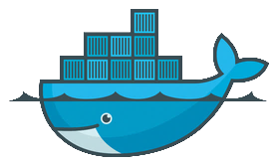
Containers and where they come from
App
(e.g. nginx)
Isolated environment in which an application runs
Like a computer in a computer… without the OS overhead
Containers are created from images…
… which can be downloaded from a central registry
… or can be built on the fly
each container has one main process with PID 1
started whenever a container is created
no init system
processes present in host system with PID ≠ 1
Tools
Libs
$ docker ps -a
CONTAINER ID IMAGE COMMAND CREATED STATUS PORTS NAMES
9682e4fba8b7 busybox "sh" 27 minutes ago Up 27 minutes elated_saha
eb2e127b9647 debian "bash" 2 days ago Exited (0) 25 hours ago goofy_shaw
e7a7aeca8c41 test_nginx "nginx –g..." 3 days ago Exited (1) 7 minutes ago pensive_elion
7318e13769aa busybox "sh" 6 days ago Exited (0) 6 days ago goofy_saha
$

Slide 6


Images
Templates that containers are created from
Pulled from a registry
Created from a Dockerfile or by committing changes
Consist of several layers
Can be and actually are stacked upon each other
$ docker images
REPOSITORY TAG IMAGE ID CREATED SIZE
test_nginx latest ee56ce14b382 3 days ago 108MB
<none> <none> 2af6607c94b9 13 days ago 108MB
debian latest 6d83de432e98 4 weeks ago 100MB
busybox latest 6ad733544a63 4 weeks ago 1.13MB
$

Slide 7
Commands for images
Download an image from a registry
Remove an image from the local disk
List all locally available images
Commit changes of a container to an image
Upload an image to a registry
View an images history
$ docker pull busybox
$ docker rmi busybox
$ docker images
$ docker commit <container name> <tag>
$ docker push busybox
$ docker history <image-ID>

Slide 8
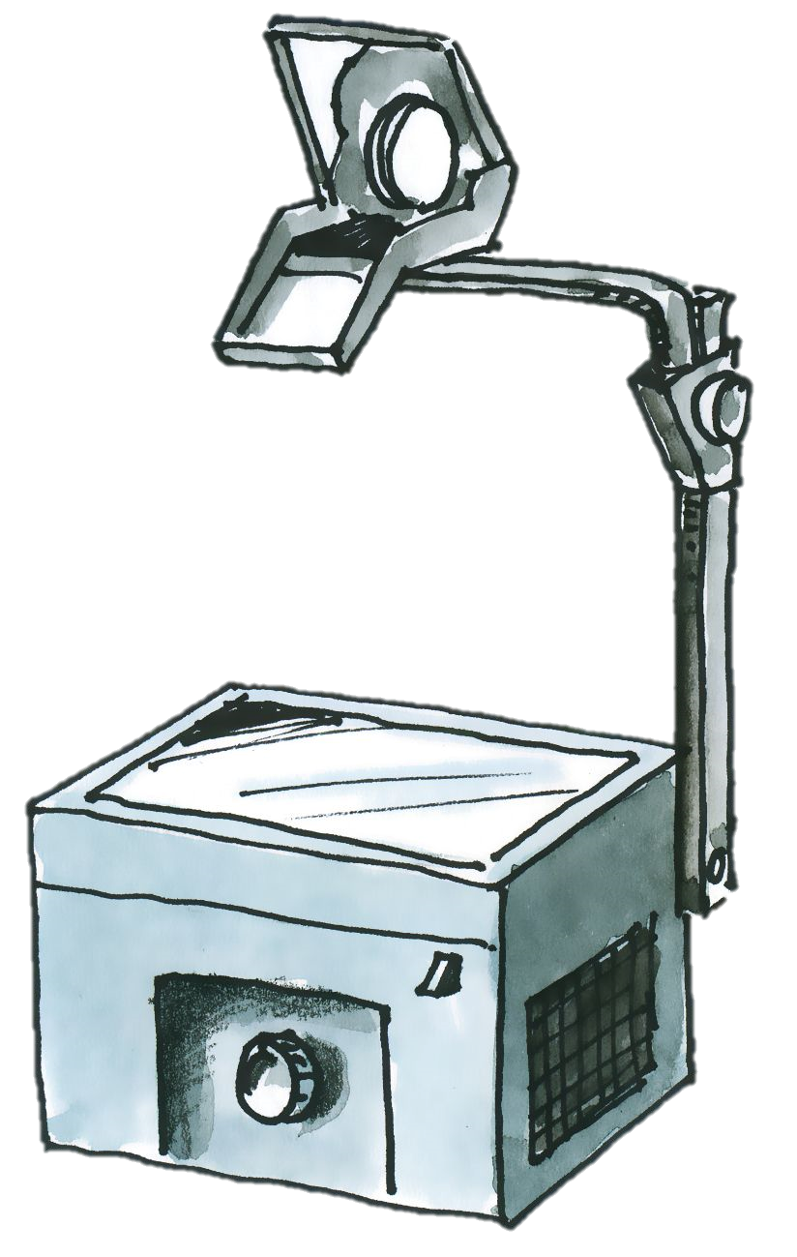
Layers of images and containers
Container
writable layer
Image
PHP
Apache
Busybox
Base Image (e.g. Debian)

Slide 9

Registries
Public registries
Docker Hub https://hub.docker.com
lots of ready-made and official images
anyone can upload his images
Private registries
Docker Hub https://hub.docker.com
Individual Organizations and projects
Automated builds
Local private registries
Runs as a container on any Docker host
Selected by image tagging
Insecure registries must be explicitly enabled in dockerd configuration
$ docker search busybox
NAME DESCRIPTION STARS OFFICIAL AUTOMATED
busybox Busybox base image. 1158 [OK]
progrium/busybox 66 [OK]
hypriot/rpi-busybox-httpd Raspberry Pi compatible Docker Image with ... 39
radial/busyboxplus Full-chain, Internet enabled, busybox made... 17 [OK]
$

Slide 10
Docker‘s client/server architecture
ReST
Docker Runtime
docker client
dockerd
nginx
nginx
Docker daemon is control entity of everything
Docker client (the docker command) just tells the daemon what to do
Communication through ReST API
when on same host: Unix socket /var/run/docker.sock
when on different hosts: TCP, port 2375 or 2376
Building images: everything is transferred from client to dockerd
Libs
Libs
Host OS
Hardware
Notes:
If you want to talk to dockerd directly, you can do so using cUrl (you will need cUrl and libcurl >= 7.40):
curl --unix-socket /var/run/docker.sock http://localhost/containers/json
Or use your web browser if you enabled dockerd‘s TCP socket:
http://<hostname>:2375/containers/json

Slide 11
runC
nginx
runC is the bed on which containers run
Infrastructure plumbing
Setup of Linux kernel features (namespaces, cgroups, etc…)
Managing the network routing
Spun out of dockerd in 2015
Implements the OCI container standard
runC, Docker… what?
runC only sets up and runs the containers as instructed by Docker
runC does not know anything about images, registries, etc.
runC can be used in different container platforms, not just Docker
dock
Libs
runC
Host OS

Slide 12
Configuration of the Docker daemon
Different places to configure the Docker daemon
systemd unit drop-in : environment settings
/etc/sysconfig/docker : command options for dockerd
/etc/docker/config.json : general config options for drivers, etc…
systemd unit drop-in
dockerd
/etc/docker/config.json
Example: Setting up the proxy server
Proxy is an environment setting
/etc/sysconfig/docker
[Service]
Environment="http_proxy=http://proxy.wdf.sap.corp:8080"
Environment="https_proxy=http://proxy.wdf.sap.corp:8080"
/etc/systemd/system/docker.service.d/proxy

