Slide 1
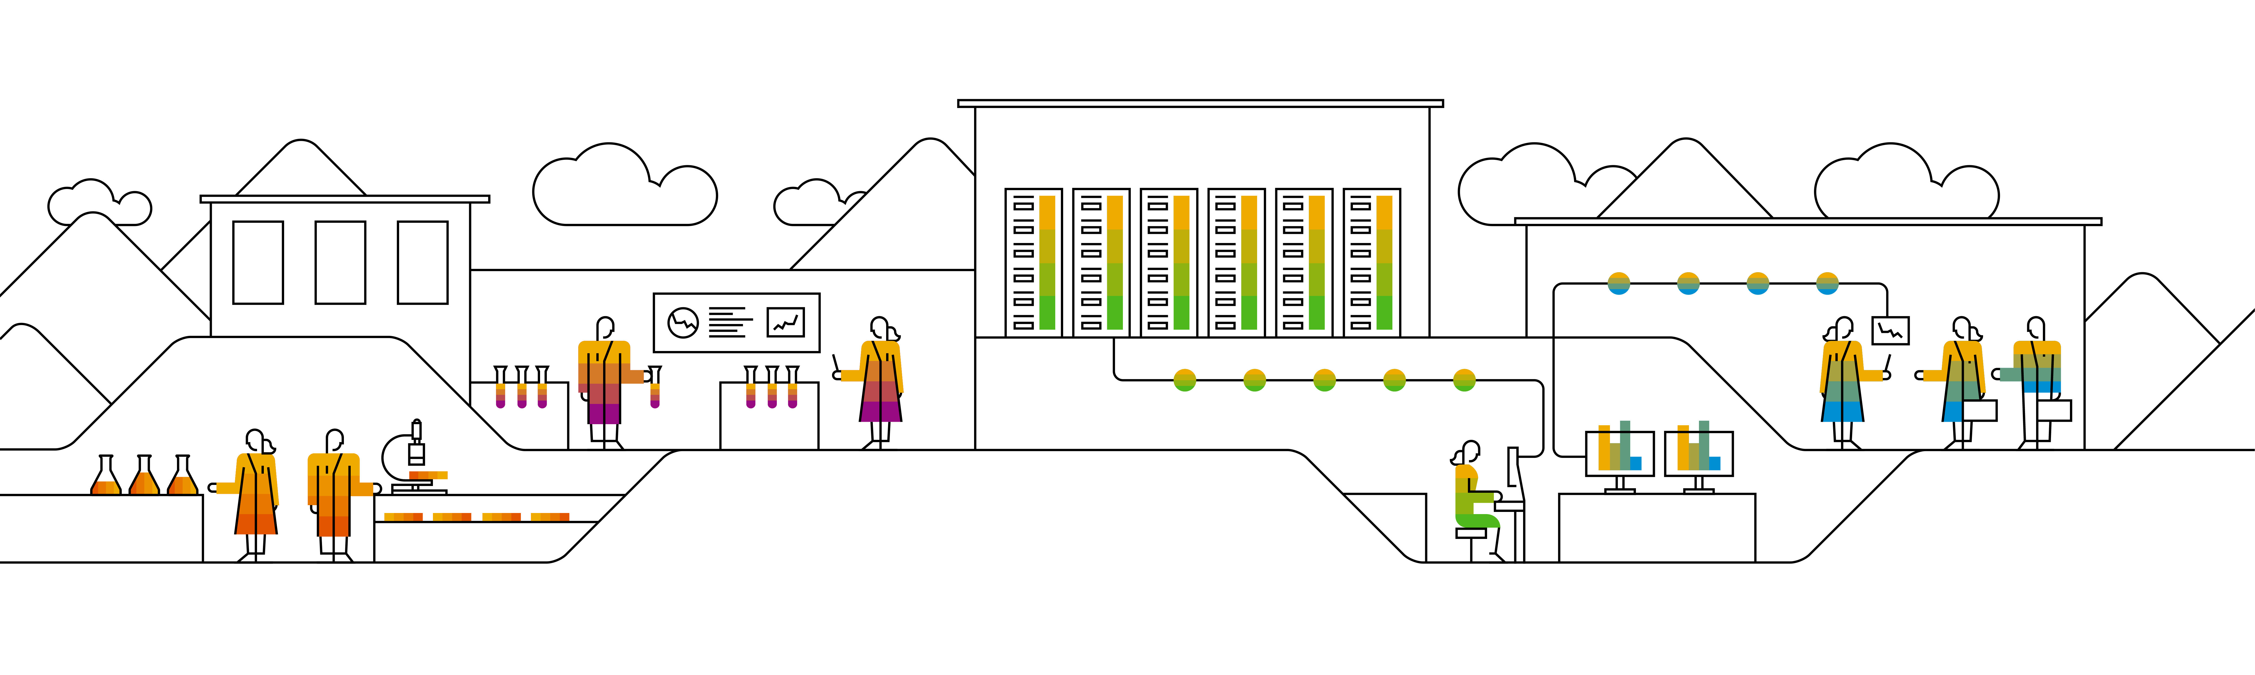
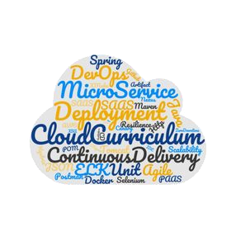

Kubernetes Microservice-based sample app: Bulletinboard

Slide 2



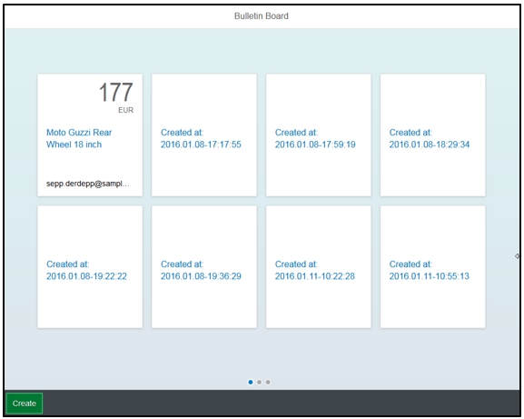



Bulletinboard in K8s: Exercise “Helm chart for Ads App & Ads DB”
ingr/ svc
HTTP/ REST
svc
HTTPS/ REST
nwp
nwp
bulletinboard- ads
bulletinboard-users
cm
cm
sec
pod
sec
pod
deployment
deployment
svc
svc
nwp
postgresql
nwp
postgresql
cm
cm
sec
pod
sec
pod
statefulset
statefulset
Notes:
- Discuss statefulset vs deployment
- Discuss headless service vs ???
- Discuss service vs ingress

Slide 3
Overview
This is a technically advanced OPTIONAL Exercise. You will need to know a lot more about helm than for the other exercises.
We want you to transfer the yamls of ads-app & ads-db into a helm chart.
We want you to parametrize some parts of this to learn how you could do this.
You will write & use some template functions.
helm install --debug --dry-run . will become your friend.

Slide 4
More on helm: Go template Engine
Helm uses a go template engine to manipulate the chart templates into the final yamls used on kubernetes.
Templates folder can contain files with a leading _ (typically _helper.tpl). These files are not transferred into a yaml but can contain custom template functions to make the templating easier.
Such template functions are accessed via: {{ template “nameOfTemplate” . }}, meaning the string generated by the template will be put at that place.
There is also {{ include “nameOfTemplate” . }} which does the same thing except that the string can be passed onto other build in functions in a (bash like) pipe.
Also there is {{- and -}} which does the same as {{ and }} except it also removes leading/trailing whitespaces and line breaks.

Slide 5
Helm templates: scopes
template & include takes actually 2 arguments, first is the name, second a scope known inside.
The context/scope . : To use e.g. the Values object in template they have to be passed into it. They are contained in the root scope. It is referenced by a . (self reference) and has to be passed as this into the template call.
{{ template “aTemplate” . }} here you can use .Values etc in the template.
{{ template “anOtherTemplate” }} in this template .Values are not accessible
You could also pass a subscope of . , which will then be the basis for references: e.g. {{ template “aTemplate” .Values }}, inside “aTemplate” you have access to all Values (without needing to add .Value before)

Slide 6
Helm templates: variables
Templates can contain variables which can be reused later in the same template. They always have a $ as the first char of their name. How you create a variable: {{ $string := “I’m a string” }} How you use a variable: {{ print $string }}
Objects to get data:
.Values: contains a map of values.yaml data
.Release: contains a map of release information like .Release.Name to get the generated release name
.Chart: contains a map of Chart.yaml data
.Files: Object to access files in your charts. e.g. .Files.Get “a relative path to a file” gets you the content of the file as a string.

Slide 7
Helm templates: pipes
Pipes are used to pass a string from one function to the next (like in bash):
A few build in functions
quote: surrounds a given string with “
indent X: adds indent of X whitespaces to a given string
b64enc: encodes a given string in base64
replace X Y: replaces substring X with Y in a given string
trunc X: truncates a given string after X chars
trimSuffix X: trims trailing string X from a given string
printf X …: prints string X , if X contains %s etc. print takes further arguments for these.
tpl X Y: takes string X and applys template engine with scope Y on it before passing it along.
Examples: {{- printf "%s-%s" .Release.Name $name | trunc 63 | trimSuffix "-" -}} {{- tpl (.Files.Get "initdb.txt") . | b64enc }}

Slide 8
Exercise 5: bulletinboard-ads helm chart

