Slide 1
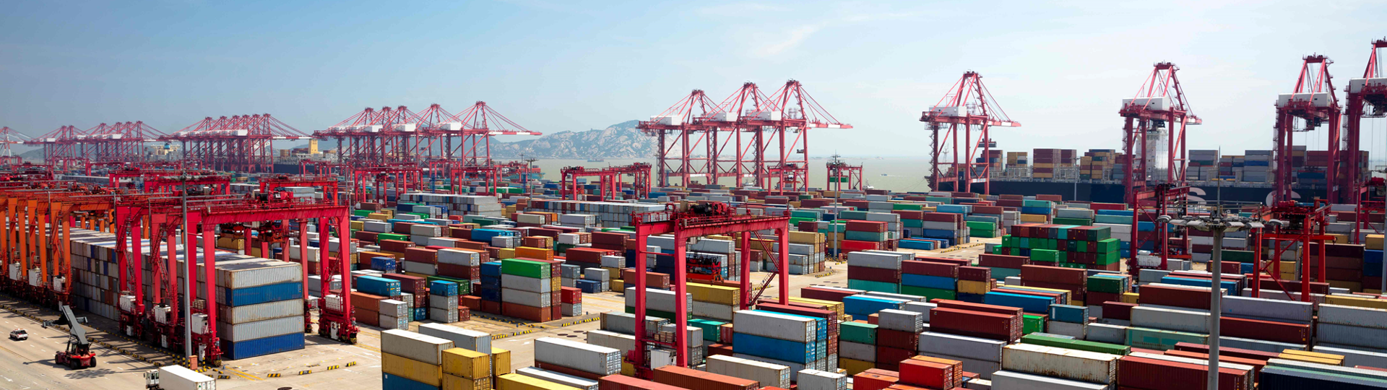
Docker and Kubernetes
Hands-On Training
Thomas Buchner, STS Infrastructure
Hendrik Kahl, SLV ABAP Component Validation

Slide 2

Basics of Containers

Slide 3
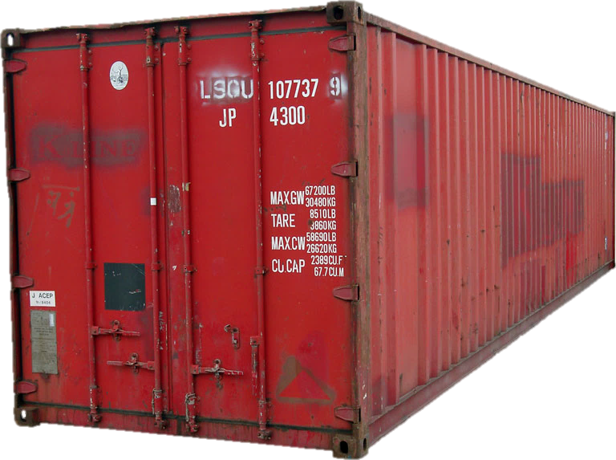
What is a Container?
App
(e.g. nginx)
Convenient package to ship „things“
Open specification
Stackable
Isolated
Portable
Lightweight
Tools
Libs

Slide 4
Containers vs. Virtual Machines
VM
VM
VM
nginx
nginx
nginx
Docker Runtime
Libraries
Libraries
Libraries
dockerd
nginx
nginx
nginx
MTA
MTA
OS
OS
OS
virtual HW
virtual HW
virtual HW
Libs
Libs
Libs
Tools
Tools
Libs
Libs
Host OS
Host OS
Hypervisor
Hardware
Hardware

Slide 5
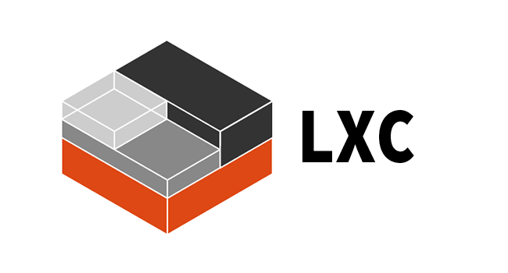

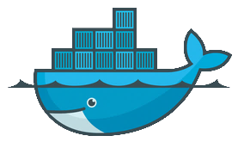
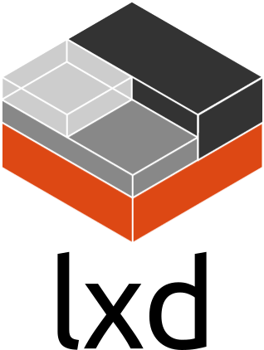
Container engines There is more than just Docker…
LXC
VM Containers in Linux kernel, since 2008
LXD
Extension of LCX by Ubuntu, adds a controlling daemon
Docker
That’s what we are talking about, since 2013
rkt [ˈr(ɒ)kit]
Container engine by CoreOS to replace Docker

Slide 6
Docker technologies
Namespaces
Isolation of resources per process
7 different namespaces
netfilter
Firewall and packet manipulation
cgroups
Manage resource allocation
Netlink
Interprocess communication between containers
SELinux/AppArmor
Security profiles to govern access to resources
capabilities
Granular control of privileges
Docker Runtime
dockerd
Container
Container
Container
Container
Linux
namespaces
SELinux
Netlink
netfilter
capabilities
cgroups
AppArmor
Hardware
Notes:
Docker extensively uses features of the Linux kernel which are listed above. But Docker exists for Windows and Mac, how is that possible?
On Windows, Docker uses Hyper-V to silently start a minimalistic Linux VM in the background to run containers. This has some limitations on where you can run Docker for Windows. If your Windows runs within a VM and Docker wants to silently start its minimal Linux VM, you would end up with a VM inside a VM, i.e. nested virtualization. This is only supported on Windows 10 and Windows 2016. This limitation does not exist for bare-metal setups.
Macs use a Virtual Box VM to run a minimal Linux VM that provides the kernel features needed for Docker.

