Slide 1
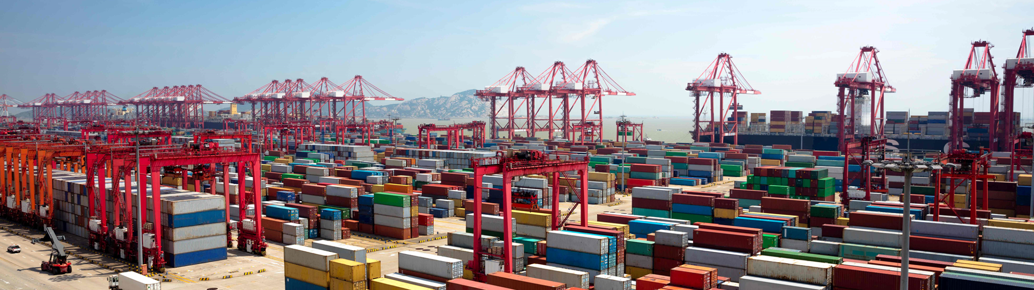
Docker and Kubernetes
Hands-On Training
Thomas Buchner, STS Infrastructure
Hendrik Kahl, SLV ABAP Component Validation

Slide 2

Working with Containers
on Docker

Slide 3
Configuration of the Docker daemon
Different places to configure the Docker daemon
systemd unit drop-in : environment settings
/etc/sysconfig/docker : command options for dockerd
/etc/docker/config.json : general config options for drivers, etc…
systemd unit drop-in
dockerd
/etc/docker/config.json
Example: Setting up the proxy server
Proxy is an environment setting
/etc/sysconfig/docker
[Service]
Environment="http_proxy=http://proxy.wdf.sap.corp:8080"
Environment="https_proxy=http://proxy.wdf.sap.corp:8080"
/etc/systemd/system/docker.service.d/proxy

Slide 4
Lifecycle of a container
docker run
docker create
docker start
docker stop
docker rm
container
container
container
container
docker start

Slide 5
Run your first container
$ docker run docker/whalesay cowsay “Rick Astley"
____________________________
< Never gonna give you up... >
----------------------------
\
\
\
## .
## ## ## ==
## ## ## ## ===
/""""""""""""""""___/ ===
~~~ {~~ ~~~~ ~~~ ~~~~ ~~ ~ / ===- ~~~
\______ o __/
\ \ __/
\____\______/
$

Slide 6
Detached and interactive containers
Detached mode
programs like do not interact with the user
Web servers
Database servers
Containers can be started in detached mode, e.g.:
Manually detach from a container with Ctrl + P followed by Ctrl + Q
Interactive mode
Programs that expect user input must be started in interactive mode or they just exit
Shells
Mail clients
Terminal might need to be explicitly allocated and connected, e.g.:
$ docker run –d nginx
$ docker run –i -t busybox

Slide 7
Information about containers
Available/present containers
the command docker ps gives a list of all running containers on a host (use –a to see also terminated containers)
$ docker ps –a
CONTAINER ID IMAGE COMMAND CREATED STATUS PORTS NAMES
dded97d9a7d6 docker/whalesay "cowsay 'Rick Astley'" 8 minutes ago Exited (0) 8 minutes ago ecstatic_goldstine
b69038e9ff35 busybox "sh" About an hour ago Created admiring_ritchie
e7a7aeca8c41 test_nginx "nginx -g 'daemon ..." 4 days ago Exited (1) 24 hours ago pensive_elion
494b7b8c9f39 mynginx1 "nginx -g 'daemon ..." 7 days ago Up 24 hours 0.0.0.0:32768->812/tcp happy_ride
image
creation time
forwarded network ports
friendly name
program that runs in the container
unique ID for each container (truncated)
current status and exit code
Notes:
truncated: the UUID has 64 digits but is truncated to just 12 digits, use --no-trunc to see all of them

Slide 8
Executing commands in a container
Possible to run additional commands in a container
Useful for debugging
Command must be present in the container
Interactive/detached mode – also applies here
$ docker exec –i –t <container ID or name> <command>
$ docker exec -i -t 494b7b8c9f39 /bin/sh
# ls -al /usr/sbin/nginx
-rwxr-xr-x 1 root root 1253840 Nov 21 14:28 /usr/sbin/nginx
# exit
$

Slide 9
Starting a stopped container
A container stops once the main process (PID 1) exits
container does not get removed but remains
can be restarted as long as it exists
$ docker start <container ID or name>
$ docker run -i -t busybox
/ # exit
$ docker ps -a
CONTAINER ID IMAGE COMMAND CREATED STATUS PORTS NAMES
033d3a22e8c8 busybox "sh" 15 seconds ago Exited (0) 13 seconds ago manic_wright
$ docker start -i 033d3a22e8c8
/ # ls
bin dev etc home proc root run sys tmp usr var
/ # exit

Slide 10
Stopping a container
A container can be forcibly stopped
necessary for containers with daemon processes
friendly termination with SIGTERM, after timeout (default 10 seconds) with SIGKILL
$ docker stop <container ID or name>
$ docker ps
CONTAINER ID IMAGE COMMAND CREATED STATUS PORTS NAMES
494b7b8c9f39 mynginx1 "nginx -g ..." 7 days ago Up 24 hours 0.0.0.0:32768->812/tcp happy_ride
$ docker stop -t 5 happy_ride
494b7b8c9f39
$ docker ps
CONTAINER ID IMAGE COMMAND CREATED STATUS PORTS NAMES
$

Slide 11
Getting logs from a container
Docker collects logs from programs inside containers
stdout and stderr of the main process get collected
logs from programs can be redirected to /dev/stdout and /dev/stderr
logs still available even after a container terminated
$ docker logs <container ID or name>
$ docker logs 494b7b8c9f39
10.19.91.230 - - [01/Dec/2017:14:48:12 +0000] "GET / HTTP/1.1" 200 230 "-" "Mozilla/5.0 (Windows NT 10.0; Win64; x64; rv:57.0) Gecko/20100101 Firefox/57.0" "-"
10.19.91.230 - - [01/Dec/2017:14:48:12 +0000] "GET /it_works.jpg HTTP/1.1" 200 25676 "http://pvxka22:32780/" "Mozilla/5.0 (Windows NT 10.0; Win64; x64; rv:57.0) Gecko/20100101 Firefox/57.0" "-"
2017/12/01 14:48:12 [error] 8#8: *1 open() "/srv/www/htdocs/favicon.ico" failed (2: No such file or directory), client: 10.19.91.230, server: localhost, request: "GET /favicon.ico HTTP/1.1", host: "pvxka22:32780"
10.19.91.230 - - [01/Dec/2017:14:48:12 +0000] "GET /favicon.ico HTTP/1.1" 404 169 "-" "Mozilla/5.0 (Windows NT 10.0; Win64; x64; rv:57.0) Gecko/20100101 Firefox/57.0" "-“
$

Slide 12

Removing a container
Finally, a container can and should be removed
all data in the container that was not part of the image is lost
when a container is removed, it is gone
removing an active container must be forced and will kill it
$ docker rm <container ID or name>
pvxKA22:~ # docker ps -a
CONTAINER ID IMAGE COMMAND CREATED STATUS PORTS NAMES
dded97d9a7d6 docker/whalesay "cowsay 'Ri..." About an hour ago Exited (0) happy_pony
9682e4fba8b7 busybox "sh" 25 hours ago Up 25 hours elated_saha
pvxKA22:~ # docker rm 9682e4fba8b7 dded97d9a7d6
dded97d9a7d6
Error response from daemon: You cannot remove a running container…
pvxKA22:~ # docker rm 9682e4fba8b7 --force
9682e4fba8b7
pvxKA22:~ # docker ps -a
CONTAINER ID IMAGE COMMAND CREATED STATUS PORTS NAMES
$

Slide 13
Commands for containers
Detaching from a container
Ctrl + P then Ctrl + Q
Start and run a new container
Reattach to a container
Forcibly stop a container
Restart a previously stopped container
Remove a container
$ docker run busybox
$ docker attach <container ID or name>
$ docker stop <container ID or name>
$ docker start <container ID or name>
$ docker rm <container ID or name>

Slide 14
Commands for containers
Run a command in an existing container
List running containers
List all containers (running and stopped)
Get the logs of a container
Get detailed information about a container
$ docker exec <container ID or name> <command>
$ docker ps
$ docker ps -a
$ docker logs <container ID or name>
$ docker inspect <container ID or name>

Slide 15

Ports and Volumes

Slide 16
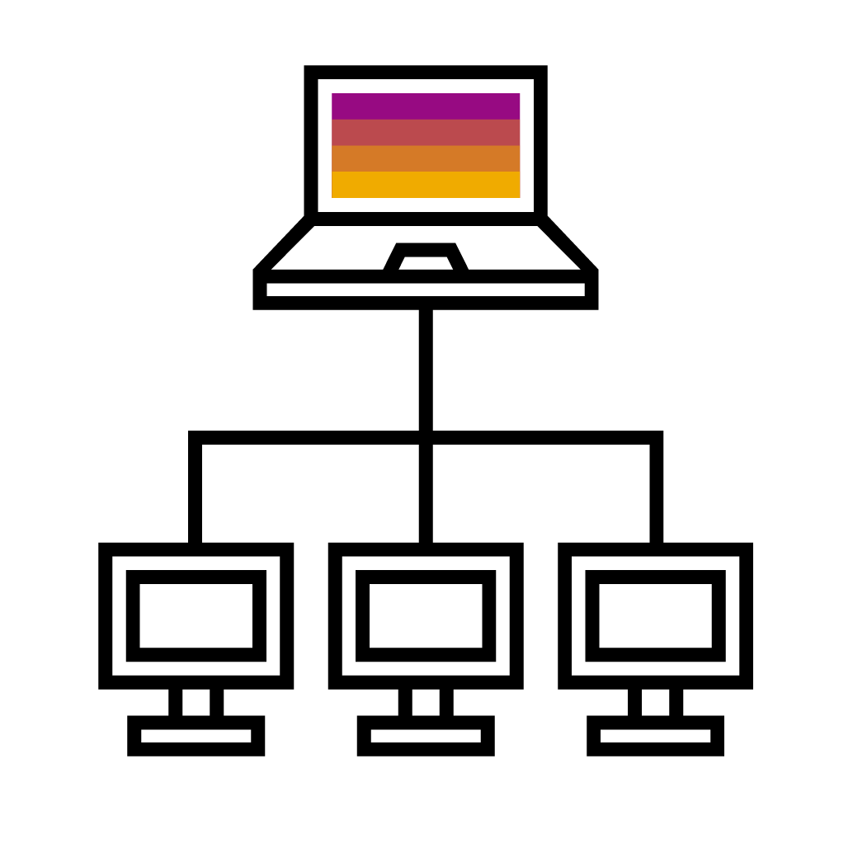
Ports
:32710
Containers in isolated network
Class B private network 172.16.0.0/16
Containers can see each other by default
not reachable from outside
NAT to connect to the outside world
Port forwarding
Port forwarding to host
docker run -p <host port>:<container port> …
Containers expose ports, can be mapped automatically
docker run -P …
Exposed ports can be inspected
172.16.0.1
172.16.0.0/16
NAT
:80
172.16.0.2
172.16.0.3
172.16.0.4

Slide 17

Volumes
Persistent storage in containers
Filesystem in containers is not persistent
Volumes used add outside storage to containers
bind-mounts vs. volumes
Bind mounts
Hides everything in destination directory
docker run –v <source path>:<container path> …
Named volumes
Contents in container are merged with volume
No straightforward access from host
docker run –v <vol name>:<container path> …

