Slide 1
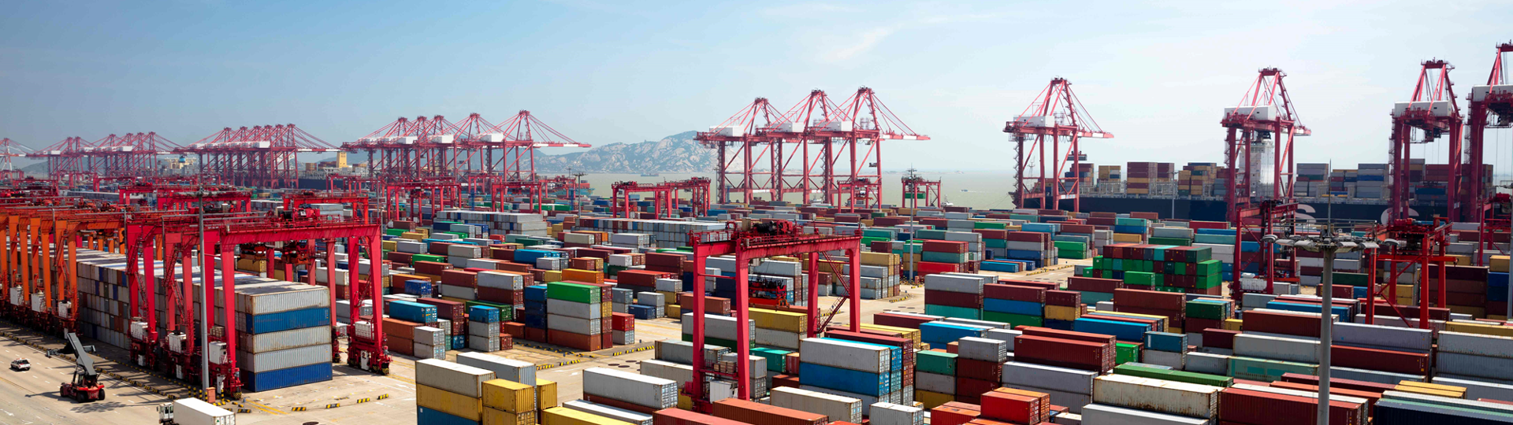
Docker and Kubernetes
Hands-On Training
Thomas Buchner, STS Infrastructure
Hendrik Kahl, SLV ABAP Component Validation

Slide 2

Docker Images

Slide 3
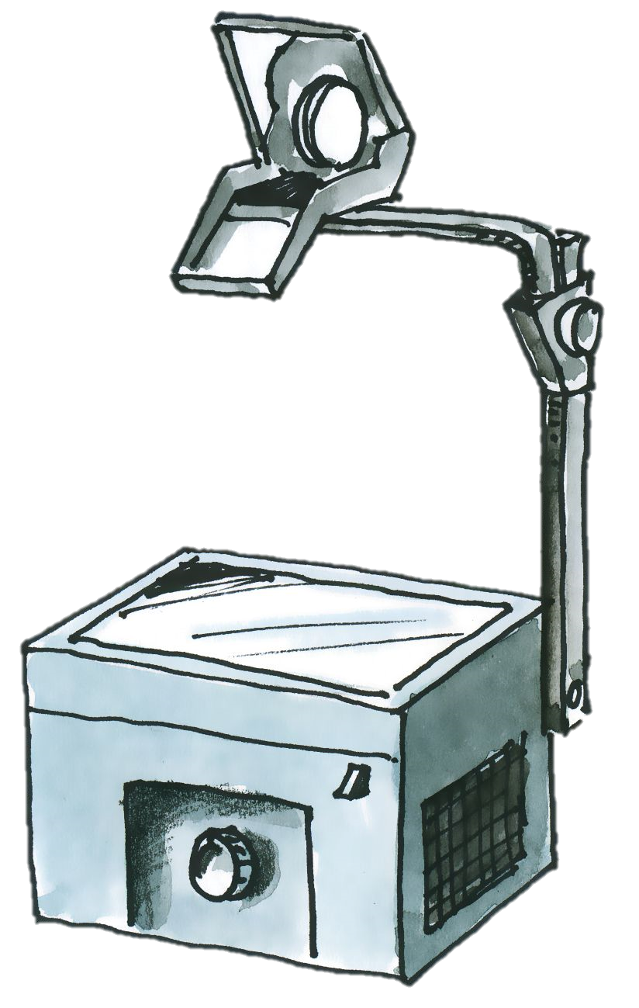
Layers of images and containers
Container
writable layer
Image
PHP
Apache
Busybox
Base Image (e.g. Debian)

Slide 4
Image Layers
Example – nginx image
Example – Azure App Service php
Container rw layer
Container rw layer
appsvc/php
nginx
php:7.0.6-apache
debian:stretch-slim
debian:jessie
scratch
scratch

Slide 5

Committing changes
commit
New container rw layer
Container rw layer
image
comitted layer
image
nginx
nginx
debian:stretch-slim
debian:stretch-slim
scratch
scratch
No build automatization
No change history

Slide 6
Registries
Docker Runtime
dockerd
container
container
image storage
Registry
nginx
busybox
exim
httpd
whalesay
nginx
java
busybox
debian
mysql
whalesay
php

Slide 7
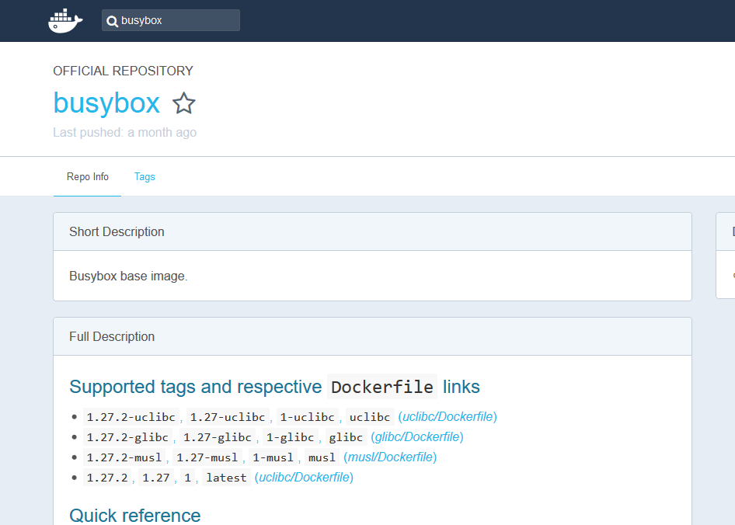
Docker Hub
https://hub.docker.com

Slide 8
Information about containers
Available/present containers
the command docker ps gives a list of all running containers on a host (use –a to see also terminated containers)
$ docker search busybox
NAME DESCRIPTION STARS OFFICIAL AUTOMATED
busybox Busybox base image. 1160 [OK]
progrium/busybox 66 [OK]
hypriot/rpi-busybox-httpd Raspberry Pi compatible Docker Image with ... 39
radial/busyboxplus Full-chain, Internet enabled, busybox made... 17 [OK]
hypriot/armhf-busybox Busybox base image for ARM. 8
...
official project maintainer
useful description
image name
automatically built on Docker Hub
LIKES!

Slide 9
Commands for images
Search for an image on all known registries
Download an image from a registry
Remove an image from the local disk
List all locally available images
View an images history
$ docker search <search term>
$ docker pull busybox
$ docker rmi busybox
$ docker images
$ docker history <image-ID>

Slide 10
Commands for images
Commit changes of a container to an image
Upload an image to a registry
Tagging an image
$ docker commit <container name> <tag>
$ docker push busybox
$ docker tag <image ID> <tag:release>

