Slide 1
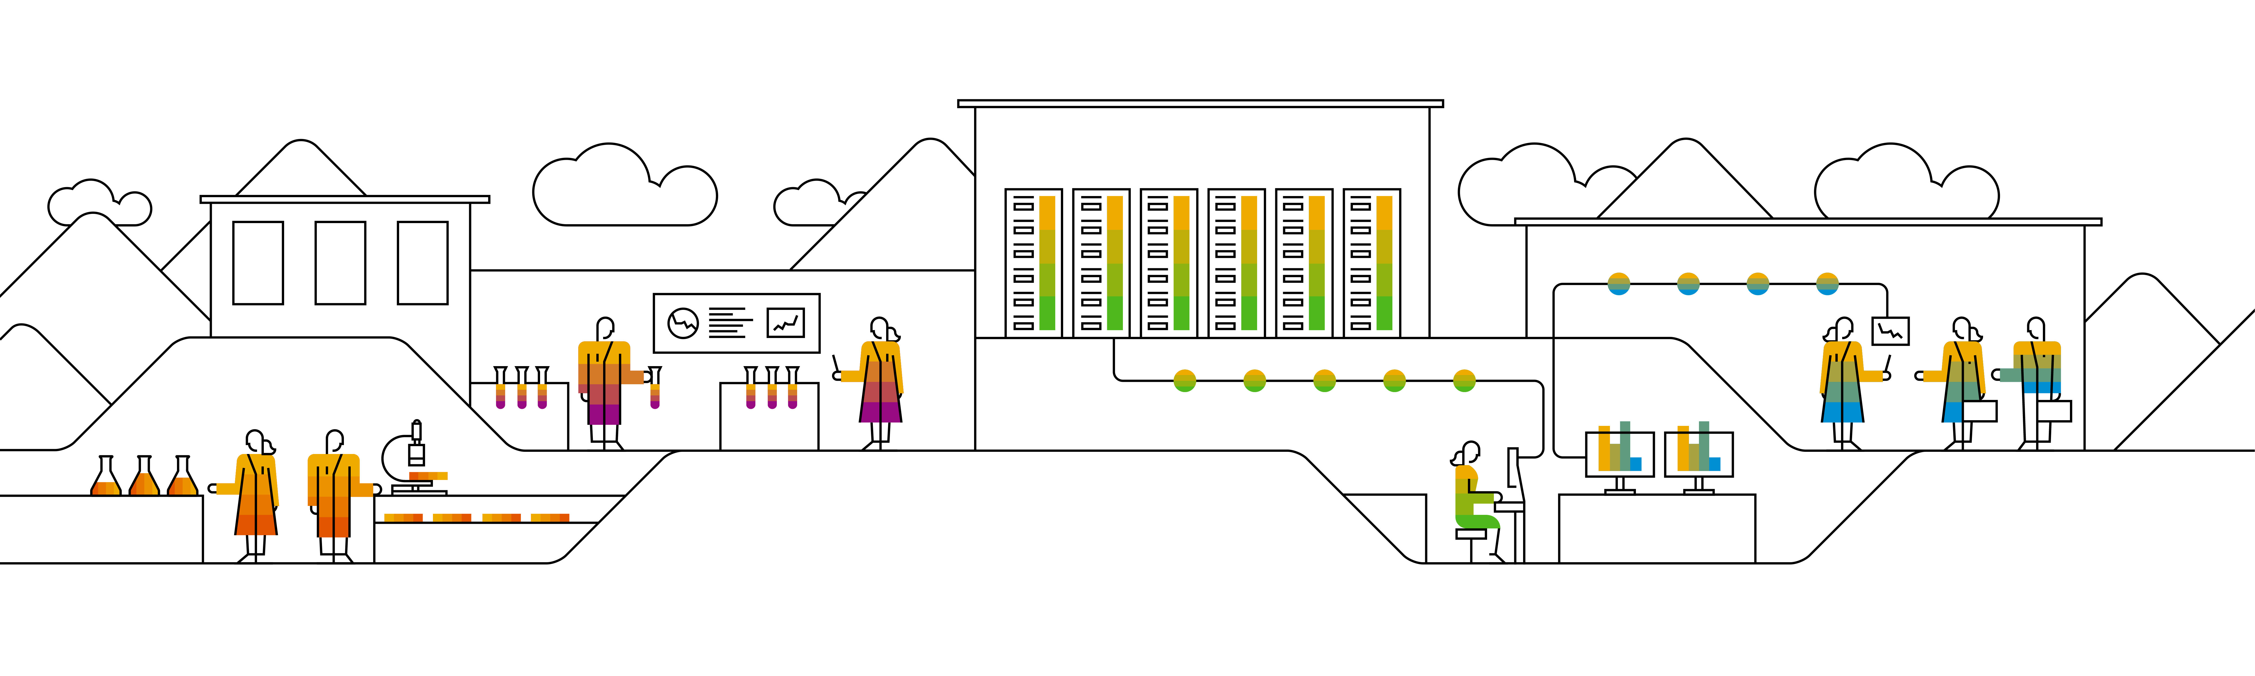

Kubernetes DaemonSets & Jobs
Notes:
When talking about scheduling, there are a few more resource type we have to take a look at (briefly): daemonSet, jobs (& cronJobs)

Slide 2
Some components require to have a pod on every node!
DaemonSet
structure is similar to deployments
selector.matchLabels
PodSpecTemplate
one pod is scheduled on each node
Node A
Node B
Node C
log collection
log collection
log collection
monitoring
monitoring
monitoring
Notes:
A daemonset works almost similar to a deployment. However the replica count is determined by the number of cluster nodes. The daemonset controller will ensure that a corresponding pod is running on each node.
Of course this behavior can be influenced by taints etc. – more details can be found here: https://kubernetes.io/docs/concepts/workloads/controllers/daemonset/

Slide 3





Job & CronJob
If exit code != 0 → consider pod as failed and restart
CronJob
Job
JobSpec
Pod
exit(??)
PodSpecTemplate
Pod terminates successfully – Job is considered ok / complete
Notes:
A job is a single or a set of pods which runs until completed successfully (usually exit code 0). Failed pods can be restarted based on the restart policy.
➔ Jobs are a way to run pods in a reliable way.
With the job resource type you can run tasks with a defined end/ no control loop.
Instances of a job (pods) can also run parallel
More details can be found here: https://kubernetes.io/docs/concepts/workloads/controllers/jobs-run-to-completion/

Slide 4
Kubernetes Scheduling

Slide 5
A note on scheduling pods…
Scheduler
Node A
Node B
Node C
Taint: NoUsers
Frontend With Backend
OnNodeB
OnNodeB
Backend With Frontend
Tolerate NoUsers
NotWith Database
NotWith Database
Notes:
There are multiple ways, to influence where pods are scheduled:
Taints & tolerations: a node is tainted and only pods explicitly tolerating the taint will be scheduled
Node selector: specify a node “type” by label to assign a pod to certain node pool
Pod affinity: explicitly schedule a pod on a node where certain pod is already running
Pod anti-affinity: don’t schedule on a node, where a certain pod is already running

Slide 6
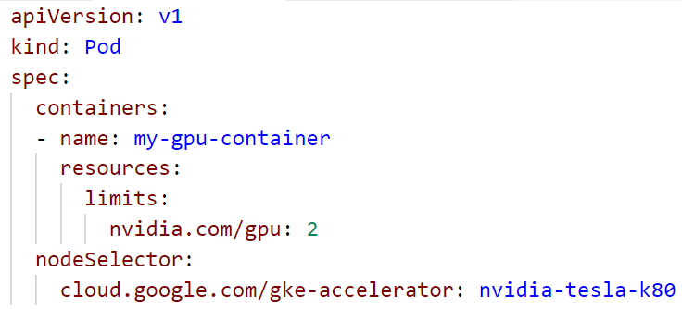
Example: NodeSelector

Slide 7

Optional Demo
Notes:
Custom scheduler - this Demo is optional!
If regular scheduling doesn’t fit to your requirements, you can build a custom scheduler.
All you need is to
a name the scheduler can be referenced by
A control loop watching the API for unscheduled pods referencing the scheduler by name
Access to the cluster API to run the loop and post the bindings
Demo :
kubectl proxy &
Create the deployment 11d_custom_scheduler_deployment.yaml
Show the pod with the specified scheduler name & run a “describe” on it. Highlight the missing default scheduling event → the default scheduler doesn’t pick it up
Run “./11e_custom_scheduler.sh <your-target-namespace>” to start the scheduling loop
Show the scheduled pods
Instead of running the scheduler locally you could also run it within the cluster – simply pack it into a docker image and use it with a deployment.

Slide 8
Kubernetes Image Pulling

Slide 9
ImagePullPolicy
Start Pod with image <> imagepullPolicy <>
imagePullPolicy:
Always
Never
IfNotPresent
Default:
if “:latest” tag is specified: “Always”
Otherwise: IfNotPresent
More info: https://kubernetes.io/docs/concepts/containers/images#updating-image
Notes:
The imagePullPolicy specifies for each container, in which cases the image should be downloaded to the node.
Always:
download each and every time a container is created.
increases security: there is no local image store that could be modified; in case of image updates with the same version tag there are no inconsistencies
may have impact on performance / startup time in case of large image size / poor network
Never:
Requires a local image store on every node
Hard to maintain
No dependency to registry at runtime
IfNotPresent:
“Download once”
May cause issues with outdated images (if version tag is re-used)
Usually sufficient

Slide 10
ImagePullPolicy: IfNotPresent
Docker
Start Pod with image <>
Image present already?
Worker
Docker
Pod
Pod
Docker pull image
Start Pod with image <>
Notes:
The docker daemon runs on each node and has an individual, local image store. So each time a pod is scheduled on a node, the daemon checks, if the image is already present.
If not the image has to be pulled (= downloaded).

Slide 11
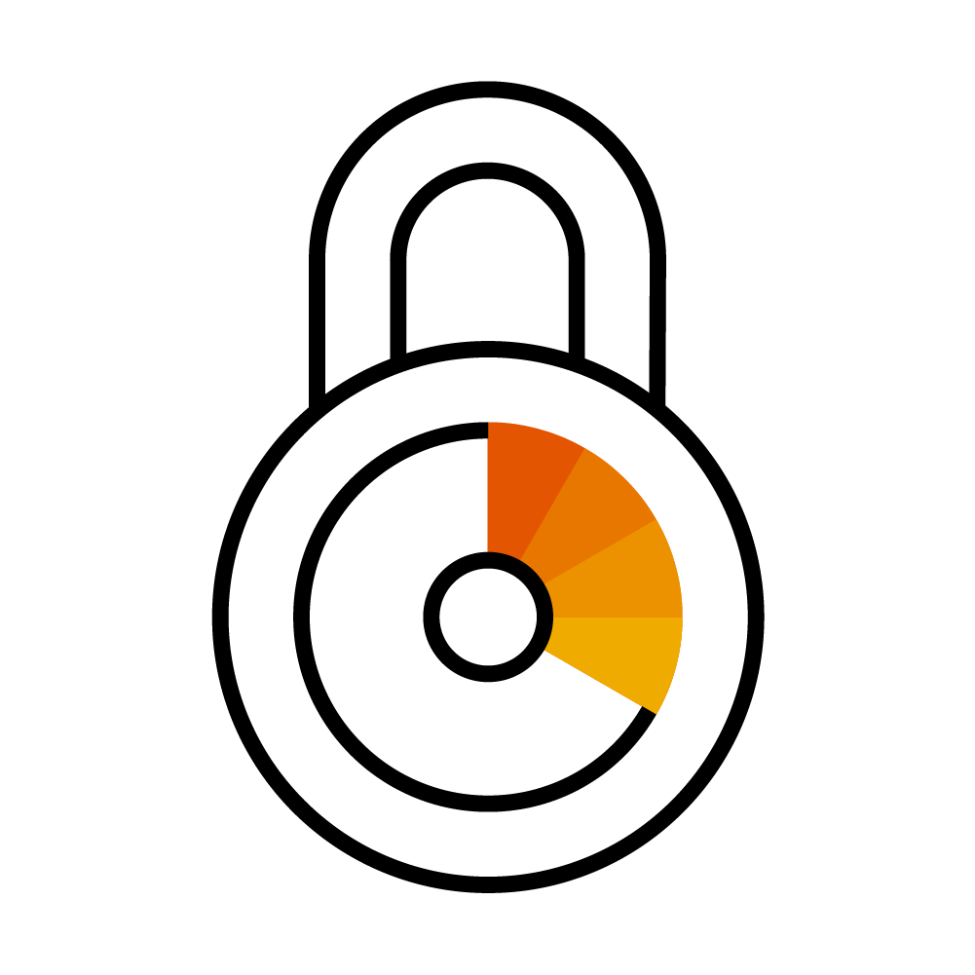
Using Images from a private registry
Kubernetes
Private Registry
Pod A
Image: private.registry.com/my-image:0.1
Notes:
Private registries are usually protect by user & password
Adocker daemon cannot pull images from a protected registry anonymously
=> So there is authentication required, similar to a local docker installation, where you run a docker login <registry>

Slide 12

Image Pull Secrets
Kubernetes
Private Registry
Pod A
Image: <>
ImagePullSecret: <>
Image Pull Secret
kubectl create secret docker-registry <name>
--docker-server=<>
--docker-username=<>
--docker-password=<>
--docker-email=<>
Notes:
Image Pull Secrets contain the same info as .docker/config.json & works similar to ‘docker login …’
ImagePullSecrets can be specified as part of the PodSpec: https://kubernetes.io/docs/reference/generated/kubernetes-api/v1.12/#podspec-v1-core
Without such a secret, the pod will end in an error state because the image cannot be downloaded

Slide 13
Image Pull Secrets
Kubernetes
Private Registry
Pod A
Image: private.registry.com/my-image:0.1
service account
“default”
Image Pull Secret
Notes:
Editing every single pod specification is cumbersome and might introduce dependencies you want to avoid.
The easier way is to assign the image pull secret to the default (or any other) service account.
As explained earlier, the service account gives its’ identity to the pod. Hence the pod can use the image pull secret implicitly.

Slide 14
Image Pull Secret together with Artifactory
Corporate Network
Docker build
Docker build
Docker push
DMZ Artifactory
Repository “test”
Docker pull
Image Pull Secret
Image Pull Secret
K8s @GCP
K8s @Azure
Notes:
How could an example look like?
Imagine, you develop locally and push your ready docker images to the artifactory in DMZ. To do so, you probably use your personal credentials to the registry and the target repository.
To deploy your application to Kubernetes, you write a deployment and specify the image you pushed to artifactory. When posting the deployment to the API server, the pod creation fails as the image cannot be downloaded – permission denied.
So next, you create an Image Pull Secret with the credentials of a technical user and attach it to the default service account of your namespace. Now the docker daemons on your nodes can download the image.

Slide 15
Kubernetes Dashboard addon

Slide 16
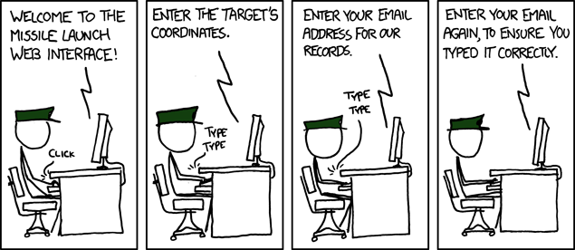
Sometimes working with kubernetes is like …
https://xkcd.com/970/

Slide 17
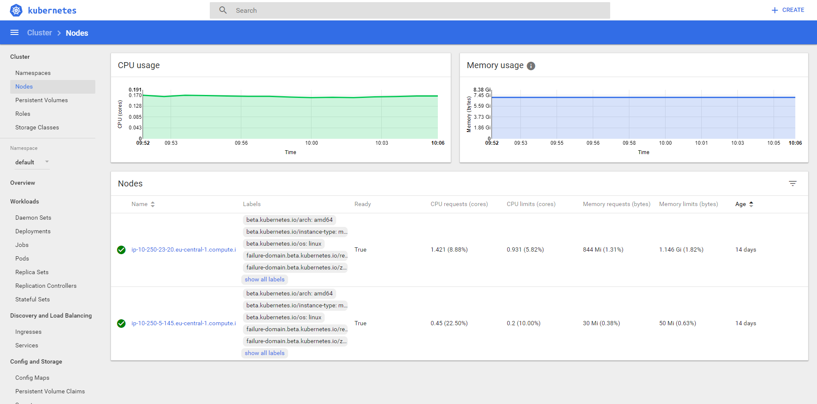
K8s Dashboard

Slide 18
(optional) Demo
Notes:
Optional demo:
To access the cluster’s dashboard, use the Gardener UI or port-forward the to dashboard pod (example: kubectl port-forward -n kube-system addons-kubernetes-dashboard-5486b968b7-zf62b 8443:8443)
Demo the dashboard
- Show status info & utilization of nodes
- Show deployments & services and how to create a new deployment

Slide 19






Wherefrom can I get a cluster?
https://github.wdf.sap.corp/pages/kubernetes/gardener
https://github.com/kubernetes/minikube
Notes:
Gardener is SAP’s solution for managed kubernetes cluster. It is open source & completely available on github: https://github.com/gardener/gardener/
Show internal landing page: https://github.wdf.sap.corp/pages/kubernetes/gardener/ including blog & help section
Jam Group Kubernetes Clusters as a Service in SAP Cloud Platform: https://jam4.sapjam.com/groups/Niq7TSBxLlzgb3nroBZJVx/overview_page/e9uqTDxXBRFbk7FJXEA4Cd

Slide 20
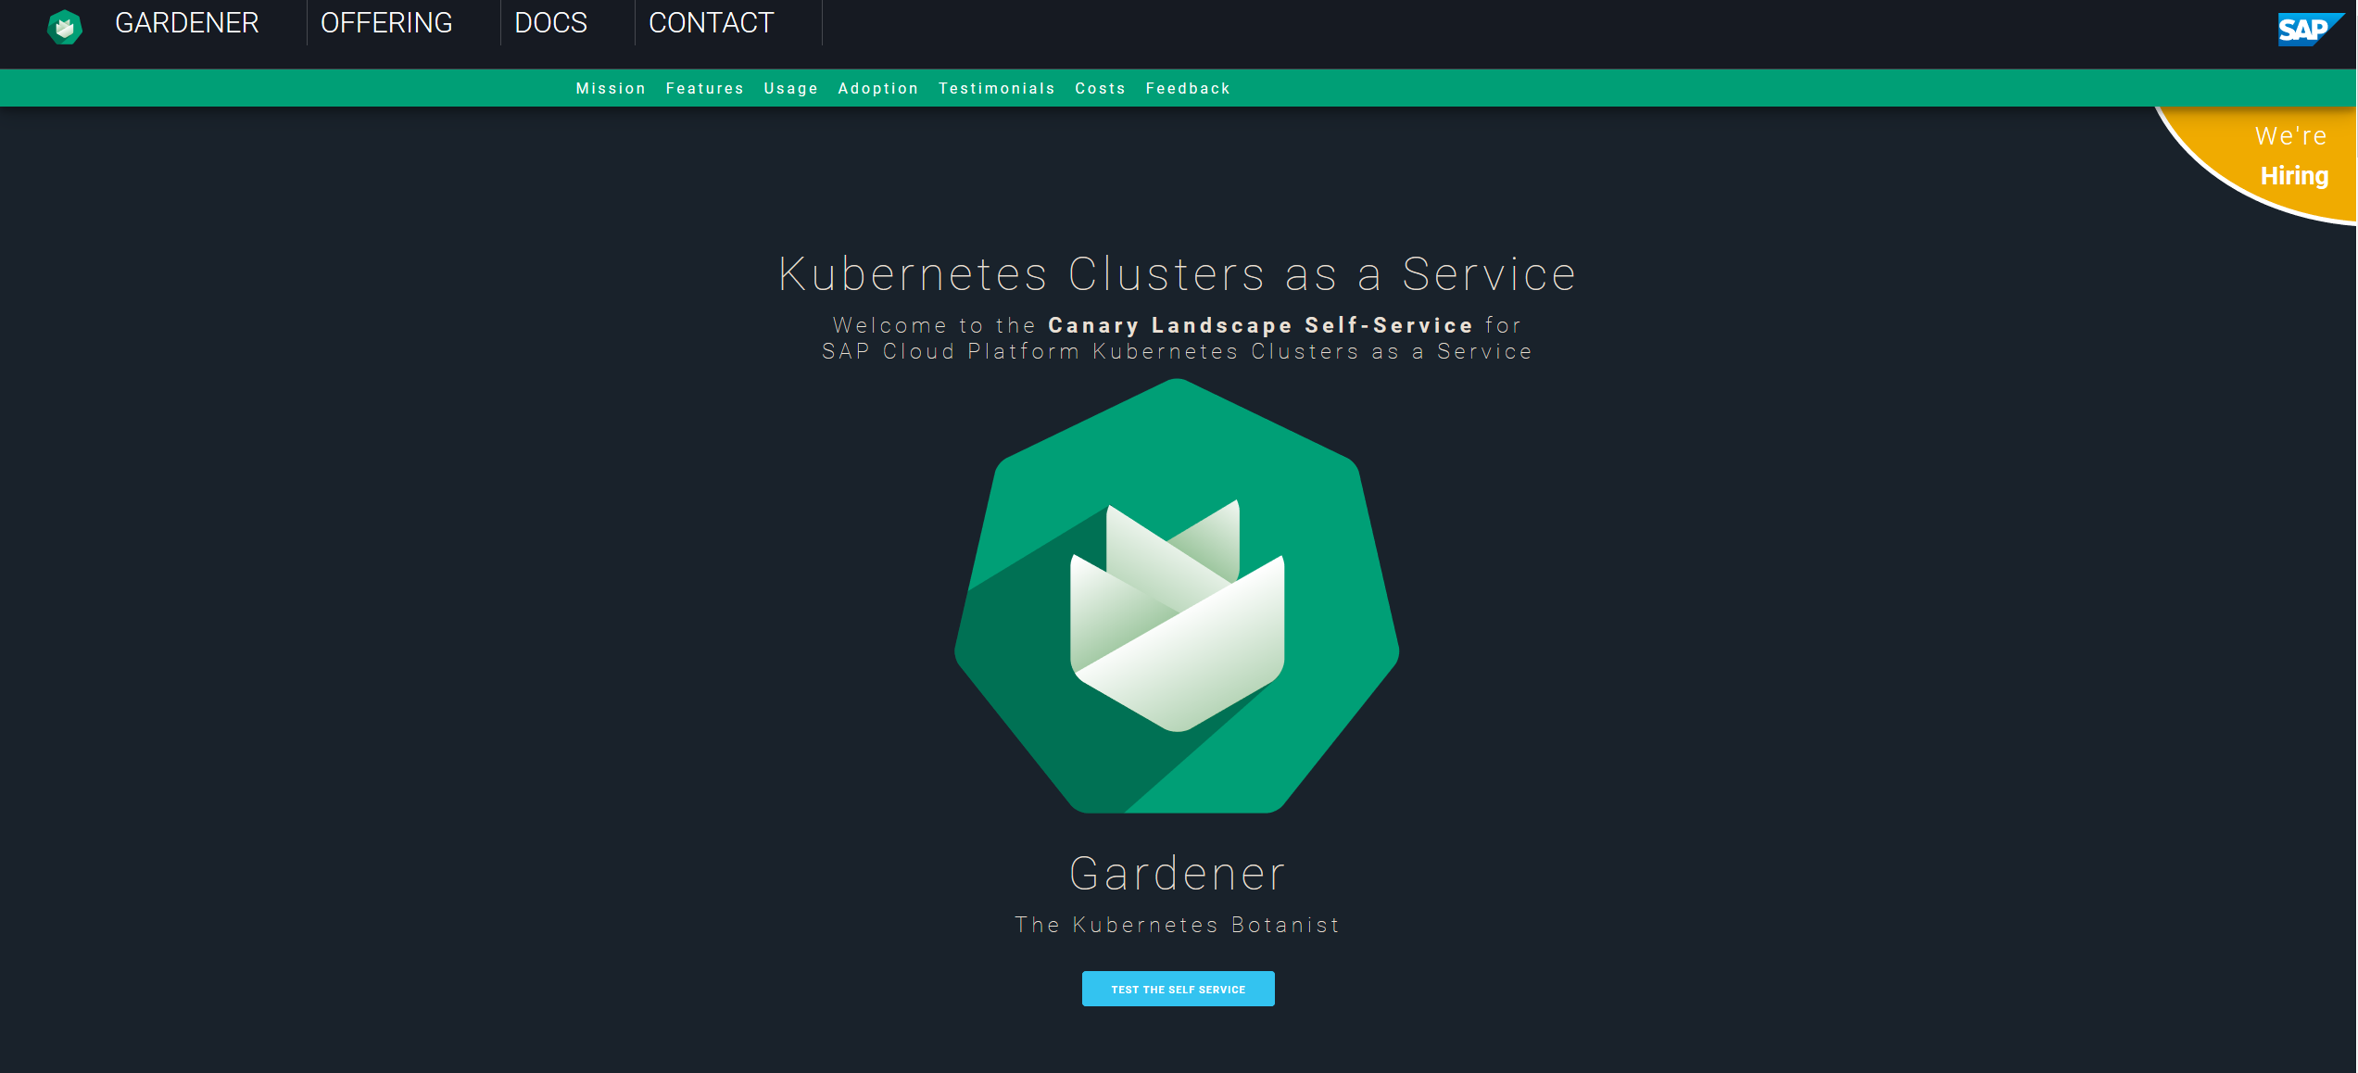
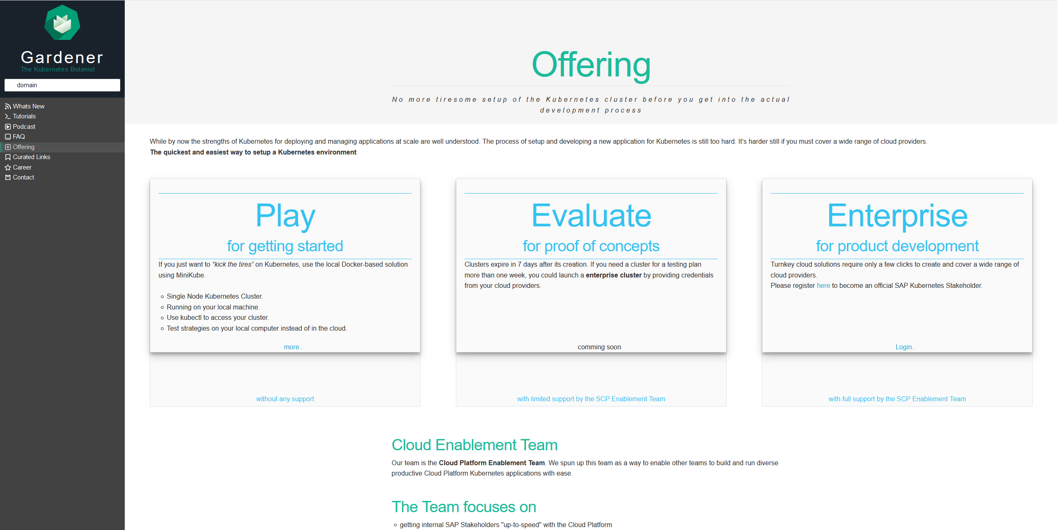
Wherefrom can I get a cluster?
Notes:
https://jam4.sapjam.com/groups/Niq7TSBxLlzgb3nroBZJVx/overview_page/e9uqTDxXBRFbk7FJXEA4Cd

Slide 21
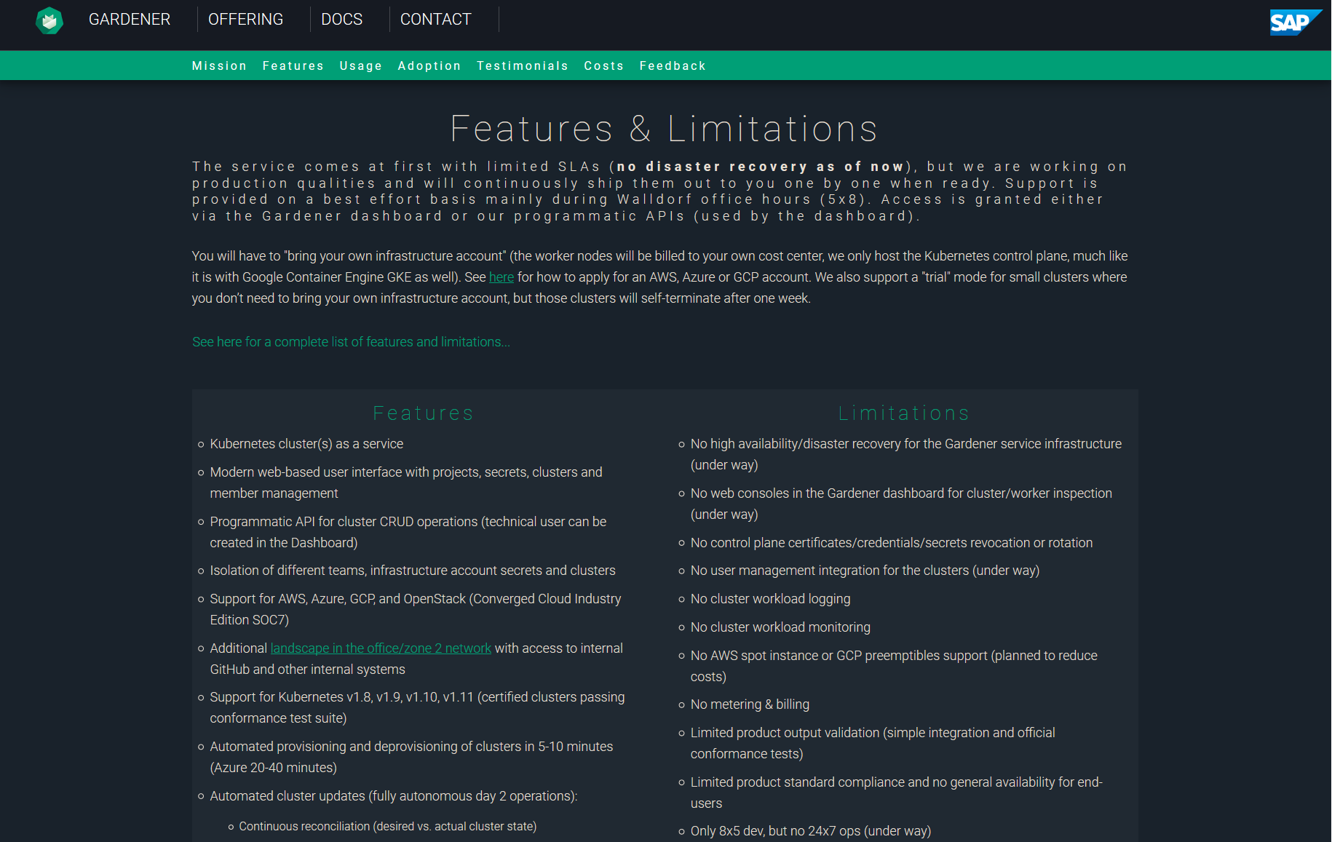
Gardener: Features & Limitations
https://github.wdf.sap.corp/pages/kubernetes/gardener/#features
https://github.wdf.sap.corp/kubernetes/kube-docs/wiki/Gardener-Service-FAQ
Notes:
https://github.wdf.sap.corp/pages/kubernetes/gardener/#features
https://github.wdf.sap.corp/kubernetes/kube-docs/wiki/Gardener-Service-FAQ
https://jam4.sapjam.com/groups/Niq7TSBxLlzgb3nroBZJVx/overview_page/e9uqTDxXBRFbk7FJXEA4Cd

Slide 22
“Traditional” Kubernetes Cluster Set-up
Master
Worker
Master
Worker
Master
Worker
Master
Worker
Master
Worker
Master
Worker
Master
Worker
Master
Worker
Master
HA
Worker
HA
HA
Master
Worker
Master
Master
Worker
Worker
Worker
Master
Worker
HA
Worker
Worker
The red nodes run the control plane,
often in HA and on separate hardware
(usually quite underutilized)
The blue nodes run the actual workload and is managed by Master Nodes (usually pretty well utilized)
Notes:
Setting up lots of small clusters individually leads to resource waste. The control plane / master needs to be high available but the resources reserved for fail-over usually idle.

Slide 23
The Gardener: Control Plane Engineering with minimal TCO!
Seed Cluster
Shoot Clusters
Master
Worker/Minion
Worker/Minion
Worker/Minion
Management Vector
into all
Control Planes
Master
Worker/Minion
Worker/Minion
Worker/Minion
Master
Worker/Minion
Worker/Minion
HA
Worker/Minion
Worker/Minion
manages
Worker/Minion
Worker/Minion
Worker/Minion
Worker/Minion
Worker/Minion
ETCD
API Server
ETCD
Worker/Minion
Worker/Minion
Scheduler
Controller Mgr
Worker/Minion
Auto-scaling via native
hyperscale provider service
or controller on bare metal
Think outside the box /
Move outside the box!
Controller Mgr
Scheduler
API Server
ETCD
…
Notes:
Solution: Gardener runs the control plane / master components of many “worker” clusters in a separate cluster

Slide 24
Appendix

Slide 25
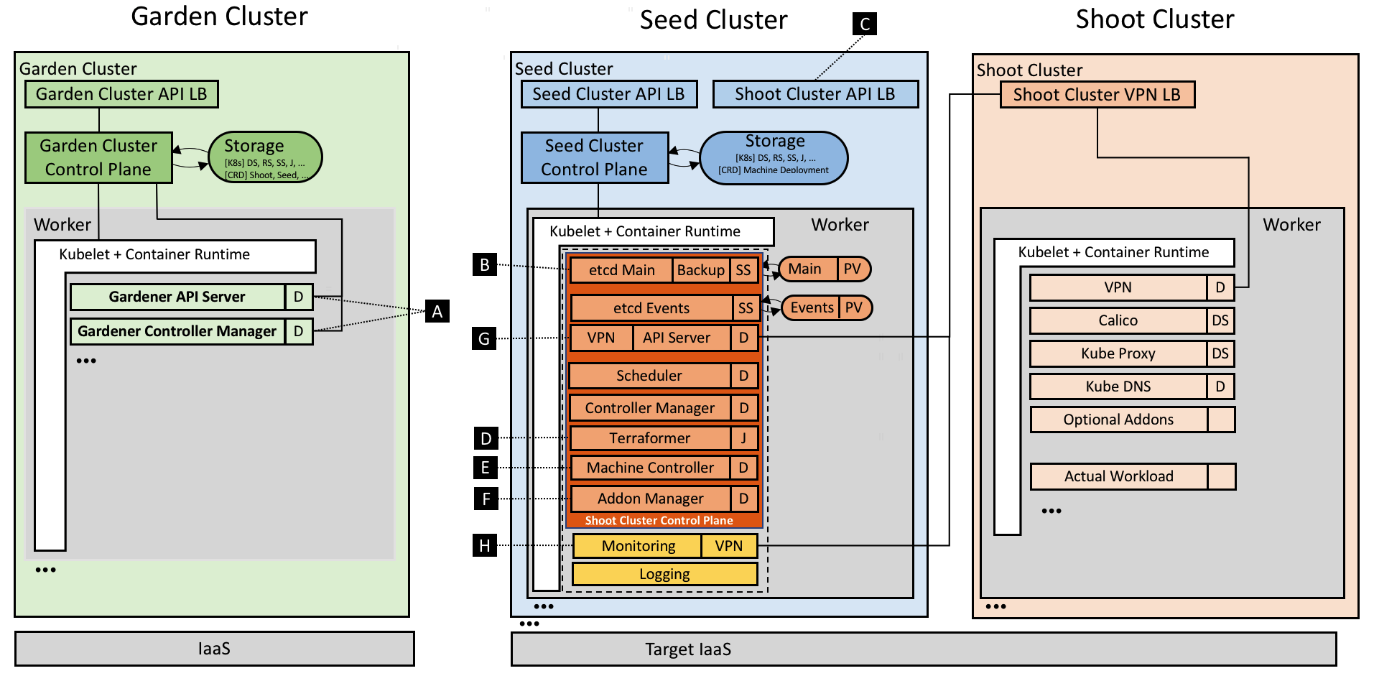
The Gardener: Technical landscape
https://kubernetes.io/blog/2018/05/17/gardener/

