Slide 1

Creating images with Dockerfiles

Slide 2

Building Docker images
Docker Runtime
Creating a Docker image involves two things
A Dockerfile containing directives on how the image is meant to be built
A build-context (or PATH) which is a directory on your hard disk
every file to be added to the image must be inside the build-context
Image is built by the Docker daemon
the whole build-context is sent to the daemon
Dockerfile is processed
Image stored in the local image store
dockerd
image storage
my image
docker build
“Warning: Do not use your root directory, /, as the PATH as it causes the build to transfer the entire contents of your hard drive to the Docker daemon.”
https://docs.docker.com/engine/reference/builder/#usage

Slide 3
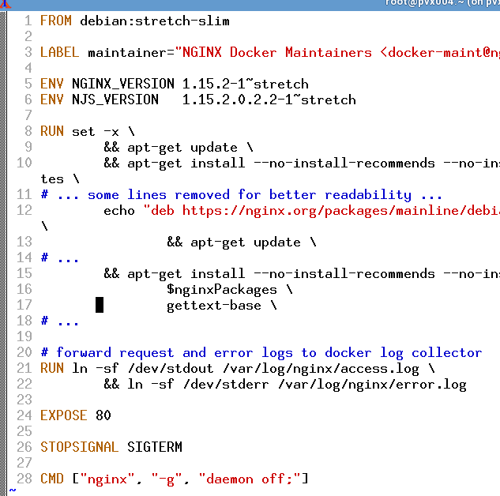
Ingredients of a Dockerfile
First line: FROM
Meta-data can be added as LABEL
Environment variables can come in handy with ENV
You can ADD or COPY files to the image
It is possible to RUN commands in the image
Do not forget to EXPOSE network ports
Containers start their life with a CMD or an ENTRYPOINT
Each line is executed in a temporary container which gets persisted as a new layer on top of the existing layers.
Remember the layer limit – keep it short and simple.

Slide 4
Dockerfile directives (1)
FROM
first line in a Dockerfile
specifies which image to build upon / to extend
special case: FROM scratch starts from scratch without any previous image
ENV
Sets an environment variable
Will be present during the build process and in the final image
Examples:
FROM debian:jessie
will pull the a Debian image from Docker Hub and use it as base image
FROM scratch
will start with an empty image
Examples:
ENV http_proxy http://proxy:8080
will set the http_proxy environment while building the image and in the finished image

Slide 5
Dockerfile directives (2)
LABEL
sets meta-data of an image
labels are key-value pairs
Examples:
LABEL maintainer="Homer Simpson"
adds a piece of meta-data to the image specifying the maintainer

Slide 6
Dockerfile directives (3)
ADD
adds a file from the build-context to the image
can download files from a URL
will automatically extract archives
COPY
copies a file from the build-context to the image
no additional magic like the ADD command
does not copy files inside the image
Examples:
ADD rootfs.tar.bz2 /
will extract the contents of rootfs.tar.bz2 to the root directory / of the image
ADD http://plx172:1080/pic.jpg /usr/share/pics
will download a picture from plx172 and place it into the image at /usr/share/pics
Examples:
COPY default.conf /etc/nginx/conf.d/
will copy the file default.conf into the image at /etc/nginx/conf.d/default.conf

Slide 7
Dockerfile directives (4)
RUN
runs the specified command in the image
command binary and shell must be present in the image
EXPOSE
exposes a port
exposed ports can be automatically mapped by Docker
Examples:
RUN apt-get update
will run the Debian package manager and build its package cache inside the image
RUN cp /etc/nginx/nginx.conf /root
will copy the file /etc/nginx/nginx.conf within the image to the directory /root within the image
Examples:
EXPOSE 80
will expose port 80 so that “docker run -P” can automatically map it to a port on the host

Slide 8
Dockerfile directives (5)
CMD
specifies the command to run when a container is created from the image
all but the last CMD directive are ignored
can be overridden upon container instantiation
ENTRYPOINT
sets the program to be directly run when a container is created
can be overridden with the option “--entrypoint”.
Examples:
CMD /bin/helloworld
will run a hello-world program when the container is started. This form is executed in a shell
CMD ["nginx", "-c", "daemon off;"]
will run the nginx binary with the arguments “-c” and “daemon off;” This form is directly executed via a system call (without shell)
Examples:
ENTRYPOINT [ "/usr/bin/nginx" ]
starts nginx directly without using a shell to start it. (Note the brackets)

Slide 9
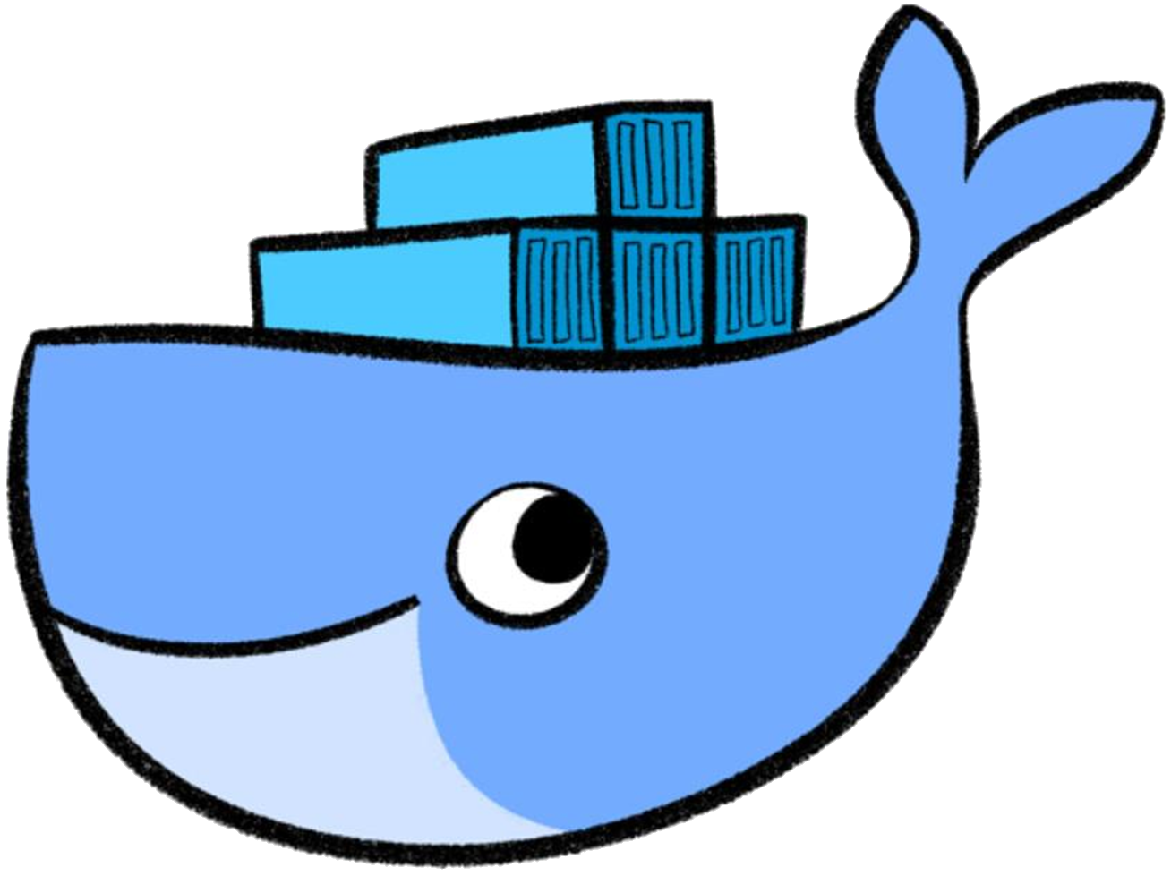

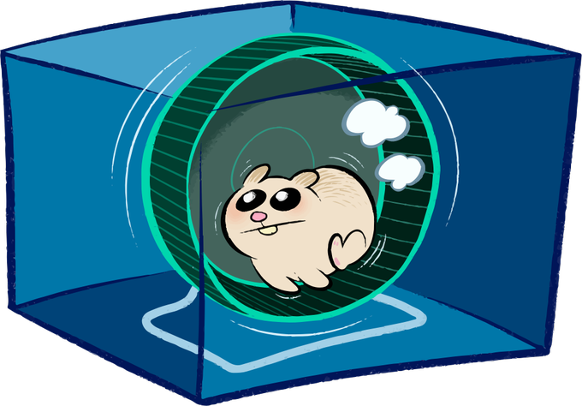
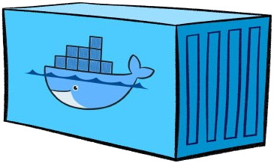
Entrypoints, CMDs and the container lifecycle
ENTRYPOINT is /bin/bash
config.json
ENTRYPOINT?
run ENTRYPOINT with CMD as argument
add some salt and pepper…
set up cgroups…
merge image layers…
create namespaces
CMD?
CMD is nginx -c daemon off;
PID 1
ENTRYPOINT CMD
/bin/bash nginx –c deamon off;

Slide 10
Dockerfile directives (6)
USER
Set the active user & group for following commands
Specified user is valid for RUN as well as CMD & Entrypoint
Prerequisite: the target user / group has to exist
Examples:
RUN adduser -D -s /sbin/nologin nginx
will create a new user with name “nginx”
USER nginx
will switch from current user to “nginx”. Valid for all following commands such as RUN but also when starting a new container later

Slide 11

Running a container as root
user “root” within the container is the same as outside
Via volumes files owned by “root” can be created or modified on the host
# whoami
>> root
# id root
>> uid=0(root) gid=0(root)
# touch /hostfs/test
$: ps aufx
…
root /usr/bin/containerd
root \_ containerd-shim -namespace moby
root \_ /bin/sh
root \_ whoami
Notes:
Let’s have a look at the implications of the USER directive.
When a process within a container is running as user root, the process will be also run as user root on the host. This can open doors for some severe (security) issues as an attacker might try to break free from the container.
What could happen? For example if the host’s file system is mounted into the container, touching or modifying files happens in the name of user root. Even if the user you used to start the container (docker run) is not root, you can now act as root user (privilege escalation) .

Slide 12
USER – non-root is best practice!
Use a different user within the container to limit access to the host
Regular permission checks apply
# whoami
>> app-user
# id app-user
>> uid=1001(app-user) gid=10001(app)
# touch /hostfs/test
Permission denied.
$: ps aufx
…
root /usr/bin/containerd
root \_ containerd-shim -namespace moby
1001 \_ /bin/sh
1001 \_ whoami
Notes:
When building images, it is recommended to create a separate user and let the CMD/ENTRYPOINT command run with this specific user.

Slide 13
User Namespace: remap
user “root” within the container is mapped to a different UID
Docker can be configured to automatically remap user & groups
# whoami
>> root
# id root
>> uid=0(root) gid=0(root)
# touch /hostfs/test
$: ps aufx
…
root /usr/bin/containerd
root \_ containerd-shim -namespace moby
231072 \_ /bin/sh
231072 \_ whoami
Notes:
Another way to deal with this topic is the usage of the user namespace. It allows to define mappings (check /etc/subuid file) so that your user appears to be root from within the container but not from the outside.
Right now the docker daemon supports the usage of the user namespace but it is not switched on by default.
To enable this feature:
Add "userns-remap": "default“ to /etc/docker/daemon.json (fit it into the existing json structure).
Reload the config & restart docker:
systemctl daemon-reload
systemctl restart docker
Check /etc/subuid -> it should have a docker remap user entry now.
Important: this feature is currently not compatible with Kubernetes!
Details can be found in these discussions:
https://github.com/scality/metalk8s/issues/484
https://github.com/kubernetes-sigs/kubespray/issues/962
https://github.com/kubernetes/kubernetes/issues/59152

Slide 14
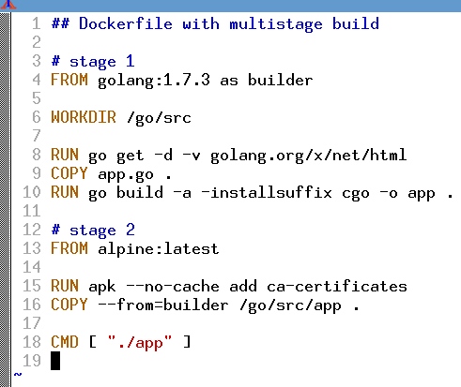
Docker multistage builds
First build stage with dedicated stage name ("as builder")
Second stage is done in a container totally separate from first stage
Files get copied from the container of the first build stage

Slide 15

Exercise #3 & #4 – Dockerfiles

