Slide 1
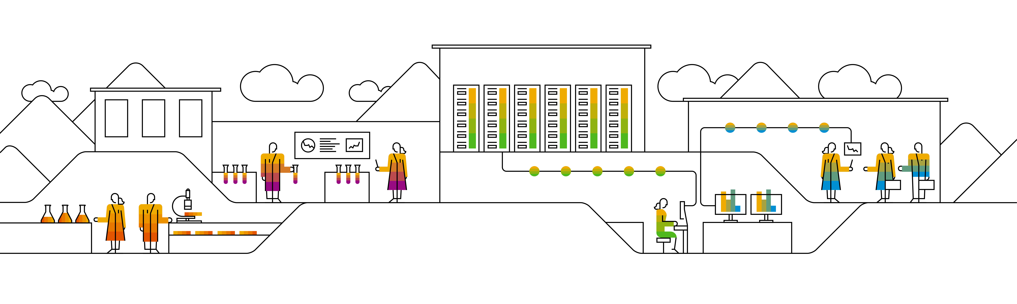

Kubernetes Pods

Slide 2
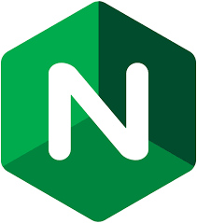

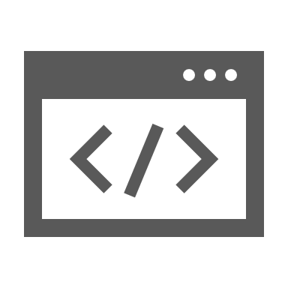


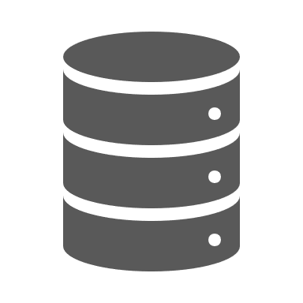



When we have containers, why do we need Pods?
Environment Variables
Application Configuration
User IDs
IP: 10.10.10.1
init.sh
Storage
Runtime Security
nginx -g 'daemon off;'
Resource Consumption
Shared Files
log_collector
Notes:
All we want, is to run a simple nginx webserver. So we need an environment to start the process, have it listen to a port and exposed via an IP address so our users can acess the webserver.
Next, we have to configure the application via config files and add some storage to persist data processed by the webserver. Also some parameters are best set via environment variables of the surrounding runtime context (i.e. shell).
Once the app webserver is properly running, we need think about security settings and resource consumption (CPU, memory).
And of course, some logging would be nice. We could use a log collector running as a separate process ingesting data via a shared file system. Also we figured out, that some steps should run prior to the webserver start. So we will run an init script beforehand.
Now, all of these things can be summed up and bundled on one host. Or in the context of Kubernetes – a Pod. It grants you all the configuration possibilities, as well as the environment to run multiple process groups as individual containers + define a sequence.
Finally, if someone pulls the plug of this virtual/logical host, no one takes care of restarting it automatically. Additional constructs are required (which will be covered in the next chapters)

Slide 3
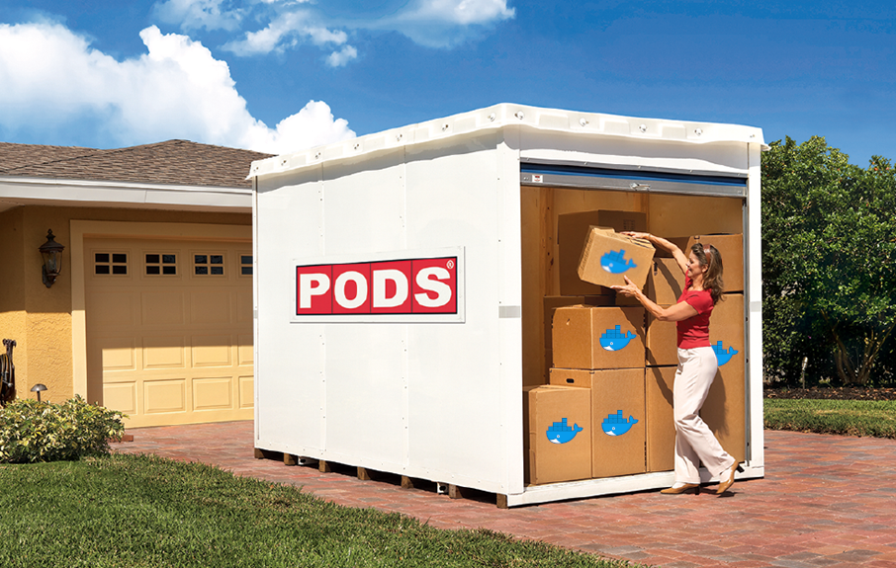
Pods – logical hosts
Pods logical constructs introduced by K8s
IP: 10.10.10.1
Container in a pod share network & storage
All containers of a pod run on the same node
Container processes run on a node
Node
Notes:
A pod (as in a pod of whales or pea pod) is a group of one or more containers (such as Docker containers), with shared storage/network, and a specification for how to run the containers
Containers of a pod share localhost network interface
A pod can provision ephemeral storage or attach persistent storage
Pods are started by kubelet but can die any time without necessarily being re-scheduled
Pods can be probed by kubelet (liveness & readiness probe)
Most important pod phases / status:
Pending
Running
Succeeded
Failed
Unknown
Usually there is 1..1 relation between pod and container on a pod. Only if you have tightly coupled applications it makes sense to run multiple containers in one pod.
Example 1: Having a Jenkins and a logging database in one pod may perform better than in separate pod. However this needs to be evaluated case by case.
Example 2: Having a side car container for maintenance

Slide 4
Pods
A pod (as in a pod of whales or pea pod) is a group of one or more containers (such as Docker containers), with shared storage/network, and a specification for how to run the containers
Containers of a pod share localhost network interface
A pod can provision ephemeral storage or attach persistent storage
Pods are started by kubelet but can deleted any time without necessarily being re-scheduled
Container in a pod can be probed by kubelet (liveness & readiness probe)
Most important pod phases / status:
Pending
Running
Succeeded
Failed
Unknown

Slide 5

Pods on process level
mount
mount
uts
uts
pid
pid
ipc
net
Notes:
Multiple container within a pod are realized by assigning several shared resources and namespaces to them.
Both containers share the user namespace (user mapping is the same in all containers in a pod), the IPC namespace (all containers can access the same shared memory segments) and the network namespaces (i.e. they are connected through the same virtual network interface and the same network stack).
What separates the containers are individual and dedicated namespaces for PID, UTS (containers have different hostnames) and mounts.

Slide 6
Anti-pattern: don’t create God pods
IP: 10.10.10.2
god-pod
Container:
database
Container:
app-layer
Container:
front-end
Container:
proxy
Container:
app-layer
volume
volume
Notes:
Why don’t we just put all container / pieces belonging to an application stack into ONE single pod? The run nicely co-located on the same host and we don’t have latency issues, they can share a network, IPC and so on…
This is probably a bad idea for following reasons:
Does it scale? Not so well – you can only scale on pod level, so you would need to replicate the complete set. Scaling of individual components is not possible at all
Usually the startup time of these constructs is poor.
Is it easy to schedule? Of course not – in the past an application stack consumed one to several VMs. Nodes in your cluster have to be of adequate size (xxl?) and there should be a sufficient amount of nodes for scaling / re-deployment. Potentially also impacts resource utilization.
Any changes to a single container definition will affect all others. For example, if the image used for the “front-end” is changed, the complete pod gets rescheduled.
Conclusion: as a rule of thumb: one pod – one purpose (+ sidecar, adapter, augmentation)

Slide 7
Sidecar pattern – or when to use multiple container in a pod
Application container
Helper container
IP: 10.10.10.2
Pod-B
Container:
nginx
Container:
proxy
volume
Notes:
We said that a pod may consist of more than one container. But when should you use such a feature? The so called ‘sidecar’ pattern gives a few ideas:
In general there is always one ‘main’ container, often also referred to as the application container. This primary container hosts the core logic of your application. In our example this is a ngnix webserver
The 2nd (sidecar) container provides augmentation to improve the application container. To do so, both container need to share certain resources like disk space or network.
Think of the following setup: You have a webserver serving on port 80 (plain http). To add https you would need to touch your application. Alternatively you could add a proxy container that augments your webserver with https. Simply let your primary container serve port 80 only to localhost and capture that traffic in your proxy container, which then provides https.
Another example would be a configuration update mechanism realized with a helper container. A nginx webserver reads its configuration from a file. If this file is updated, a restart would be required. Think of a helper container, which takes notice of the configuration change and restarts the nginx in order to make it re-load the configuration. This is possible, since both container share the same volume (disks) and also the process namespace (if configured properly).

Slide 8
More useful pattern – adapter
Adapter processes & exposes data in a common format
Application container
IP: 10.10.10.2
Pod-A
Container:
nginx
Container:
log-collector
volume
Adapter collects data via shared volume
Notes:
Instead of augmenting your application with a helper – as we did for the sidecar – there are two more “standardized” approaches to common issues.
Adapter – this pattern is often used to process data output and provide these to a consumer. An adapter presents a standardized view or abstraction of the application to entities outside of the pod.
One of the most obvious use cases is a log collector. Data is shared via a volume within the pod and converted into a standardized format. The log collector might also ship the data to central logging system.

Slide 9
More useful pattern – ambassador
Application container
The ambassador is an abstraction of another service entity
IP: 10.10.10.2
Pod-B
Container:
nginx
Container:
access-to-DB
It is available via localhost and takes care of traffic forwarding
volume
Notes:
Instead of augmenting your application with a helper – as we did for the sidecar – there are two more “standardized” approaches to common issues.
The ambassador pattern is a way to manage access to other entities. It is responsible for the service discovery /configuration part, while the application usually works with a localhost interface.
In this example the application container needs to access a database. Instead of hard-coding a specific database name, it just talks to the localhost interface. In a test setup the database might be available on the same host as well. In a distributed setup the ambassador acts as an interface that forwards the traffic to an actual DB instance.
This way the application doesn’t have to store setup specific information and only the ambassador needs to be aware of its environment.
So this pattern can be used to hide the complexity of the environment outside the pod.

Slide 10
Basic structure of most K8s resources
api the resource belongs to, e.g. “v1”
apiVersion
value
resource type, e.g. “pod”
kind
value
metadata
metadata like name, annotations or labels are maintained here
metadata object
spec
spec object
specification of the resource based on its “kind”
status
status object
Information supplied by k8s, not maintained by users
Notes:
Example for a resource with different structure: configMap
configMaps have no spec, but a data sections.
When looking at the api reference, you can see this basic structure too. Simply navigate to a resource, like pod, and see with fields and object there are. Usually fields have either a list or string/integer as values. Objects link to their object definition.

Slide 11
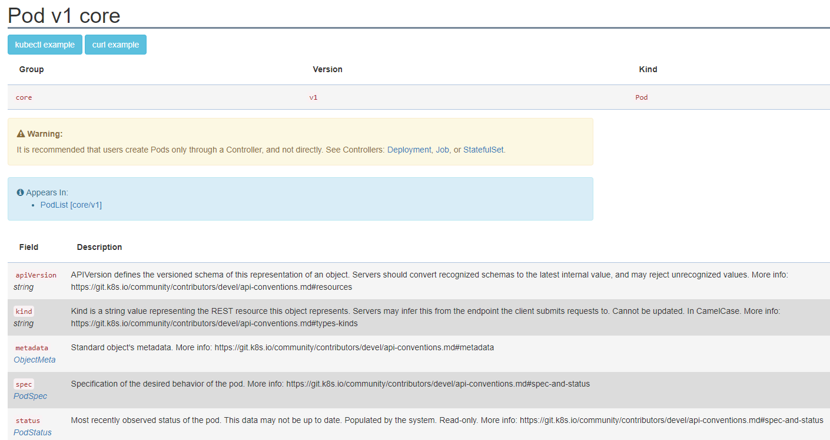
API documentation – Pod structure
https://kubernetes.io/docs/reference/#api-reference
Notes:
If you want to know more about the structure of any kubernetes resource, you can go to the official API documentation on https://kubernetes.io/docs/reference/#api-reference or use “kubectl explain <resource>” command.

Slide 12
kubectl explain pod
$: kubectl explain pods
KIND: Pod
VERSION: v1
DESCRIPTION:
Pod is a collection of containers that can run on a host. This resource is
created by clients and scheduled onto hosts.
FIELDS:
apiVersion <string>
APIVersion defines the versioned schema of this representation of an
object. Servers should convert recognized schemas to the latest internal
value, and may reject unrecognized values. More info:
https://git.k8s.io/community/contributors/devel/api-conventions.md#resources
kind <string>
Kind is a string value representing the REST resource this object
represents. Servers may infer this from the endpoint the client submits
requests to. Cannot be updated. In CamelCase. More info:
https://git.k8s.io/community/contributors/devel/api-conventions.md#types-kinds
metadata <Object>
Standard object's metadata. More info:
https://git.k8s.io/community/contributors/devel/api-conventions.md#metadata
spec <Object>
Specification of the desired behavior of the pod. More info:
https://git.k8s.io/community/contributors/devel/api-conventions.md#spec-and-status
status <Object>
Most recently observed status of the pod. This data may not be up to date.
Populated by the system. Read-only. More info:
https://git.k8s.io/community/contributors/devel/api-conventions.md#spec-and-status
Notes:
kubectl explain <resource> is the command line access to the api documentation. It gives the same information as the online documentation.
You can get more details on specific objects or fields by appending them with .<field> → e.g. “.spec” or “.apiVersion”

Slide 13
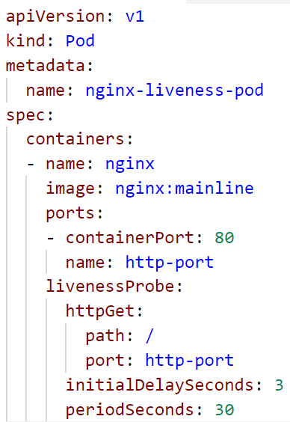
Pod definition - https://kubernetes.io/docs/api-reference/v1.8/#pod-v1-core
Resources of “kind:pod” belong to “apiVersion: v1”
Within “metadata” the pod’s name is specified
The pod’s “spec” provides all the necessary details, like the image to use, to actually start a container
The livenessProbe defines a check, to determine, if the pod is in a healthy state

Slide 14
Liveness & Readiness Probes
Respond with HTTP 200, if you are alive!
Send back the index.html, if you are ready!
HTTP 200 ‘OK’
index.html
nginx-pod
Container:
app
Notes:
Demo: http & exec liveness pods (see pod_exec_liveness & pod_http_liveness yaml files in the solutions folder)
Consequence of failed probe:
liveness: kill the container and restart it depending on the restart policy.
Readiness: mark pod as not ready and don’t route service traffic to it
Other options for probes:
TCP: can a connection be opened successfully?
EXEC: run a command and evaluate return/exit code

Slide 15

Demo
Notes:
Start with the “kubectl explain pod” and “kubectl explain pod.spec”
Show how to get an overview as well as detailed info about a resource type.
When creating pods, demo the --dry-run flag
Create a pod: ~/kubernetes/demo/02b_pod_exec_liveness.yaml
Discuss the probe and how it should fail
Show how it fails & get restarted
Point out the failure threshold
Create a 2nd pod, this time with a web server: ~/kubernetes/demo/02_pod_http_liveness.yaml
Explain the http probe and how it should fill up the logs
Show logs of the container (will be the access log) and discuss the effect of the liveness probe
Access nginx:
Run kubectl port-forward pod/nginx-liveness-pod 8080:80
Open a browser and connect to 127.0.0.1:8080
Port-forward is a nice command to test access to something that you don’t want to expose (yet). However it is not recommended for any production like setup as the traffic is routed via the cluster’s API server

Slide 16
What YOU will do in exercise #02
Create a single pod
nginx
nginx
nginx
content
config
tls certs

