Slide 1
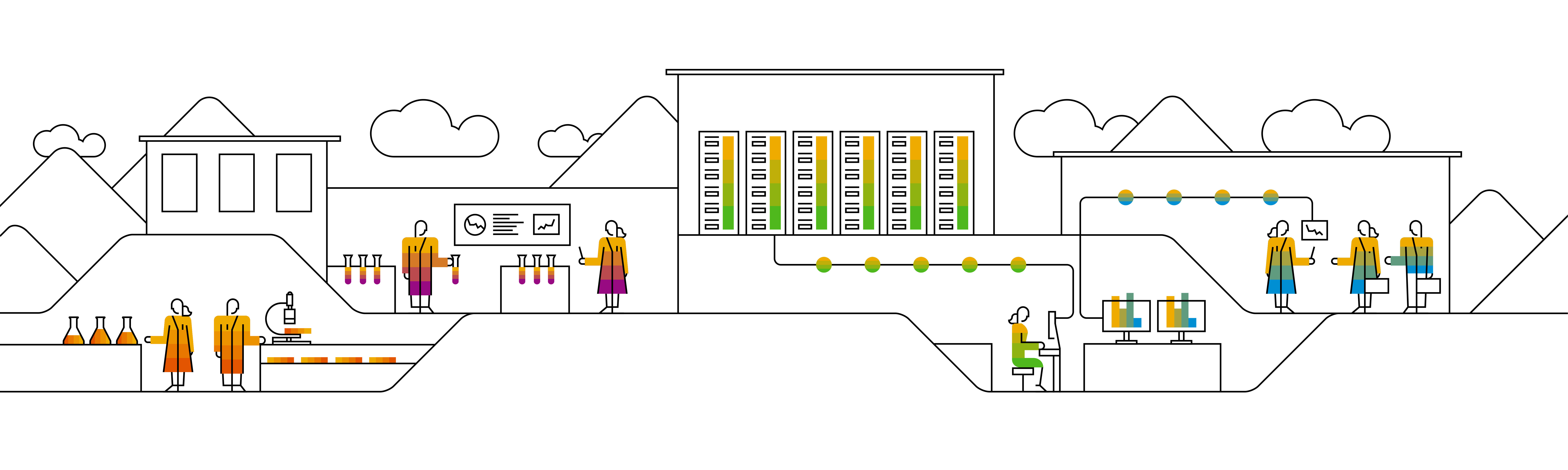

Kubernetes Ingress

Slide 2


External availability of services – how did it work, so far?
Inside K8s
Load Balancer
External IP
Load Balancer
External IP
Service
Pod
Load Balancer
External IP
Service
Pod
Service
Pod
NodePort:30123
Pod
No
de
s
Service
Pod
Notes:
What we’ve learned so far:
To expose a service to the outside world (outside of cluster scoped DNS/IP range), we can use NodePorts or LoadBalancer / External IP services.
The NodePorts are straight forward as they re-use the cluster nodes to get externally available endpoints.
The LoadBalancer type of service however requires a 3rd party entity, which assigns it a public IP address and sets up forwarding rules etc.
The problem here is most likely the availability of such a 3rd party entity that is able to provision IP addresses. It is also possible to assign a previously acquired external IP address manually to a service, but that doesn’t scale well nor is it properly automated.
Additionally, the external endpoints we know, only serve exactly one type of backend. You can have multiple ports in a service, but they all point to the same backend type determined by label selectors. Managing two different applications with one service is not possible (in a reliable way).
Ingress resources address most of the issues.

Slide 3
Ingress
Services target networking on L4
Ingress are a L7 construct
Services can only expose one backend
More backends involved, imply more services needed
Exposing several applications to the internet, requires multiple services ➔ multiple IP endpoints
Ingress resources can help:
Bundle services into one endpoint
Make application available via a URL
TLS support
…
Ingress
Service A
Service B
Service C
Pod A
Pod B
Pod C
Notes:
A service can only serve one backend. Complex applications may need more than one backend. With Ingress resources, several backends can be exposed via a single entrypoint
Allows to create a network entity on top of services to expose applications
Expose applications via a URL and a shared “loadbalancer” IP
Requires an “ingress-controller” inside the cluster
https://kubernetes.io/docs/concepts/services-networking/ingress/

Slide 4
How does it work?
Ingress
Ingress resource describes the desired state
Cluster specific “ingress controller” will enforce desired state
Creation of endpoints
Creation of an external loadbalancer or re-use of existing
URL mapping
TLS termination
…
https://kubernetes.io/docs/concepts/services-networking/ingress/
https://github.com/kubernetes/ingress-nginx
Ingress-controller
Notes:
The ingress controller needs to be present in the respective cluster. It is configured to watch for new ingress objects being posted to the k8s api server.
Once an ingress resource is created, the controller will try to enforce the desired state. That can include the setup of URL & corresponding routing info etc.
Most common ingress controller is the “nginx ingress controller”

Slide 5
Single service ingress (with TLS)
Ingress controller is in charge of *.ingress.com domain to register new records
Inside K8s
Pod
Port 80
Ingress
https://app.ingress.com
35.205.166.164
Service
Port 8081
Pod
Port 80
Users access the backend via https://app.ingress.com
TLS secret
server-key.pem
server.pem
TLS termination at Ingress endpoint requires a secret with correct subject
Notes:
The easiest way of using an Ingress is as an entry point to a single service with one to multiple pods. The ingress is created for a dedicated URL (assuming the controller is in control of the domain). Users can use the URL specified with the Ingress resource to access the service & associated backend pods.
You can add TLS termination at the Ingress endpoint by specifying a TLS secret with the corresponding hostname as subject or alternative subject.
From the services perspective everything works as usual. A port and a target port are specified and base on labels and selectors the traffic is routed.

Slide 6
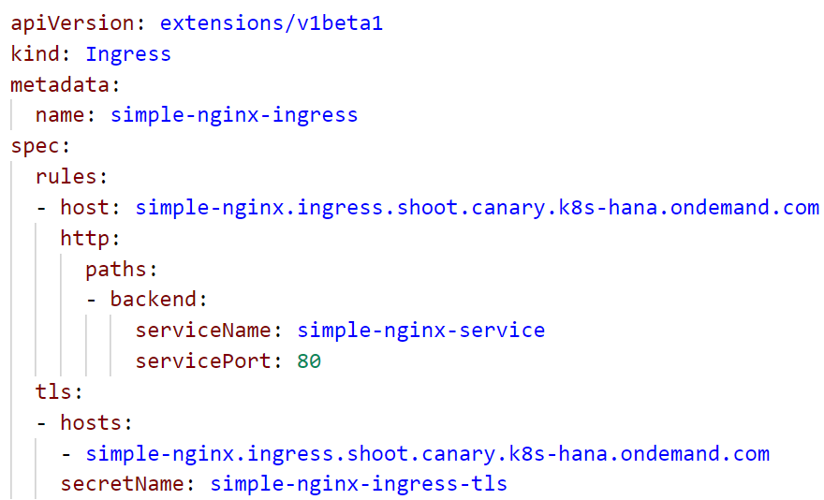
Ingress resource with TLS
spec with rules & managed hosts
Traffic is forwarded to service simple-nginx-service on port 80
support https with the certificates stored in the tls secret
Notes:
In the spec, there is a section about rules & TLS.
Rules define forwarding of incoming traffic to services.

Slide 7

Demo
Notes:
Go to the admin folder in the repo and run the create_ingress_tls.sh script
Create a secret with the generated files as suggested by the script
Use the 09_tls_ingress.yaml to create a deployment, service and corresponding ingress resource
Show the deployment & service
Show the ingress with the host & tls section. Highlight that the nginx itself is not configured for https but the connection terminates at the ingress endpoint.
Open the URL in a browser, ignore the ssl error as it is self-signed
Go to the yaml file of the deployment and show the init container that runs upon pod start.
Highlight that it writes some text to an emptyDir volume which is then mounted into the nginx container.

Slide 8
Fanout
The ingress routes to the service based on URL paths
Inside K8s
Ingress
https://app.ingress.com/my
https://app.ingress.com/your
35.205.166.164
Pod
Port 80
Service
Port 8081
Pod
Port 80
Pod
Port 80
Users access different backends via https://app.com /my or /your
Service
Port 8081
Pod
Port 80
Notes:
It is possible to mesh up multiple services within one Ingress endpoint and differentiate via URL paths. A user trying to access green needs to use https://app.ingress.com/my

Slide 9
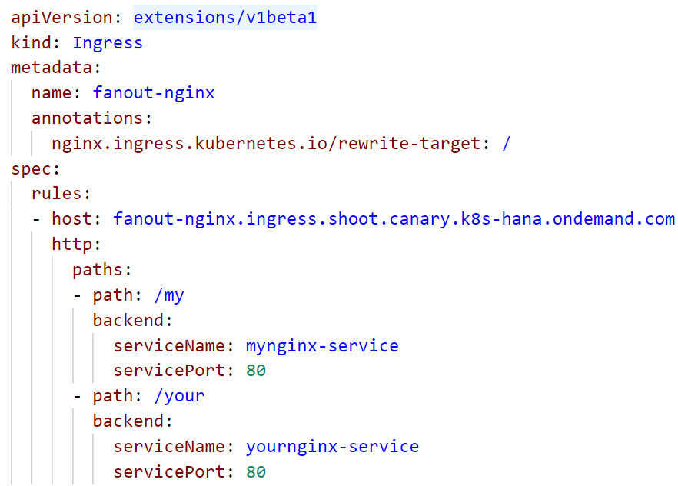
Ingress resource with fanout
Annotation is required to route traffic to /index.html and not /my/index.html
spec with rules & managed host
Traffic to /my is forwarded to service mynginx-service on port 80
Traffic to /your is forwarded to service yournginx-service on port 80
Notes:
In the spec, there is a section about rules & TLS.
Rules define forwarding of incoming traffic to services.

Slide 10
Demo
Notes:
Use the 09_fanout_and_virtual_host_ingress.yaml to create a deployment, service and corresponding ingress resources
Note, that this file contains not only the fanout demo but based on the same 2 deployments & services also the virtual host demo.
Show the deployments & services
Show the fanout ingress
Highlight the rewrite-target annotation and its importance.
Without this annotation the traffic would be forwarded to my-nginx-service/mynginx or your-nginx-service/yournginx. Obviously none of the services is aware of this path, so you would get an error instead of your index.html.
Open the URL in a browser and show the different endpoints based on their path

Slide 11
Name based virtual hosting
Though there are 2 URLs, it is only one IP endpoint
Inside K8s
Ingress
https://my-app.ingress.com
https://your-app.ingress.com/
35.205.166.164
Pod
Port 80
Service
Port 8081
Pod
Port 80
Pod
Port 80
Users access different backends via different URLs
https://my-app.com
https://your-app.com
Service
Port 8081
Pod
Port 80
Notes:
The 3rd option to make services available is to have several URLs managed by one Ingress resource. The IP also here, the IP endpoint remains stable.

Slide 12
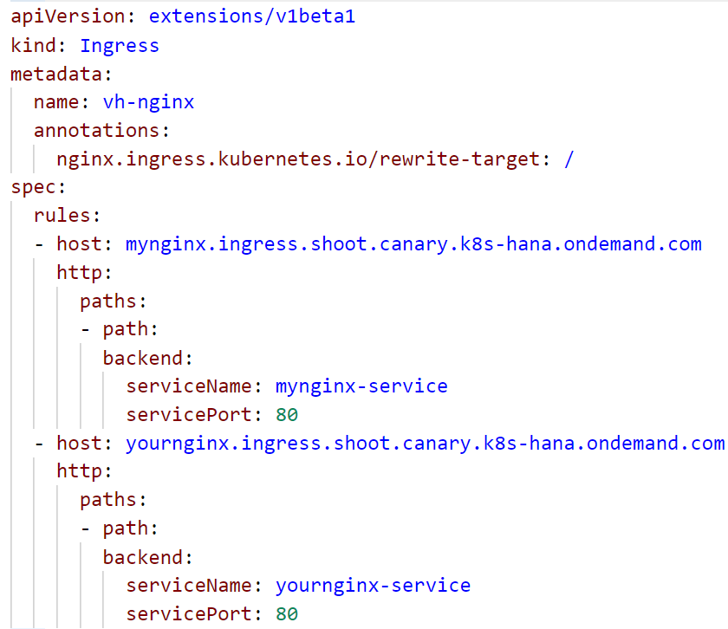
Ingress resource with name based virtual hosting
1st host & forwarding rules
2nd host & forwarding rules
Notes:
In the spec, there is a section about rules & TLS.
Rules define forwarding of incoming traffic to services.

Slide 13
Demo
Notes:
Use the 09_fanout_and_virtual_host_ingress.yaml to create a deployment, service and corresponding ingress resources
Note, that this file contains not only the fanout demo but based on the same 2 deployments & services also the virtual host demo.
Show the deployments & services
Show the virtual hosts ingress
Highlight the rewrite-target annotation and its importance.
Without this annotation the traffic would be forwarded to my-nginx-service/mynginx or your-nginx-service/yournginx. Obviously none of the services is aware of this path, so you would get an error instead of your index.html.
Open the URL in a browser and show the different endpoints based on their URL

Slide 14
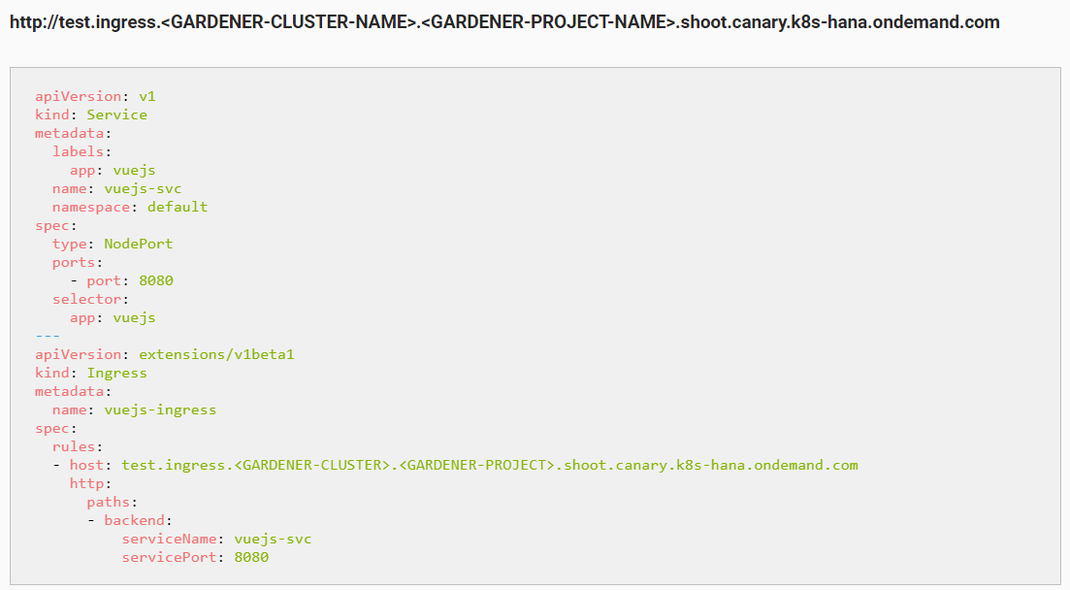
Ingress on Gardener
https://github.wdf.sap.corp/pages/kubernetes/gardener/doc/2017/01/16/howto-service-access.html
Notes:
With Gardener, you get an ingress controller for free ☺ it is also registered with a domain, so you will get your own sub-domain to register your URLs.
The schema is described in the Gardener how-to docs. You might need to adapt the ingress.yaml to your training project.

Slide 15
What was this something about a “controller”?
Observe
Analyze
Act
CRD
Pod
Operator
CRO
Pod
Notes:
About controller & the operator pattern:
In the beginning of our course we said: “Kubernetes is extensible”. You cannot only bring your workloads into container and onto Kubernetes, you can also enhance the way Kubernetes is working. We start with the simplest way of doing so – writing a “controller” or “operator”. It basically consists of 3 logical parts:
Observe - write a control loop, checking certain objects for their state.
Analyze – check the current state against a desired state (may be stored in a different resource, outside of the cluster, hardcoded, …)
Action – if there’s a difference between desired & current state, the controller should act and trigger a defined action to bring the observed objects into the desired state
Lets combine the controller/operator with another powerful mechanism in the K8s realm: “Custom Resource Definition/Object” API (CRD / CRO)
CRDs allow you to specify your own objects and integrate them with the K8s API (like a deployment or PVC). Once you defined a CRD, you can start to create objects of that type. But only if you have an operator watching for these objects, something will happen.
Example:
You want to run a distributed database on K8s. The actual instances are wrapped into a deployment. However for actions like backup or scaling, you would need to logon to each pod and prepare it manually. A possible solution would be to put scripts into the container images and trigger them. But it still is a manual action to trigger.
Instead writing a controller, that watch for certain annotations in the resources metadata is a very valid option. The controller could not only process the action associated with these annotations but also update them.
A slightly different approach would be to go with an API extension via CRD. Define a representation of your database as a custom resource definition and write an operator that observes/analyzes/acts on objects of this type.

Slide 16
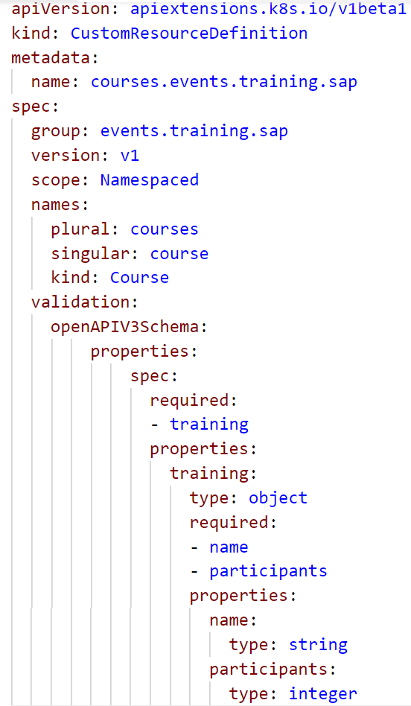
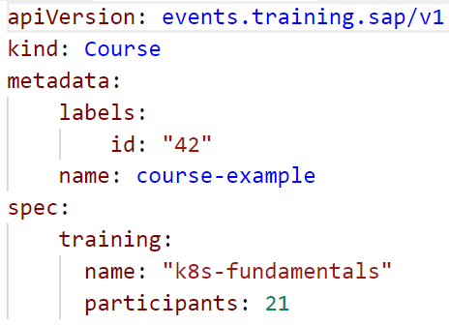
CRD/CRO Example
Newly created API endpoint
API specification
Validation schema to outline resource structure
Resource structured according to validation schema

Slide 17
Demo
Notes:
Optionally you can show this demo
Firstly, try to create the custom resource object (09_cro.yaml). It will fail, as the cluster api doesn’t know about this resource type
Create the custom resource definition (09_crd.yaml). Show the yaml and explain the spec
Group: this is path in the api (like apps or apiextensions.k8s.io)
Version: version of the api objects in this group (like v1 or v1beta1)
Scope: objects can exist within a namespace like pods or outside like nodes
Names: names for the object, can also include a short version like pvc for persistentvolumeclaim
Validation: this is the definition of the objects structure and how to validate it. The example requires the training object with properties name and participants
To move on one could write an operator, that could create namespaces based on course objects.
A real life example is how Gardener manages the shoot clusters. When you create a new Gardener cluster, actually a yaml file is generated and send to the seed clusters api server. The operator evaluates it and triggers corresponding actions.

