Slide 1
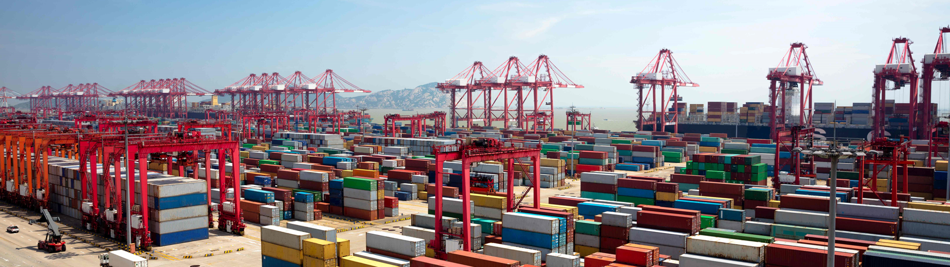
Docker and Kubernetes
Hands-On Training
Thomas Buchner, STS Infrastructure
Hendrik Kahl, SLV ABAP Component Validation

Slide 2

Working with Containers
on Docker

Slide 3
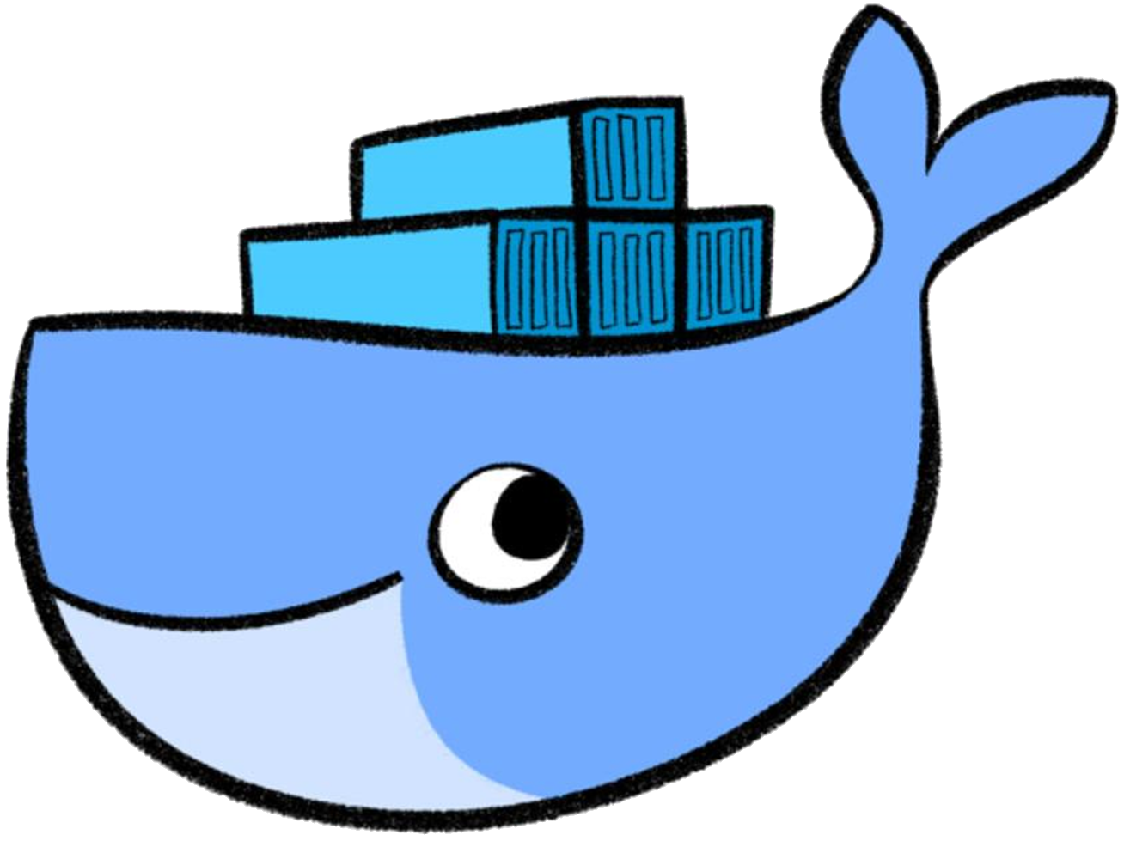
Lifecycle of a container
Image
PHP
Apache
docker run
Busybox
Base Image (e.g. Debian)
docker create
docker start
writable layer a320d5f4bd36
writable layer a320d5f4bd36
docker start
docker stop
docker rm
writable layer a320d5f4bd36
writable layer a320d5f4bd36
Notes:
When talking about a “container”, we are referring to the combination of read-only layers from the image and one read-write layer on top of it. You can derive / instantiate an indefinite number of containers from the same image. They only vary by the read-write layer on top. Or stated another way: A container consists of just the read-write layer, some meta data (settings, flags pass on start) and a reference to the image. All containers share only one common image.
The container lifecycle illustrates, what happens to this read-write layer. With “docker create” you tell docker to create such a read-write layer. With “docker start” you bring it to life, meaning a process with ID 1 is started. The “run” command combines “create” & “start”.
Once you have the read-write layer everything that happens inside the container is stored there. You can “stop” the container (killing PID 1) and re-start it. Since all these operations happen on the same read-write layer, everything you did when the container ran, is still present.
But if you “rm” the read-write layer everything is irretrievably gone.

Slide 4
Run your first container
$ docker run docker/whalesay cowsay “Rick Astley"
____________________________
< Never gonna give you up... >
----------------------------
\
\
\
## .
## ## ## ==
## ## ## ## ===
/""""""""""""""""___/ ===
~~~ {~~ ~~~~ ~~~ ~~~~ ~~ ~ / ===- ~~~
\______ o __/
\ \ __/
\____\______/
$

Slide 5
Detached, interactive, tty, tt-what?
docker run –i –t ubuntu /bin/bash
docker run –d ubuntu /bin/systemd
stdin
Keyboard
stdin
Keyboard
Process
Process
Display
Log collector
stdout
stderr
stdout
stderr
Running an interactive session requires –i & -t :
-t allocates a pseudo-tty, -i keeps stdin open.
Running a detached session keeps process 1 alive without stdin open.
Notes:
First, lets take a look at how terminals used to work. The standard input stream (stdin) is used to send input to the process. The standard output and error streams send the output to a terminal to display (as text).
Docker allows to use stdin interactively and receive the results via stdout/stderr. To keep stdin open, the –i flag is required (interactive). To capture the output accordingly a pseudo-tty is required. Use –t to allocate it. Try to run “docker -i ubuntu:18.04” – you will be able to type (something like “exit”) but you don’t see the output. Try the same again, but adding a “-t”. You will be able to type & see what happens.
Use the combination of interactive and tty (combine to –it) when you start a shell or anything else that requires input.
Docker also allows to start containers in the background (similar to a linux processes started in background). No output will be sent to the user but captured for logging (check the container logs, if there are any). Use the –d switch ('daemon') to run the process in background and check with “docker ps”.
Use the detached mode to run daemons or applications that have a control loop like a websever.

Slide 6
Detached and interactive containers
Detached mode
Programs like these do not interact with the user via stdin/stdout
Web servers
Database servers
Containers can be started in detached mode, e.g.:
Manually detach from a container with Ctrl + P followed by Ctrl + Q
Interactive mode
Programs that expect user input (via stdin/stdout) must be started in interactive mode or they just exit
Shells
Mail clients
Terminal might need to be explicitly allocated and connected, e.g.:
$ docker run –d nginx
$ docker run –i -t busybox

Slide 7
Information about containers
Available / present containers
the command docker ps gives a list of all running containers on a host (use –a to see also terminated containers)
$ docker ps –a
CONTAINER ID IMAGE COMMAND CREATED STATUS PORTS NAMES
dded97d9a7d6 docker/whalesay "cowsay 'Rick Astley'" 8 minutes ago Exited (0) 8 minutes ago ecstatic_goldstine
b69038e9ff35 busybox "sh" About an hour ago Created admiring_ritchie
e7a7aeca8c41 test_nginx "nginx -g 'daemon ..." 4 days ago Exited (1) 24 hours ago pensive_elion
494b7b8c9f39 mynginx1 "nginx -g 'daemon ..." 7 days ago Up 24 hours 0.0.0.0:32768->812/tcp happy_ride
image
creation time
forwarded network ports
friendly name
program that runs in the container
unique ID for each container (truncated)
current status and exit code
Notes:
The container IDs reference the read-write layer on top of the immutable read-only image layers.
The UUID has 64 digits but is truncated to just 12 digits, use --no-trunc to see all of them.
A stopped container retains the state of its r/w file system layer (you see them when you start the container again)

Slide 8
Executing commands in a container
It is possible to run additional commands in a container
Useful for debugging
Command must be present in the container
Interactive/detached mode – also applies here
$ docker exec –i –t <container ID or name> <command>
$ docker exec -i -t 494b7b8c9f39 /bin/sh
# ls -al /usr/sbin/nginx
-rwxr-xr-x 1 root root 1253840 Nov 21 14:28 /usr/sbin/nginx
# exit
$
Notes:
To be able to connect to the container in an interactive shell session, again -i and -t are required. They can be combined to -it.

Slide 9
Starting a stopped container
A container stops once the main process (PID 1) exits
container does not get deleted (removed) but remains
can be restarted as long as it exists
$ docker start <container ID or name>
$ docker run -i -t busybox
/ # exit
$ docker ps -a
CONTAINER ID IMAGE COMMAND CREATED STATUS PORTS NAMES
033d3a22e8c8 busybox "sh" 15 seconds ago Exited (0) 13 seconds ago manic_wright
$ docker start -i 033d3a22e8c8
/ # ls
bin dev etc home proc root run sys tmp usr var
/ # exit

Slide 10
Stopping a container
A container can be forcibly stopped
necessary for containers with daemon processes
friendly termination with SIGTERM, after timeout (default 10 seconds) with SIGKILL *
$ docker stop <container ID or name>
$ docker ps
CONTAINER ID IMAGE COMMAND CREATED STATUS PORTS NAMES
494b7b8c9f39 mynginx1 "nginx -g ..." 7 days ago Up 24 hours 0.0.0.0:32768->812/tcp happy_ride
$ docker stop -t 5 happy_ride
494b7b8c9f39
$ docker ps
CONTAINER ID IMAGE COMMAND CREATED STATUS PORTS NAMES
$
* you can specify wait time between SIGTERM and SIGKILL with the "-t" option

Slide 11
Getting logs from a container
Docker collects logs from programs inside containers
stdout and stderr of the main process get collected
logs from programs can be redirected to /dev/stdout and /dev/stderr
logs still available even after a container terminated
$ docker logs <container ID or name>
$ docker logs 494b7b8c9f39
10.19.91.230 - - [01/Dec/2017:14:48:12 +0000] "GET / HTTP/1.1" 200 230 "-" "Mozilla/5.0 (Windows NT 10.0; Win64; x64; rv:57.0) Gecko/20100101 Firefox/57.0" "-"
10.19.91.230 - - [01/Dec/2017:14:48:12 +0000] "GET /it_works.jpg HTTP/1.1" 200 25676 "http://pvxka22:32780/" "Mozilla/5.0 (Windows NT 10.0; Win64; x64; rv:57.0) Gecko/20100101 Firefox/57.0" "-"
2017/12/01 14:48:12 [error] 8#8: *1 open() "/srv/www/htdocs/favicon.ico" failed (2: No such file or directory), client: 10.19.91.230, server: localhost, request: "GET /favicon.ico HTTP/1.1", host: "pvxka22:32780"
10.19.91.230 - - [01/Dec/2017:14:48:12 +0000] "GET /favicon.ico HTTP/1.1" 404 169 "-" "Mozilla/5.0 (Windows NT 10.0; Win64; x64; rv:57.0) Gecko/20100101 Firefox/57.0" "-“
$

Slide 12

Removing a container
Finally, a container can and should be removed
all data in the container that was not part of the image is lost
when a container is removed, it is gone
removing an active container must be forced and will kill it
$ docker rm <container ID or name>
pvxKA22:~ # docker ps -a
CONTAINER ID IMAGE COMMAND CREATED STATUS PORTS NAMES
dded97d9a7d6 docker/whalesay "cowsay 'Ri..." About an hour ago Exited (0) happy_pony
9682e4fba8b7 busybox "sh" 25 hours ago Up 25 hours elated_saha
pvxKA22:~ # docker rm 9682e4fba8b7 dded97d9a7d6
dded97d9a7d6
Error response from daemon: You cannot remove a running container…
pvxKA22:~ # docker rm 9682e4fba8b7 --force
9682e4fba8b7
pvxKA22:~ # docker ps -a
CONTAINER ID IMAGE COMMAND CREATED STATUS PORTS NAMES
$

Slide 13
Commands for containers
Detaching from a container
Ctrl + P then Ctrl + Q
Start and run a new container
Reattach to a container
Forcibly stop a container
Restart a previously stopped container
Remove a container
$ docker run busybox
$ docker attach <container ID or name>
$ docker stop <container ID or name>
$ docker start <container ID or name>
$ docker rm <container ID or name>

Slide 14
Commands for containers
Run a command in an existing container
List running containers
List all containers (running and stopped)
Get the logs of a container
Get detailed information about a container
$ docker exec <container ID or name> <command>
$ docker ps
$ docker ps -a
$ docker logs <container ID or name>
$ docker inspect <container ID or name>

Slide 15
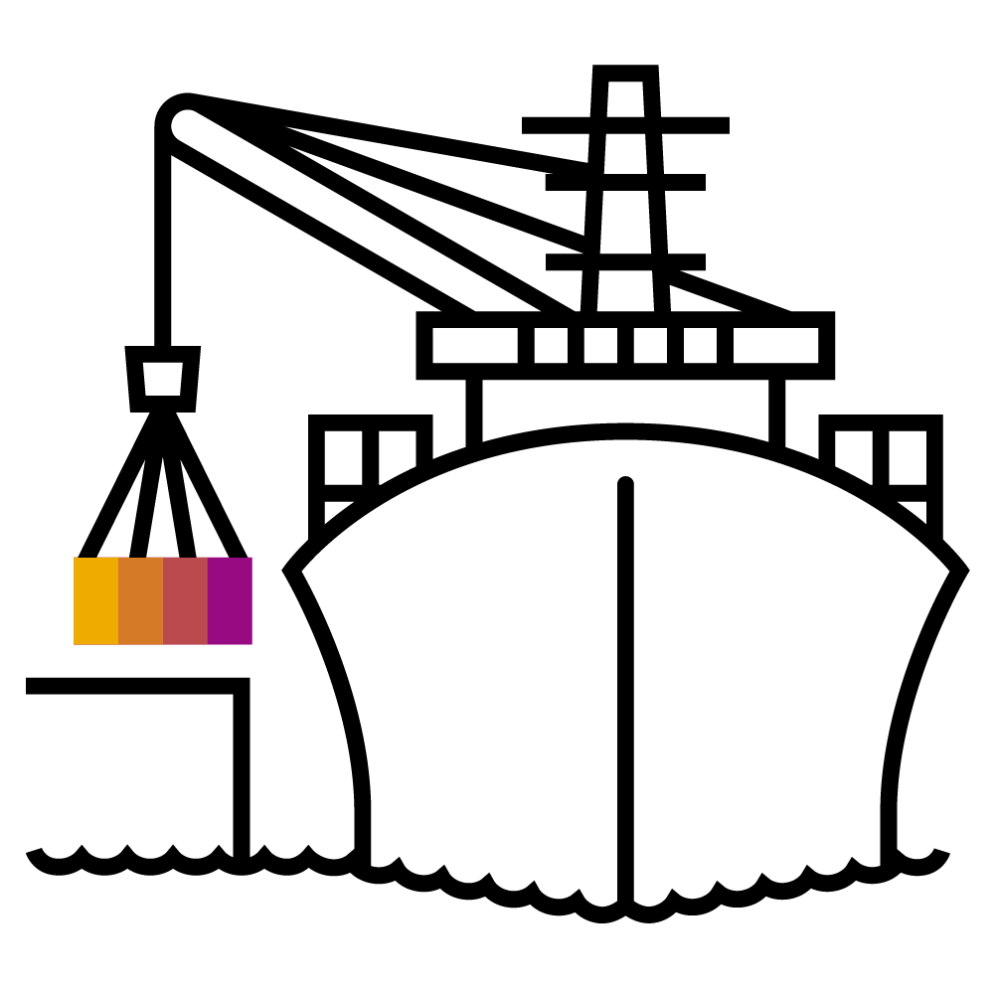
Ports and Volumes

Slide 16
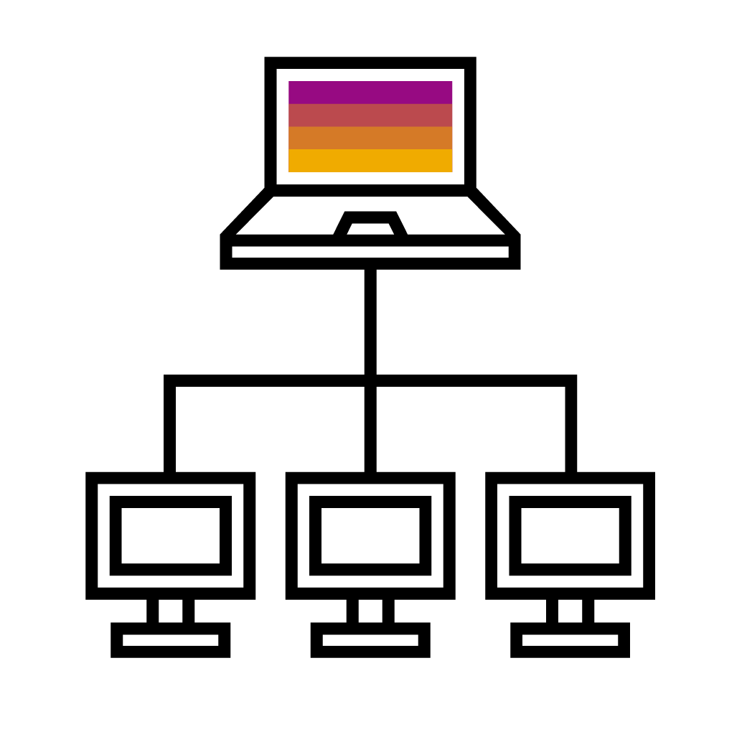
Ports
:32710
Containers in isolated network
Class B private network 172.16.0.0/16
Containers can see each other by default
Not reachable from outside
NAT to connect to the outside world
Port forwarding
Port forwarding to host
docker run -p <host port>:<container port> …
Containers expose ports, can be mapped automatically
docker run -P …
Exposed ports can be inspected
192.168.52.1
172.16.0.0/16
NAT
:80
172.16.0.2
172.16.0.3
172.16.0.4
Notes:
Every docker host spins up a local private network. A container will get an IP address form this network to be reachable locally. So as long as all container are on the same host, they can communicate via this network.
However, this is a very unlikely scenario. Probably there are more hosts involved or you want to expose your application to the outside. Docker supports network address translation to map a <container_ip>:<port> to a port on the external network interface of the docker host. If you have a container with 172.16.0.2:80 locally it could be exposed to the outside on 192.168.52.1:32710 (ip address of the docker host + unused port).
This feature is called port forwarding and docker knows two flavors of it.
Map a dedicated host port to a container port – this has to be specified manually. So you have to keep track of all your used ports in order to avoid conflicts. Use the “-p” (lower case) switch and specify host port & container port.
Map a random port to a container port. Use the “-P” (upper case) switch. Docker detects the ports a container exposes and automatically assigns an unused port. Check with “docker ps” or “docker container list”, which port was assigned.

Slide 17

Volumes
Persistent storage in containers
Filesystem in containers is not persistent
Volumes used add outside storage to containers
bind-mounts vs. volumes
Bind mounts
Hides everything in destination directory
docker run –v <source path>:<container path> …
Named volumes
Contents in container are merged with volume
No straightforward access from host
docker run –v <vol name>:<container path> …
Notes:
Since it is not recommendable to store data in a docker container, adding a persistence is quite important. With the volumes API it is possible to assign persistent storage to a container.
Docker supports 2 ways of doing so:
Bind mounts: mount a local host directory onto a certain path in the container. Everything that was present before in the target directory is hidden (nature of the bind mount). For example, if you have some configuration you want to inject, write your config file, store it on your docker host at /home/container/config and mount the content of this directory to /usr/application/config (assuming the application reads config from there).
Named volumes: docker can create a separated storage volume. Its lifecycle is independent from the container but still managed by docker. Upon creation, the content of the mount target is merged into the volume.
How to differentiate between bind mounts and named volumes? When specifying an absolute path, docker assumes a bind mount. When you just give a name (like in a relative path “config”), it will assume a named volume and create a volume “config”.
Note: Persistent storage is 'provided' by the host. It can be a part of the file system on the host directly but also an NFS mount.

