Slide 1
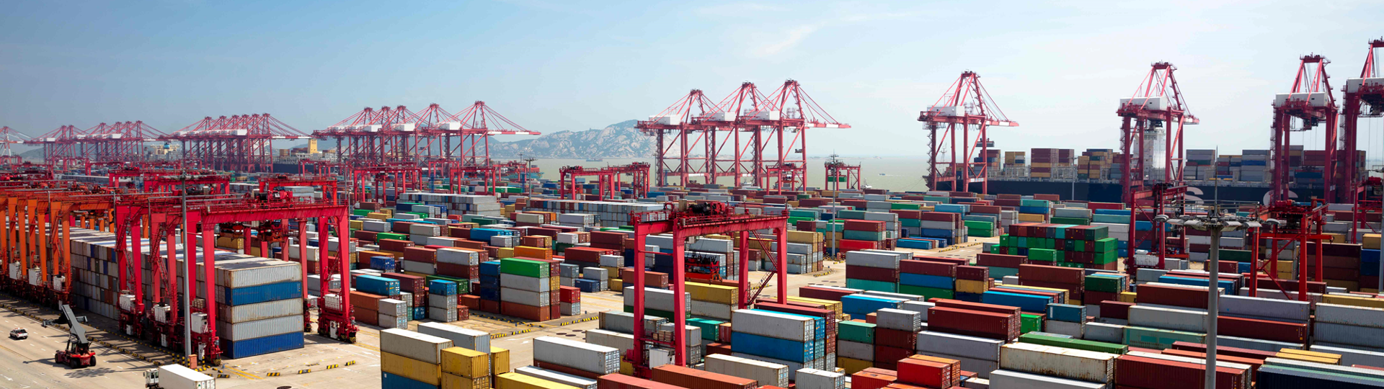
Docker and Kubernetes
Hands-On Training
Thomas Buchner, STS Infrastructure
Hendrik Kahl, SLV ABAP Component Validation

Slide 2

Docker Images

Slide 3
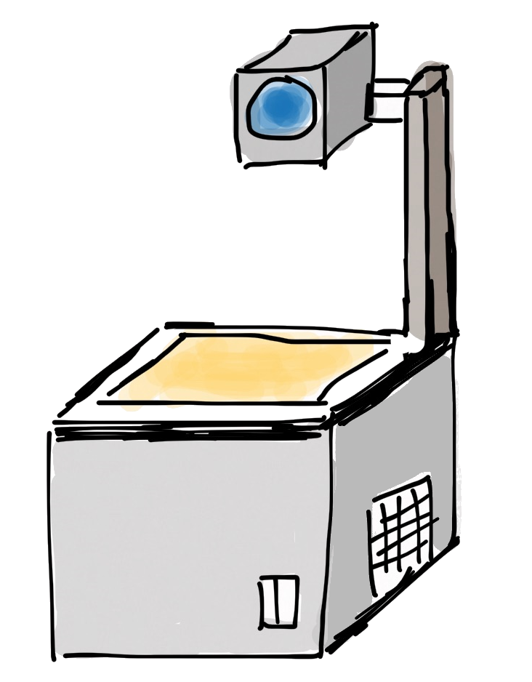
Layers of images and containers
Container
writable layer
Image
PHP
Apache
Busybox
Base Image (e.g. Debian)

Slide 4
Image Layers
Example – nginx image
Example – Azure App Service php
Container rw layer
Container rw layer
appsvc/php
nginx
php:7.0.6-apache
debian:stretch-slim
debian:jessie
scratch
scratch
Notes:
Images were discussed earlier in the context of layered file system.
You can create a new image by starting from another image (or empty 'scratch') and adding 'things'. These 'things' are usually files – which add another layer in the file system hierarchy – or environment settings. Installing software means adding another layer.

Slide 5

Committing changes
commit
New container rw layer
Container rw layer
image
comitted layer
image
nginx
nginx
debian:stretch-slim
debian:stretch-slim
scratch
scratch
No build automatization
No change history
Notes:
You can also make manual changes to images by:
Start a container from an image
Make manual changes, e.g. install software, change config / settings (in files), … that manifest in the file system (persisted).
'Commit' the changes by writing a new image that contains the current state, i.e. the changes relative to the starting image.
Drawback: Manual changes leave no trace / history / version control. Not repeatable.

Slide 6
Registries
Docker Runtime
dockerd
container
container
image storage
Registry
nginx
busybox
exim
httpd
whalesay
nginx
java
busybox
debian
mysql
whalesay
php
Notes:
Images are kept in 'docker registries'. The docker runtime will look in the configured registry when it needs to load an image (e.g. for a 'docker run'). When it doesn't have the image already in its local cache, it will load it from the registry.
The default registry is the docker hub: hub.docker.com. You can also have local registries, e.g. to have tight control of what goes in.

Slide 7
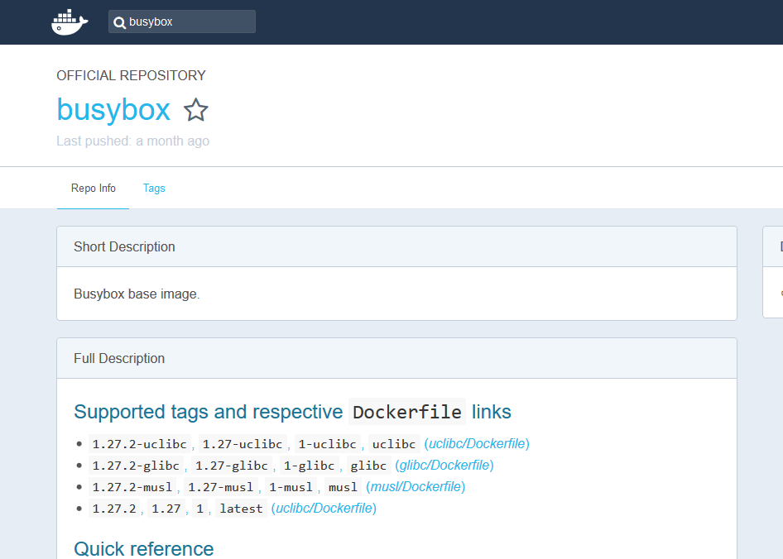
Docker Hub
https://hub.docker.com
Notes:
The docker hub offers (provides storage and the push/pull protocol for) docker images.
Each docker image has a clearly specified version. There can be multiple version tags.
The 'Dockerfile' defines the automated build instructions and show what is in the image. (see Dockerfile chapter). Dockerfiles are also included in images and document the contents.

Slide 8
Information about containers
Available/present containers
the command docker ps gives a list of all running containers on a host (use –a to see also terminated containers)
$ docker search busybox
NAME DESCRIPTION STARS OFFICIAL AUTOMATED
busybox Busybox base image. 1160 [OK]
progrium/busybox 66 [OK]
hypriot/rpi-busybox-httpd Raspberry Pi compatible Docker Image with ... 39
radial/busyboxplus Full-chain, Internet enabled, busybox made... 17 [OK]
hypriot/armhf-busybox Busybox base image for ARM. 8
...
official project maintainer
useful description
image name
automatically built on Docker Hub
LIKES!

Slide 9
Commands for images
Search for an image on all known registries
Download an image from a registry
Remove an image from the local disk
List all locally available images
View an images history
$ docker search <search term>
$ docker pull busybox
$ docker rmi busybox
$ docker images
$ docker history <image-ID>

Slide 10
Commands for images
Commit changes of a container to an image
Upload an image to a registry
Tagging an image
$ docker commit <container name> <tag>
$ docker push busybox
$ docker tag <image ID> <tag:release>

