Slide 1

Kubernetes Namespaces and Pods

Slide 2
Architecture overview – components
kubectl
Master
Worker
API Server
kubelet
proxy
Docker
etcd
(distributed) key-value store
Scheduler
Pod
Pod
Controller Manager

Slide 3
Architecture overview – namespaces
Namespace: your-namespace
Pod
Pod
Pod
Namespace: my-namespace
Pod
Pod
Pod
Worker
Worker
Worker

Slide 4
Namespaces
Isolate resources and restrict visibility to objects in the same namespace
Basic user management is handled on namespace level
Resource quotas / limits managed per namespace
Uniqueness of names required per namespace
Access to services in a different namespace via FQDN <service-name>.<namespace>
Use –n (--namespace) <namespace> switch with kubectl to access resources

Slide 5
Pods
Namespace: your-namespace
IP: 10.10.10.1
IP: 10.10.10.2
Pod-A
Pod-B
container
nginx
container
nginx
container
client
volume
volume
Worker

Slide 6
Pods
A pod (as in a pod of whales or pea pod) is a group of one or more containers (such as Docker containers), with shared storage/network, and a specification for how to run the containers
Containers of a pod share localhost network interface
A pod can provision ephemeral storage or attach persistent storage
Pods are started by kubelet but can die any time without being re-scheduled
Pods can be probed by kubelet (liveness & readiness probe)
Pod phases / status:
Pending
Running
Succeeded
Failed
Unkown

Slide 7
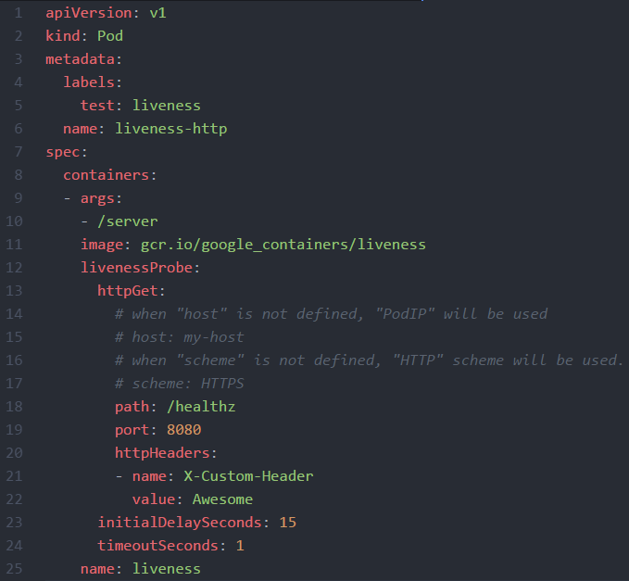
Pod definition - https://kubernetes.io/docs/api-reference/v1.8/#pod-v1-core

Slide 8
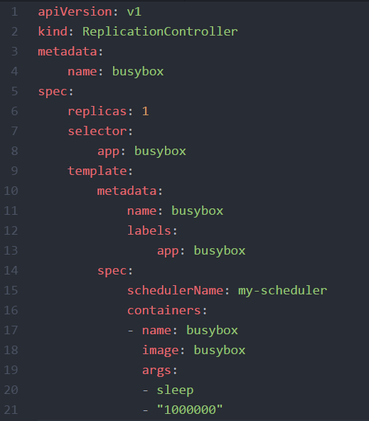
YAML
YAML: “YAML Ain't Markup Language”
YAML is a human friendly data serialization standard for all programming languages.
Indentation based
Supports key:value maps and lists
Supports nesting - a value can also contain another key:value pair, map or a list

Slide 9
Demo
Show all namespaces in cluster
Query a pod from a dedicated namespace (kube-system)
Create a pod: https://github.wdf.sap.corp/raw/D051945/docker-k8s-training/master/kubernetes/pod_example.yaml

