Slide 1
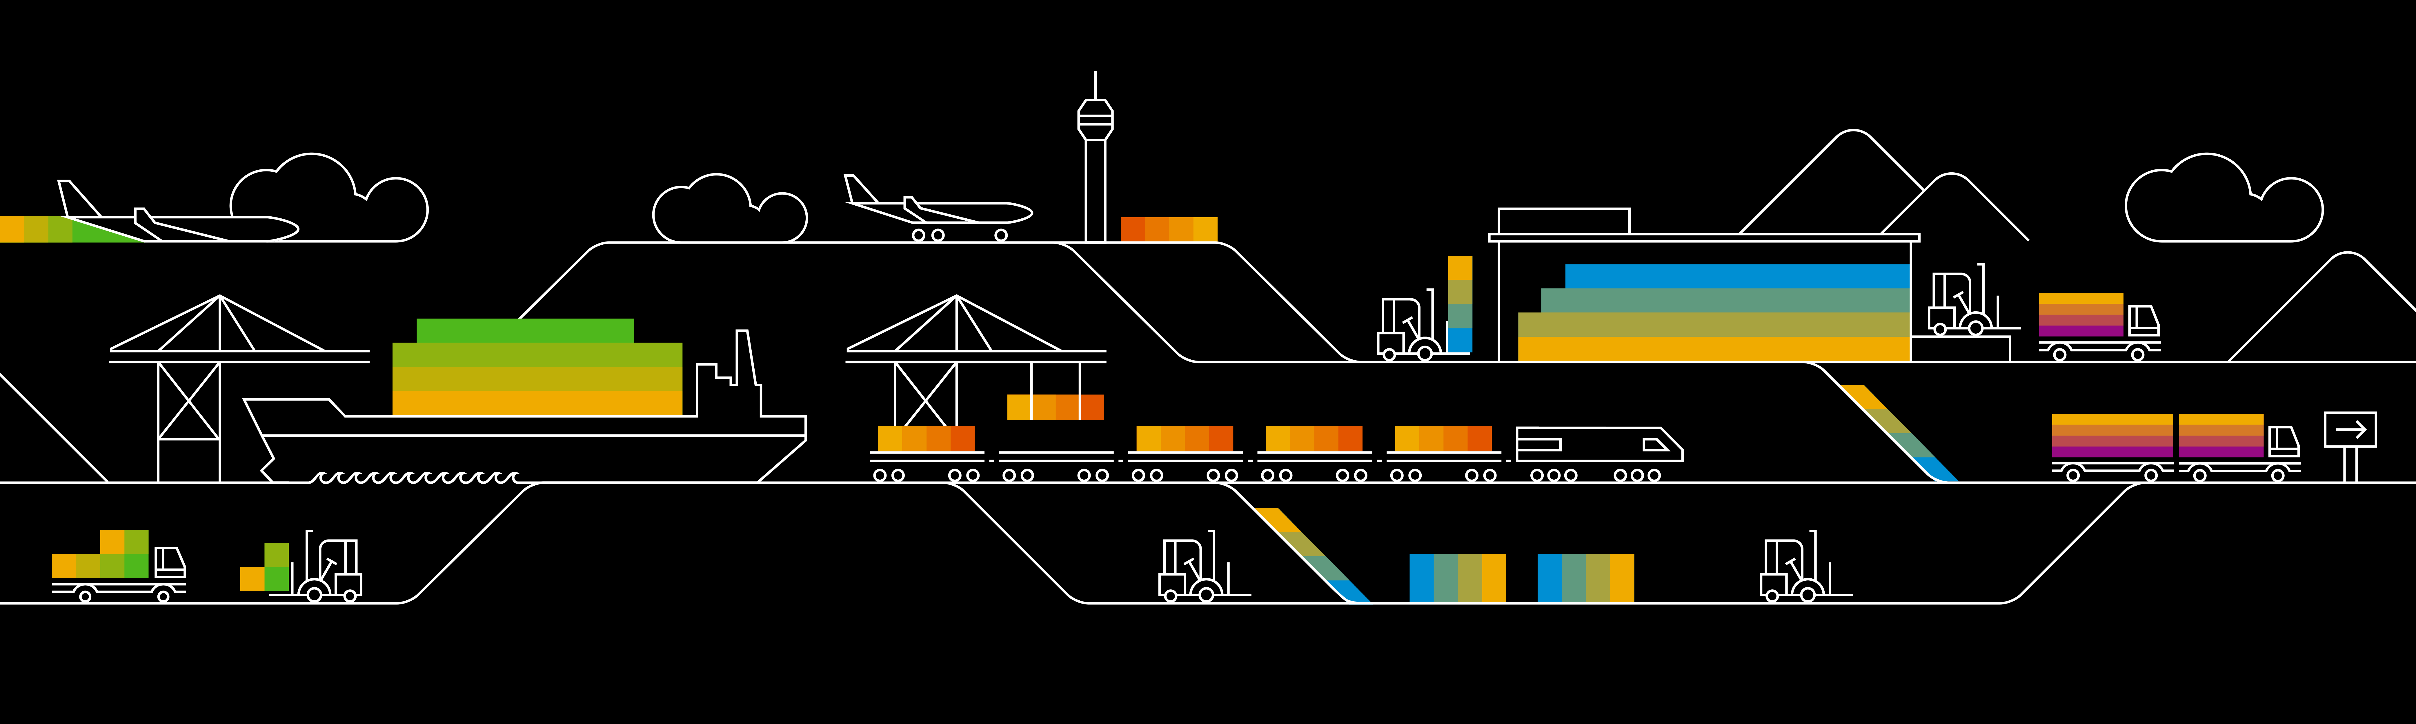
Kubernetes Persistence

Slide 2
Recap: Pods
Namespace: your-namespace
IP: 10.10.10.1
IP: 10.10.10.2
Pod-A
Pod-B
container
nginx
container
nginx
container
client
volume
volume
Worker

Slide 3
What‘s the issue?
Pods are ephemeral and can vanish any moment
Data residing in a pod will vanish with the pod
IP: 10.10.10.1
Pod-A
container
nginx
volume

Slide 4
How to solve it?
Let the pod access persistent storage
Kubernetes offers different types of storage integration:
https://kubernetes.io/docs/concepts/storage/volumes/
IP: 10.10.10.1
Pod-A
Storage representation
volume
container
nginx

Slide 5
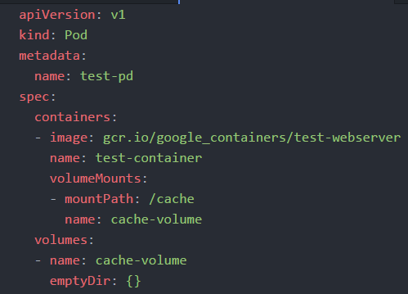
Storage types
Volume
Direct representation & access to storage
Volumes are bound to a pod and mounted into the specified container
Available for a lot of scenarios like nfs, hostPath, ceph
Direct access to cloud storage (Azure, GCP, AWS,…)
Special volumes:
emptyDir()
secret
configMap

Slide 6
Storage with PersistentVolumes & PersistentVolumeClaims
PersistentVolumes & claims are an API object in kubernetes
Abstraction / representation of storage
managed by an admin (therefore resource is not namespaced)
Can represent any supported storage type (NFS, glusterFS, rbd, …)
PersistentVolumeClaim is a users request for storage
A claim binds a volume, the claim is propagated to pod as mountable object
Pod-A
Storage representation
Storage representation on admin level
Physical storage
container
nginx
NFS, …
Persistent Volume Claim
Persistent Volume

Slide 7
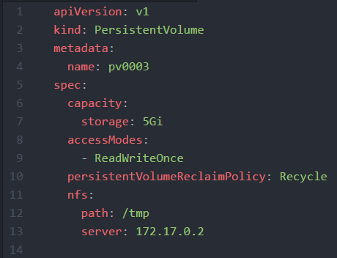
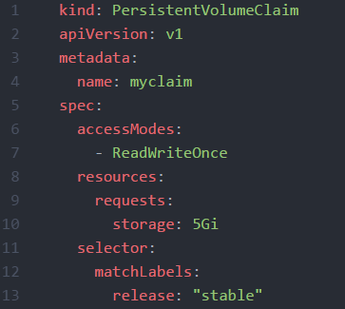
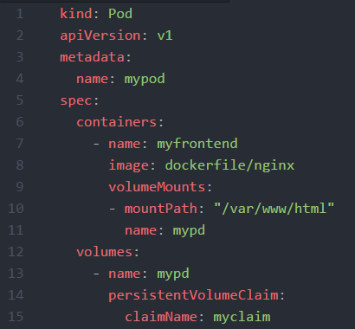
Storage with PersistentVolumes & PersistentVolumeClaims
PV:PVC is always 1:1
PV size must match or exceed PVC requested size
Depending on storage backend, a claim can be assigned to several pods

Slide 8
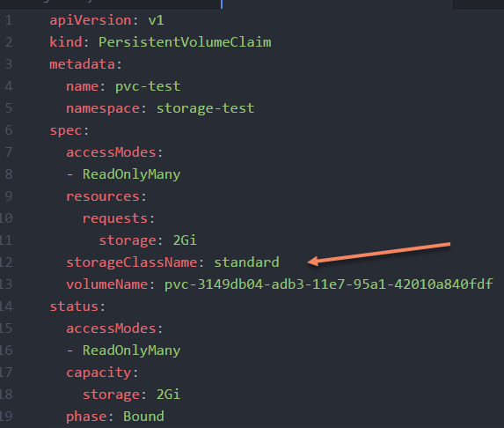
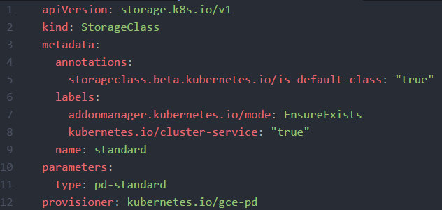
Storage Classes
Provisions a PV for based on PVC request
Overcomes need to manually provision PV (which is not namespaced and could be claimed by anybody)

Slide 9
Demo
Show existing PV & PVC
Show storage class
Create a PVC and display status
Show corresponding PV

