Slide 1

Kubernetes Service Accounts

Slide 2
Service Accounts
Service accounts are technical user in Kubernetes
Bound to a namespace
Allowed to communicate with the API server
Provide identity for pods
Pods can inherit permissions to access the API server or a registry (image pull secret)
Namespace
Pod A
service account
“default”
secrets
Pod B

Slide 3
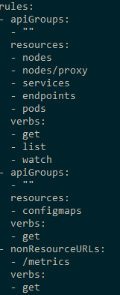
Role based authorization (RBAC)
roles define which api’s / resources can be accessed in which way
Roles can be assigned to service accounts
Roles are pre-configured or custom defined
Bindings: cluster-wide or restricted to namespace
Namespace
Pod A
Role binding
role
Secret A

Slide 4
Demo
Show service accounts
Create a new service account & show created token
Show clusterroles & rolebindings

