Slide 1
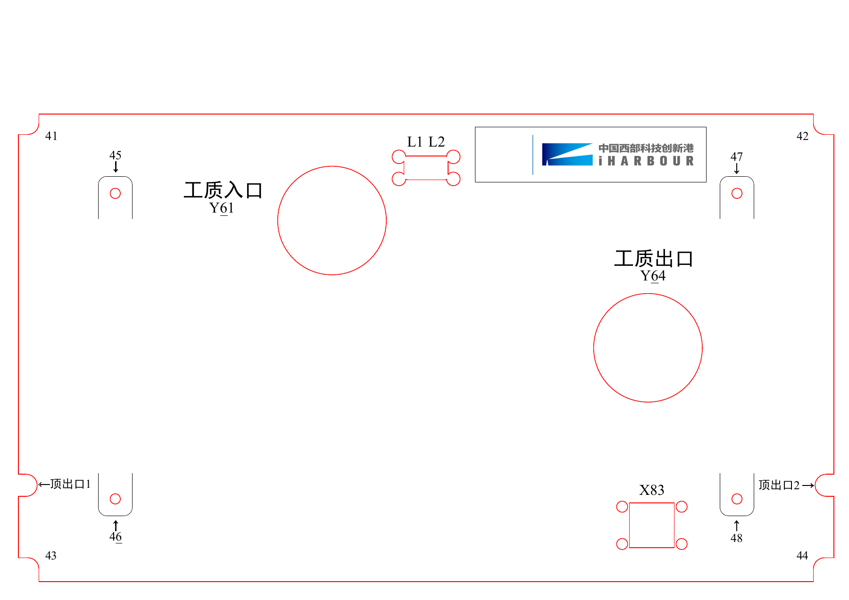

新型无泵式沸腾散热实验模块
Z01-1
TGMTYY14027
2026
项目负责人：
杨小平 魏进家
项目成员：
崔庆杰 王晋璞
Notes:
[Sources]
- User-provided C:/Users/32933/Desktop/123.pdf.
The fixed engineering geometry, connector markings, and Innovation Harbour graphic are retained from the source PDF as a non-editable background. Only the explicitly permitted elements are reconstructed as movable slide objects. Confirm final silk-screen clearance against the engineering source before manufacture.

