Slide 1
A (Brief) Overview of Data Science

Slide 2
Readings
Required – expect to be on a quiz
PDFs of full books on Canvas – these are very short blog-length chapters.
Leek, J. (2015). The Elements of Data Analytic Style. Chapters 1, 2.
Peng, R.D. & Matsui, E. (2018). The Art of Data Science. Chapters 1, 2, 3.
Wilcom, “A Beginner’s Guide to Using Developer Documentation Like a Pro.”
Optional – won’t be on a quiz but may be a part of lecture, class, notebooks, etc.
Tukey, J.W. (1962). “The Future of Data Analysis.” Annals of Mathematical Statistics.
Cleveland, W.S. (2001). “Data science: An action plan for expanding the technical areas of the field of statistics.” International Statistical Review.
Tufte, E. (2016). “The Future of Data Analysis.” Microsoft Machine Learning & Data Science Summit.
Donoho, D. (2017). “50 Years of Data Science.” J. of Computational and Graphical Statistics.
McNichol, D. (2017). “The Many Futures of Data Analysis.” Towards Data Science.

Slide 3
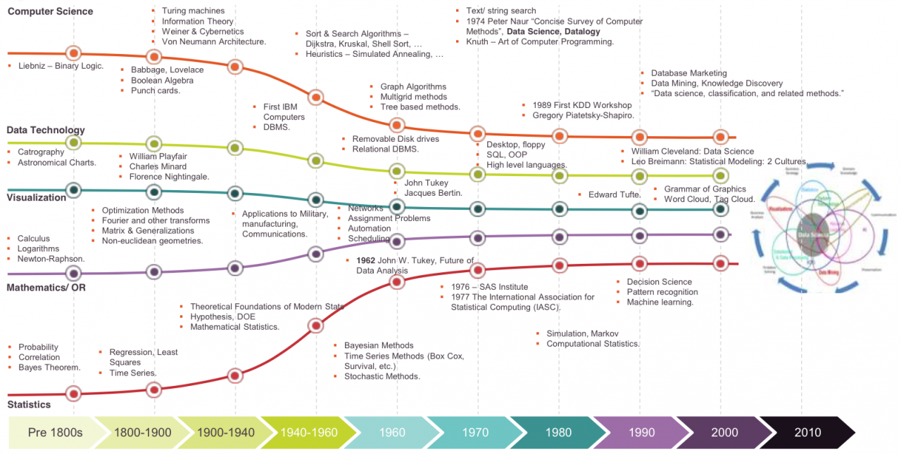
Standing on the shoulders of giants
Walker, M. (2018). “History of Data Science.” Data Science Association blog.

Slide 4

Statistics
Census used since antiquity for military drafts, taxation, apportionment
Collecting and tabulating data was an enormous and expensive process
John Graunt’s analysis of bills of mortality in 1662 is an early example of quantitative epidemiology and demography
“Statistics” emerged in 1700s for collecting demographic and economic data
Literally, “science of the state”: status (la) → statista (it) → statistik (de) → statistics (en)
Tied to transformations like nation-state, democracy, capitalism, industrial revolution
Creating institutions and practices for systematic data collection and analysis
Developments of probability, uncertainty, optimization, correlation, sampling, induction, and experiments in 1800s lead to modern statistics
Computing transforms collection, storage, retrieval, analysis, visualization of data
But math, statistics, and CS academic disciplines ignored each other for decades…
Stigler, S.M. (2002). Statistics on the Table.; Porter, T.M. (1988). The Rise of Statistical Thinking.; Desrosières, A. (2002). The Politics of Large Numbers.; Scott, J.C. (1998). Seeing Like a State.

Slide 5
Social Statistics and Democracy
Democracy requires numbers for its proper functioning
There is social statistics infrastructure
The Census is the bedrock of this infrastructure in the U.S. discontinuity
Sullivan, T. (2020). Coming To Our Census: How Social Statistics Underpin Our Democracy. Harvard Data Science Review.

Slide 6
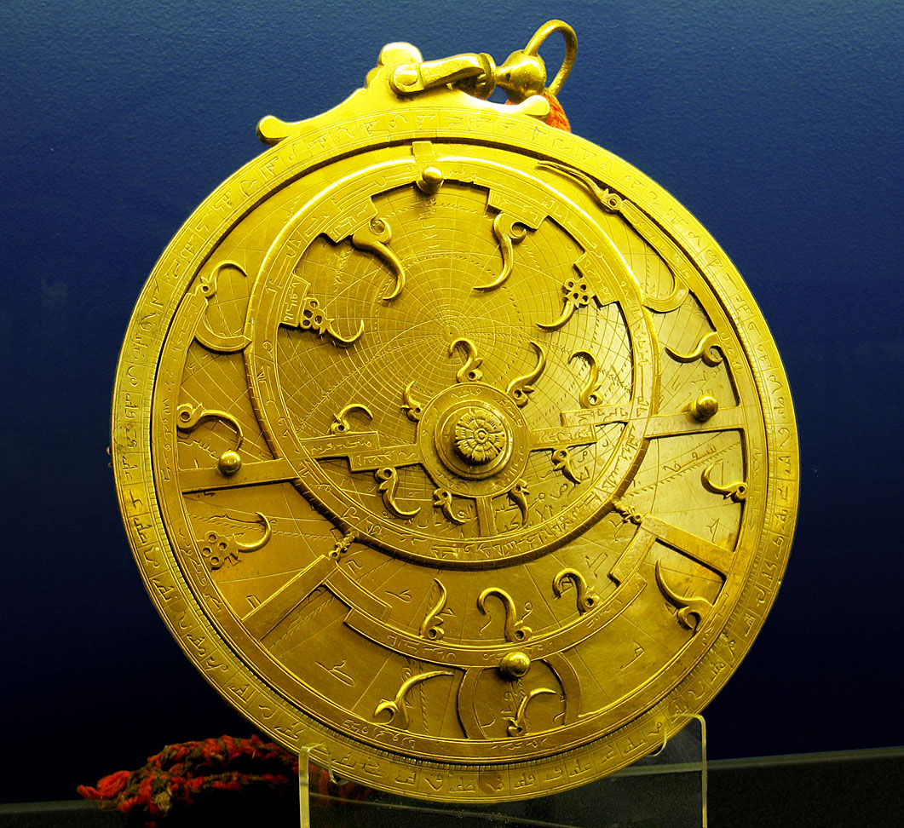
Computer Science
Astrolabes used in antiquity to predict eclipses and astronomical events
Mathematical and technological developments in 17-18C using binary logic
Boolean logic allowed complex operations from binary elements
Jacquard loom, punched cards used abstraction and algorithms for automation
Through 1950s, “computers” were (female) clerks performing calculations
Solving complex equations for WW1, WW2, & Space Race [Light 1999; Grieg 2005]
Babbage, Lovelace, Turing, Shannon, von Neumann, Weiner, et al.
Theoretical and technical breakthroughs before 1950 are still used today
“But is CS really a science? Isn’t it more applied like engineering?”
Algorithmic processes for describing and transforming information [Denning 2005]
Light, J.S. (1999). When Computers Were Women. Technology & Culture; Grieg, D.A. (2005). When Computers Were Human; Denning, P.J. (2005). Is Computer Science Science? CACM.

Slide 7
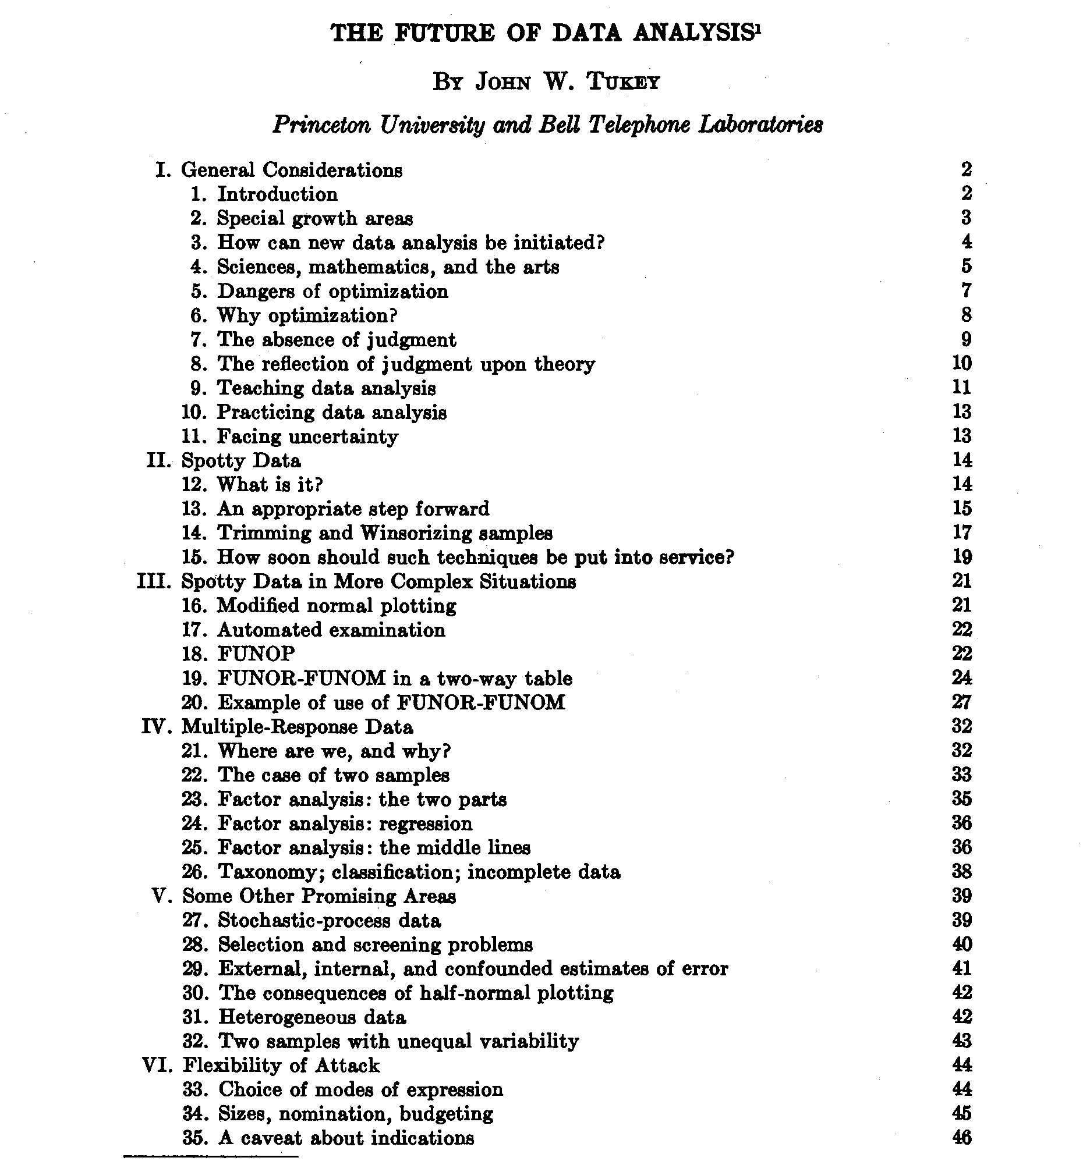
Tukey (1962) The Future of Data Analysis
“my central interest is in data analysis, which I take to include, among other things: procedures for analyzing data, techniques for interpreting the results of such procedures, ways of planning the gathering of data to make its analysis easier, more precise or more accurate, and all the machinery and results of (mathematical) statistics which apply to analyzing data … data analysis is a very difficult field. It must adapt itself to what people can and need to do with data. In the sense that biology is more complex than physics, and the behavioral sciences are more complex than either, it is likely that the general problems of data analysis are more complex than those of all three.”

Slide 8


Data Mining Becomes a Street Fight
1974: Peter Naur offers the first definition of “data science”
“The science of dealing with data… while the relation of the data to what they represent is delegated to other fields and sciences.”
1970s-80s: Introduction of SQL syntax and relational database models
1989: First workshop on “knowledge discovery in database systems”
1994: First BusinessWeek cover on how companies are using data
1997: Jeff Wu calls for statistics to be renamed data science
2001: William Cleveland publishes his “Data Science Action Plan”
Collaboration, statistical model building, computing technologies, education and training, tool development and use, mathematical theories
2003: Michael Lewis publishes Moneyball
Organizations everywhere realize analytics will disrupt everything [Davenport 2006]
Davenport, T.H. Competing on Analytics. HBR.; Press, G. (2013). A Very Short History of Data Science. Forbes.; Li, R. (2016). History of Data Mining. KDnuggets.

Slide 9
Sexy Data Scientists and Big Data
2005 – now: Federal government reports emphasize importance of supporting data science
Data is sexy?
Hal Varian: “the sexy job in the next ten years will be statisticians.” (2009)
HBR: “data scientist is the sexiest job of the 21st century” (2012)
2010 – 2016: huge volumes of data being generated need specialized analytics infrastructures
Hadoop, Spark, Hive, AWS, Azure, pipelines, lakes, etc.
This class will use “medium data” → bigger than what Excel can handle but it still fits into memory
2016 – present: social good; fairness, accountability, transparency, ethics (FATE); human-centered
It turns out that data science can be used for not-so-good purposes; need to design “good” in

Slide 10
Data-centered vs. Human-centered
Do you care more about the data or the people?
>90% of data science education focuses on data-centered perspectives
 | Data-centered | Human-centered
Who | Unicorn expert-hacker-engineer | Anyone with a question
What | How to do data science | How to be a data scientist
Where | CS, stats, math | INFO, social sciences, real world
When | On the job | As a citizen
Why | Because data can help something | Because data can help someone
How | Life-cycles, frameworks, processes | Context, participation, responsibility

Slide 11
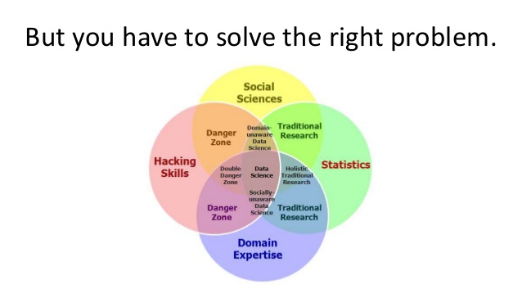
Real Data Scientists Use Venn Diagrams
Tunkelang, D. Data Science: A Mindset for Productivity.

Slide 12
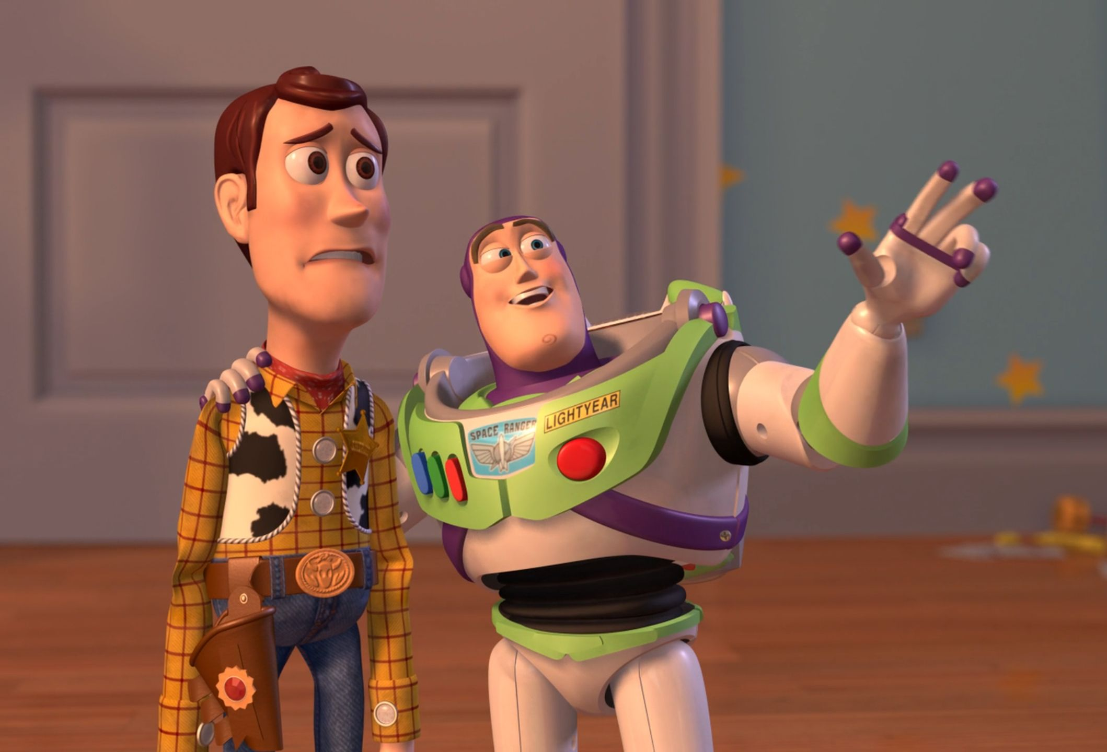
…and flow charts
FLOW CHARTS
FLOW CHARTS EVERYWHERE

Slide 13

CRISP-DM
Cross-industry standard process for data mining

Slide 14
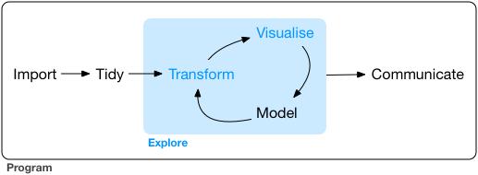
Data Exploration Life-cycle
Wickham, H. & Grolemund, G. (2017). R for Data Science.

Slide 15
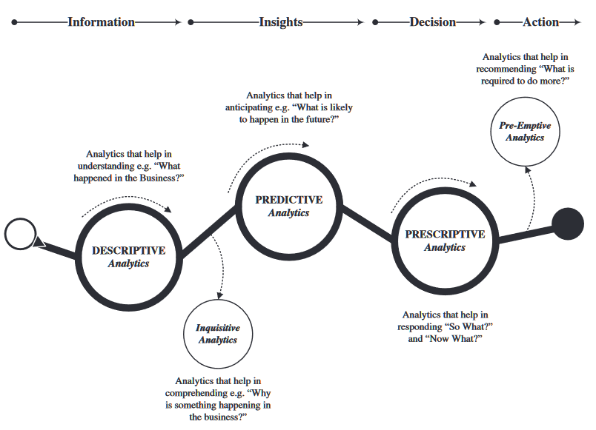
Types of Analytics
Sivarajah, U., Kamal, M. M., Irani, Z., & Weerakkody, V. (2017). Critical analysis of Big Data challenges and analytical methods. Journal of Business Research, 70, 263-286.

Slide 16
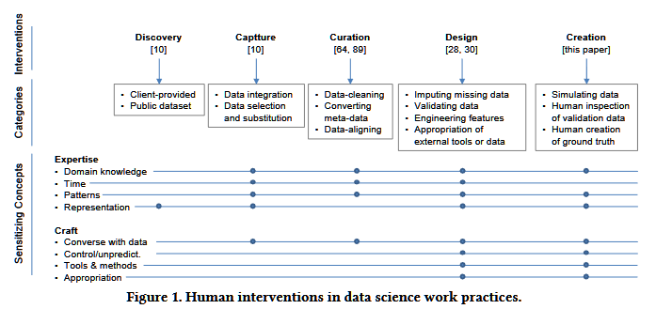
How Data Scientists Work with Data
Muller, M., ... & Erickson, T. (2019). How data science workers work with data: Discovery, capture, curation, design, creation. In Proc. CHI 2019.

Slide 17
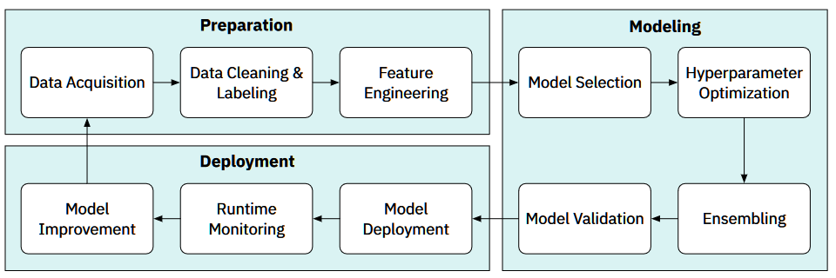
Data Science Workflows
Zhang, A. X., Muller, M., & Wang, D. (2020). How do data science workers collaborate? roles, workflows, and tools. PACM CSCW.

Slide 18
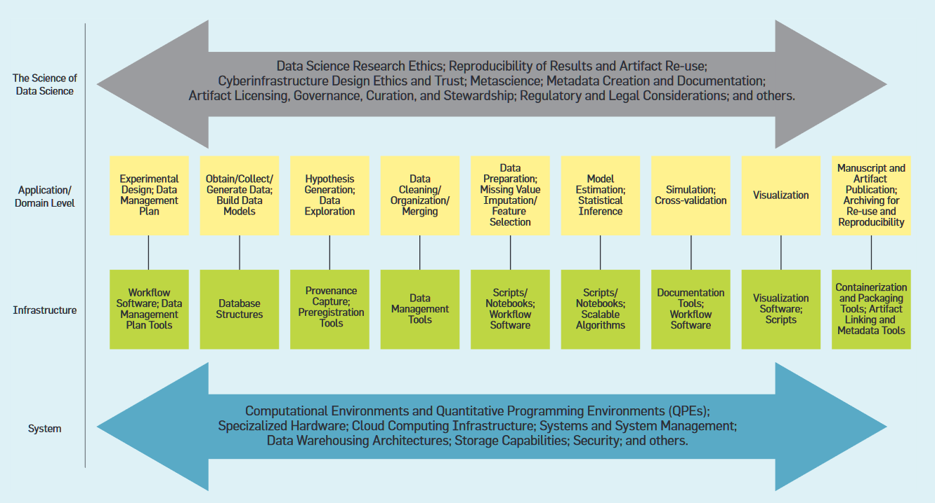
Another Data Science Life-cycle
Stodden, V. (2020). The data science life cycle: A disciplined approach to advancing data science as a science. Communications of the ACM, 63(7), 58–66.

Slide 19
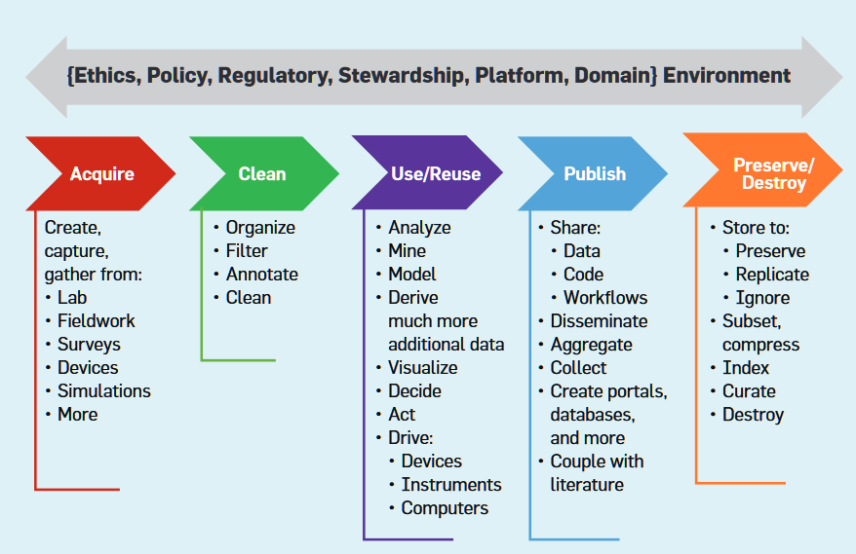
Yet Another Data Life-cycle
Stodden, V. (2020). The data science life cycle: A disciplined approach to advancing data science as a science. Communications of the ACM, 63(7), 58–66.

Slide 20
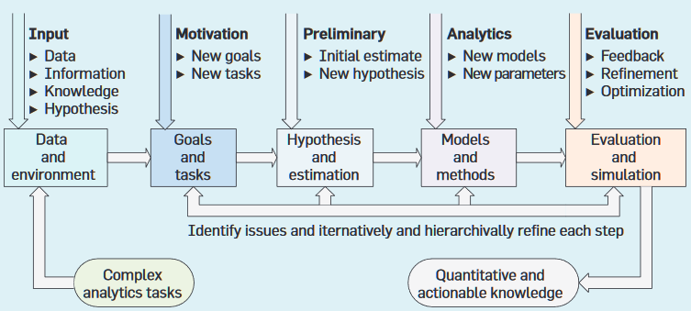
Still Another Data Life-cycle
Cao, L. (2017). Data science: Challenges and directions. Communications of the ACM, 60(8), 59–68.

Slide 21
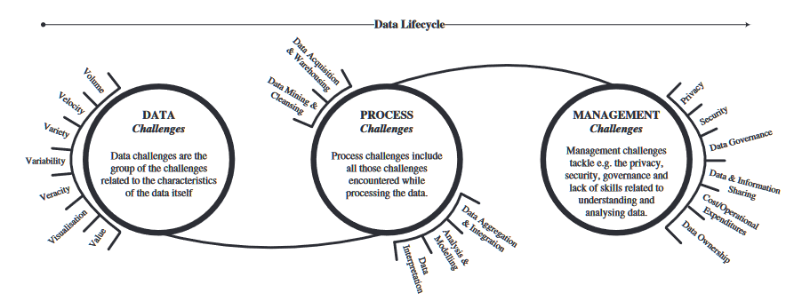
Challenges in the Data Life-cycle
Sivarajah, U., Kamal, M. M., Irani, Z., & Weerakkody, V. (2017). Critical analysis of Big Data challenges and analytical methods. Journal of Business Research, 70, 263-286.

Slide 22
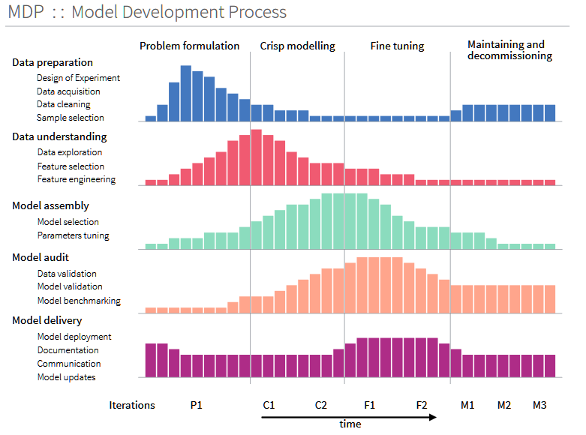
Data Science Model Development
Biecek, P. (2019). Model Development Process.

Slide 23
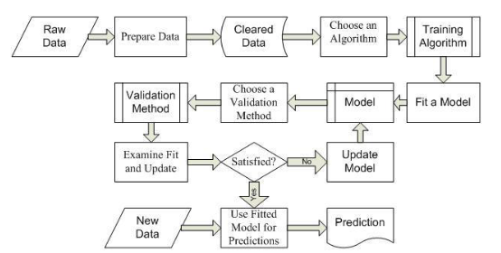
Machine Learning Workflow
Misnevs, B., & Jackiva, I. Y. (2016). Data science: professional requirements and competence evaluation. Baltic Journal of Modern Computing, 4(3), 441.

Slide 24







Where to Then?
These models are not wrong, just not helpful for starting out
Technical skills are non-negotiable in data science
After this class, you will be a much stronger programmer and analyst
You should expect to invest a lot of time in programming and analysis
“Aren’t the themes for each module around a different type of data? Doesn’t that mean this is just another data-centered class?”
How to apply a data science mindset across diverse kinds of data
Building this mindset — rather than specific methods, tools, and models — is the human-centered approach we want you to learn
What is a data science mindset?

