Slide 1

Class 01 Introductions
INFO 3401: Information Explorations
Abe Handler abram.handler@colorado.edu

Slide 2
Agenda
Building a data scientist mindset
In-class:
Introductions
Zoom norms
Course design input/questions
Mindset exercise

Slide 3
Course Overview

Slide 4
Why Are You Here?
INFO 1201
INFO 2201
INFO 3401
INFO 3402
INFO 1301
INFO 2301
Integrating concepts and skills from the rest of the computational and quantitative track
Improve your confidence analyzing diverse kinds of data
Develop your ability to match questions, data, and solutions
Understand professional data science tools and methods
Think critically about the opportunities and limitations of data

Slide 5
Course Overview

Slide 6
Course Overview

Slide 7
Evaluation
Module Assignments – 50%
Quizzes – 20%
Attendance – 5%
Final Project – 25%
All assignments and quizzes will occur on Canvas, please do not attempt to submit via email

Slide 8

COVID-19 Contingencies
If you require sequestration, treatment, convalescence:
We will try to accommodate through extensions and incompletes
If a roommate, partner, or family member’s diagnosis will affect you:
We will also try to accommodate through extensions and incompletes
We are bound by and will enforce campus COVID-19 policy
Do not ghost us! Notify us as soon as possible of diagnoses or events that will impact your ability to participate in class so we can accommodate without end-of-term scrambling.

Slide 9
Building a Data Science Mindset

Slide 10

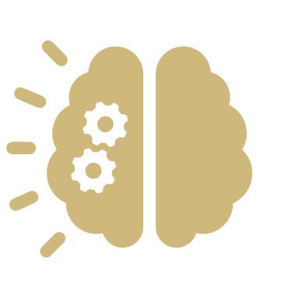


A Modest Proposal
Growth Mindset
Computational Thinking
Hacker Ethic
Scientific Norms

Slide 11
A Modest Proposal
Growth Mindset
Computational Thinking
Hacker Ethic
Scientific Norms

Slide 12
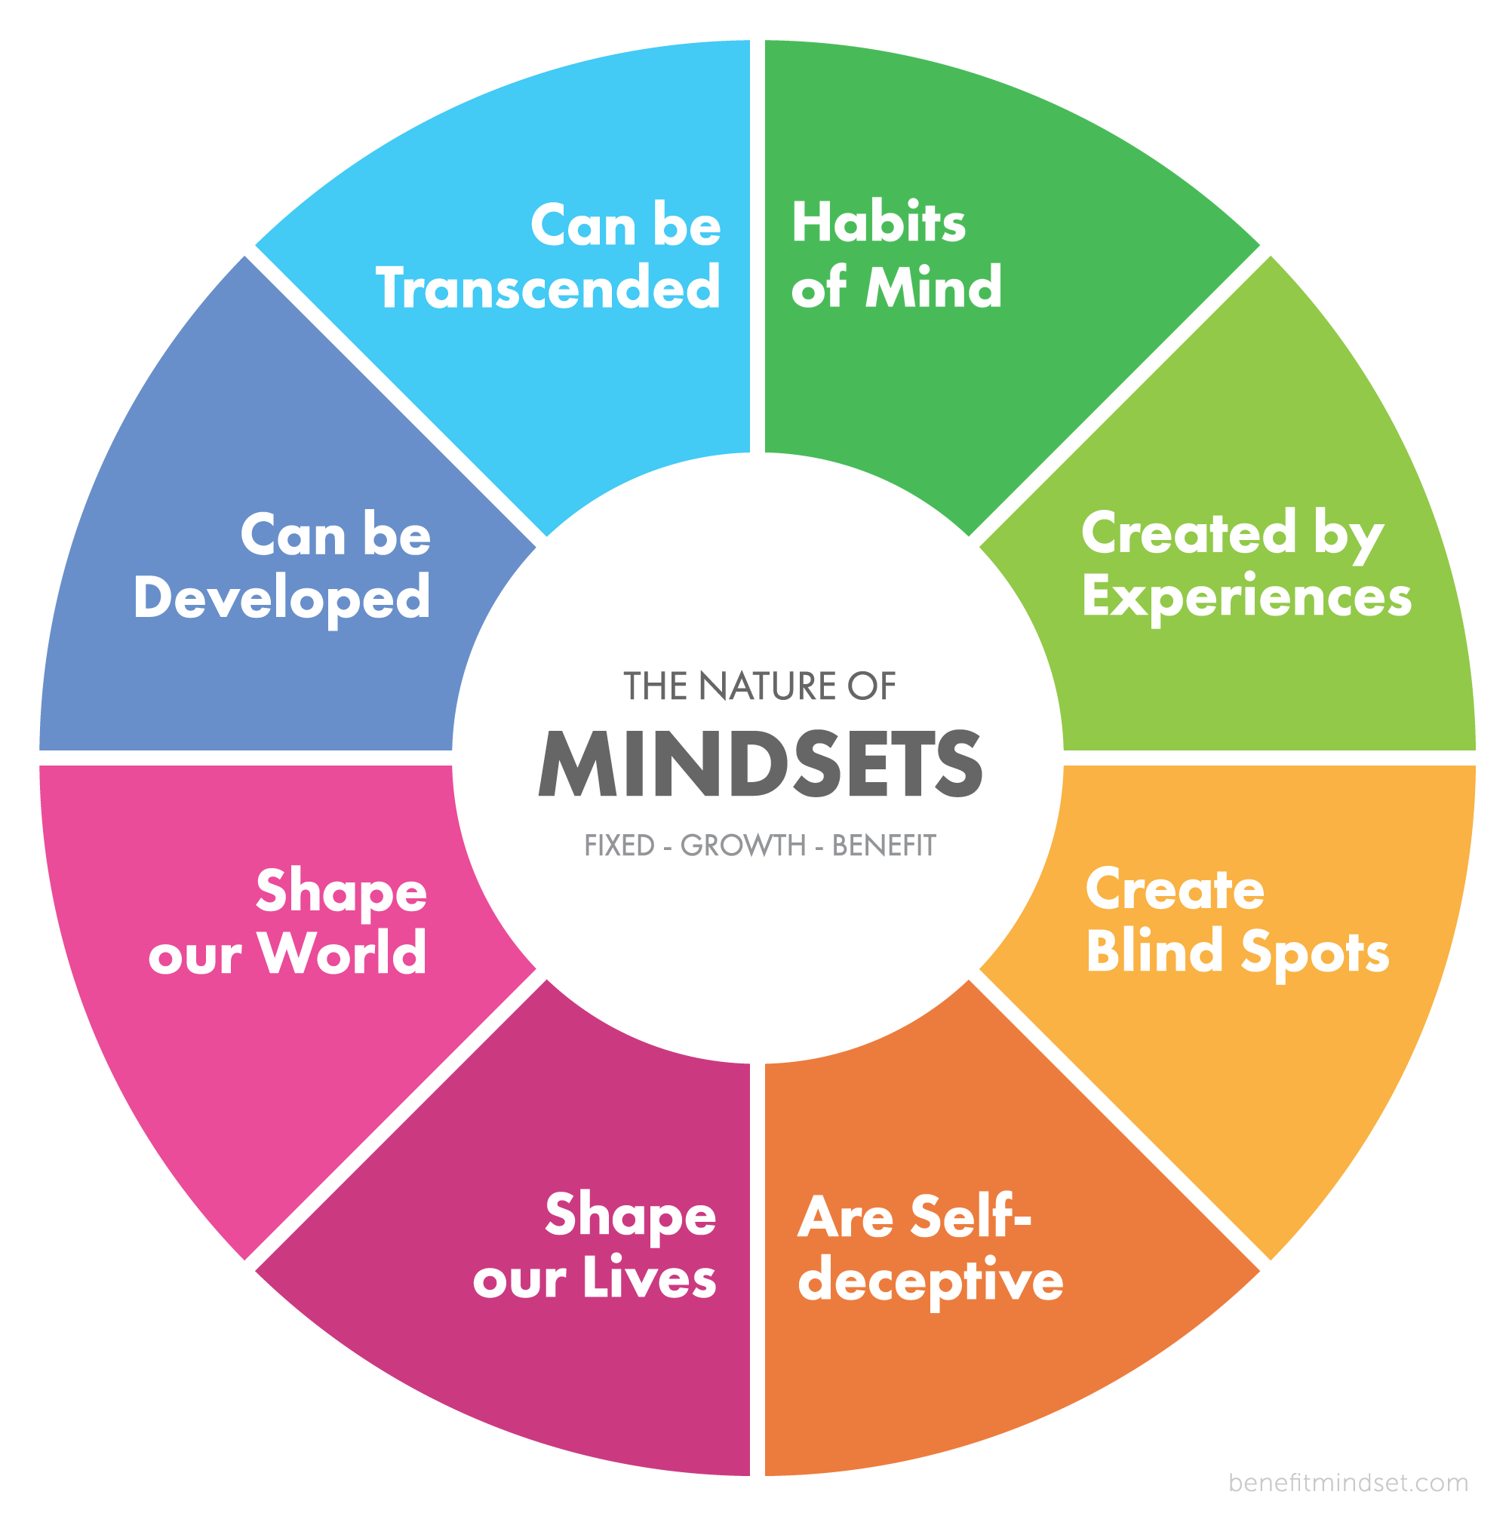
Growth Mindset
Pre-Renaissance: fixed endowments, predetermined positions, ability is heritable, mobility is a threat to social order
Not gone: high-stakes testing used to “discover” ability and to exclude
Early cognitive psychology
Learned helplessness: animals exposed to uncontrollable shocks made little effort to prevent shocks even after they were controllable
Attribution theory: people’s explanations for what happens to them shapes their reactions to future events
Fixed mindset: fears lack of ability, need to prove ability, challenge-avoiding, stereotype belief/threat, mind as a mold
Growth mindset: fears lack of effort, need to improve ability, challenge-seeking, resilience, mind as a muscle
We make these judgments about ourselves and others
Dweck, C. S., & Yeager, D. S. (2019). Mindsets: A View From Two Eras. Perspectives on Psychological Science; Buchanan, A. (2017). The nature of mindsets.

Slide 13
Growth Mindset Questions
How will you challenge yourself today?
What can you learn from a mistake?
Who can you ask for help?
How could you make this more interesting?
What can you do to focus better?
What’s the next challenge to tackle?
What support resources can you find?
What else do you want to learn?

Slide 14
Mindset Exercise
Discuss a time when you overcame a struggle and learned to solve a hard problem.
Academic, athletic, hobby, etc.
What helped you overcome this struggle?
Personal effort?
Using another perspective?
Confronting a fear?
Internal or external goals?
Support from others?
Take 3 minutes to think about it for yourself and then ~5 people will share out

Slide 15
A Modest Proposal
Growth Mindset
Computational Thinking
Hacker Ethic
Scientific Norms

Slide 16
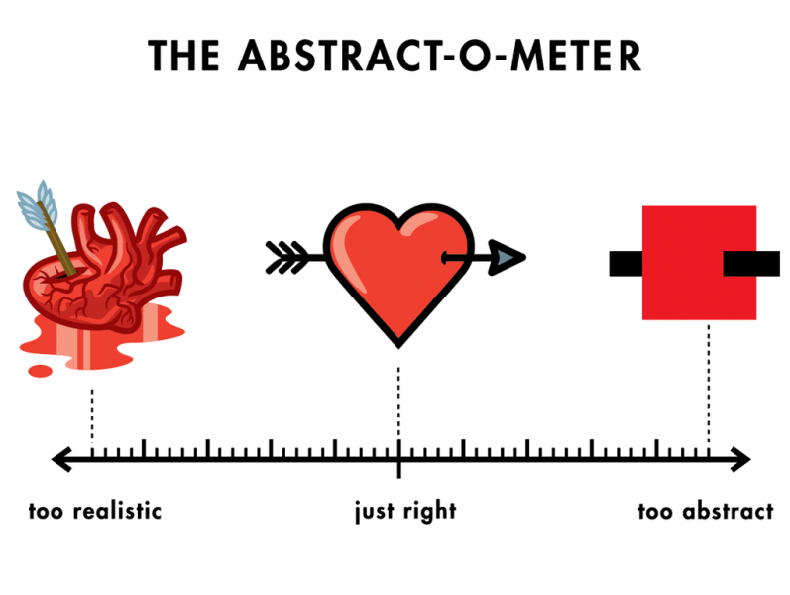
Computational Thinking (CT)
Formulating problems and their solutions that can be executed computationally
Reformulation, recursion, decomposition, abstraction, testing [Wing 2006, Grover & Pea 2013]
Creativity, algorithmic thinking, cooperativity, critical thinking, problem solving [Korkmaz, et al. 2017]
Data practices, simulation, computational problem solving, systems thinking [Weintrop, et al. 2016]
Decomposition, abstraction, algorithms, debugging, iteration, generalization [Shute, et al. 2017]
https://computersciencewiki.org/index.php/File:Abstract_heart.png
Wing, J.M. (2006). Computational thinking. CACM; Grover, S., & Pea, R. (2013). Computational Thinking in K–12. Educational Researcher; Korkmaz, Ö., et al. (2017). A validity and reliability study of the computational thinking scales. Computers in Human Behavior; Shute, V., et al. (2017). Demystifying computational thinking. Educational Research Review; Weintrop, D., et al. (2016). Defining Computational Thinking for Mathematics and Science Classrooms. Journal of Science Education and Technology.

Slide 17
CT Isn’t Just Technical Skills
Concepts: sequences, loops, parallelism, events, conditionals, operators, data
This is what INFO 1201, 2201and 2301 are designed for and INFO 3401 and 3402 will continue to reinforce
Practices
Experimenting and iterating: developing, experimenting, and developing some more
Testing and debugging: making sure things work and solving problems when they arise
Reusing and remixing: building on existing projects or ideas and sharing your own work
Abstracting and modularizing: building something complex by putting together smaller parts
Perspectives
Expressing: computation as a medium for creative and critical expression
Connecting: computation as a tool for of creating for and interacting with others
Questioning: computation as a tool for investigating how the world works
Brennan, K. & Resnick, M. (2012). New Frameworks for Studying and Assessing the Development of Computational Thinking.

Slide 18
A Modest Proposal
Growth Mindset
Computational Thinking
Hacker Ethic
Scientific Norms

Slide 19
Hacker Ethic
“Hacking” as a culture of subverting technical systems not cyber-crime
Common values within hacker ethic [Levy 1984]
Sharing & openness – access to computers/software/data/information should be free and open
Autonomy & meritocracy – hackers should be free to pursue individual goals and judged by their work
Creativity & playfulness – novelty and efficiency; irreverence and references to geek culture
Decentralization & anti-authoritarianism – build technologies to resist bureaucracy and support freedom
Exploring then exploiting opportunities by gaining then using know-how
Moving from curiosity and observation to execution and efficiency
These values emerged from a culture that remains overwhelmingly white and male [Coleman 2012]
Levy, S. (1984). Hackers: Heroes of the computer revolution; Coleman, E.G. (2012). Coding freedom: The ethics and aesthetics of hacking.

Slide 20
The Hacker Attitude
The world is full of fascinating problems waiting to be solved.
“to be a hacker you have to get a basic thrill from solving problems, sharpening your skills, and exercising your intelligence.”
No problem should ever have to be solved twice.
“it's almost a moral duty for you to share information, solve problems and then give the solutions away just so other hackers can solve new problems instead of having to perpetually re-address old ones.”
Boredom and drudgery are evil.
“Hackers should never be bored or have to drudge at stupid repetitive work, because when this happens it means they aren't doing what only they can do — solve new problems.”
Freedom is good.
“[Authoritarians] distrust voluntary cooperation and information-sharing. [Hackers] have to develop an instinctive hostility to censorship, secrecy, and the use of force or deception to compel responsible adults.“
Attitude is no substitute for competence.
“Hackers won't let posers waste their time, but they worship competence... at demanding skills that few can master and skills that involve mental acuteness, craft, and concentration is best.”
Raymond, E.S. (2001). How To Become A Hacker.

Slide 21
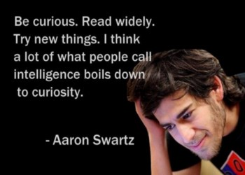
Ten Commandments of Hacker Culture
Give before you get. Horizontal groups, judged on contributions, respect is earned.
Don’t ask for permission. Do things without permission, then evaluate the outcome.
Doing > Talking. Doing creates new solutions and is sign of respect.
No excuses. Hackers are responsible for their actions.
Solve problems. Use creativity to solve problems in new ways.
Follow your curiosity. Hunger for learning and knowing more about topics.
Failing is growing. Grow from overcoming adversity and uncertainty.
Know tools/communities. Don’t reinvent the wheel.
Always be learning. Explore new ideas and experiences.
Get involved. Fix things wrong in the world.
Have fun. Work on projects you care about.
Morato, M. (2015). The Ten Commandments of Hacker Culture.

Slide 22
A Modest Proposal
Growth Mindset
Computational Thinking
Hacker Ethic
Scientific Norms

Slide 23
Scientific Norms
Merton (1942) proposed four norms that guided scientific culture (CUDOS)
Communalism: common ownership of scientific results and methods, duty to share
Universalism: scientific work should be evaluated objectively and impersonally
Disinterestedness: scientific work should be altruistic and avoid self-enrichment and promotion
Organized skepticism: transparency of results, consideration of all evidence, scrutiny by peer review
Widely-criticized and many counter-examples exist, but they remain influential with new norms
Governance: scientists are responsible for direction, control, and self-regulation of science
Quality: scientists judge contributions on the basic of quality not quantity
Calling: science is a higher purpose worthy of sacrificing material benefits
Breadth: scientists fulfill responsibilities like teaching and service in addition to research
Merton, R. K. (1942). A note on science and democracy. J. Legal & Pol. Soc.; Anderson, M. S., et al. (2010). Extending the Mertonian Norms. Journal of Higher Education.

Slide 24
Science as a Profession
Understanding issues of ethics, social responsibility, and awareness of regulations and policies
Privacy, property, accessibility, security, human rights
Communicating results of analyses back to both expert and general audiences
Visualization, evaluation, explanation, trust, persuasion, storytelling
Collaborating to manage complexity and accomplish larger goals
Teamwork, brokerage, delegation, translation, infrastructuring
Management of people and projects
Planning, documentation, leadership, conflict resolution, mentorship, consciousness
Hall, K.L., et al. (2018). The science of team science. American Psychologist; National Academies. (2017). Communicating Science Effectively.

Slide 25
Data Science Mindset Components
Growth Mindset
Computational Thinking
Hacker Ethic
Scientific Norms
Growth Mindset: effort not ability, continual improvement, challenge-seeking, resilience
Computational Thinking: concepts, practices, perspectives of applying computing technologies
Hacker Ethic: sharing, openness, creativity, autonomy, curiosity, bias towards action
Scientific Norms: communalism, skepticism, responsibility, communication, collaboration

Slide 26
Data-centered vs. Human-centered
Do you care more about the data or the people?
 | Data-centered | Human-centered
Who | Unicorn expert-hacker-engineer | Anyone with a question
What | How to do data science | How to be a data scientist
Where | CS, stats, math | INFO, social sciences, real world
When | On the job | As a citizen
Why | Because data can help something | Because data can help someone
How | Life-cycles, frameworks, processes | Context, participation, responsibility

Slide 27
Data-centered vs. Human-centered
Do you care more about the data or the people?
>90% of data science education focuses on data-centered perspectives
 | Data-centered | Human-centered
Who | Unicorn expert-hacker-engineer | Anyone with a question
What | How to do data science | How to be a data scientist
Where | CS, stats, math | INFO, social sciences, real world
When | On the job | As a citizen
Why | Because data can help something | Because data can help someone
How | Life-cycles, frameworks, processes | Context, participation, responsibility

Slide 28
Data Science Mindset Components
Growth Mindset
Computational Thinking
Hacker Ethic
Scientific Norms

Slide 29
Software setup
https://canvas.colorado.edu/courses/76471/pages/software-setup-for-class

