Slide 1
Data Collection
INFO-4604, Applied Machine Learning
University of Colorado Boulder
October 18, 2018
Prof. Michael Paul

Slide 2
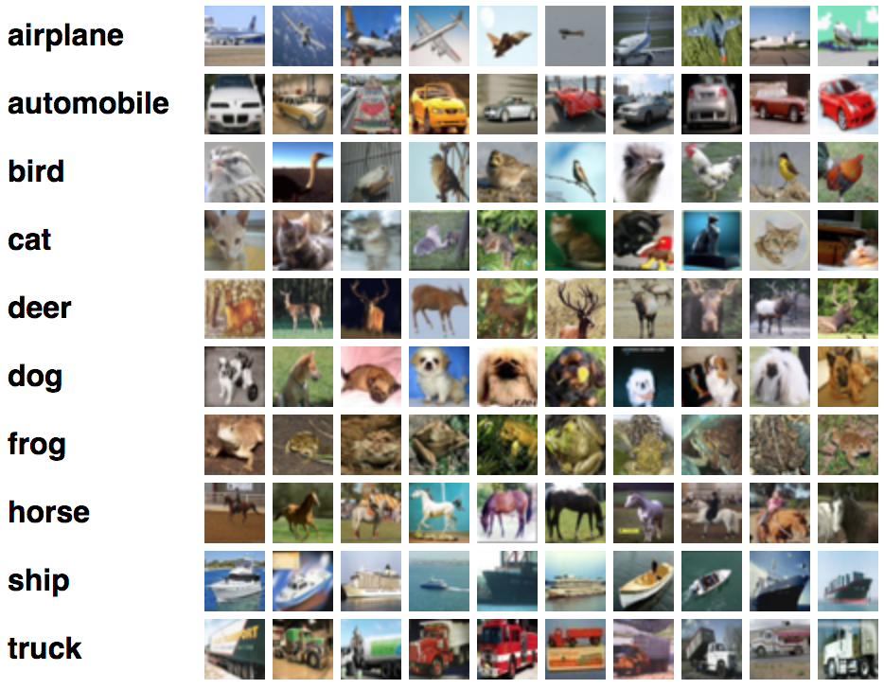
Where did these images come from?

Slide 3
Where did these labels come from?

Slide 4
Collecting a Dataset
What are you trying to do?
Where will the instances come from?
What should your labels be?
Where can you get labels?
They might already exist
You might be able to approximate them from something that exists
You might have to manually label them

Slide 5
Define the Task
What is the prediction task? Might seem obvious, but important things to think about:
Output discrete or continuous?
Some tasks could be either, and you have to decide
e.g., movie recommendation:
how much will you like a movie on a scale from 1-5?
will you like a movie, yes or no?
How fine-grained do you need to be?
Image search: probably want to distinguish between “deer” and “dog”
Self-driving car: know that an animal walked in front of the car; not so important what kind of animal

Slide 6
Get the Data
Won’t go too much into obtaining data in this class.
Sometimes need to do some steps to get data out of files:
Convert PDF to text
Convert plots to numbers
Parse HTML to get information

Slide 7
Label the Data
Training data needs to be labeled! How do we get labels?
One of the most important parts of data collection in machine learning
Bad labels → bad classifiers
Bad labels → misleading evaluation
Good labels can be hard to obtain – needs thought

Slide 8
Label the Data
Some data comes with labels
Or information that can be used as approximate labels
Sometimes you need to create labels
Data annotation

Slide 9


Label the Data
Example: sentiment analysis
The reviews already comes with scores that indicate the reviewers’ sentiment

Slide 10

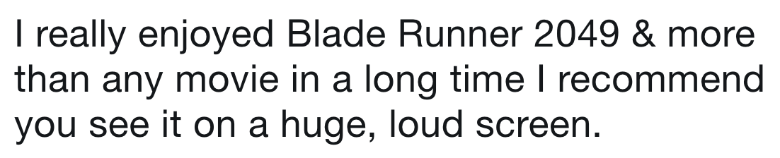
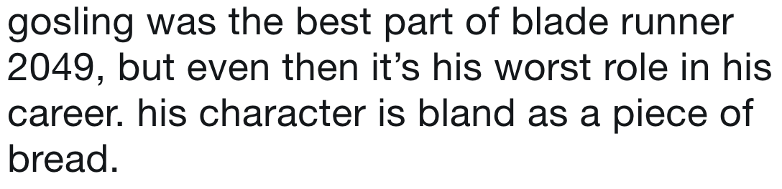
Label the Data
Example: sentiment analysis
Positive
Negative
These tweets don’t come with a rating, but a person could read these and determine the sentiment

Slide 11
Label the Data
Example: sentiment analysis
Thought: could you train a sentiment classifier on IMDB data and apply it to Twitter data?
Answer is: maybe
Sentiment will be similar – but there will also be differences in the text in the two sources
Domain adaptation methods deal with changes between train and test conditions

Slide 12
Labeled Data
Let’s start by considering cases where we don’t have to create labels from scratch.

Slide 13
Labeled Data
A lot of user-generated content is labeled in some way by the user
Ratings in reviews
Tags of posts/images
Usually correct, but:
Sometimes not what you think
May be incomplete
Variation in how different users rate/tag things

Slide 14


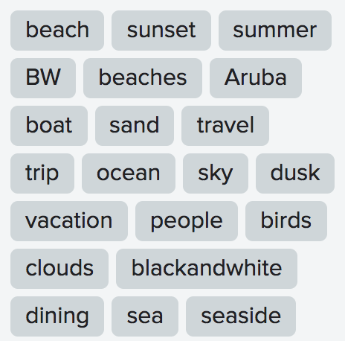
Labeled Data
Notes:
trees

Slide 15
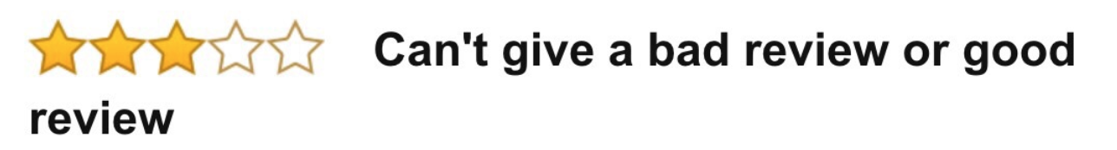
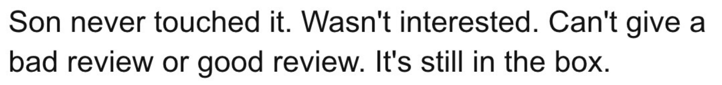
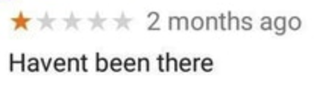
Labeled Data

Slide 16
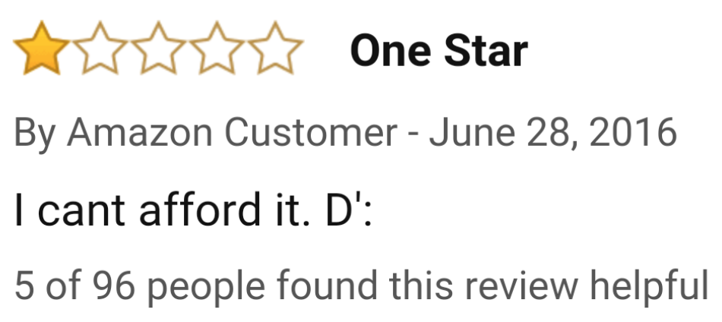
Labeled Data
Some data also comes with ratings of the quality of content, which you could leverage to identify low-quality instances

Slide 17
Implicit Labels
Many companies can use user engagement (e.g., clicks, “likes”) with a product as a type of label
Often this type of feedback is only a proxy for what you actually want, but it is useful because it can be obtained without effort

Slide 18
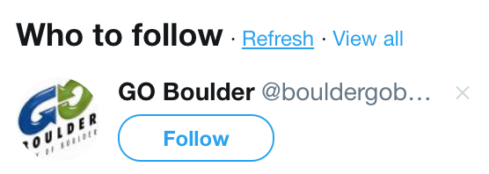
Implicit Labels
Clicking this signals that this was a bad recommendation
Clicking this signals that this was a good recommendation
Not clicking doesn’t signal anything either way

Slide 19
Implicit Labels
Reasons you might “like” a post:
You liked the content
You want to show the poster that you liked it (even if you didn’t)
You want to make it easier to find later (maybe because you hated it)
Might be wrong to assume “likes” would be good training data for predicting posts you will like
But maybe a good enough approximation

Slide 20
Implicit Labels
Summary:
Clicking might not mean what you think
Not clicking might not mean anything
Might be reasonable to use clicks to get ‘positive’ labels, but a lack of click shouldn’t count as a ‘negative’ label

Slide 21
Annotation
Annotation (sometimes called coding or labeling) is the process of having people assign labels to data by hand.
Annotation can yield high-quality labels since they have been verified by a person.
But can also give low-quality labels if done wrong.
A person doing annotation is called an annotator.

Slide 22
Annotation
Sometimes seemingly straightforward:
“does this image contain a truck?”
Though often annotation becomes less straightforward once you start doing it…
Is a truck different from a car?
Is a pickup truck different from a semi-truck?
Is an SUV a truck?
The answers to these questions will depend on your task (as discussed at the start of this lecture)

Slide 23
Annotation
Need to decide on the set of possible labels and what they mean.
Need clear guidelines for annotation, otherwise annotator(s) will make inconsistent decisions (e.g., what counts as a truck)
Often an iterative process is required to finalize the set of labels and guidelines.
i.e., you’ll start with one idea, but after doing some annotations, you realize you need to refine some of your definitions

Slide 24
Annotation
Annotation can be hard.
If an instance is hard to label, usually this is either because:
the definition of the label is ambiguous
the instance itself is ambiguous (maybe not enough information, or intentionally unclear like from sarcasm)

Slide 25
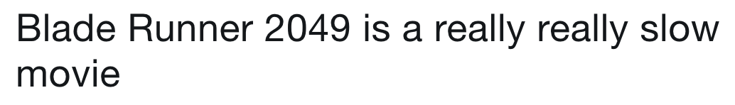
Annotation
Does this tweet express negative sentiment?
Maybe?

Slide 26

Annotation
The ability to annotate an instance depends on how much information is available.

Slide 27
Annotation
What if an instance is genuinely unclear and you don’t know how to assign a label?
One solution: just exclude from training data
Then classifier won’t learn what to do when it encounters similar instances in the future
But maybe that’s better than teaching the classifier something that’s wrong

Slide 28
Annotation
What if an instance is genuinely unclear and you don’t know how to assign a label?
Sometimes you might want a special class for ‘other’ / ‘unknown’ / ‘irrelevant’ instances
For some tasks, there is a natural class for instances that do not clearly belong to another; e.g., sentiment classification should have a ‘neutral’ class

Slide 29
Crowdsourcing
Annotation can be slow. What if you want thousands or tens of thousands of labeled instances?
Crowdsourcing platforms (e.g., Amazon Mechanical Turk, CrowdFlower) let you outsource the work to strangers on the internet
Split the work across hundreds of annotators

Slide 30
Crowdsourcing
Harder to get accurate annotations for a variety of reasons:
You don’t have the same people labeling every instance, so harder to ensure consistent rules
Crowd workers might lack the necessary expertise
Crowd workers might work too quickly to do well

Slide 31
Crowdsourcing
Usually want 3-5 annotators per instance so that if some of them are wrong, you have a better chance of getting the right label after going with the majority
You should also include tests to ensure competency
Sometimes have an explicit test at the start, to check their expertise
Can include “easy” examples mixed with the annotation tasks to see if they get them correct

Slide 32
Crowdsourcing
There are entire courses on crowdsourcing; mostly beyond scope of this course
But fairly common in machine learning
Many large companies have internal crowdsourcing platforms
That way you can crowdsource data that can’t be shared outside the company
Maybe higher quality work, though safeguards still a good idea

Slide 33
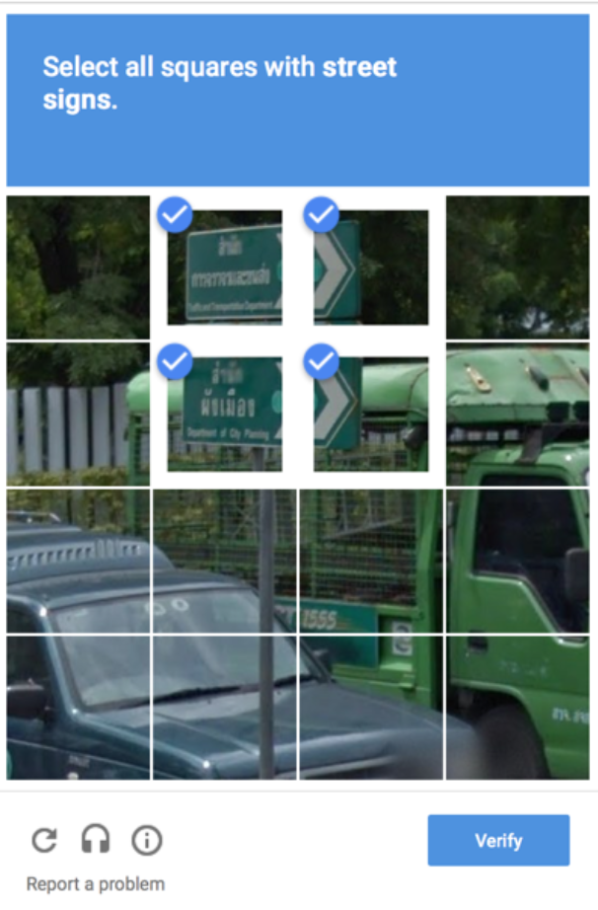
Crowdsourcing
Other creative ways of getting people to give you labels…

