Slide 1
Dimensionality Reduction
INFO-4604, Applied Machine Learning
University of Colorado Boulder
October 25, 2018
Prof. Michael Paul

Slide 3
Dimensionality
The dimensionality of data is the number of variables
Usually this refers to the number of input variables
In other words, the number of features
The curse of dimensionality refers to challenges that arise when data has many dimensions
Training: the more features you have, the more data you need to learn
Distance: all points are far apart in high-dimensional space, harder to define “close” vs “far”

Slide 4
Dimensionality Reduction
Dimensionality reduction refers to the process of reducing the number of features in your data
Last time we saw feature selection as one approach that reduces the number of features
Today, we’ll see methods that transform the feature space, creating features that are different from the original features

Slide 5

Dimensionality Reduction

Slide 6
Dimensionality Reduction
“go forward”
or
“go up”
“go right”
Going from 3D to 2D: can lose information, create ambiguity

Slide 7
Dimensionality Reduction
“go forward”
“go up”
“go right”
Can adjust the 2D values to carry over 3D meaning

Slide 8
Dimensionality Reduction
Example: two different types of blood pressure, usually correlated
BP(S) | BP(D) | Heart Rate | Temperature
120 | 80 | 75 | 98.5
125 | 82 | 78 | 98.7
140 | 93 | 95 | 98.5
112 | 74 | 80 | 98.6

Slide 9
Dimensionality Reduction
Example: two different types of blood pressure, usually correlated
You might replace the two BP features with a new feature that simply averages the two original BP values
This reduces the number of features, but different from feature selection (not just selecting existing features)
BP(S) | BP(D) | BP-Avg | Heart Rate | Temperature
120 | 80 | 100 | 75 | 98.5
125 | 82 | 104 | 78 | 98.7
140 | 93 | 117 | 95 | 98.5
112 | 74 | 93 | 80 | 98.6

Slide 10
Geometric Intuition
Like feature selection, transformation-based dimensionality reduction is usually automated
You don’t manually specify rules (like averaging BP in the previous example)
In general, what does it mean to transform or change the features?

Slide 11
Suppose we have two dimensions (two features)

Slide 12
Feature selection: choose one of the two features to keep

Slide 13
Suppose we choose the feature represented by the x-axis
Project the points onto the x-axis

Slide 14
Suppose we choose the feature represented by the x-axis
The positions along the x-axis now represent the feature values of each instance

Slide 15
Suppose we choose the feature represented by the y-axis
Project the points onto the y-axis

Slide 16
Suppose we choose the feature represented by the y-axis
The positions along the y-axis now represent the feature values of each instance

Slide 17
We don’t have to restrict ourselves to picking either the x-axis or y-axis
We could create a new axis!

Slide 18
We don’t have to restrict ourselves to picking either the x-axis or y-axis
Project points onto this new axis

Slide 19
We don’t have to restrict ourselves to picking either the x-axis or y-axis
The positions along this new axis represent the feature values of each instance

Slide 20
This is an example of transforming the feature space (as opposed to selecting a subset of features)
The positions along this new axis represent the feature values of each instance

Slide 21
Dimensionality Reduction
In general:
Original feature space has D dimensions (axes)
New feature space has K dimensions (axes), K < D
The transformed feature vectors are sometimes called embeddings

Slide 22
Dimensionality Reduction
Why does dimensionality reduction work?
Why can it be automated?

Slide 23
Dimensionality Reduction
One intuition:
If multiple features are correlated, they can often be mapped to the same feature without losing a lot of information
The blood pressure example applies here

Slide 24
Dimensionality Reduction
Another intuition:
It’s possible to change the dimensionality so that instances that were similar to each other (or close to each other) in the original feature space are still similar to each other in the reduced space
and instances that were previously dissimilar should be dissimilar in the new space
You might imagine automating this, trying to learn a reduction that minimizes the difference between the original similarities and new similarities

Slide 25
Dimensionality Reduction
Another intuition:
Think about dimensionality reduction as a compression problem (lossy compression)
Want to compress the data as much as possible while retaining “most” information
If you transform your feature vectors into new feature vectors with fewer dimensions, how well could you reconstruct the original vectors from the smaller vectors?

Slide 26
Dimensionality Reduction
Most dimensionality reduction techniques work based on some of these intuitions (maybe not all of them, though they are related)
If you don’t know a particular technique, you can probably still assume it is taking advantage of these general principles
We’ll look at two of the more common techniques today, but won’t cover a lot of technical detail

Slide 27
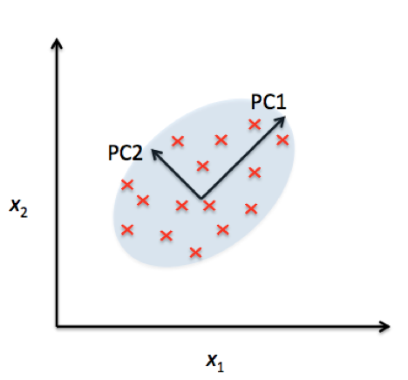
Principle Component Analysis
Principle component analysis (PCA) is a widely used technique that chooses new axes to project the data onto
The new axes are called principle components

Slide 28
Principle Component Analysis
PCA does not use any information about the class labels
Unsupervised dimensionality reduction
This has advantages and disadvantages (we’ll discuss later)
So how does PCA decide how to choose axes?
Idea: pick an axis so that the values will have high variance once projected onto it

Slide 29
Principle Component Analysis
A
B
Projection onto A:
Projection onto B:

Slide 30
Principle Component Analysis
A
B
Projection onto A:
Projection onto B:
B yields higher variance (points are more spread out)
More “informative”; separates the points better
More likely to be useful for separating by class

Slide 31
Principle Component Analysis
Overview of PCA algorithm (details in book):
Start by identifying the principle component (axis) with the highest variance
Pick another principle component that is orthogonal (forms a right angle with) the previous component(s) with the next-highest variance
Why orthogonal? Don’t want to just pick another nearly identical component, or it won’t give you much information beyond what the other component is already providing
Point is to reduce redundancy
Keep repeating until K principle components have been chosen

Slide 32
Principle Component Analysis
Overview of PCA algorithm (details in book):
The algorithm will also learn a function that transforms an instance x into the projected space
Then you can use the transformed instances in your prediction algorithm
Note: variance depends on the scale of the values
For PCA to work, important that all features are on the same scale
Perform normalization/standardization first

Slide 33
Principle Component Analysis
What is the dimensionality, K?
This is a hyperparameter you have to provide
Common values are on the order of 10–100
But you can tune this, like other hyperparameters
Next week

Slide 34
Linear Discriminant Analysis
Linear discriminant analysis (LDA*) is another technique that works similarly to PCA
Key difference: instead of choosing axes that have high variance, LDA chooses axes that best separate the class labels
Supervised dimensionality reduction
* not to be confused with Latent Dirichlet Allocation (also abbreviated LDA), a topic modeling algorithm that is also sometimes used for dimensionality reduction

Slide 35
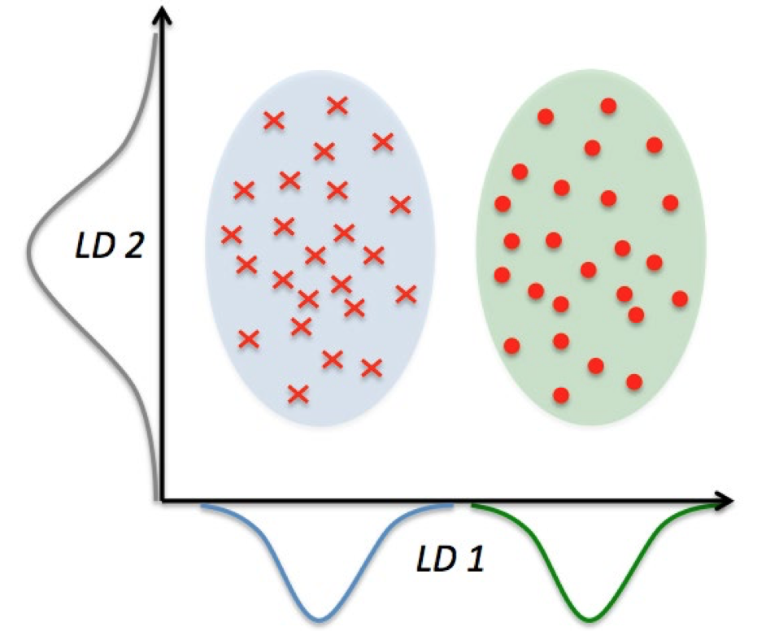
Linear Discriminant Analysis

Slide 36
Linear Discriminant Analysis
LDA uses a metric called scatter that measures how separated the class labels are along an axis
See book for more detail (not needed in this class)
Similar idea to how decision trees choose features at each node
Want features that will separate the classes

Slide 37
Supervised or Unsupervised?
Supervised reduction (LDA)
Changes the feature space in a way that directly optimizes for the prediction task
Unsupervised reduction (PCA)
Can take advantage of unlabeled data
Potentially advantageous when you have a small amount of training data but a large amount of unlabeled data from the same domain

Slide 38
Supervised or Unsupervised?
How can unlabeled data help?
Example: Classifying news articles
Suppose you never see the word “iPad” in your training set
But it occurs plenty of times in your entire collection of news articles (just not labeled)
This word is probably correlated with other words like “iPhone”, “tablet”, “Apple”, etc.
Most techniques will pick up on this correlation, and instances containing the word “iPad” will get transformed similarly to instances containing these other words

Slide 39
Revisiting Neural Networks
Input Feature
Hidden Feature
Input Feature
Input Feature
Hidden Feature
Prediction
Input Feature
Hidden Feature
Input Feature
…
Neural networks perform dimensionality reduction in the hidden layers

Slide 40
Revisiting Neural Networks
Input Feature
Hidden Feature
Input Feature
Input Feature
Hidden Feature
???
Input Feature
Hidden Feature
Input Feature
…
Researchers have discovered that the first layer often learns similar outputs even when the data and task change

Slide 41
Revisiting Neural Networks
Input Feature
Hidden Feature
Input Feature
Input Feature
Hidden Feature
???
Input Feature
Hidden Feature
Input Feature
…
An increasingly common technique is to train the first layer once (“pre-training”) and keep reusing it, doing most experimentation in the hidden layers

Slide 42
Revisiting Neural Networks
Input Feature
Hidden Feature
Input Feature
Input Feature
Hidden Feature
???
Input Feature
Hidden Feature
Input Feature
…
Many resources now exist of “pre-trained” embeddings created with neural networks that can be used for various problems

