Slide 1
Generative Learning
INFO-4604, Applied Machine Learning
University of Colorado Boulder
November 29, 2018
Prof. Michael Paul

Slide 2
Generative vs Discriminative
The classification algorithms we have seen so far are called discriminative algorithms
Learn to discriminate (i.e., distinguish/separate) between classes
Generative algorithms learn the characteristics of each class
Then make a prediction of an instance based on which class it best matches
Generative models can also be used to randomly generate instances of a class

Slide 3
Generative vs Discriminative
A high-level way to think about the difference: Generative models use absolute descriptions of classes and discriminative models use relative descriptions
Example: classifying cats vs dogs
Generative perspective:
Cats weigh 10 pounds on average
Dogs weigh 50 pounds on average
Discriminative perspective:
Dogs weigh 40 pounds more than cats on average

Slide 4
Generative vs Discriminative
The difference between the two is often defined probabilistically:
Generative models:
Algorithms learn P(X | Y)
Then convert to P(Y | X) to make prediction
Discriminative models:
Algorithms learn P(Y | X)
Probability can be directly used for prediction

Slide 5
Generative vs Discriminative
While discriminative models are not often probabilistic (but can be, like logistic regression), generative models usually are.

Slide 6
Example
Classify cat vs dog based on weight
Cats have a mean weight of 10 pounds (stddev 2)
Dogs have a mean weight of 50 pounds (stddev 20)
Could model the probability of the weight with a normal distribution
Normal(10, 2) distribution for cats, Normal(50, 20) for dogs
This is a distribution of probability density, but will refer to this as probability in this lecture

Slide 7
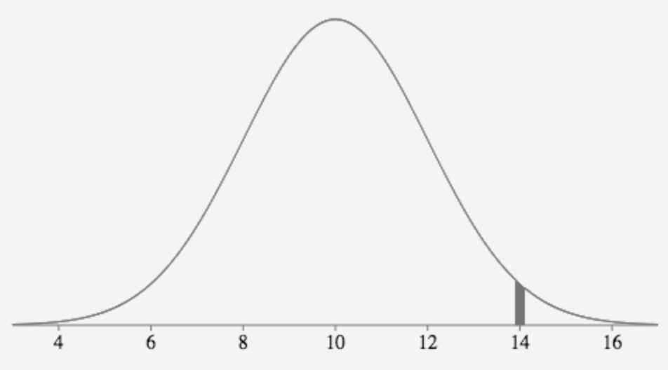
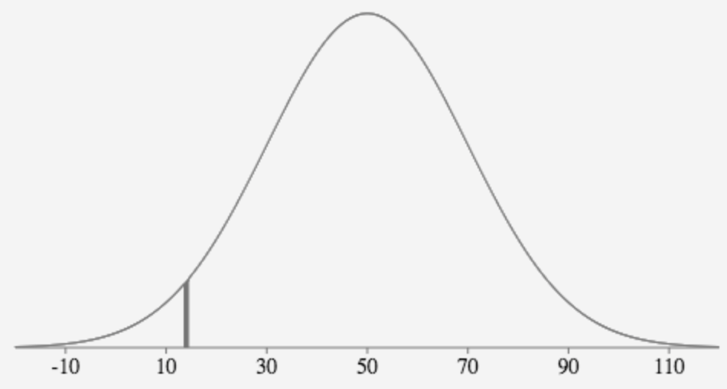
Example
Classify an animal that weighs 14 pounds
P(weight=14 | animal=cat) = .027
P(weight=14 | animal=dog) = .004

Slide 8
Example
Classify an animal that weighs 14 pounds
P(weight=14 | animal=cat) = .027
P(weight=14 | animal=dog) = .004
Choosing the Y that gives the highest P(X | Y) is reasonable… but not quite the right thing to do
What if dogs were 99 times more common than cats in your dataset? That would affect the probability of being a cat versus a dog.

Slide 9
Bayes’ Theorem
We have P(X | Y), but we really want P(Y | X)
Bayes’ theorem (or Bayes’ rule):
P(B | A) = P(A | B) P(B)
P(A)

Slide 10
Naïve Bayes
Naïve Bayes is a classification algorithm that classifies an instance based on P(Y | X), where P(Y | X) is calculated using Bayes’ rule:
P(Y | X) = P(X | Y) P(Y)
P(X)
Why naïve? We’ll come back to that.

Slide 11
Naïve Bayes
Naïve Bayes is a classification algorithm that classifies an instance based on P(Y | X), where P(Y | X) is calculated using Bayes’ rule:
P(Y | X) = P(X | Y) P(Y)
P(X)
Called the prior probability of Y
Usually just calculated as the percentage of training instances labeled as Y

Slide 12
Naïve Bayes
Naïve Bayes is a classification algorithm that classifies an instance based on P(Y | X), where P(Y | X) is calculated using Bayes’ rule:
P(Y | X) = P(X | Y) P(Y)
P(X)
Called the posterior probability of Y
The conditional probability of Y given an instance X

Slide 13
Naïve Bayes
Naïve Bayes is a classification algorithm that classifies an instance based on P(Y | X), where P(Y | X) is calculated using Bayes’ rule:
P(Y | X) = P(X | Y) P(Y)
P(X)
This conditional probability is what needs to be learned

Slide 14
Naïve Bayes
Naïve Bayes is a classification algorithm that classifies an instance based on P(Y | X), where P(Y | X) is calculated using Bayes’ rule:
P(Y | X) = P(X | Y) P(Y)
P(X)
What about P(X)?
Probability of observing the data
Doesn’t actually matter!
P(X) is the same regardless of Y
Doesn’t change which Y has highest probability

Slide 15
Example
Classify an animal that weighs 14 pounds
Also: dogs are 99 times more common than cats in the data
P(weight=14 | animal=cat) = .027
P(animal=cat | weight=14) = ?

Slide 16
Example
Classify an animal that weighs 14 pounds
Also: dogs are 99 times more common than cats in the data
P(weight=14 | animal=cat) = .027
P(animal=cat | weight=14)
≈ P(weight=14 | animal=cat) P(animal=cat)
= 0.027 * 0.01 = 0.00027

Slide 17
Example
Classify an animal that weighs 14 pounds
Also: dogs are 99 times more common than cats in the data
P(weight=14 | animal=dog) = .004
P(animal=dog | weight=14)
≈ P(weight=14 | animal=dog) P(animal=dog)
= 0.004 * 0.99 = 0.00396

Slide 18
Example
Classify an animal that weighs 14 pounds
Also: dogs are 99 times more common than cats in the data
P(animal=dog | weight=14) > P(animal=cat | weight=14)
You should classify the animal as a dog.

Slide 19
Naïve Bayes
Learning:
Estimate P(X | Y) from the data
Estimate P(Y) from the data
Prediction:
Choose Y that maximizes:
P(X | Y) P(Y)

Slide 20
Naïve Bayes
Learning:
Estimate P(X | Y) from the data
???
Estimate P(Y) from the data
Usually just calculated as the percentage of training instances labeled as Y

Slide 21
Naïve Bayes
Learning:
Estimate P(X | Y) from the data
Requires some decisions (and some math)
Estimate P(Y) from the data
Usually just calculated as the percentage of training instances labeled as Y

Slide 22
Defining P(X | Y)
With continuous features, a normal distribution is a common way to define P(X | Y)
But keep in mind that this is only an approximation: the true probability might be something different
Other probability distributions exist that you can use instead (not discussed here)
With discrete features, the observed distribution (i.e., the proportion of instances with each value) is usually used as-is

Slide 23
Defining P(X | Y)
Another complication… Instances are usually vectors of many features
How do you define the probability of an entire feature vector?

Slide 24
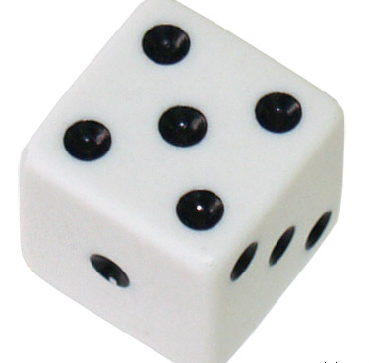
Joint Probability
The probability of multiple variables is called the joint probability
Example: if you roll two dice, what’s the probability that they both land 5?

Slide 25
Joint Probability
36 possible outcomes:
1,1 2,1 3,1 4,1 5,1 6,1
1,2 2,2 3,2 4,2 5,2 6,2
1,3 2,3 3,3 4,3 5,3 6,3
1,4 2,4 3,4 4,4 5,4 6,4
1,5 2,5 3,5 4,5 5,5 6,5
1,6 2,6 3,6 4,6 5,6 6,6

Slide 26
Joint Probability
36 possible outcomes:
1,1 2,1 3,1 4,1 5,1 6,1
1,2 2,2 3,2 4,2 5,2 6,2
1,3 2,3 3,3 4,3 5,3 6,3
1,4 2,4 3,4 4,4 5,4 6,4
1,5 2,5 3,5 4,5 5,5 6,5
1,6 2,6 3,6 4,6 5,6 6,6
Probability of two 5s:
1/36

Slide 27
Joint Probability
36 possible outcomes:
1,1 2,1 3,1 4,1 5,1 6,1
1,2 2,2 3,2 4,2 5,2 6,2
1,3 2,3 3,3 4,3 5,3 6,3
1,4 2,4 3,4 4,4 5,4 6,4
1,5 2,5 3,5 4,5 5,5 6,5
1,6 2,6 3,6 4,6 5,6 6,6

Slide 28
Joint Probability
36 possible outcomes:
1,1 2,1 3,1 4,1 5,1 6,1
1,2 2,2 3,2 4,2 5,2 6,2
1,3 2,3 3,3 4,3 5,3 6,3
1,4 2,4 3,4 4,4 5,4 6,4
1,5 2,5 3,5 4,5 5,5 6,5
1,6 2,6 3,6 4,6 5,6 6,6
Probability the first is a 5 and the second is anything but 5:
5/36

Slide 29
Joint Probability
A quicker way to calculate this:
The probability of two variables is the product of the probability of each individual variable
Only true if the two variables are independent ! (defined on next slide)
Probability of one die landing 5: 1/6
Joint probability of two dice landing 5 and 5: 1/6 * 1/6 = 1/36

Slide 30
Joint Probability
A quicker way to calculate this:
The probability of two variables is the product of the probability of each individual variable
Only true if the two variables are independent ! (defined on next slide)
Probability of one die landing anything but 5: 5/6
Joint probability of two dice landing 5 and not 5: 1/6 * 5/6 = 5/36

Slide 31
Independence
Multiple variables are independent if knowing the outcome of one does not change the probability of another
If I tell you that the first die landed 5, it shouldn’t change your belief about the outcome of the second (every side will still have 1/6 probability)
Dice rolls are independent

Slide 32
Conditional Independence
Naïve Bayes treats the feature probabilities as independent (conditioned on Y)
P(<X₁, X₂, …, X_{M}> | Y)
= P(X₁ | Y) * P(X₂ | Y) … * P(X_{M} | Y)
Features are usually not actually independent!
Treating them as if they are is considered naïve
But it’s often a good enough approximation
This makes the calculation much easier

Slide 33
Conditional Independence
Important distinction: the features have conditional independence: the independence assumption only applies to the conditional probabilities P(X | Y)
Conditional independence:
P(X₁, X₂ | Y) = P(X₁ | Y) * P(X₂ | Y)
Not necessarily true that P(X₁, X₂) = P(X₁) * P(X₂)

Slide 34
Conditional Independence
Example: Suppose you are classifying the category of a news article using word features
If you observe the word “baseball”, this would increase the likelihood that the word “homerun” will appear in the same article
These two features are clearly not independent
But if you already know the article is about baseball (Y=baseball), then observing the word “baseball” doesn’t change the probability of observing other baseball-related words

Slide 35
Defining P(X | Y)
Naïve Bayes is most often used with discrete features
With discrete features, the probability of a particular feature value is usually calculated as:
# of times the feature has that value in instances with label Y
total # of occurrences of the feature in instances with label Y

Slide 36
Document Classification
Naïve Bayes is often used for document classification
Given the document class, what is the probability of observing the words in the document?

Slide 37
Document Classification
Example:
3 documents:
“the water is cold”
“the pig went home”
“the home is cold”
P(“the”) = 3/12
P(“is”) = 2/12
P(“home”) = 2/12
P(“cold”) = 2/12
P(“water”) = 1/12
P(“went”) = 1/12
P(“pig”) = 1/12
P(“the water is cold”)
= P(“the”) P(“water”) P(“is”) P(“cold”)

Slide 38
Document Classification
Example:
3 documents:
“the water is cold”
“the pig went home”
“the home is cold”
P(“the”) = 3/12
P(“is”) = 2/12
P(“home”) = 2/12
P(“cold”) = 2/12
P(“water”) = 1/12
P(“went”) = 1/12
P(“pig”) = 1/12
P(“the water is very cold”)
= P(“the”) P(“water”) P(“is”) P(“very”) P(“cold”)

Slide 39
Document Classification
Example:
3 documents:
“the water is cold”
“the pig went home”
“the home is cold”
P(“the”) = 3/12
P(“is”) = 2/12
P(“home”) = 2/12
P(“cold”) = 2/12
P(“water”) = 1/12
P(“went”) = 1/12
P(“pig”) = 1/12
P(“very”) = 0/12
P(“the water is very cold”)
= P(“the”) P(“water”) P(“is”) P(“very”) P(“cold”)
= 0

Slide 40
Document Classification
Example:
3 documents:
“the water is cold”
“the pig went home”
“the home is cold”
P(“the”) = 3/12
P(“is”) = 2/12
P(“home”) = 2/12
P(“cold”) = 2/12
P(“water”) = 1/12
P(“went”) = 1/12
P(“pig”) = 1/12
P(“very”) = 0/12
One trick: pretend every value occurred one more time than it did

Slide 41
Document Classification
Example:
3 documents:
“the water is cold”
“the pig went home”
“the home is cold”
P(“the”) = 4/12
P(“is”) = 3/12
P(“home”) = 3/12
P(“cold”) = 3/12
P(“water”) = 2/12
P(“went”) = 2/12
P(“pig”) = 2/12
P(“very”) = 1/12
One trick: pretend every value occurred one more time than it did

Slide 42
Document Classification
Example:
3 documents:
“the water is cold”
“the pig went home”
“the home is cold”
P(“the”) = 4/20
P(“is”) = 3/20
P(“home”) = 3/20
P(“cold”) = 3/20
P(“water”) = 2/20
P(“went”) = 2/20
P(“pig”) = 2/20
P(“very”) = 1/20
Need to adjust both numerator and denominator

Slide 43
Smoothing
Adding “pseudocounts” to the observed counts when estimating P(X | Y) is called smoothing
Smoothing makes the estimated probabilities less extreme
It is one way to perform regularization in Naïve Bayes (reduce overfitting)

Slide 44
Generative vs Discriminative
The conventional wisdom is that discriminative models generally perform better because they directly model what you care about, P(Y | X)
When to use generative models?
Generative models have been shown to need less training data to reach peak performance
Generative models are more conducive to unsupervised and semi-supervised learning
More on that point next week

