Slide 1
Generative Clustering, Topic Modeling, & Bayesian Inference
INFO-4604, Applied Machine Learning
University of Colorado Boulder
December 11-13, 2018
Prof. Michael Paul

Slide 2
Unsupervised Naïve Bayes
Last week you saw how Naïve Bayes can be used in semi-supervised or unsupervised settings
Learn parameters with the EM algorithm
Unsupervised Naïve Bayes is considered a type of topic model when used for text data
Learns to group documents into different categories, referred to as “topics”
Instances are documents; features are words
Today’s focus is text, but ideas can be applied to other types of data

Slide 3
Topic Models
Topic models are used to find common patterns in text datasets
Method of exploratory analysis
For understanding data rather than prediction (though sometimes also useful for prediction – we’ll see at the end of this lecture)
Unsupervised learning means that it can provide analysis without requiring a lot of input from a user

Slide 4
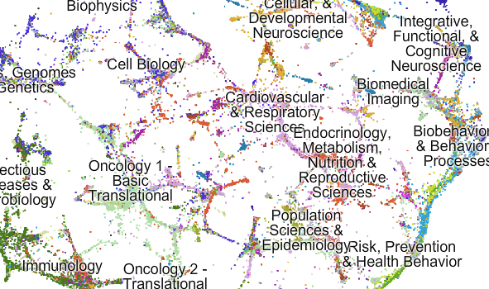
Topic Models
From Talley et al (2011)

Slide 5
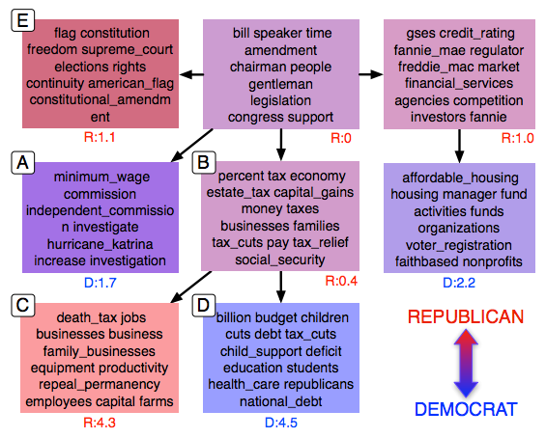
Topic Models
From Nguyen et al (2013)

Slide 6
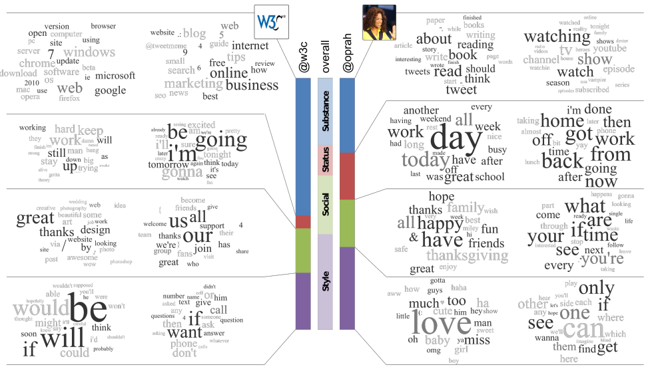
Topic Models
From Ramage et al (2010)

Slide 7
Unsupervised Naïve Bayes
Naïve Bayes is not often used as a topic model
We’ll learn more common, more complex models today
But let’s start by reviewing it, and then build off the same ideas

Slide 8
Generative Models
When we introduced generative models, we said that they can also be used to generate data

Slide 9
Generative Models
How would you use Naïve Bayes to randomly generate a document?
First, randomly pick a category, Y Z
Notation convention to use Z for latent categories in unsupervised modeling instead of Y (since Y often implies it is a known value you are trying to predict)
The category should be randomly sampled according to the prior distribution, P(Z)

Slide 10
Generative Models
How would you use Naïve Bayes to randomly generate a document?
First, randomly pick a category, Z
Then, randomly pick words
Sampled according to the distribution, P(W | Z)
These steps are known as the generative process for this model

Slide 11
Generative Models
How would you use Naïve Bayes to randomly generate a document?
This process won’t result in a coherent document
But, the words in the document are likely to be related to each other, since P(W | Z) will give high probability to words that are common in the particular category

Slide 12
Generative Models
Another perspective on learning:
If you assume that the “generative process” for a model is how the data was generated, then work backwards and ask:
What are the probabilities that most likely would have generated the data that we observe?
The generative process is almost always overly simplistic
But it can still be a way to learn something useful

Slide 13
Generative Models
With unsupervised learning, the same approach applies
What are the probabilities that most likely would have generated the data that we observe?
If we observe similar patterns across multiple documents, those documents are likely to have been generated from the same latent category

Slide 14
Naïve Bayes
Let’s first review (unsupervised) Naïve Bayes and Expectation Maximization (EM)

Slide 15
Naïve Bayes
Learning probabilities in Naïve Bayes:
P(X_{j}=x | Y=y) =
# instances with label y where feature j has value x
# instances with label y

Slide 16
Naïve Bayes
Learning probabilities in unsupervised Naïve Bayes:
P(X_{j}=x | Z=z) =
# instances with category z where feature j has value x
# instances with category z

Slide 17
Naïve Bayes
Learning probabilities in unsupervised Naïve Bayes:
P(X_{j}=x | Z=z) =
Expected # instances with category z where feature j has value x
Expected # instances with category z
Using Expectation Maximization (EM)

Slide 18
Expectation Maximization (EM)
The EM algorithm iteratively alternates between two steps:
1. Expectation step (E-step)
Calculate P(Z=z | X_{i}) = P(X_{i} | Z=z) P(Z=z)
for every instance Σ_{y’} P(X_{i} | Z=z’) P(Z=z’)
These parameters come from the previous iteration of EM

Slide 19
Expectation Maximization (EM)
The EM algorithm iteratively alternates between two steps:
2. Maximization step (M-step)
Update the probabilities P(X | Z) and P(Z), replacing the observed counts with the expected values of the counts
Equivalent to Σ_{i} P(Z=z | X_{i})

Slide 20
Expectation Maximization (EM)
The EM algorithm iteratively alternates between two steps:
2. Maximization step (M-step)
P(X_{j}=x | Z=z) = Σ_{i} P(Z=z | X_{i}) I(X_{ij}=x)
Σ_{i} P(Z=z | X_{i})
for each feature j and each category z
These values come from the E-step

Slide 21
Unsupervised Naïve Bayes
Need to set the number of latent classes
Initially define the parameters randomly
Randomly initialize P(X | Z) and P(Z) for all features and classes
Run the EM algorithm to update P(X | Z) and P(Z) based on unlabeled data
After EM converges, the final estimates of P(X | Z) and P(Z) can be used for clustering

Slide 22
Unsupervised Naïve Bayes
In (unsupervised) Naïve Bayes, each document belongs to one category
This is a typical assumption for classification (though it doesn’t have to be – remember multi-label classification)

Slide 23
Admixture Models
In (unsupervised) Naïve Bayes, each document belongs to one category
This is a typical assumption for classification (though it doesn’t have to be – remember multi-label classification)
A better model might allow documents to contain multiple latent categories (aka topics)
Called an admixture of topics

Slide 24
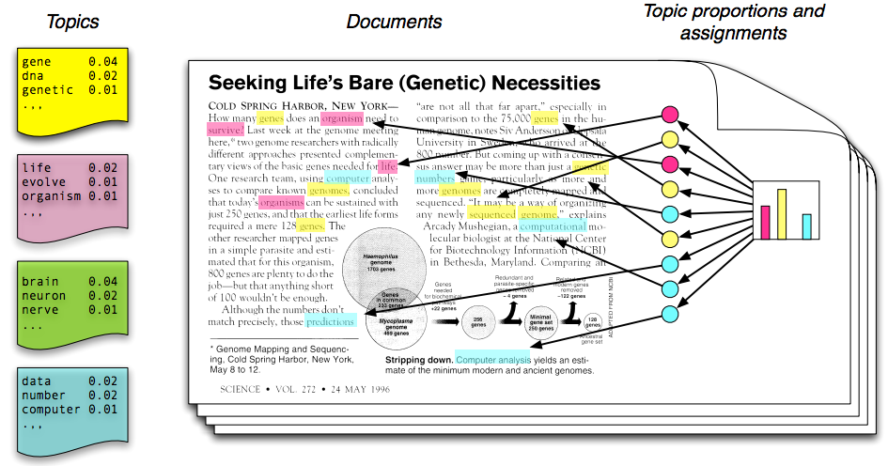
Admixture Models
From Blei (2012)

Slide 25
Admixture Models
In an admixture model, each document has different proportions of different topics
Unsupervised Naïve Bayes is considered a mixture model (the dataset contains a mixture of topics, but each instance has only one topic)
Probability of each topic in a specific document
P(Z | d)
Another type of parameter to learn

Slide 26
Admixture Models
In this type of model, the “generative process” for a document d can be described as:
For each token in the document d:
Sample a topic z according to P(z | d)
Sample a word w according to P(w | z)
Contrast with Naïve Bayes:
Sample a topic z according to P(z)
For each token in the document d:
Sample a word w according to P(w | z)

Slide 27
Admixture Models
In this type of model, the “generative process” for a document d can be described as:
For each token in the document d:
Sample a topic z according to P(z | d)
Sample a word w according to P(w | z)
Same as in Naïve Bayes (each “topic” has a distribution of words)
Parameters can be learned in a similar way
Called β (sometimes Φ)by convention

Slide 28
Admixture Models
In this type of model, the “generative process” for a document d can be described as:
For each token in the document d:
Sample a topic z according to P(z | d)
Sample a word w according to P(w | z)
Related to but different from Naïve Bayes
Instead of one P(z) shared by every document, each document has its own distribution
More parameters to learn
Called θ by convention

Slide 29
Admixture Models
β₁
β₂
θ_{d}
β₃
β₄
From Blei (2012)

Slide 30
Learning
How to learn β and θ?
Expectation Maximization (EM) once again!

Slide 31
Learning
E-step
P(topic=j | word=v, θ_{d} , β_{j})
= P(word=v, topic=j | θ_{d} , β_{j})
Σ_{k} P(word=v, topic=k | θ_{d} , β_{k})

Slide 32
Learning
M-step
new θ_{dj}
= # tokens in d with topic label j
# tokens in d
if the topic labels were observed!
just counting

Slide 33
Learning
M-step
new θ_{dj}
= Σ_{i∈d} P(topic i=j | word i, θ_{d} , β_{j}) Σ_{k} Σ_{i∈d} P(topic i=k | word i, θ_{d} , β_{k})
sum over each token i in document d
numerator: the expected number of tokens with topic j in document d
denominator: the number of tokens in document d
just the number of tokens in the document

Slide 34
Learning
M-step
new β_{jw}
= # tokens with topic label j and word w
# tokens with topic label j
if the topic labels were observed!
just counting

Slide 35
Learning
M-step
new β_{jw}
= Σ_{i} I(word i=w) P(topic i=j | word i=w, θ_{d} , β_{j}) Σ_{v} Σ_{i} I(word i=v) P(topic i=j | word i=v, θ_{d} , β_{j}) sum over vocabulary
sum over each token i in the entire corpus
numerator: the expected number of times word w belongs to topic j
denominator: the expected number of all tokens belonging to topic j

Slide 36
Smoothing
From last week’s Naïve Bayes lecture:
Adding “pseudocounts” to the observed counts when estimating P(X | Y) is called smoothing
Smoothing makes the estimated probabilities less extreme
It is one way to perform regularization in Naïve Bayes (reduce overfitting)

Slide 37
Smoothing
Smoothing is also commonly done in unsupervised learning like topic modeling
Today we’ll see a mathematical justification for smoothing

Slide 38
Smoothing: Generative Perspective
In general models, we can also treat the parameters themselves as random variables
P(θ)?
P(β)?
Called the prior probability of the parameters
Same concept as the prior P(Y) in Naïve Bayes
We’ll see that pseudocount smoothing is the result when the parameters have a prior distribution called the Dirichlet distribution

Slide 39
Geometry of Probability
A distribution over K elements is a point on a K-1 simplex
a 2-simplex is called a triangle
A
B
C

Slide 40
Geometry of Probability
A distribution over K elements is a point on a K-1 simplex
a 2-simplex is called a triangle
A
P(A) = 1
P(B) = 0
P(C) = 0
B
C

Slide 41
Geometry of Probability
A distribution over K elements is a point on a K-1 simplex
a 2-simplex is called a triangle
A
P(A) = 1/2
P(B) = 1/2
P(C) = 0
B
C

Slide 42
Geometry of Probability
A distribution over K elements is a point on a K-1 simplex
a 2-simplex is called a triangle
A
P(A) = 1/3
P(B) = 1/3
P(C) = 1/3
B
C

Slide 43
Dirichlet Distribution
Continuous distribution (probability density) over points in the simplex
“distribution of distributions”
A
B
C

Slide 44
Dirichlet Distribution
Continuous distribution (probability density) over points in the simplex
“distribution of distributions”
A
Denoted Dirichlet(α)
α is a vector that gives the mean/variance of the distribution
In this example, α_{B} is larger than the others, so points closer to B are more likely
Distributions that give B high probability are more likely than distributions that don’t
B
C

Slide 45
Dirichlet Distribution
Continuous distribution (probability density) over points in the simplex
“distribution of distributions”
A
Denoted Dirichlet(α)
α is a vector that gives the mean/variance of the distribution
In this example, α_{A}=α_{B}=α_{C}, so distributions close to uniform are more likely
Larger values of α give higher density around mean
(lower variance)
B
C

Slide 46
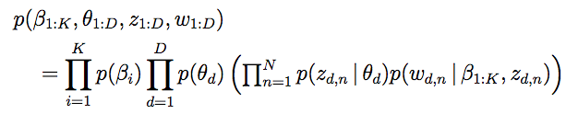
Latent Dirichlet Allocation (LDA)
LDA is the topic model previous slides, but with Dirichlet priors on the parameters θ and β
P(θ | α) = Dirichlet(α)
P(β | η) = Dirichlet(η)
Most widely used topic model
Lots of different implementations / learning algorithms

Slide 47

MAP Learning
How to learn β and θ with Dirichlet priors?
The posterior distribution of parameters for LDA:
Want to maximize this

Slide 48
MAP Learning
So far we have used EM to find parameters that maximize the likelihood of the data
EM can also find the maximum a posteriori (MAP) solution
the parameters that maximum the posterior probability
Similar objective as before, but with additional terms for the probability of θ and β
constant

Slide 49
MAP Learning
E-step is the same
M-step is modified
new θ_{d1}
= α₁ - 1 + Σ_{i∈d} P(topic i=1 | word i, θ_{d} , β₁) Σ_{k} (α_{k} - 1 + Σ_{i∈d} P(topic i=k | word i, θ_{d} , β_{k}))
pseudocounts

Slide 50
MAP Learning
Where do the pseudocounts come from?
The probability of observing the kth topic n times given the parameter θ_{k} is proportional to:
θ_{k}^{n}
The probability density of the parameter θ_{k} given the Dirichlet parameter α_{k} is proportional to:
θ_{k}^{αk-1}
The product of these probabilities is proportional to:
θ_{k}^{n+αk-1}

Slide 51
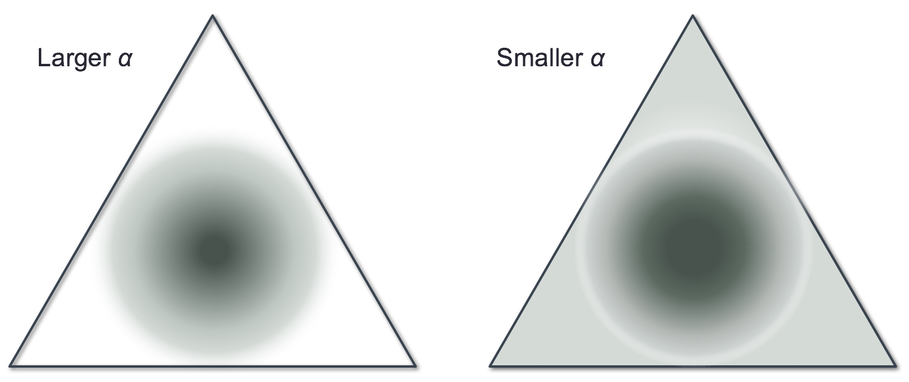
Smoothing: Generative Perspective
Larger pseudocounts will bias the MAP estimate more heavily
Larger Dirichlet parameters concentrate the density around the mean

Slide 52
Smoothing: Generative Perspective
Dirichlet prior MAP estimation yields “α – 1” smoothing
So what happens if α < 1?
Highest density around edges of simplex
Prior favors small number of topics per document

Slide 53
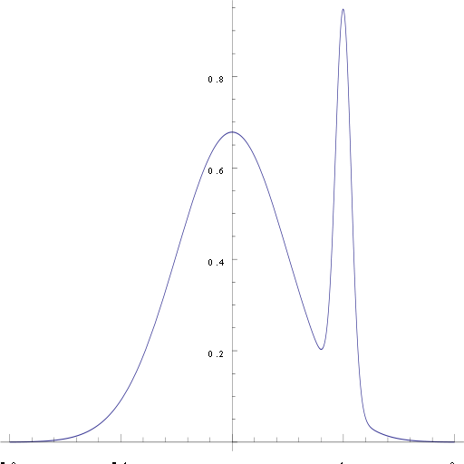
Posterior Inference
What if we don’t just want the parameters that maximize the posterior?
What if we care about the entire posterior distribution?
or at least the mean of the posterior distribution
Why?
maybe the maximum doesn’t look like the rest
other points of the posterior more likely to generalize to data you haven’t seen before

Slide 54
Posterior Inference
What if we don’t just want the parameters that maximize the posterior?
This is harder
Computing the denominator involves summing over all possible configurations of the latent variables/parameters

Slide 55
Posterior Inference
Various methods existing for approximating the posterior (also called Bayesian inference)
Random sampling
Monte Carlo methods
Variational inference
Optimization using EM-like procedure
MAP estimation is a simple case of this

Slide 56
Dimensionality Reduction
Recall:
Methods like PCA can transform a high-dimensional feature space (e.g., each word is a feature) into a low-dimensional space
Each feature vector is rewritten as a new vector

Slide 57
Dimensionality Reduction
Topic models can also be used as a form of dimensionality reduction
Each document’s feature vector is θ_{d}, aka P(Z | d)
With 100 topics, this is a 100-dimensional vector
Semantically similar words will map to a similar part of the feature space, since then tend to be grouped into the same topics
This is similar to the ideas behind “embedding” methods like word2vec

Slide 58
Priors as Regularization
We saw that Dirichlet priors are equivalent to pseudocount smoothing, which is used as regularization in Naïve Bayes
Other types of priors are equivalent to other types of regularization you’ve seen!

Slide 59
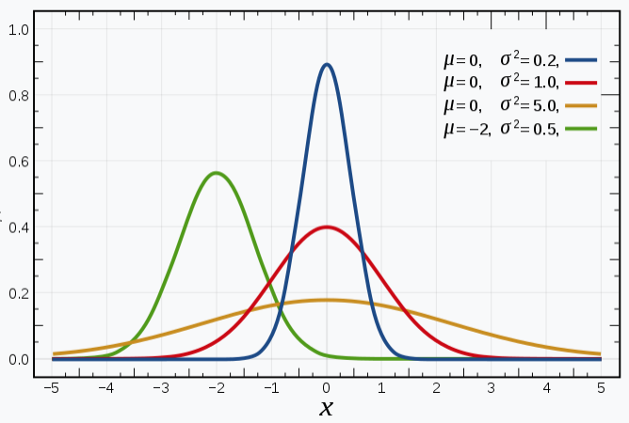
Priors as Regularization
Recall: For real-valued weights (e.g., SVM or logistic regression), the most common type of regularization is to minimize the L2 norm of the weights
Minimizing the L2 norm ends up being mathematically equivalent to having a prior distribution on the weights where the prior is the Gaussian (normal) distribution!
The mean of the Gaussian is 0
The variance of the Gaussian acts as the regularization strength (‘C’ or ‘alpha’)

Slide 60
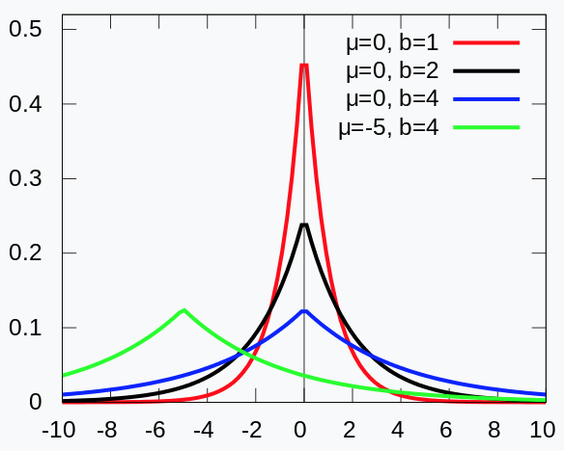
Priors as Regularization
L1 regularization, which favors weights that are exactly 0, is equivalent to the Laplace (double exponential) distribution as the prior
Like with Gaussian, the mean is 0 and variance adjusts the regularization strength

Slide 61
Priors as Inductive Bias
Recall that an inductive bias intentionally biases what a classifier learns toward certain characteristics that you think will be useful
Regularization toward small weights is a common type of inductive bias in machine learning
There are other useful inductive biases that can be encoded as priors
Any prior on the parameters is an inductive bias

Slide 62
Priors as Inductive Bias
In topic models:
Dirichlet priors bias the learned distributions toward the uniform distribution
Yields less extreme probabilities, reducing overfitting
But Dirichlet priors don’t have to bias toward uniform!
Other biases can be useful.

Slide 63
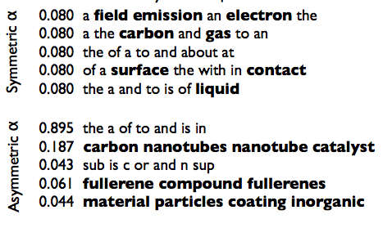
Priors as Inductive Bias
In topic models:
From Wallach et al (2009)

Slide 64
Priors as Inductive Bias
For real-valued parameters, a Gaussian prior with mean of 0 is equivalent to L2 regularization
Can also use a Gaussian prior with a mean set to some value other than 0!
If you believe certain features should have a positive or negative weight, you could set the mean of the prior to a positive or negative value to bias it in that direction

Slide 65
Priors as Inductive Bias
Example: domain adaptation
What to do when your training data includes different domains (distributions of data)?
e.g., sentiment classification on reviews of movies and reviews of mattresses
Challenge in machine learning: might learn patterns that work in one domain but not another

Slide 66
Priors as Inductive Bias
One idea: learn each domain separately
But this is limited because you have less training data for each domain
How to learn domain-specific parameters while still using all of the training data?
One approach (Finkel and Manning 2009):
Learn “overall” feature weights for all domains
Learn domain-specific feature weights
The prior for the domain-specific weights is a Gaussian distribution where the mean is the “overall” weight

Slide 67
The End!

