Slide 1
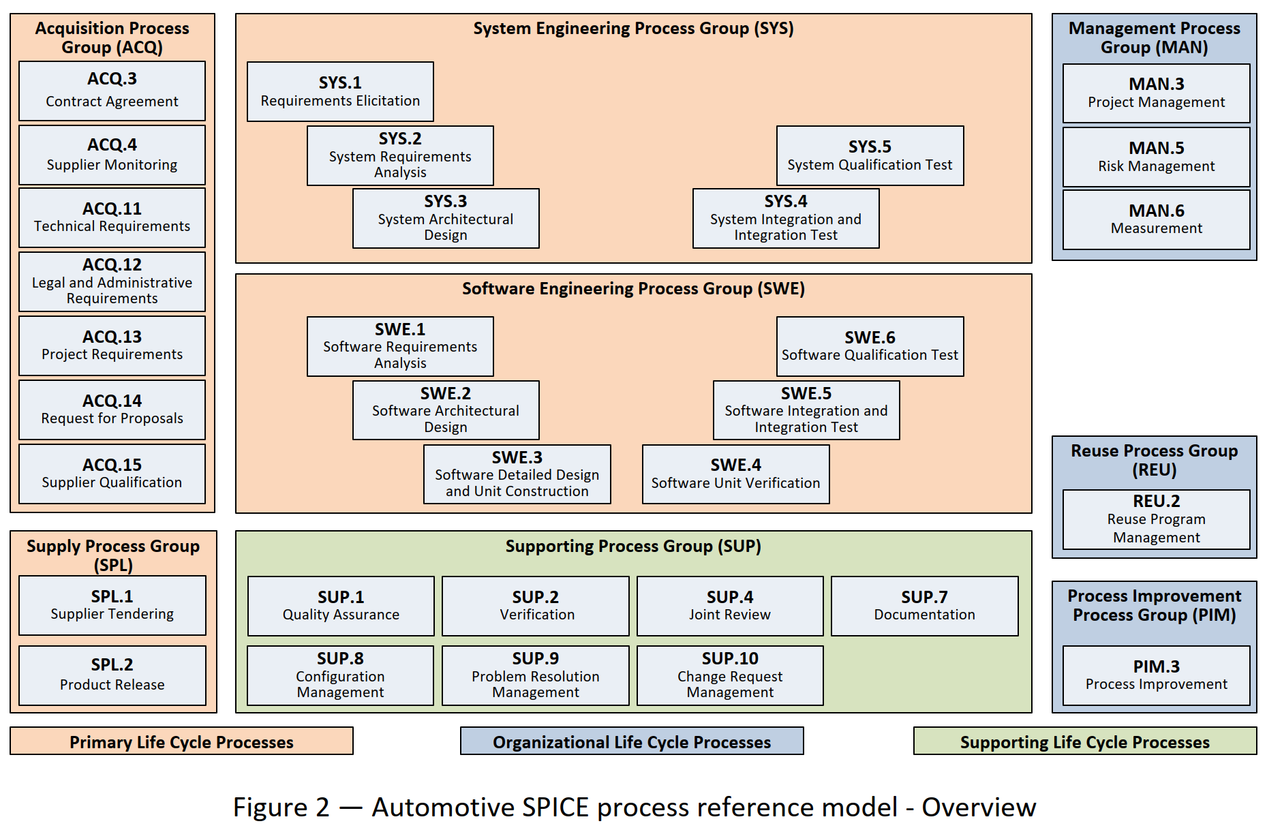


Slide 4
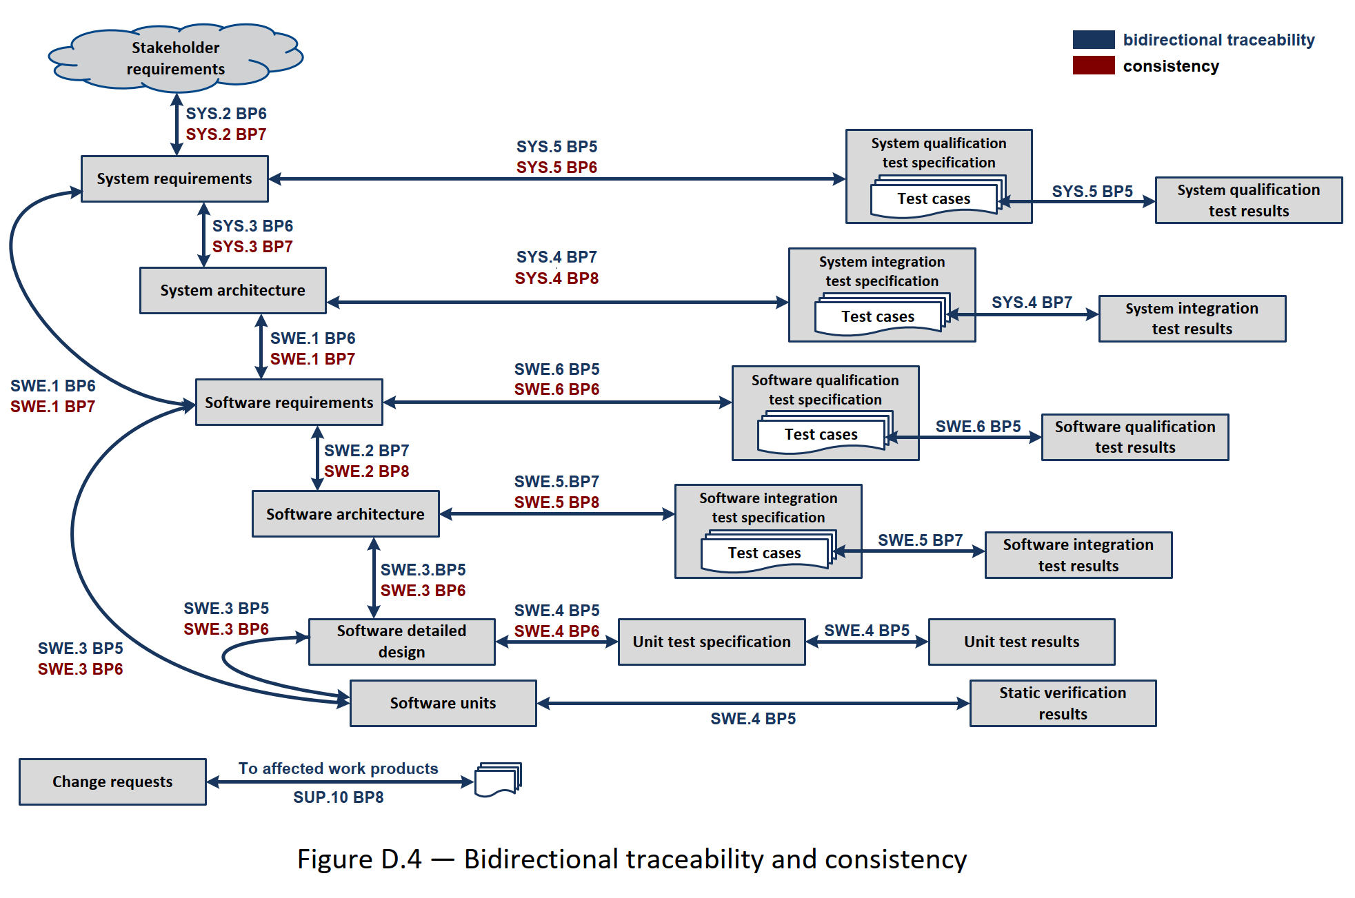

Slide 10
 | src | P1 | P2 | P3 | ...
old |  | comp.c | comp.c | comp.c
new | comp.c | config.txt | config.txt | config.txt

Slide 11
Qualification
Integration
Unit
Effort and Feedback time

