Slide 1


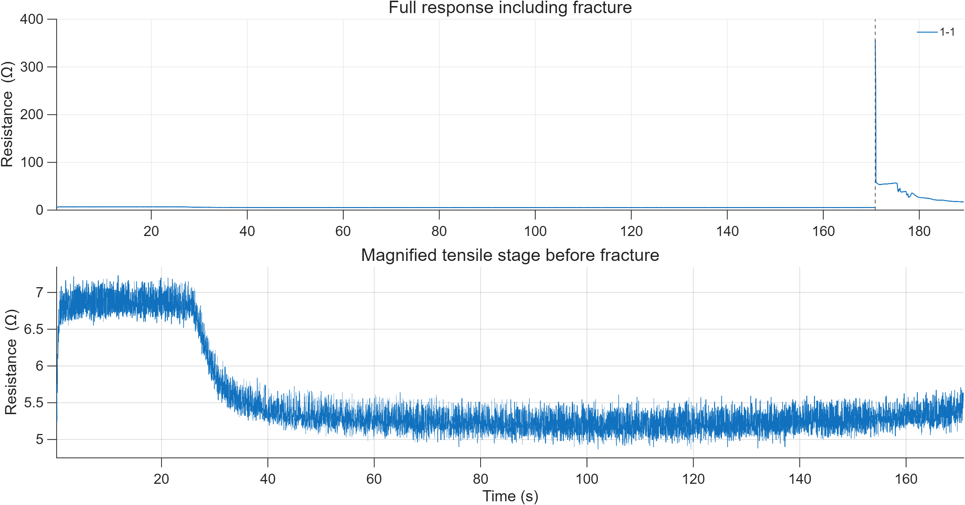
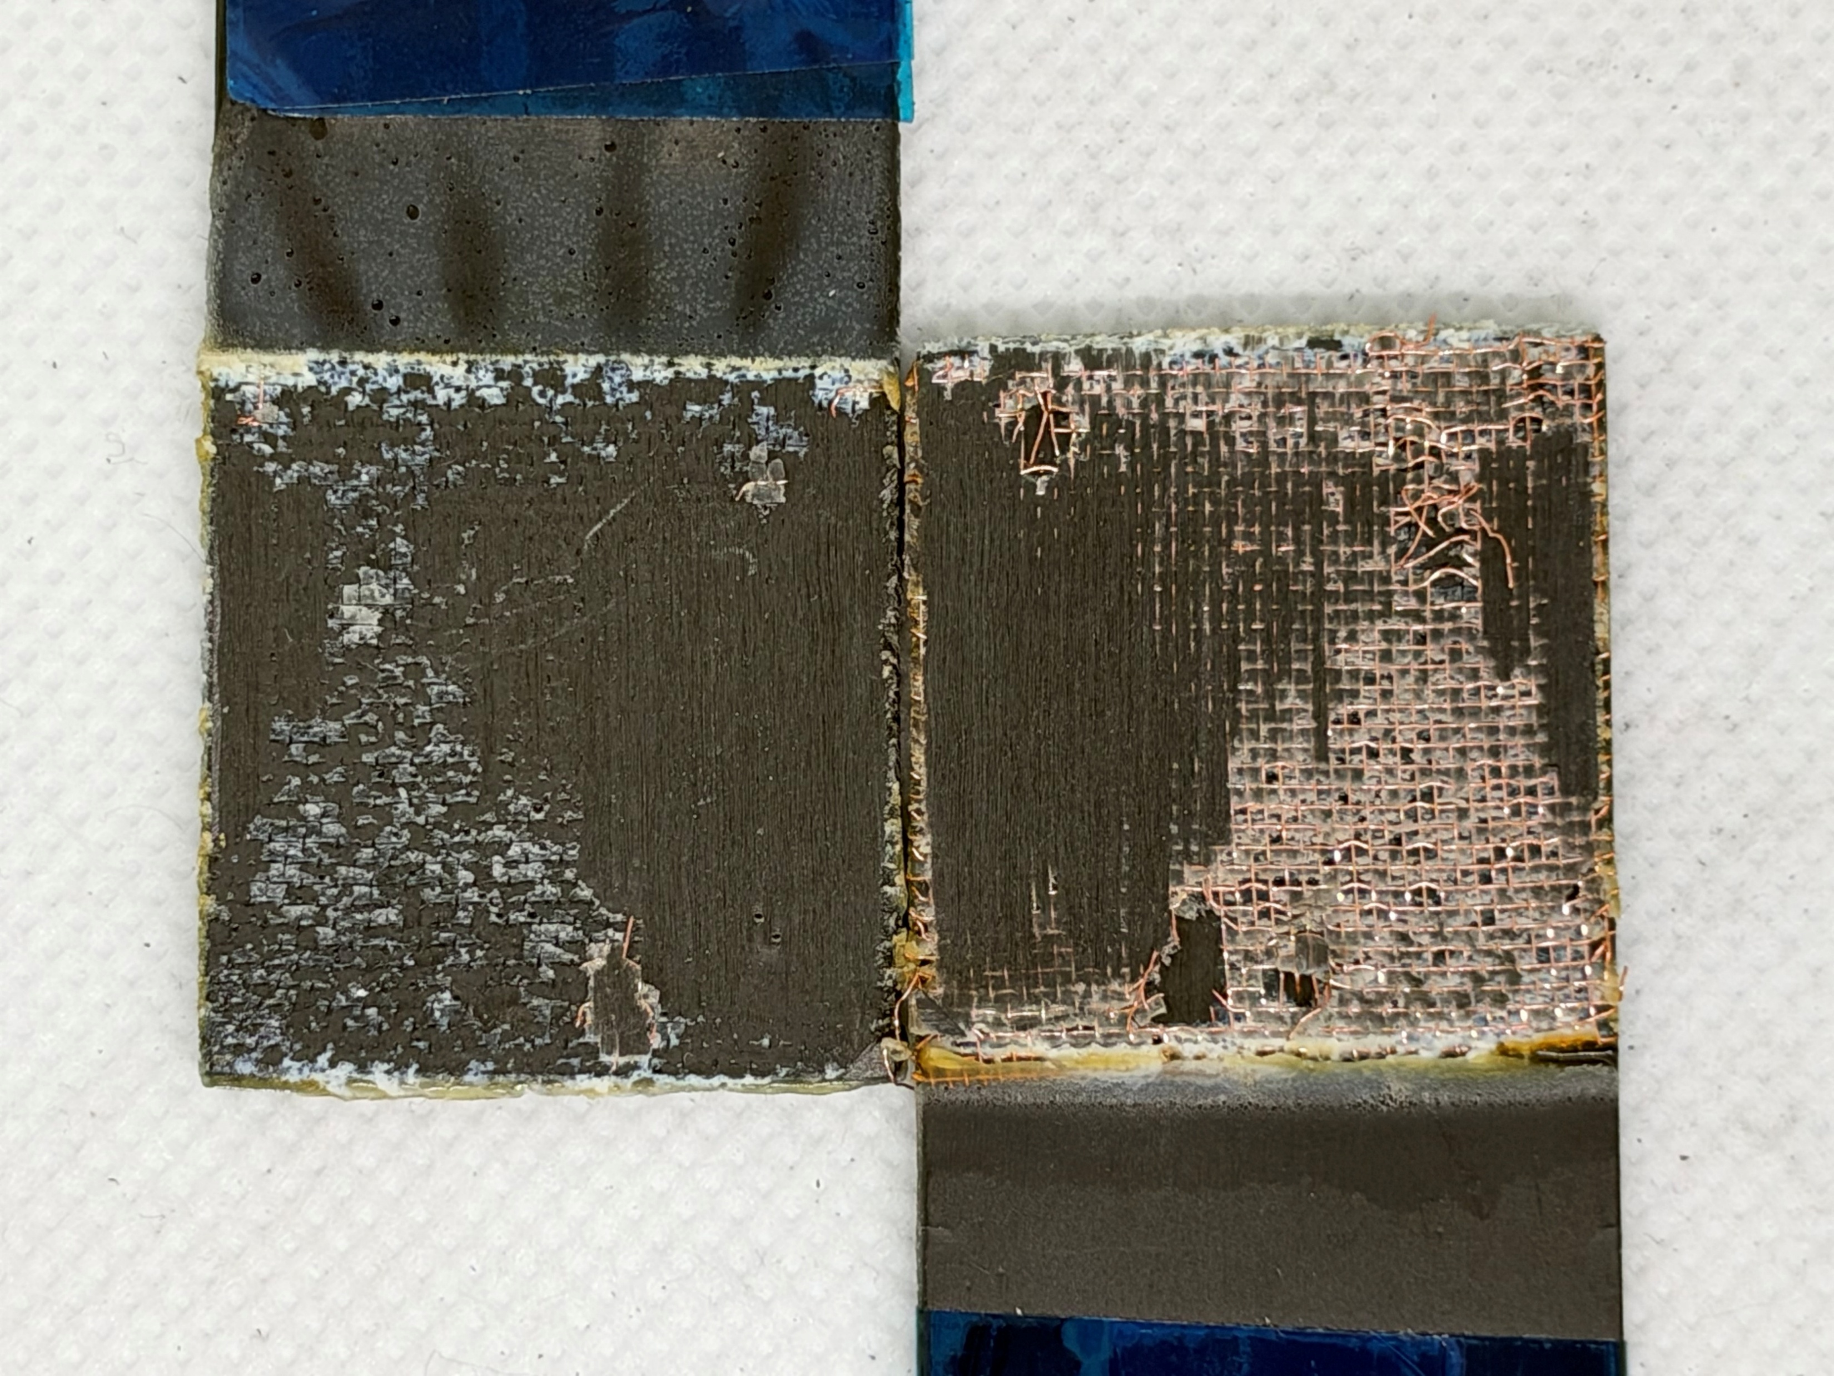
KSME CONFERENCE / RESEARCH POSTER / REVIEW DRAFT
Electrical Structural Health Monitoring
of Cu-Mesh-Integrated CFRP Adhesive Joints
[Author names and order to be confirmed] • [Corresponding author]
[Department / Institution] | [Contact email]
[Conference year / session / poster number]
Introduction
Results: SHM Response
Can an embedded copper mesh and the CFRP conductive network provide an electrical indicator of adhesive-joint damage?
Representative specimen 1-1: supplied R(t) trace [1]
Combine directional resistance measurements with single-lap shear (SLS) testing and post-test surface observations.
BASELINE
JOINT
SHM
Map current paths
Integrate Cu mesh
Track R during SLS
Experimental Setup & Sensing Concept
CFRP lay-up: [0/45/90/−45]₂ₛ
40-mesh Cu: principal direction at 90° to loading x.
Joint cross-section (schematic)
Upper CFRP
The large event-related resistance peak contrasts with the smaller, non-monotonic pre-fracture evolution. A declining R before failure is also observed.
Adhesive + Cu mesh + adhesive
x: longitudinal / loading
Lower CFRP
Post-test surfaces: 1-1
Same-side resistance across the joint
Visible exposed mesh and separated joint surfaces are consistent with conductive-path reconfiguration. Failure mode requires systematic classification.
R(t)
Diagrams are conceptual and not to scale.
Original trace and photograph retained; no time-series data reconstructed.
Working hypothesis: competing current paths
Results: Specimen Variability
CFRP paths, Cu-mesh bypasses and local contacts form a network. Interface separation or contact loss can change R; the mesh is not a single series resistor.
Peak load and reported diagnostic SNR [1]
Electrical Characterization
Peak load (kN)
Diagnostic SNR (linear ratio)
Single laminate: mean ± sample SD (Ω)
20
17.5
17.5
17.2
17.5
1000
358
409
487
15
13.1
10.0
100
29
29
30
Same-side
1.324 ± 0.048
10
8.2
10
11
Transverse
0.468 ± 0.027
5
2.9
Longitudinal
0.350 ± 0.043
0
1-1
1-2
1-3
1-4
1-5
1-6
1-7
1-8
1
1-1
1-2
1-3
1-4
1-5
1-6
1-7
1-8
O/R
Through-thickness
4.084 ± 0.285
SNR = |ΔRdurable| / σbaseline • log axis • O/R: over-range
0
1
2
3
4
13.0 ± 5.5 kN
≈42% CV
11–487
Measured resistance (Ω)
Peak load; sample SD
Mechanical scatter
Reported finite SNR
Cu-mesh joint: measured resistance (Ω)
Charts use rounded values printed in the source summary. SNR was not recomputed; over-range is excluded from its numeric range. Peak load is not lap-shear strength.
Configuration
Mean ± sample SD
Longitudinal
3.295 ± 0.525
Conclusions & Future Work
Through-thickness
4.331 ± 0.695
Same-side
5.711 ± 0.841
Electrical monitoring shows potential as a fracture-event indicator in Cu-mesh CFRP joints.
Each row uses 5 listed measurements; independence / repeat structure remains to be confirmed. Statistics recalculated from source tables [1].
Signal magnitude varies strongly; high diagnostic SNR does not establish high load capacity.
Interpretation: electrode configuration and current-path geometry must be controlled when comparing R.
Next: synchronize raw signals, classify failure modes and validate noise thresholds and lead time.
A fracture-related electrical event is observed;
pre-fracture resistance trends vary across specimens.
8
11.7×
SLS specimens
Measured R ratio
(through / longitudinal)
[1] SHM-v4.pptx: pp. 2, 11–12, 22–29, 33, 38–39. Primary project material.
A0 PORTRAIT • 841 × 1189 mm
Draft: metadata and raw-data checks pending
[Funding / acknowledgements / selected literature to be added]
Notes:
ENGLISH A0 POSTER — REVIEW DRAFT
Source: SHM-v4.pptx, 39 slides. Layout revised using the subsequently supplied template screenshot: light-blue header, centered black title, blue italic/underlined headings, blue rules and two columns. Logos reused from slide 1 of the project deck; high-resolution official assets and affiliation confirmation are needed before printing. No title, author, experimental values or claims from the unrelated joining-technology template were copied.
No new experiments or synthetic measured curves were generated. Original representative resistance trace (slide 33, specimen 1-1) and fracture photograph (slide 29) are retained. Architecture and measurement schematics are conceptual and editable.
Baseline: slide 11 and slide 25, arithmetic means and sample SD (ddof=1) recomputed from the five listed values in each configuration. Count refers to listed measurements; independent specimens vs repeated measurements not established.
Across-specimen plots: rounded peak-load labels and diagnostic SNR labels from slide 38. SNR is a reported linear ratio plotted on a logarithmic axis; specimen 1-8 over-range is not SNR=1. Load is not converted to shear strength because overlap area is absent.
The 11.7 ratio is of measured resistance for two electrode configurations, not an intrinsic resistivity ratio.
Excluded unverified results: slide 36 specimen 1-7 duplicated annotations; inconsistent normalized fracture ratios for 1-2 and 1-3; resistivity/conductivity comparisons until effective geometry and averaging method are confirmed; inconsistent original SD labels.
Conclusions support fracture-event indication. Early damage warning, damage localization, detection accuracy, and mesh-induced strength improvement have not been established.
Replace all bracketed metadata before presentation; confirm official poster size and conference requirements. See accompanying Chinese review guide and audit.

