Slide 1
Object Oriented Programming
TOPIC 6
Demonstration of types of cell division
Teacher: PhD Nguyen Thi Thu Trang
Teaching Assistance: Le Thanh Giang
Group 8:
Ho Van Duc – 20215037 – Test and Debug
Nguyen Huu Duc – 20210192 – Project Architect, Top Contributer
Dam Tran Ngoc Duc – 20210208 – Slide, UI Design
Bui Manh Dung – 20215010 – Report, UI Design

Slide 2
PROBLEM STATEMENT
Overview: Demonstration of types of cell division
Basic Knowledge: Cell cycle, Cell Division

Slide 3
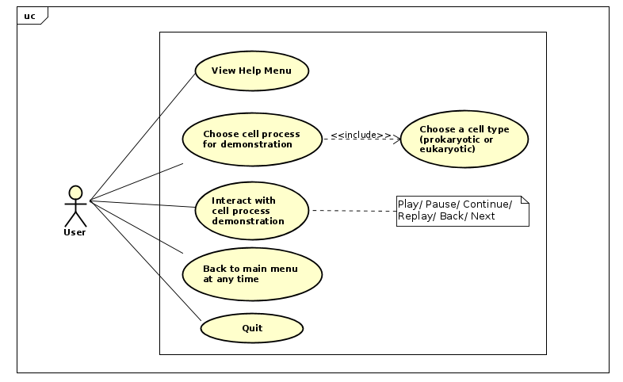
USE-CASE DIAGRAM

Slide 4
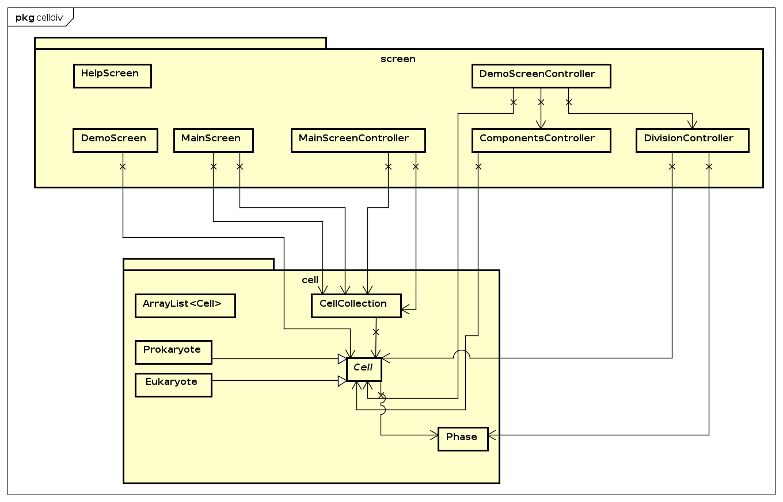
GENERAL CLASS DIAGRAM

Slide 5
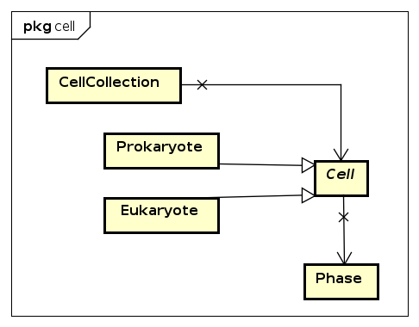
Class diagram of cell package

Slide 6
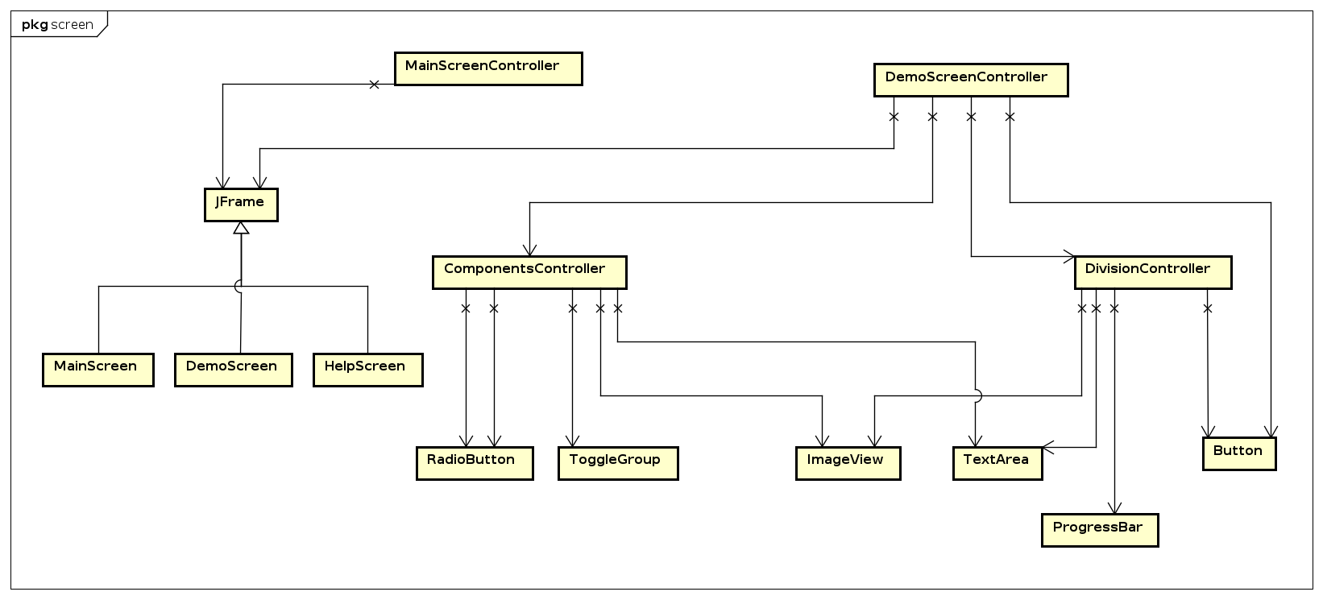
Class diagram of screen package

Slide 7
OOP Techniques
Encapsulation
Cannot get information from private attributes directly
→ Use public getter/setter methods
Inheritance
Prokaryote and Eukaryote classes inherit from Cell class.
Polymorphism
Method overloading
Composition
One Cell object has many (cell division) Phases.
Phase is a part-of Cell.

Slide 8
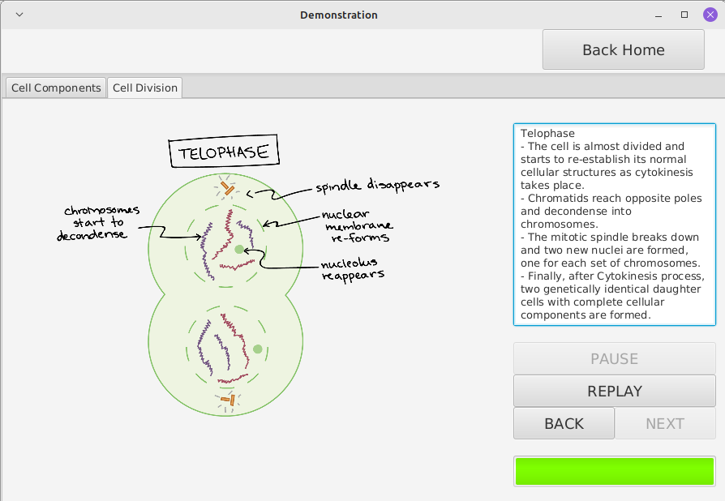
DEMO VIDEO
Link demo video: https://drive.google.com/file/d/1fSjiJIrxv0anFSU3t8i7TZEO2Vph3RK_/view
Cell Division Demonstrating Screen

