Slide 1
AWS Solution Architecture Design
Wentao,Cui

Slide 2
General - Background & Objective
Background
New and small startup company
Based on LAMP – MySQL + Apache + PHP
Running on one desktop PC within small office
With enough confident of rapid development in future
There are few concerns and uncertainty
Objective
Functionalities
Security
High Availability & Disaster Recovery
Scalability
Performance
Data Backup and Recovery Flexibility
Cost

Slide 3
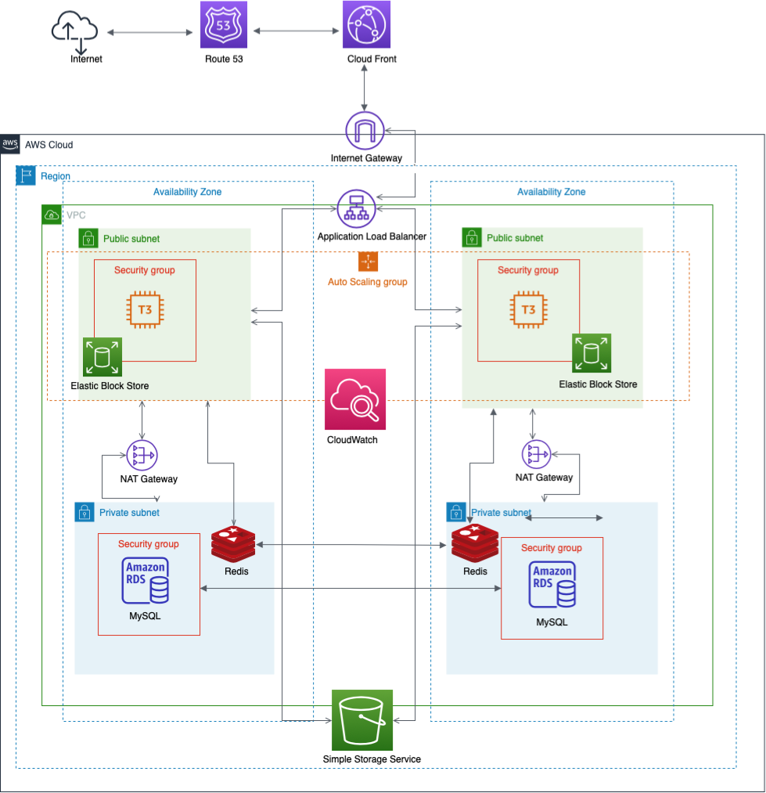
Solution Overview
Below services are mainly involved in solution
EC2 - Virtual Machine
EBS - Local Storage
RDS - Relation Database
VPC - Virtual Private Cloud
Storage - S3
Route53 - DNS
ACM - AWS Certificate Manager
IAM – Identify and Access Management
ElastiCache – Redis Memory Service
CloudFront - Content Delivery Network(CDN)
CloudWatch – Monitoring and Observability

Slide 4


EC2 – Instance Selection
1/3
Instance type: T2 or T3,
Great for a diversity of workloads such as webs server
Low-cost
Good balance of compute, memory, and network resources
Network Performance is low to moderate
Operating System: Linux
Storing data: EBS-Only
T3 instance
T2 instance
https://aws.amazon.com/ec2/instance-types/

Slide 5
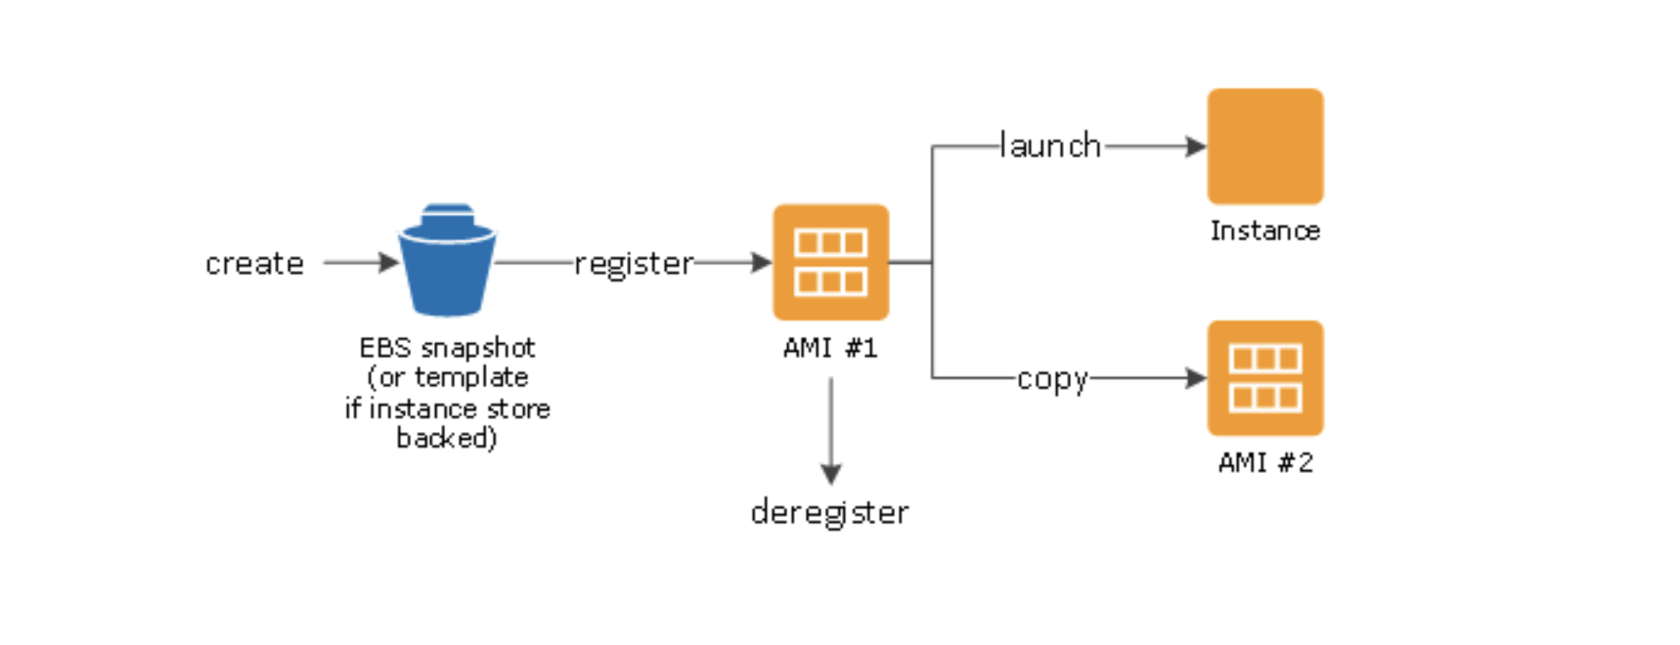

EC2 – AMI
AMI – an image to use create EC2 instances
Can be built for Linux or Windows
Built for a specific AWS region
Mainly Provides below advantages
Pre-installed package needed
Faster boot time
Install app ahead of time, e.g. for faster deploy when auto-scaling
Security
AMI
https://docs.aws.amazon.com/AWSEC2/latest/UserGuide/AMIs.html

Slide 6

EC2 – EBS
EBS – Elastic Block Store Volume is a network driver, which can be attached to EC2 instance
Can be detached from one EC2 instance, and attached to another one quickly
Specific AZ – Availability Zone ONLY
Allows EC2 instance to persist data
Store PHP and other utility files
GP2(SSD): General purpose SSD that balances price and performance for wide variety of workloads
Snapshots
Incremental backup – only changed blocks
S3 store
Copy snapshots across AZ or Region
Can be restored by snapshots
Can be automated using Amazon Data Life Cycle Manager
Amazon Elastic Block Store (Amazon EBS)
https://docs.aws.amazon.com/AWSEC2/latest/UserGuide/AmazonEBS.html

Slide 7



EC2 – High Availability
AWS Cloud
Running EC2 instances at least 2 data centers(AZ)
Auto Scaling Group multi AZ
Load Balancer multi AZ
Provides below advantages
Manager service, AWS guarantees that it will be working
AWS take care of upgrades, maintenance and high availability
Few configuration and setup
Expose single point of access (DNS)
Seamlessly handle failures of downstream instances, e.g. EC2
Do regular health checks to instances
Provide SSL access
Across AZ
ALB – Application Load Balancer is used
Layer 7(HTTP)
Support HTTP/HTTPS
Region
Availability Zone
Users
Application Load Balancer
Availability Zone
https://aws.amazon.com/elasticloadbalancing/application-load-balancer

Slide 8

EC2 – Scalability
Support and make application handle greater loads by adapting
Two kinds of scalability, Vertical and Horizontal
Vertically means
Increasing the size of EC2 instance
Launch new EC2 instance by using AMI with different instance size
Horizontal means
Increasing the number of EC2 instance
Supported by ASG – Auto Scaling Group
Cross multi AZ
Linked but different to High Availability
AMI
Amazon EC2 Auto Scaling
https://docs.aws.amazon.com/autoscaling/ec2/userguide/AutoScalingGroup.html

Slide 9


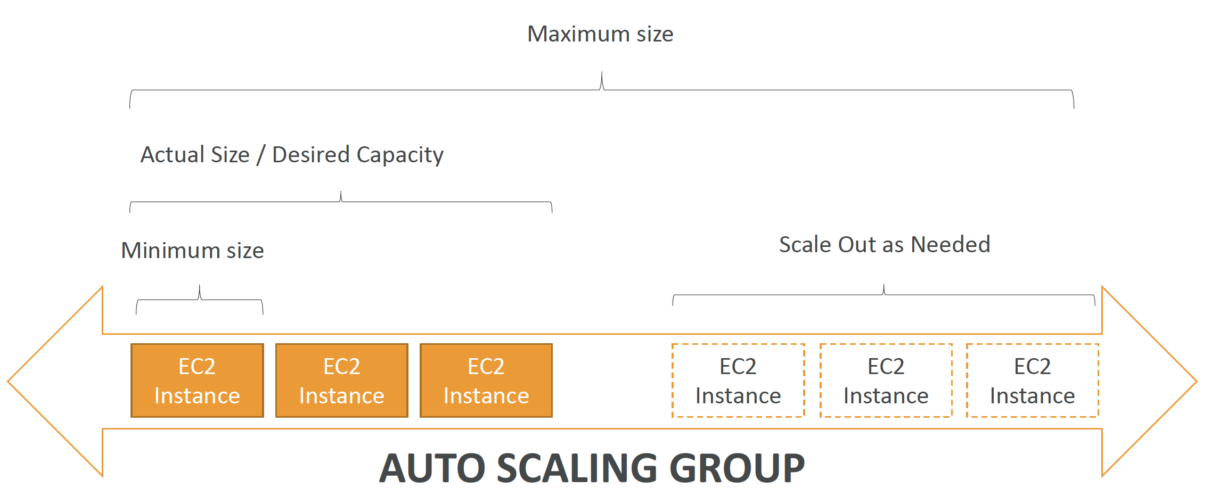
EC2 – Scalability Contd.
AWS Cloud
Auto Scaling Group,
Scale out (add EC2 instance) to match increased load
Scale in( remove EC2 instance) to match decreased load
Minimum/Maximum number of running instances
Automatically register new instances to Load Balancer
ASG capacity
Minimum: 2
Maximum: 4
Desired capacity: 2
CloudWatch Alarm
Scale in/out based on CloudWatch Watch alarms
Simple Scaling: When a CloudWatch alarm is triggered (CPU > 80%), then add 1 unit
Amazon CloudWatch
Availability Zone
Availability Zone
Auto Scaling group
https://docs.aws.amazon.com/autoscaling/ec2/userguide/AutoScalingGroup.html

Slide 10


RDS – General
Managed DB service for DB use SQL as query language
Provides below advantages
Automated provisioning, OS patching
Continuous backup and restore to specific timestamp
Monitoring
Read replicas for improved read performance
Multi AZ for Disaster Recovery
Vertical and Horizontal scaling capability
Storage backup
Security Encryption, e.g. master/read replicas with AWS KMS, in-flight of SSL
Instance Type: db.t3.micro
Read replicates for read scalability: master/slave, cross AZ
Backup enabled
Amazon RDS instance
MySQL
instance

Slide 11
RDS – Backup, Contd.
Backups are automatically enabled in RDS
Automated backups:
Daily full backup
Transaction logs (5minutes)
Ability to restore to any point in time
7Days retention default
Snapshots
Manually triggered by user
Retention of backup for as long as you want
Amazon RDS instance
MySQL
instance

Slide 12
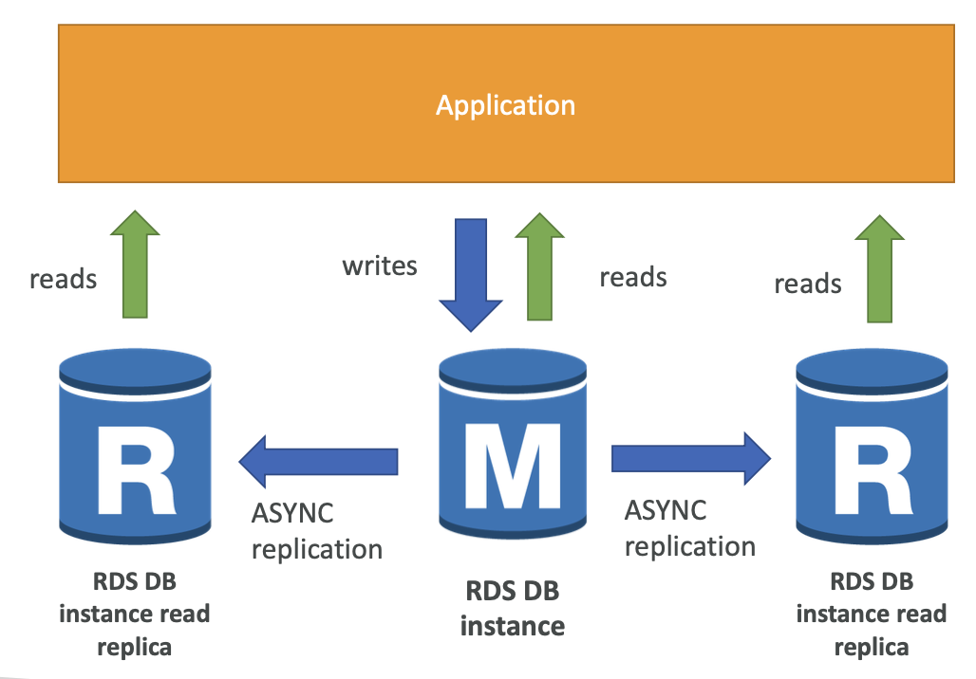
RDS – Read Replicas, Contd.
Within AZ, cross AZ or cross region
Replication is ASYNC, reads are eventually consistent
Application must update to maintain connection to leverage read replicas
Support capability of Disaster Recovery
There’s network cost when data goes cross AZ
No cost within single AZ
https://aws.amazon.com/rds

Slide 13
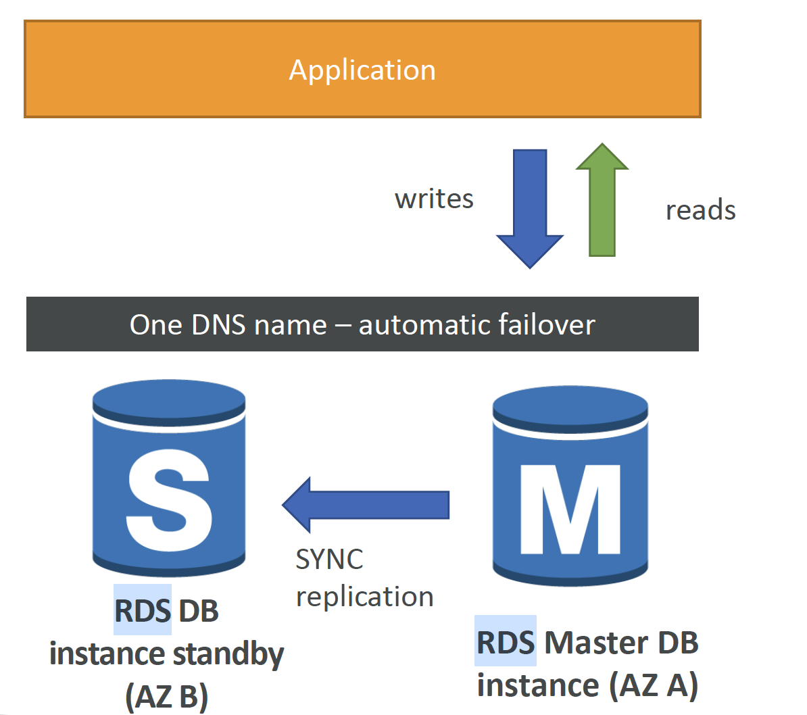
RDS – Sync Replication, Contd.
One DNS name, automatic app failover to standby
Support High Availability
Failover in case of loss of AZ, network, instance or storage failure
https://aws.amazon.com/rds

Slide 14




Network – Virtual Private Network
Two subnets are created in each AZ
Public subnet for webserver
Private subnet for RDS/MySQL
Internet gateway
helps VPC instance to connect with internet
Scales horizontally and HA is available
NAT gateway
Allow instance in the private subnet to connect to the internet
Elastic IP attached
Different security groups are created as below
RDS/MySQL
Application Load Balancer
ElastiCache – Redis
EC2-ALB: used for the connection between EC2 instance and MySQL
Elastic IP: attached to NAT gateway
DNS enabled
AWS Cloud
Availability Zone 1
Availability Zone 2
VPC
Internet gateway
Public Security group
Public Security group
NAT gateway
NAT gateway
Private Security group
Private Security group
https://aws.amazon.com/vpc

Slide 15

S3 – Storage and Data Management
Store objects(files) in “buckets” (directories)
Globally unique name
Objects have a Key, and key is the FULL path
Version is supported
Enabled in bucket level
Protect against unintended deletes
Easy to roll back to previous version
Encryption of objects is supported
SSE-S3, encrypts S3 object using keys managed by AWS
SSE-KMS: leverage AWS key Management Service to manage encryption keys
SSE-C: manager your own encryption keys
Amazon Simple Storage Service (Amazon S3)
https://aws.amazon.com/s3

Slide 16


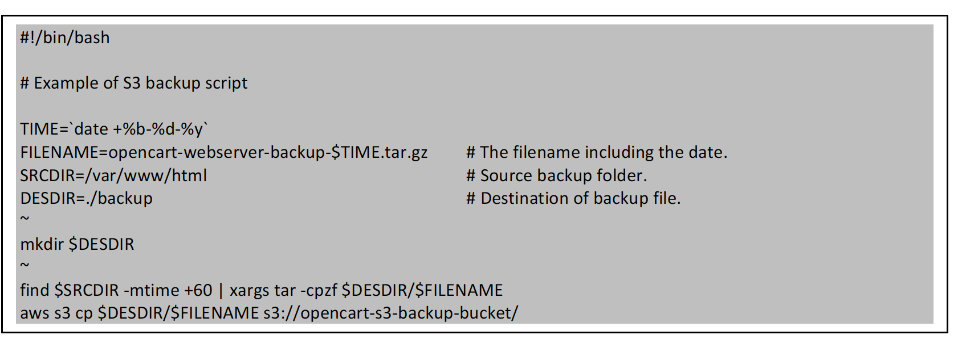
S3 – Backup Script of Archival Strategy, Contd.
AWS Cloud
Backup script is created, and it’s used to backup data to S3 bucket
Inactive data with greater than 6 months old
Create scheduled task to execute backup script
Linux native “crond”, or AWS CloudWatch plus Lambda Function based Serverless solution can be used
Trigger 1 hour
Amazon CloudWatch
AWS Lambda
AWS Bucket with
objects

Slide 17

ElastiCache Overview
Managed Redis/Memcached
In-memory and sub-millisecond latency
Multi-nodes cluster support
Multi AZ and read replicas support
Backup/Snapshot support
Security through IAM, Security Groups, KMS and Redis Auth
User case: Key/Value store, frequent reads and less writes
T3 instance
Amazon ElastiCache
MySQL
instance
https://aws.amazon.com/redis

Slide 18
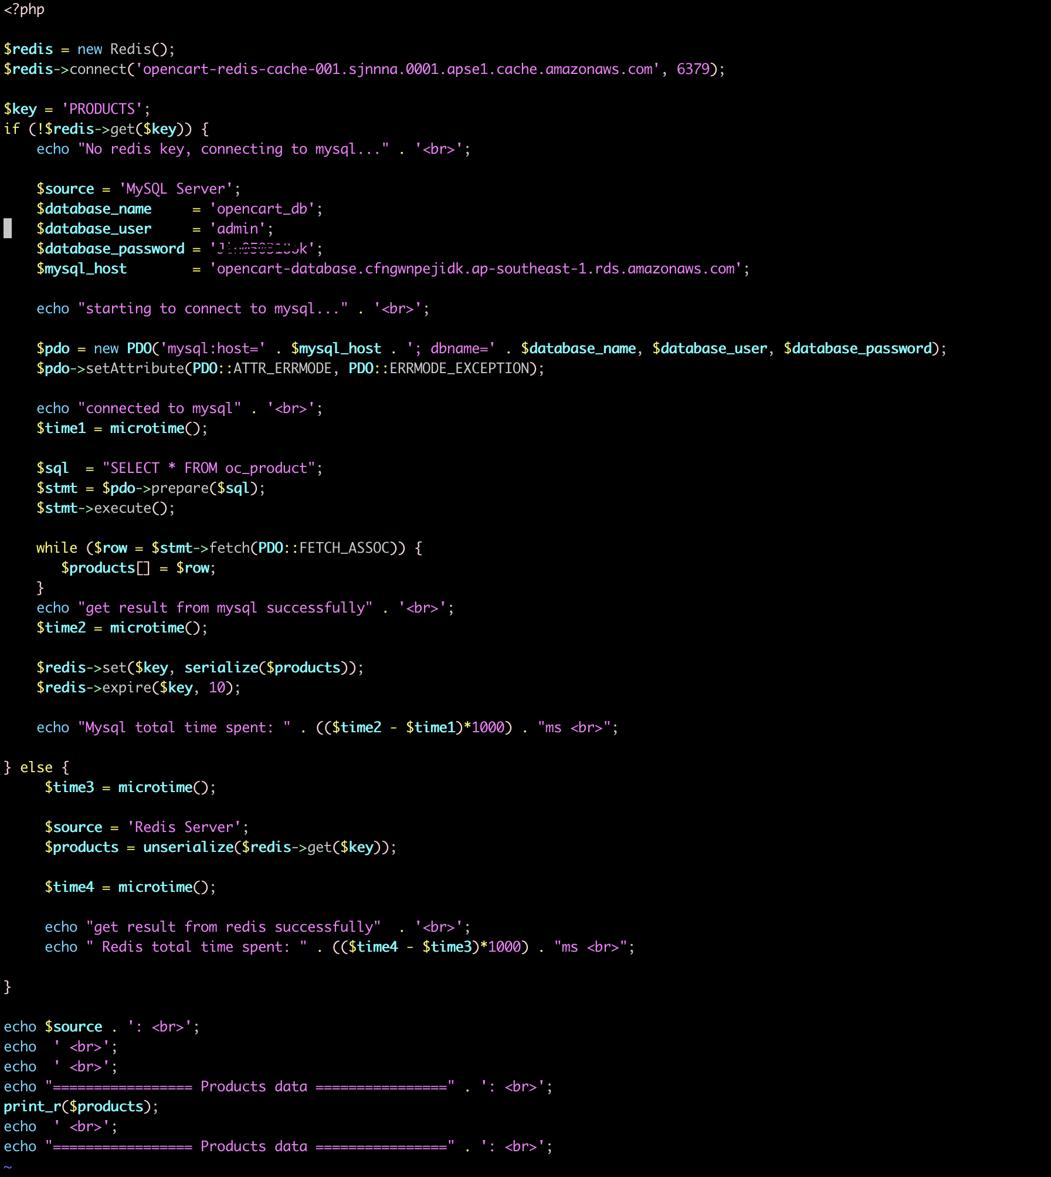
ElastiCache - PHP MySQL Query Optimization Sample, Contd.
Optimization for SQL “SELECT” statement of product table query
Get data from Redis directly, if data exist in Redis
Get data from MySQL and insert into Redis, if data does not exist in Redis

Slide 19

Route53 Overview
Managed DNS – Domain Name System
Collection rules and records which helps clients understand how to reach server through URLs
Common record types
A: hostname to IPv4
AAAA: hostname to IPv6
CNAME: hostname to hostname
Alias: hostname to AWS resource
Amazon Route 53
https://aws.amazon.com/route53

Slide 20
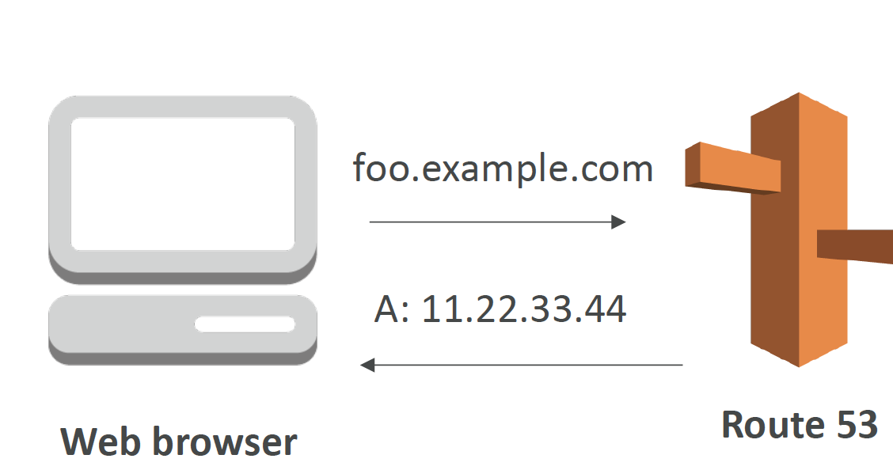
Route53 Solution Design, Contd.
TTL (Time to Live): 300 seconds
Routing policy: Simple
Record Type: CNAME, points to Application Load Balancer
https://aws.amazon.com/route53

Slide 21
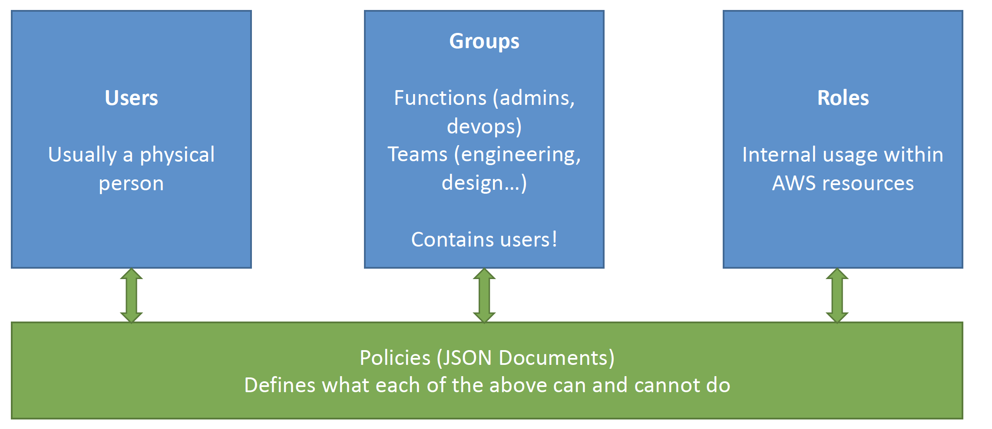

IAM – Identity and Access Management
Provides security
Users
Groups
Roles
Global View
Groups only contain users, not other groups
Users don’t have belong to a group, and user can belong multiple groups
Users are created with proper permissions
Policies are written in JSON (JavaScript Object Notation), and can be assigned to users and groups
MFA( Multi Factor Authentication) support
AWS Identity and Access Management (IAM)
https://aws.amazon.com/iam

Slide 22
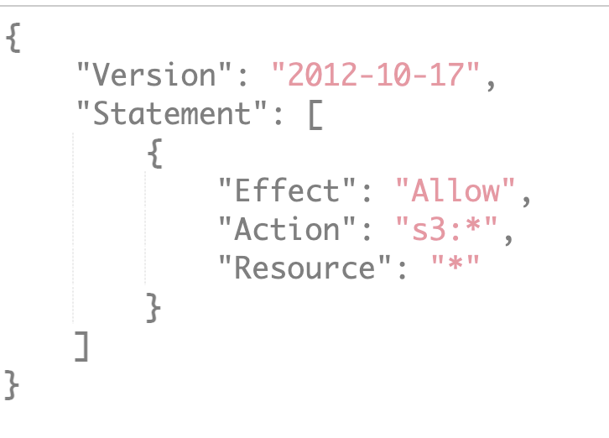
IAM – Solution Design Contd.
New user e.g. “aws_cli_admin” with “Programmatic access” access type
“aws_cli_admin” is used to execute backup script , to backup data to from webserver to S3 bucket
More secure and robust JSON polices need to be designed
More users, groups with different roles can be created to meet “delivery team expands” requirement in the future
https://aws.amazon.com/iam

Slide 23
CloudWatch Overview
Provides metrics for every services in AWS
Metric is a variable to monitor, e.g. CPU Utilization, NetworkIn/NetworkOut, DiskReadBytes/DiskWriteBytes
Dimension, a name/value pair that is part of the identity of a metric
Up to 10 dimensions per metric
Metrics have timestamps
Dashboards of metrics can be created
Amazon CloudWatch
https://aws.amazon.com/cloudwatch

Slide 24
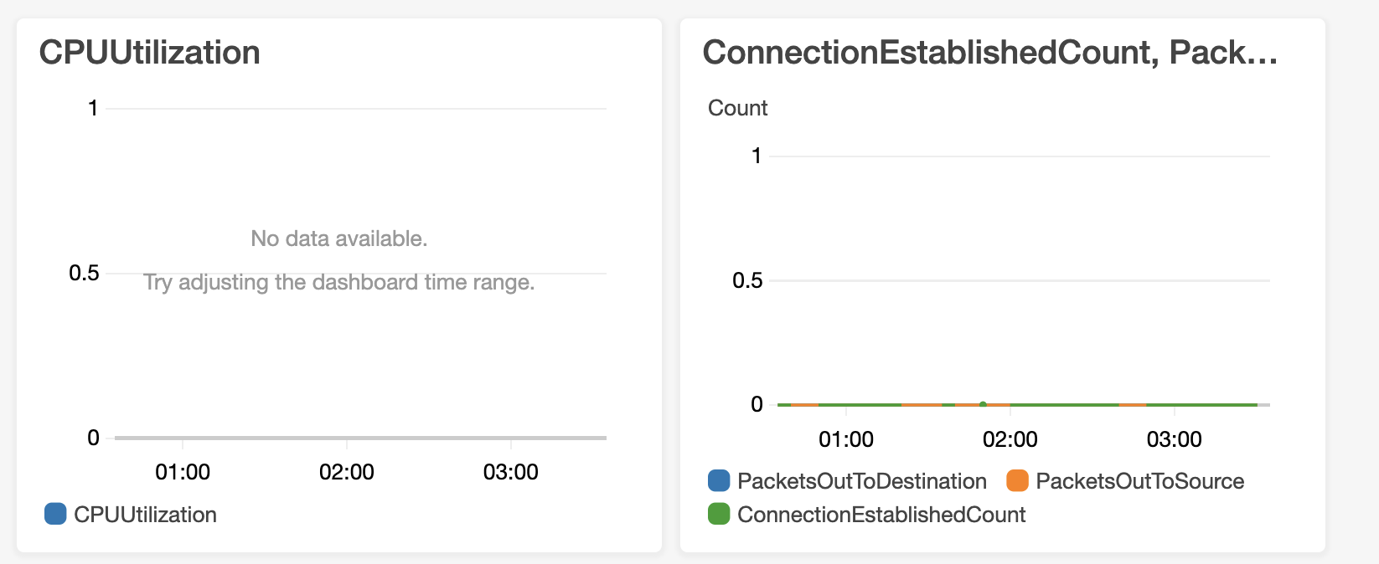
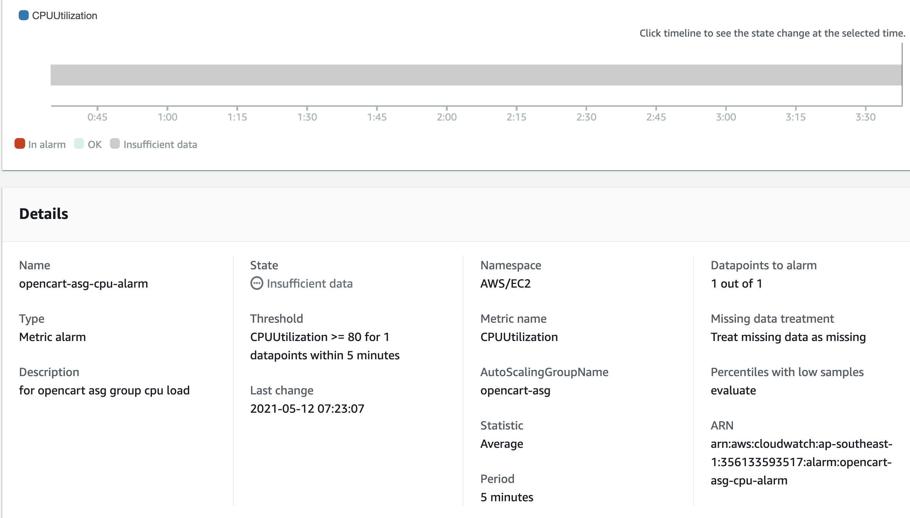
CloudWatch – Solution Design, Contd.
Attached and used by ASG
“CPUUtilization” metric of ASG is used
Metrics with “every 5 minutes” period
Dashboard of “CPUUtilization” ASG is created
More metrics and dashboard can be created
https://aws.amazon.com/cloudwatch

Slide 25


CloudFront
AWS Cloud
Content Delivery Network(CDN)
Improves read performance, content is cached at the edge
DDoS protection
Expose external HTTPS, and communicate with HTTPS internal backends
Create for static content, e.g. image, video and so on
Custom Origin Mainly include
Application Load Balancer
EC2
S3
Edge location
Edge location
s3
Edge location
Edge location
Amazon CloudFront
https://aws.amazon.com/cloudfront

Slide 26

ACM – AWS Certificate Manger
Allocate, manage and deploy public and private certificates with Secure Socket Layer/Transport Layer Security(SSL/TLS) support.
SSL/TLS certificates are used to secure network communications and establish the identity of website over the internet
ACM removes the time-consuming manual process of purchasing, uploading and renew SSL/TLS certificates
AWS Certificate Manager (ACM)
https://aws.amazon.com/certificate-manager

Slide 27
Cost Optimization - EC2 Instance Purchasing Options
On-Demand
Short workload
Predicable price
Pay for what you use
Highest cost
No upfront
Reserved(Convertible/Scheduled)
Long workload, 1 or 3 years
Long workload with flexible instances (Convertible)
Scheduled instances, e.g. every Monday between 10am ~ 14pm
Spot
Slow workload
Reduce costs significantly
Can lose (less reliable)
Dedicated: no customer share hardware
Dedicated Host: book an entire physical server, and control over physical placement
https://docs.aws.amazon.com/AWSEC2/latest/UserGuide/instance-purchasing-options.html
https://docs.aws.amazon.com/AWSEC2/latest/UserGuide/dedicated-hosts-overview.html#dedicated-hosts-dedicated-instances

Slide 28
Cost Optimization Contd.
For cost optimization consideration, the following combination is suggested
Reserved Instance with period 1 or 3 years
Pay upfront
Add on-demand and spot instance for temporary jobs, e.g. short-period high traffic, batch jobs, data analysis(image/video)
https://docs.aws.amazon.com/AWSEC2/latest/UserGuide/instance-purchasing-options.html

Slide 29
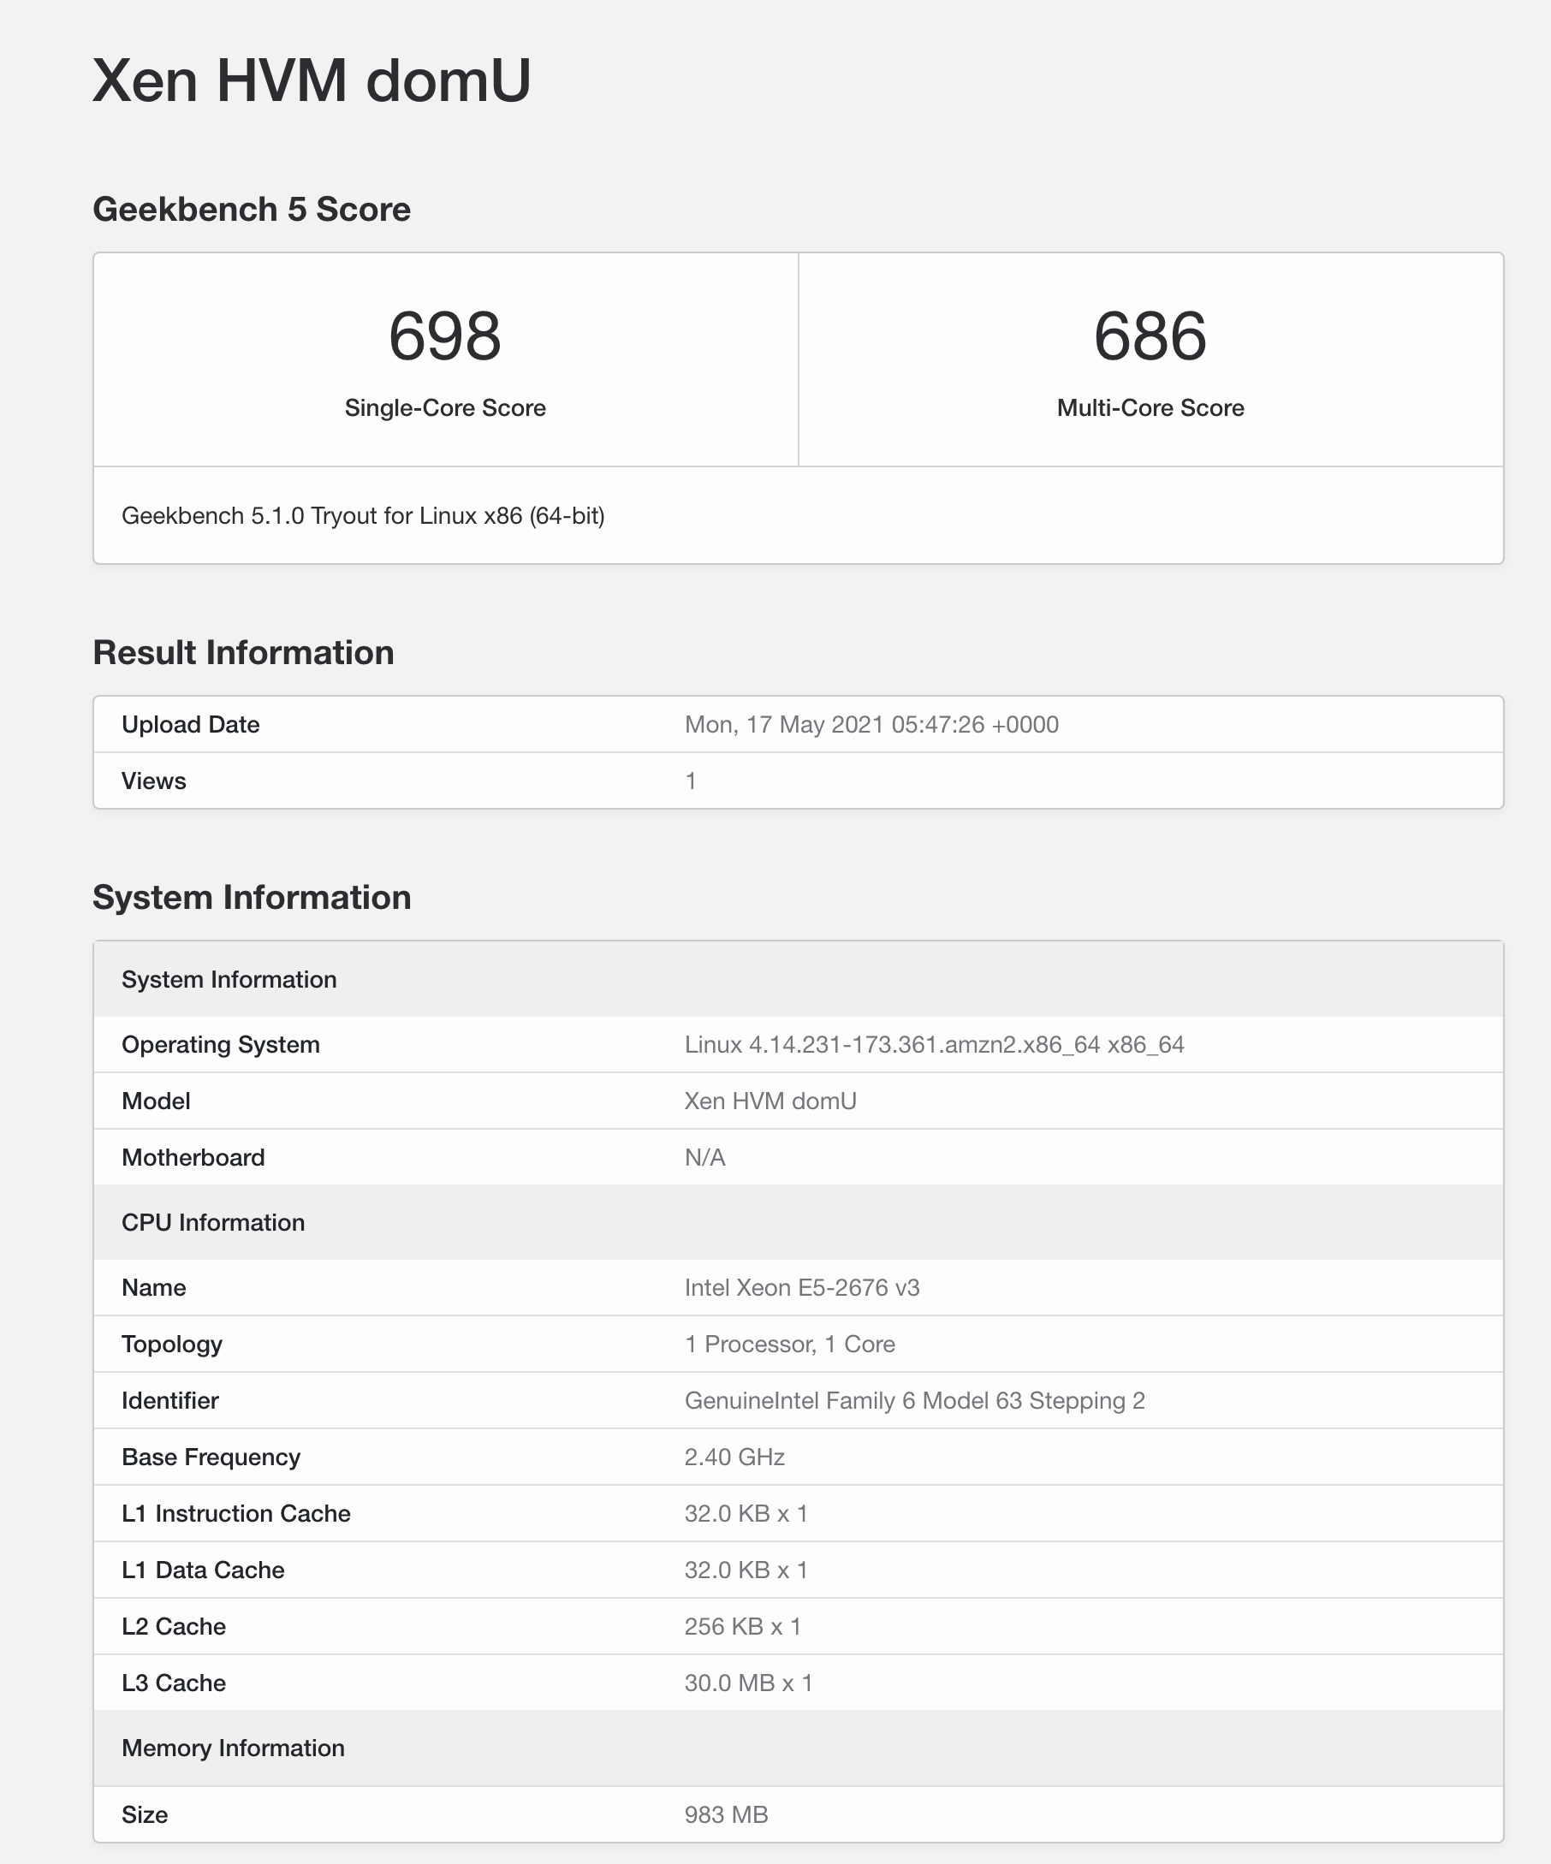
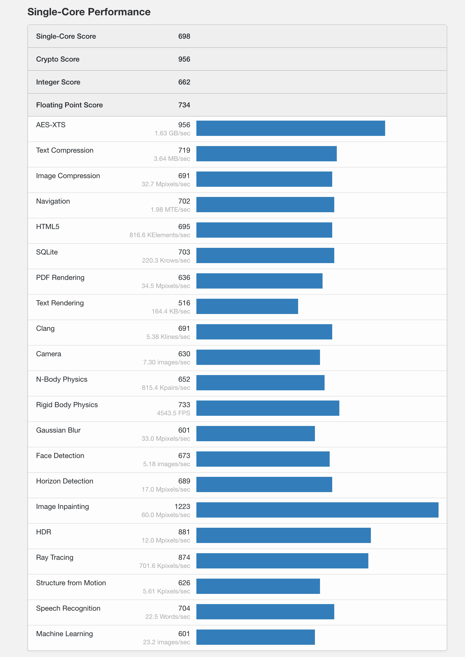
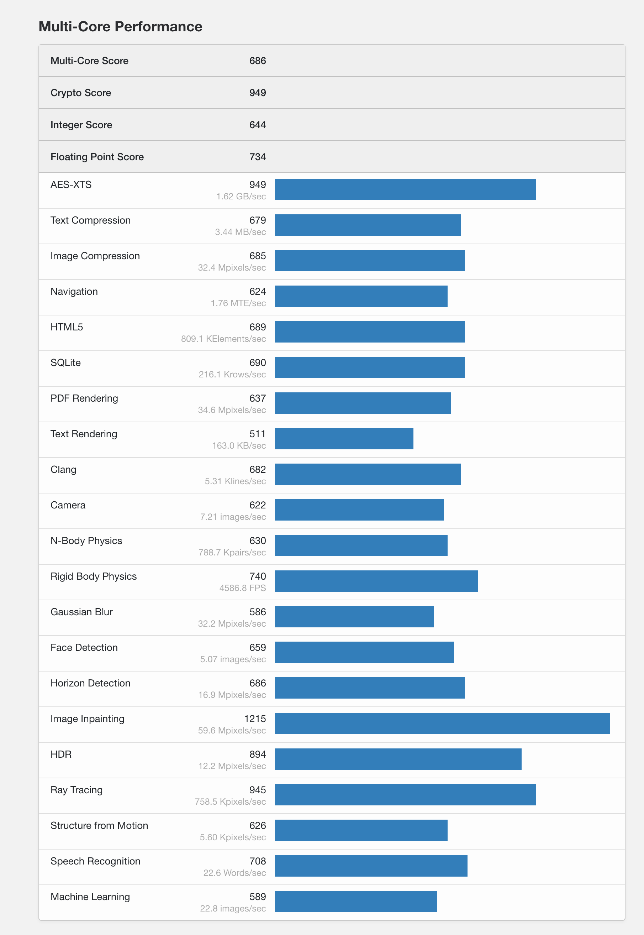
EC2 - CPU Performance Benchmark
Different benchmark tools can be used for measuring system performance, including CPU
“Geekbench” is good option
ssh -i opencart-key-pair.pem ec2-user@ec2-54-169-154-124.ap-southeast-1.compute.amazonaws.com
sudo wget -0 http://cdn.geekbench.com/Geekbench-5.1.0-Linux.tar.gz
sudo tar -xzvf Geekbench-5.1.0-Linux.tar.gz
cd Geekbench-5.1.0-Linux
sudo ./geekbench5
https://www.geekbench.com

Slide 30
CPU – INTEL vs AMD vs ARM
 | GENERAL | Price | Performance | Instruction Set | Power Consumption
INTEL | Most popular and well-known maker of processors | Moderate to High | Most stable and offer the best all-round performance | CISC - Complex Instruction Set | High power consumption Focused on performance
AMD | Intel’s biggest competitor | Similar to Intel’s, but for the most part, cheaper price | Similar to Intel’s | Similar to Intel’s | Similar to Intel’s
ARM | Generally used in smartphones, mobile devices and tablets | Cheap | Slower than their Intel counterparts. | RISC - Reduced Instruction Set | Low power consumption Use less battery life have a reduced operating temperature
https://www.hireanitexpert.com/intel-amd-and-arm-processors-explained

