Slide 1
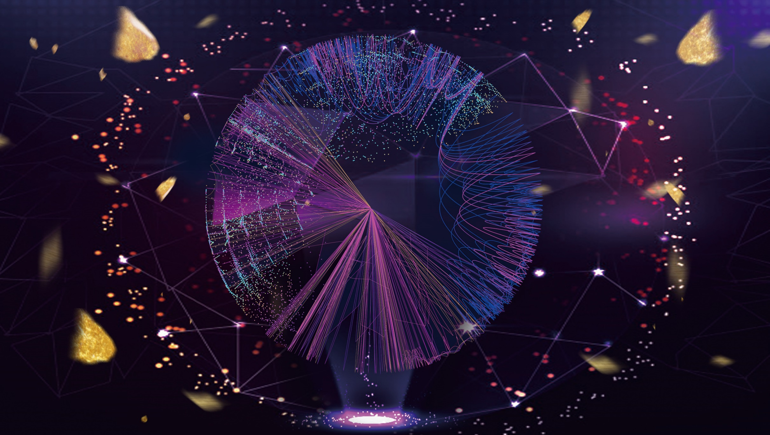
01
BACKGROUND

Slide 2
BACKGROUND
Buy a cellphone?
Notes:
What would you like to do if you want to buy a cellphone?
You may open a online shopping mall like JingDong.

Slide 3

BACKGROUND
Buy a cellphone?
Notes:
What would you like to do if you want to buy a cellphone?
You may open a online shopping mall like JingDong.

Slide 4
BACKGROUND
Exchange for some dollars?
Buy a cellphone?
Notes:
What would you do if you want to exchange for some dollars?
You will go to the bank.

Slide 5
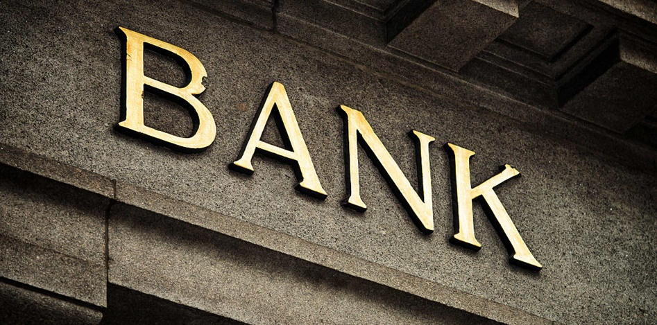
BACKGROUND
Exchange for some dollars?
Buy a cellphone?
Notes:
What would you do if you want to exchange for some dollars?
You will go to the bank.

Slide 6
BACKGROUND
Exchange for some dollars?
Buy a cellphone?
Get a job?
Notes:
What if you want to get a job?
You will open some the job searching Apps like

Slide 7
BACKGROUND
Exchange for some dollars?
Buy a cellphone?
Get a job?
Notes:
What if you want to get a job?
You will open some the job searching Apps like

Slide 8
BACKGROUND
Exchange for some dollars?
Buy a cellphone?
Get a job?
Have a meal?
Notes:
What about have a meal?
You open a takeaway platform, for example, MeiTuan.

Slide 9

BACKGROUND
Exchange for some dollars?
Buy a cellphone?
Get a job?
Have a meal?
Notes:
What about have a meal?
You open a takeaway platform, for example, MeiTuan.

Slide 10
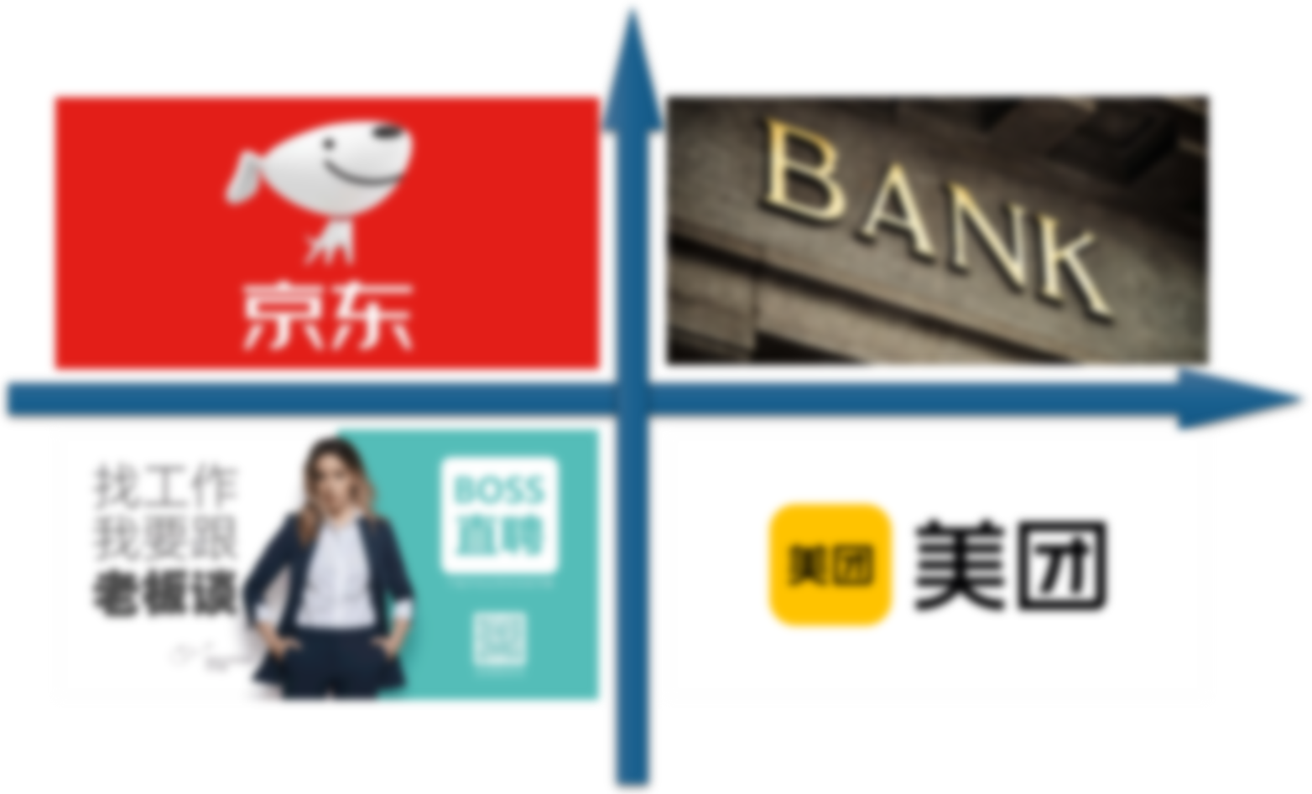
BACKGROUND
What's in common?
Exchange for some dollars?
Buy a cellphone?
Get a job?
Have a meal?
Notes:
Through all these deals? What's in common?
They all go through some certain institution. In other words, they are all centralized.
From ancient times to the present, this is the pattern of our human deals: centralized.

Slide 11
BACKGROUND
What's in common?
Exchange for some dollars?
Buy a cellphone?
They are all through some certain institutions
Get a job?
Have a meal?
Notes:
Through all these deals? What's in common?
They all go through some certain institution. In other words, they are all centralized.
From ancient times to the present, this is the pattern of our human deals: centralized.

Slide 12
BACKGROUND
Centralized
What's in common?
Exchange for some dollars?
Buy a cellphone?
They are all through some certain institutions
Get a job?
Have a meal?
Notes:
Through all these deals? What's in common?
They all go through some certain institution. In other words, they are all centralized.
From ancient times to the present, this is the pattern of our human deals: centralized.

Slide 13
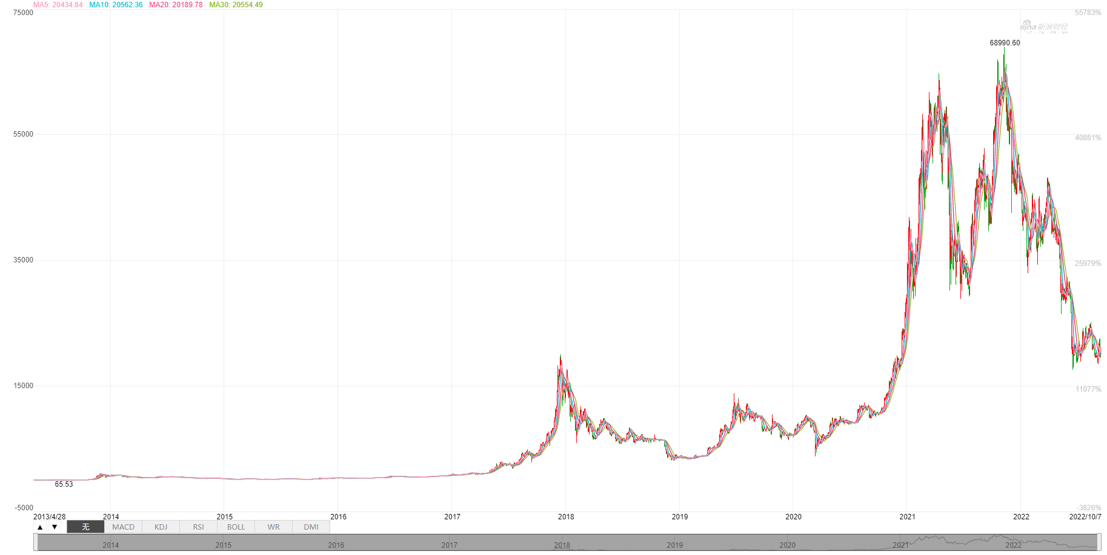


BACKGROUND
Satoshi Nakamoto
2009
2014
2017
2021
Notes:
However, in 2009, a man named Satoshi Nakamoto invented a totally different money, bitcoin. He wants to use bitcoin to change such a centralized trading model. The bitcoin began to grow wildly during this decade, skyrocketing from worthless to tens of thousands of dollars a piece.

Slide 14

BACKGROUND
Satoshi Nakamoto
2009
2014
2017
2021
Notes:
However, in 2009, a man named Satoshi Nakamoto invented a totally different money, bitcoin. He wants to use bitcoin to change such a centralized trading model. The bitcoin began to grow wildly during this decade, skyrocketing from worthless to tens of thousands of dollars a piece.

Slide 15
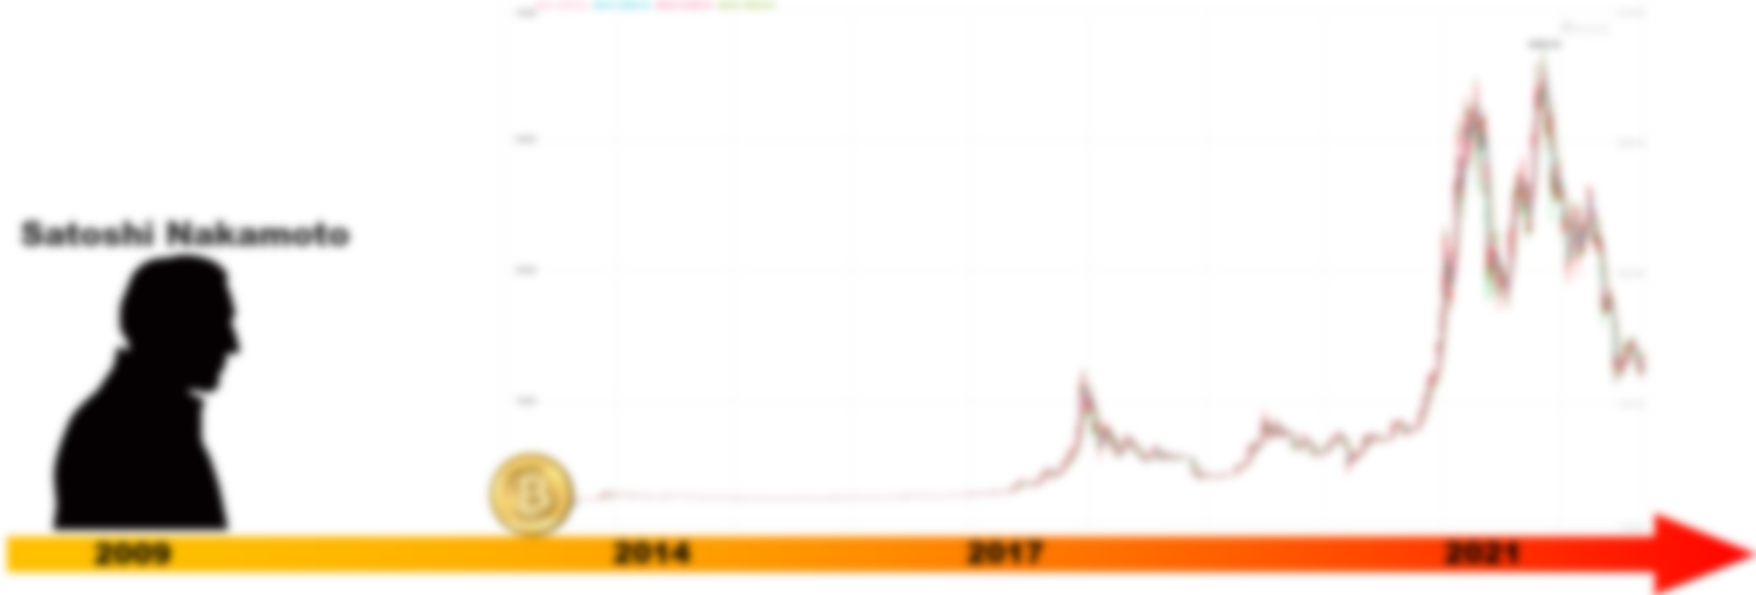
BACKGROUND
Why are the capital markets so bullish on Bitcoin?
How exactly will blockchain affect our economy?
Notes:
You may want to ask:
Why are the capital markets so bullish on Bitcoin?
And how exactly will blockchain affect our economy?
That’s today’s topic. Let’s go to chapter 2: Structure.

