Slide 1
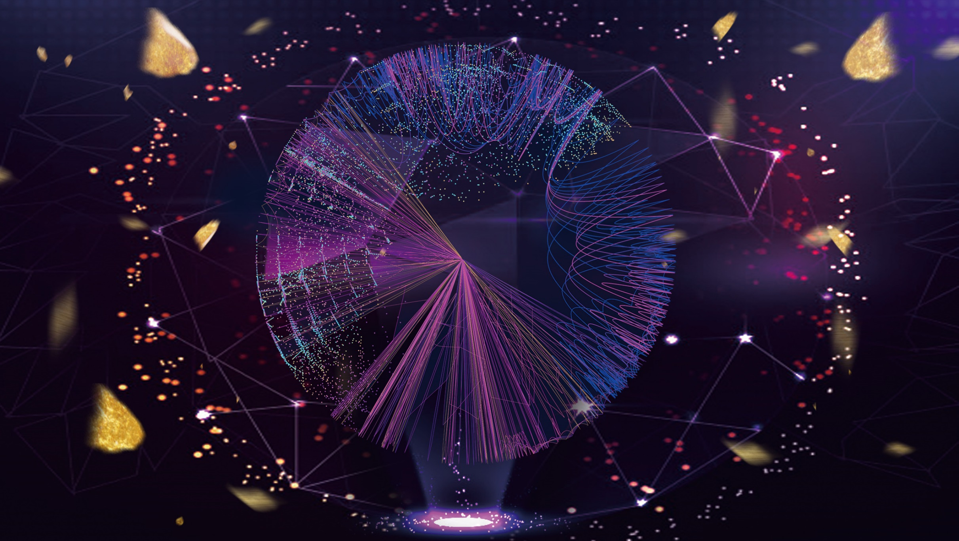
01
BACKGROUND

Slide 2
BACKGROUND
Buy a cellphone?

Slide 3

BACKGROUND
Buy a cellphone?

Slide 4
BACKGROUND
Exchange for some dollars?
Buy a cellphone?

Slide 5
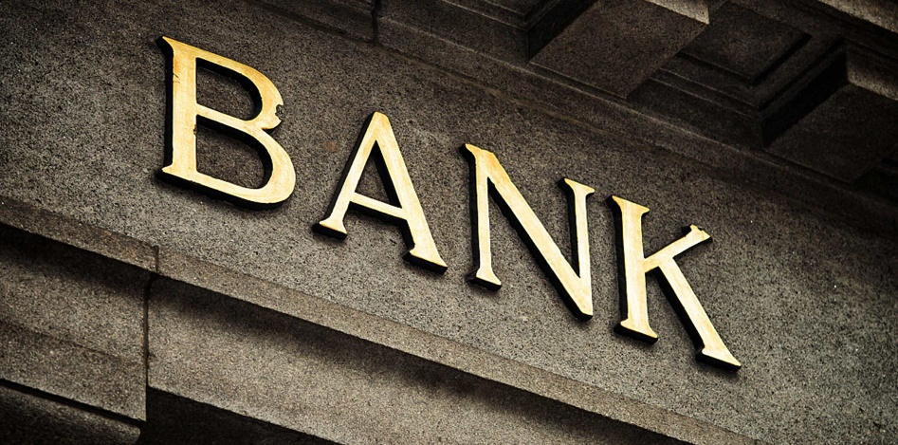
BACKGROUND
Exchange for some dollars?
Buy a cellphone?

Slide 6
BACKGROUND
Exchange for some dollars?
Buy a cellphone?
Get a job?

Slide 7
BACKGROUND
Exchange for some dollars?
Buy a cellphone?
Get a job?

Slide 8
BACKGROUND
Exchange for some dollars?
Buy a cellphone?
Get a job?
Have a meal?

Slide 9

BACKGROUND
Exchange for some dollars?
Buy a cellphone?
Get a job?
Have a meal?

Slide 10
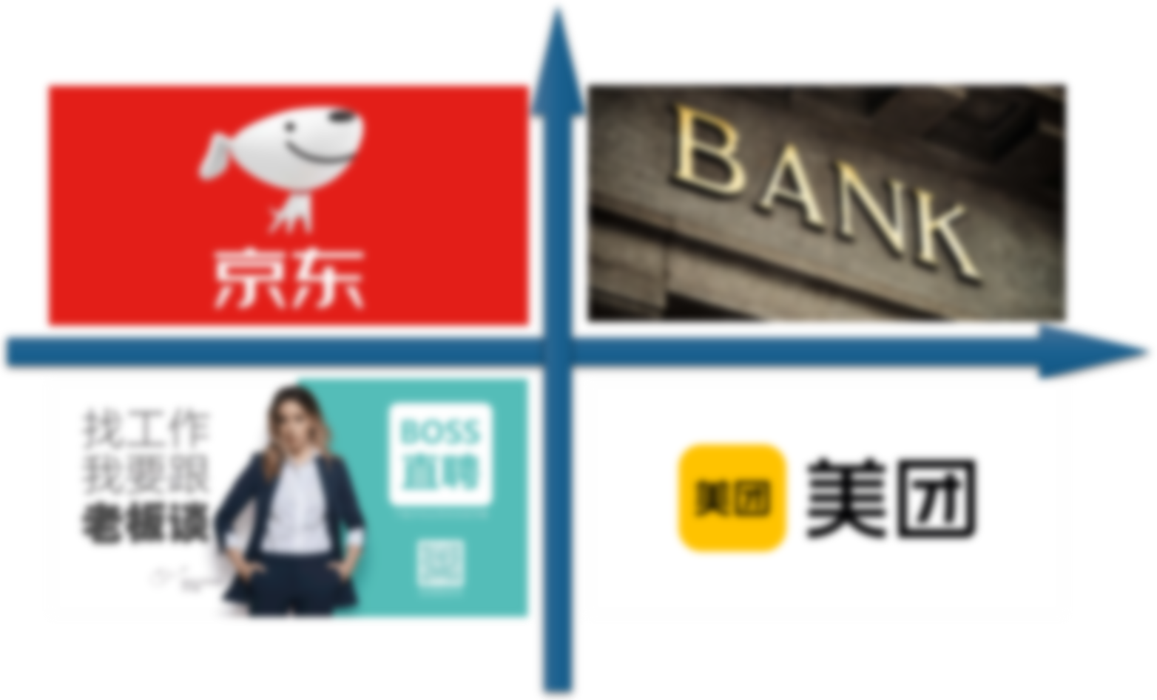
BACKGROUND
What's in common?
Exchange for some dollars?
Buy a cellphone?
Get a job?
Have a meal?

Slide 11
BACKGROUND
What's in common?
Exchange for some dollars?
Buy a cellphone?
They are all through some certain institutions
Get a job?
Have a meal?

Slide 12
BACKGROUND
Centralized
What's in common?
Exchange for some dollars?
Buy a cellphone?
They are all through some certain institutions
Get a job?
Have a meal?

Slide 13
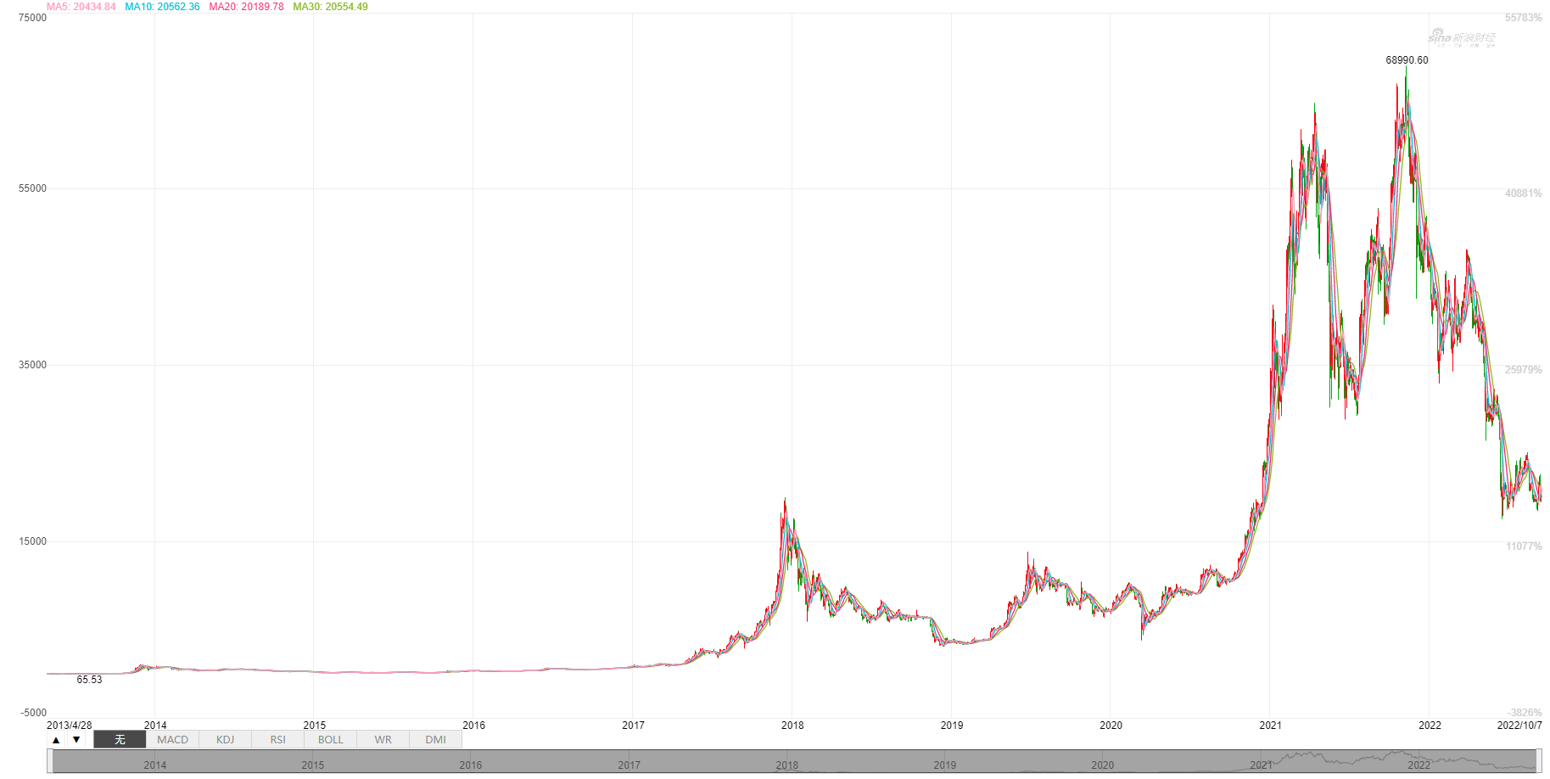
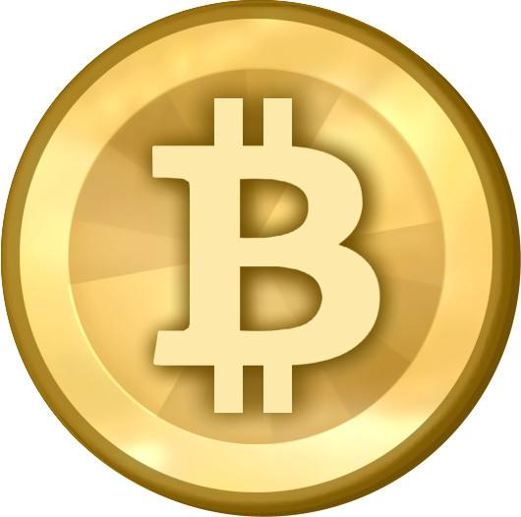

BACKGROUND
Satoshi Nakamoto
2009
2014
2017
2021

Slide 14

BACKGROUND
Satoshi Nakamoto
2009
2014
2017
2021

Slide 15
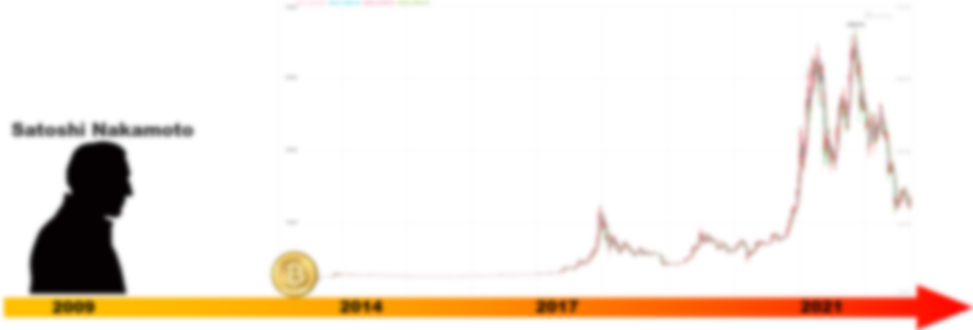
BACKGROUND
Why are the capital markets so bullish on Bitcoin?
How exactly will blockchain affect our economy?

